Slide 1
Zurn Backflow Prevention - Overview
July 16, 2019

Slide 2
agenda what you’ll learn
01
value proposition
02
how it works
03
features & benefits
04
design & specify
05
summary
06
resources

Slide 3
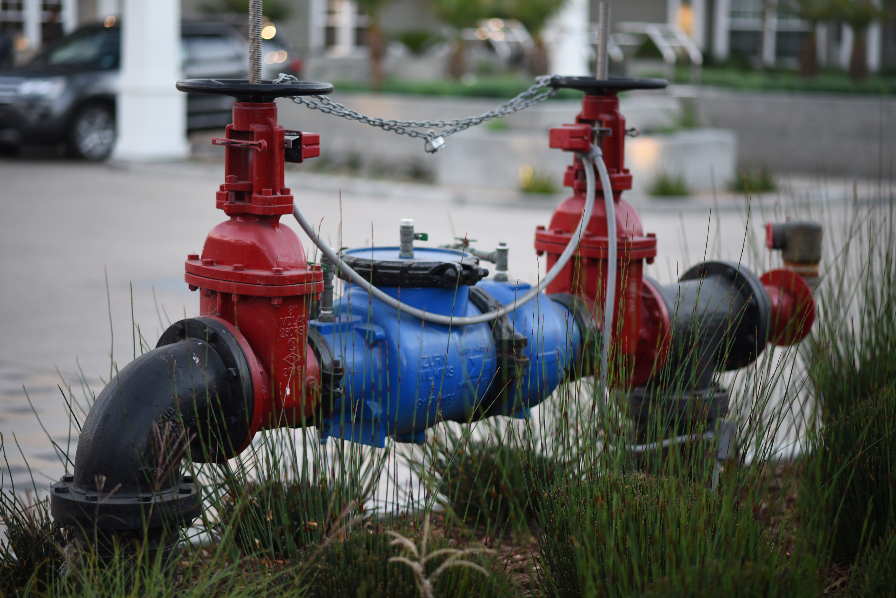
For those who want to protect against backsiphonage and backpressure of contaminated water into the water supply,
Zurn Industries provides backflow preventers
that offer a durable, low lifecycle cost solution
unlike any competitor allowing you to provide
high or low hazard protection for water applications

Slide 4
voice of customer industries
building owner
architect & engineer
contractor
“I need products that are durable and have a low total cost of ownership and require minimum downtime for maintenance.”
“I need products that are durable and
cost-effective.”
“I need products that are easy and cost-effective to install and maintain, that are assembled and packaged in a manner that streamlines installation.”
Healthcare | Retail | Food Service | Hospitality | Restaurants | Institutional/Education | Government

Slide 5
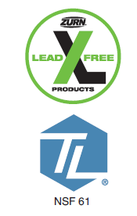
code compliance regulations All plumbing codes require backflow prevention products be installed to protect the drinking water system
USA Federal Safe Drinking Water Act of 1974 established water quality standards
Mandated State enforcement of standards and State supervision of water utilities
Established Water Purveyor’s responsibility to ensure that water is un-compromised through the delivery system and to develop Cross-Connection Control programs
Canadian Federal and Provincial Requirements
From Source To Tap - The Multi-Barrier Approach To Safe Drinking Water 2002
Introduced language on backflow
From Source to Tap: Guidance on the Multi-Barrier Approach to Safe Drinking Water 2002, 2004
Detailed language on backflow programs
Guidance For Providing Safe Drinking Water in Areas of Federal Jurisdiction – Version 2 2013

Slide 6
definitions backflow overview
4:05 Video
What is Backflow and What is a Backflow Preventer?
Backflow is the undesirable reversal of flow of water or mixture of water and/or other substances into the distribution pipes of the potable supply of water from one or more source(s)
Backsiphonage
Negative or sub-atmospheric pressure in the supply piping, allowing downstream substances to be siphoned into the potable water supply construction and retrofit applications
Caused by broken water mains and under-sized pipes - pipeline breaks - vacuums created by high withdrawal rates, such as fighting a fire
Backpressure
Pressure higher than the supply is created in the downstream piping, allowing downstream substances to be pushed into the potable water supply
Caused by pumps - thermal expansion – piping elevation
Degree of Hazard
Low Hazard – Pollutant that if allowed to enter drinking water would not cause sickness or death, but would impair the quality of the water by sight, smell or taste
High Hazard – Contaminant that if allowed to enter drinking water would cause sickness or death
Cross-Connection
For backflow to occur, a cross connection of some type must also be present. Cross-connection refers to any unprotected actual or potential connection between the potable water system and any other source through which a substance, other than potable water, may be introduced.
Caused by garden hose connected to a hose bibb - jumper connections - removable sections of piping - swivel or change-over devices - by-pass arrangements - other temporary or permanent devices where backflow may occur

Slide 7
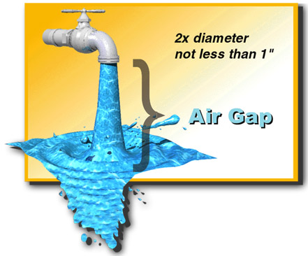
definitions backflow prevention
We cannot eliminate the occurrence of backflow conditions AND
We cannot prevent cross-connections from being created
THUS, we must provide a means of protecting drinking water systems
from the hazards of backflow occurrences through cross-connections
Air gap, the most basic means of backflow prevention
An air gap must be 2X the diameter of the outlet or at least 1” whichever is greater
Although effective, an air gap is not always the most practical means of backflow prevention since:
Water pressure is lost when using an air gap
Where water pressure is needed, a pump is usually required to re-pressurize the system
Once water passes through an air gap, the water often can no longer be considered potable
Mechanical backflow prevention devices and assemblies
A more practical means of protection against cross-connection hazards

Slide 8
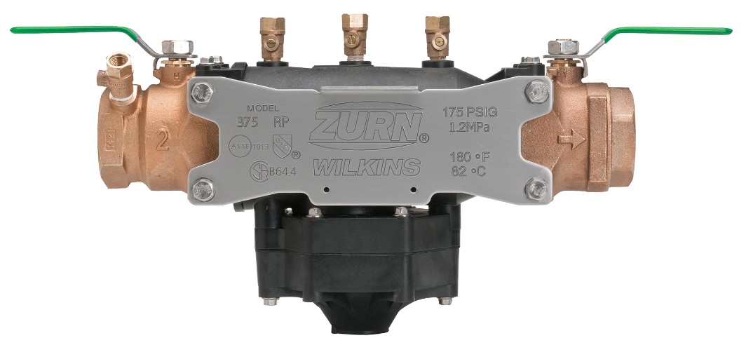
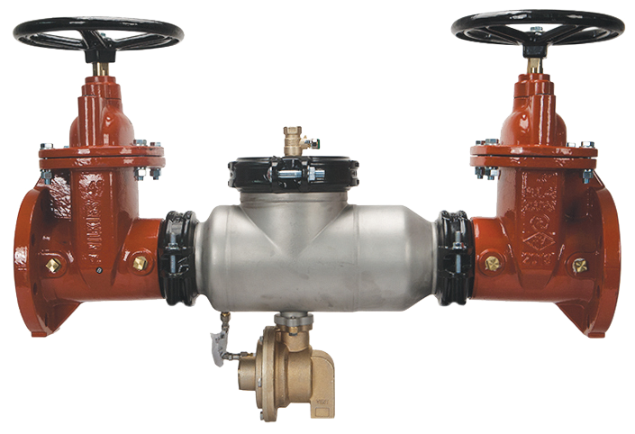
features & benefits overview
backflow prevention assemblies
Protect life and property
For plumbing, irrigation, waterworks, fire protection, and retrofit applications
All Plumbing Codes require backflow prevention products be installed to protect the drinking water system
key capabilities
protect from backpressure
protect from backsiphonage
avoid high health hazards
avoid low health hazards
isolatable
testable and repairable

Slide 9
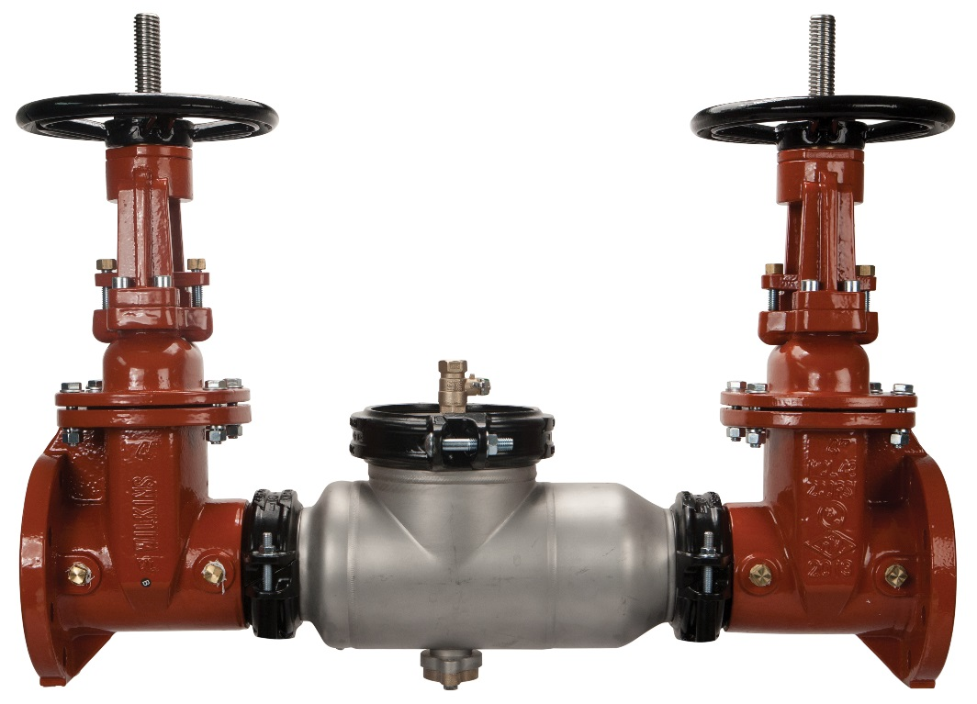
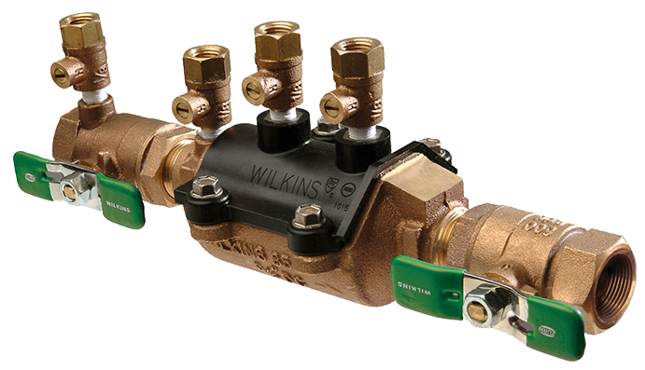
features & benefits double check assembly
The Zurn Wilkins 350 Series and 950 Series Double Check Backflow Preventers provide low hazard protection from backsiphonage and backpressure for all water application
Features two spring loaded check valves designed to close drip tight
Pressure Loss is approximately 10 psi static
950XLT2, 950XL, 350XL, 350, 350A, 350AST, 450, 450ST
350AST
Sizes 2 ½” – 10”
350XL
5:19 Video:
Wilkins 300AR Series Backflow
Sizes ¾” – 2”

Slide 10
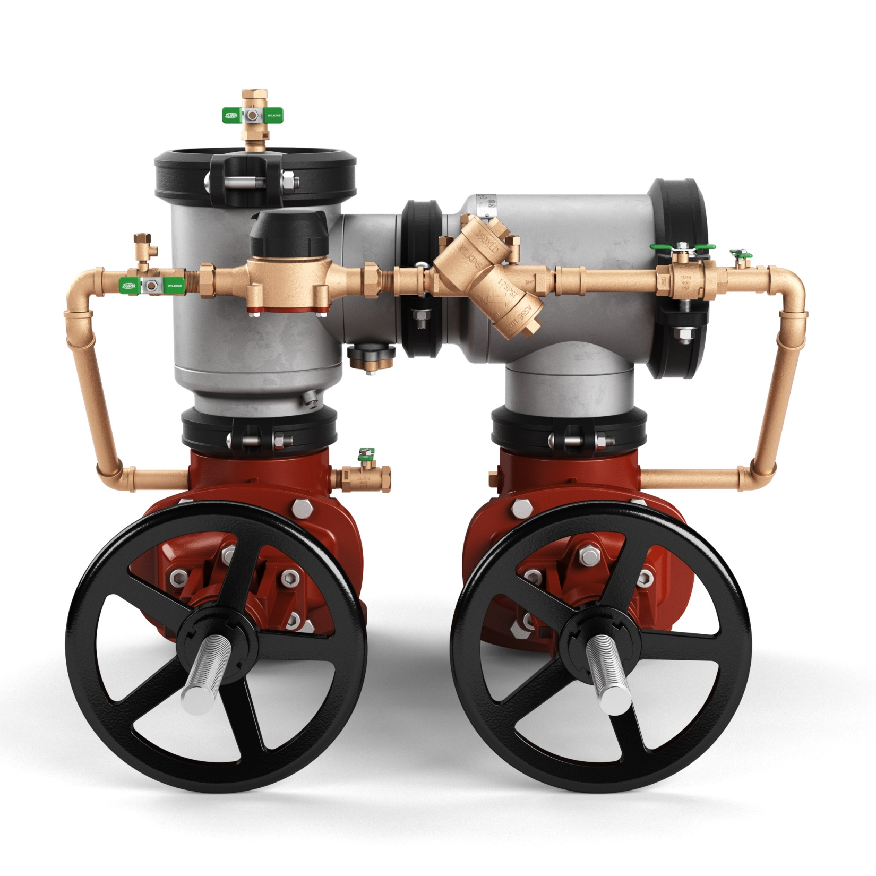
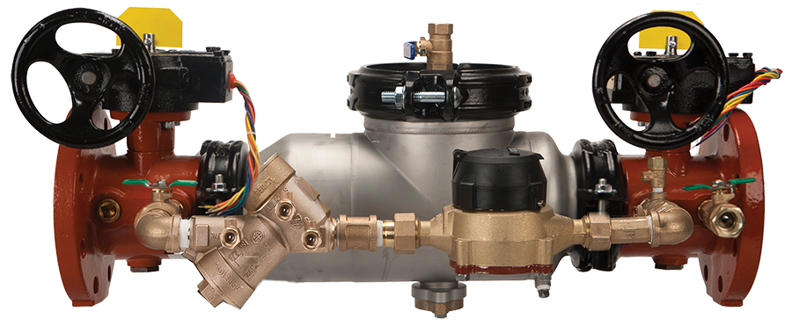
features & benefits double check detector assembly
The Zurn Wilkins Double Check Detector Backflow Preventers provide low hazard protection from backsiphonage and backpressure, including a metered by-pass to detect leaks and unauthorized water use in unmetered fire sprinkler systems.
Bypass valve provides an equal level of protection. (double check)
950XLTDA, 350DA, 350ADA, 350ASTDA, 450DA, 450STDA
450STDA
Sizes 4” – 10”
350ASTDA
Sizes 2 ½” – 10”

Slide 11
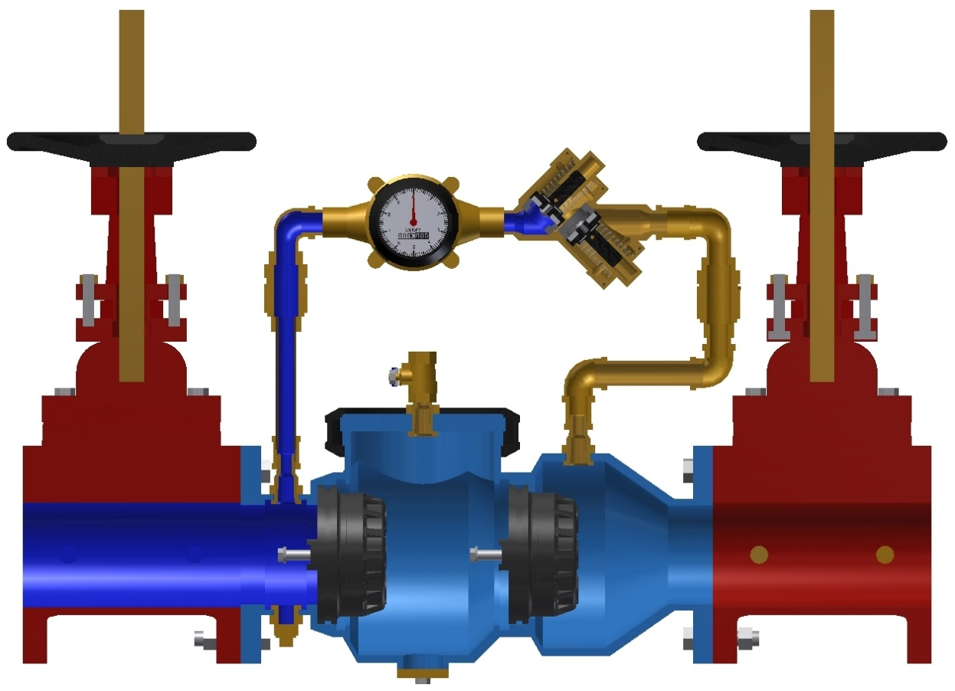
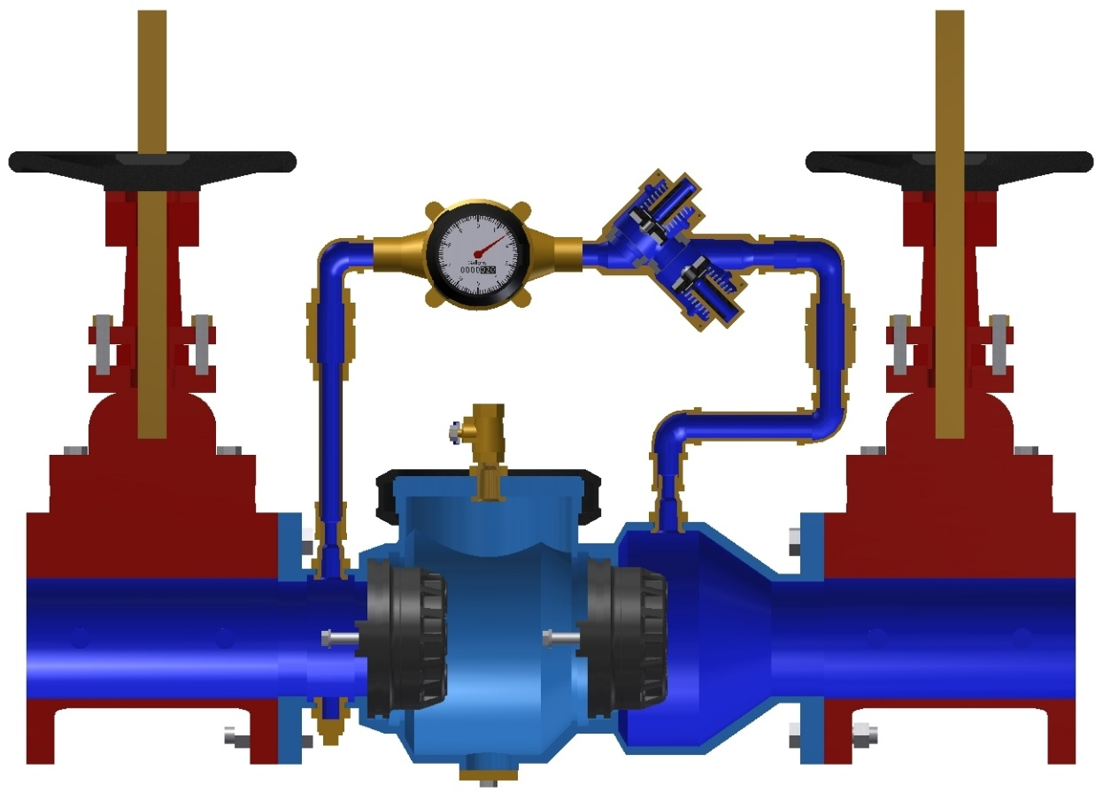
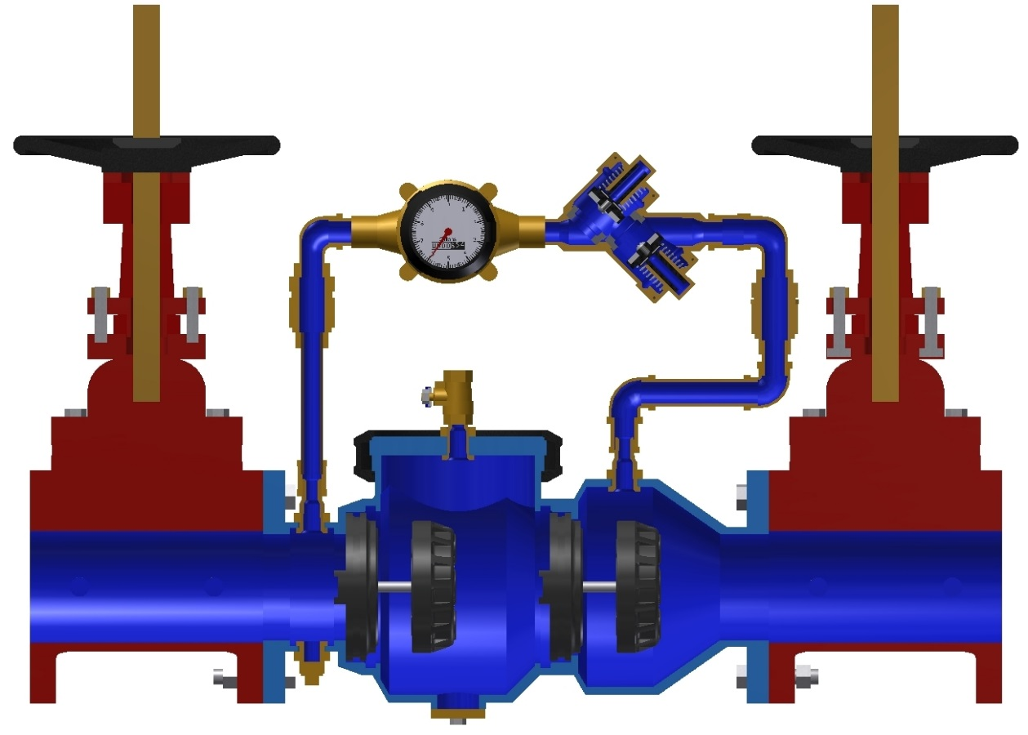
how it works backflow detector assemblies
“Tattletale” Meter
Bypass Valve
Inlet
 | No flow (static) | Low flow (<5gpm) | High flow (>5gpm)
Main Valve checks | closed | closed | open
Bypass checks | closed | open | open
Meter | not moving | registering flow | registering bypass flow only

Slide 12
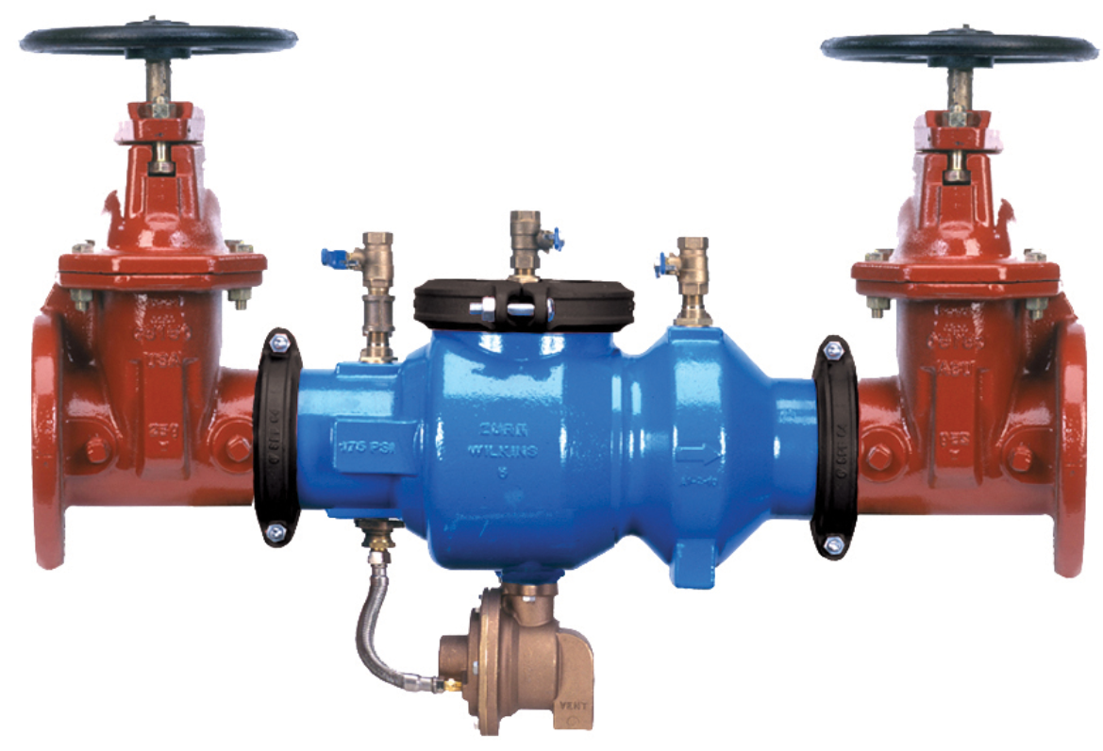
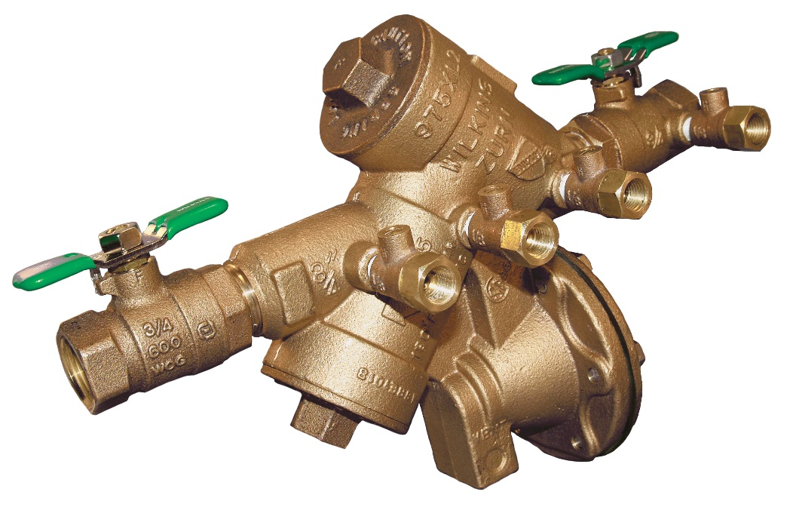
features & benefits reduced pressure principle assembly
The Zurn Wilkins Reduced Pressure Principle Backflow Preventers provide high hazard protection against backsiphonage and backpressure for all water applications
Features two spring loaded check valves designed to close drip tight and a relief valve
Pressure Loss is approximately 15 psi static
975XL2, 975XL, 375XL, 375, 375A, 375AST, 475, 475ST
375A
Sizes 2 1/2” – 10”
975XL2
page
012
Sizes ½” – 2”

Slide 13
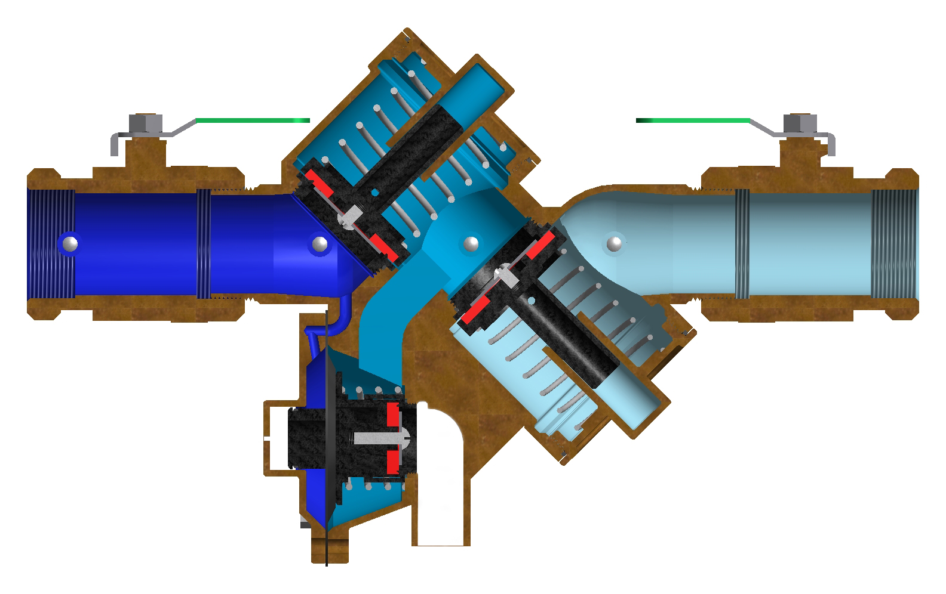
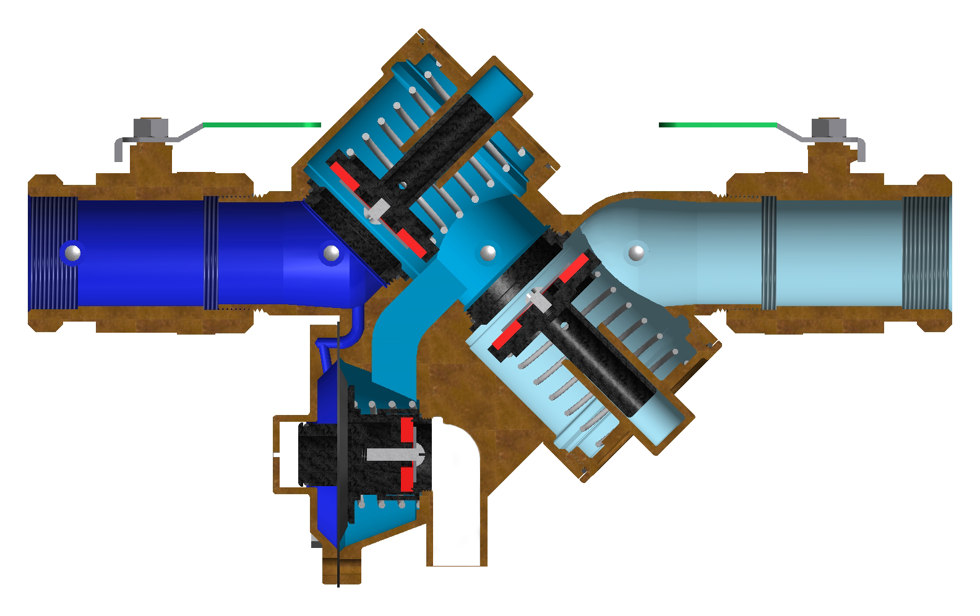
how it works RPZ functions
1st check valve closed
1st check valve open
2nd check valve closed
2nd check valve open
static (no flow) condition
normal flow
Both check valves and the relief valve are in the closed position. The difference in color reflects the pressure drop across each check valve
Both check valves have lifted off of their seats and the relief valve remains in the closed position
page
013

Slide 14
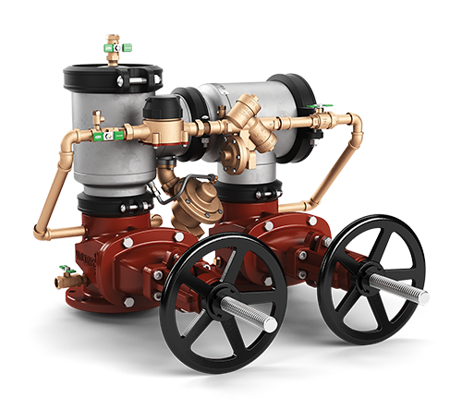
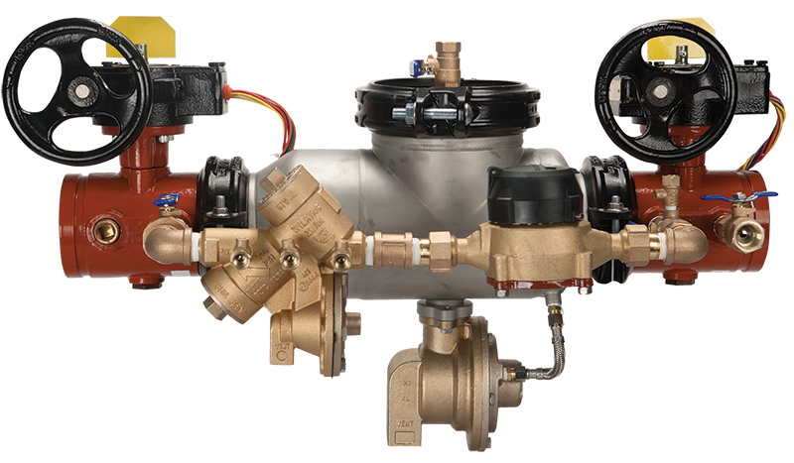
features & benefits reduced pressure principal detector assembly
The Zurn Wilkins Reduced Pressure Principal Detector Assembly Backflow Preventers provide high hazard protection from backsiphonage and backpressure, including a metered by-pass to detect leaks and unauthorized water use in unmetered fire sprinkler systems.
Bypass valve provides an equal level of protection. (RPZ)
375DA, 375ADA, 375ASTDA, 475DA, 475STDA
475DA
Sizes 4” – 10”
INSERT PHOTO
375ADASTBG
page
014
Sizes 2 ½” – 10””

Slide 15
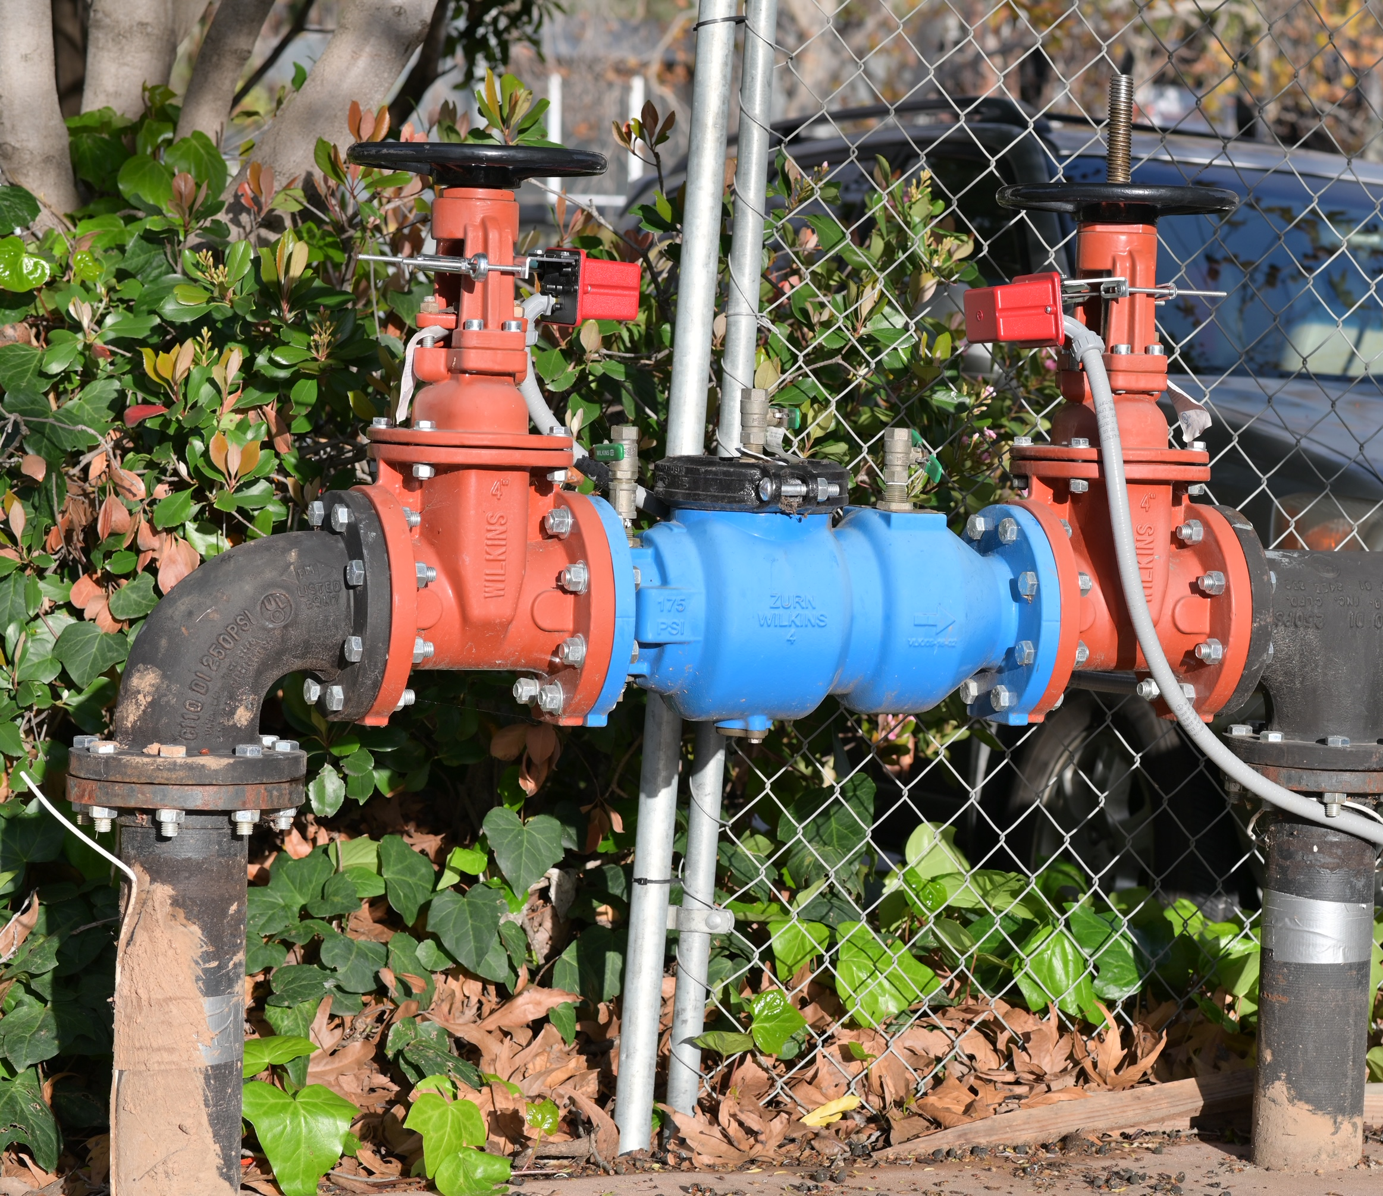
Test Your Knowledge
What visually differentiates a double check assembly from a reduced pressure principal assembly?
1st check valve
2nd check valve
Relief valve
All of the above

Slide 16
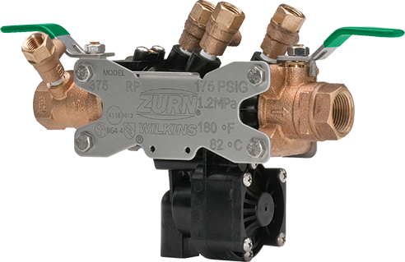
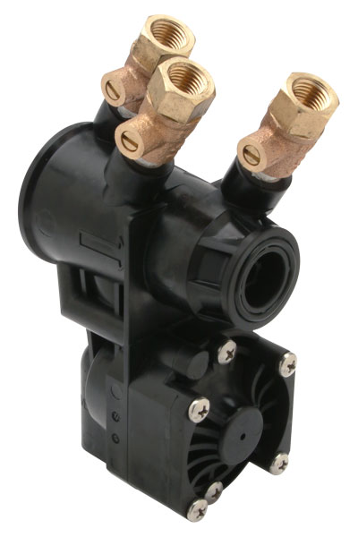
features & benefits 300 Series with EZSwap pressure vessel
key features
Ease of repair/maintenance saving up to 35 minutes in repair and rebuild time
Labor savings from ease of flushing saves up to 15 minutes per installation
EZSwap pressure vessel can be changed out within 2 minutes
Contractors should keep a spare EZSwap on hand for easy maintenance and repairs
simple and safe line flushing
Line flushing to remove fouling debris is fast, simple and safe with the EZSwap pressure vessel
“The 300 Series with EZSwap Pressure Vessel saves me time and money. My customers love it because the water system is down for less than 5 minutes and we don’t have to schedule a second appointment for repairs.”
– Ben Bennett, Backflow Prevention Specialists, Inc.

Slide 17
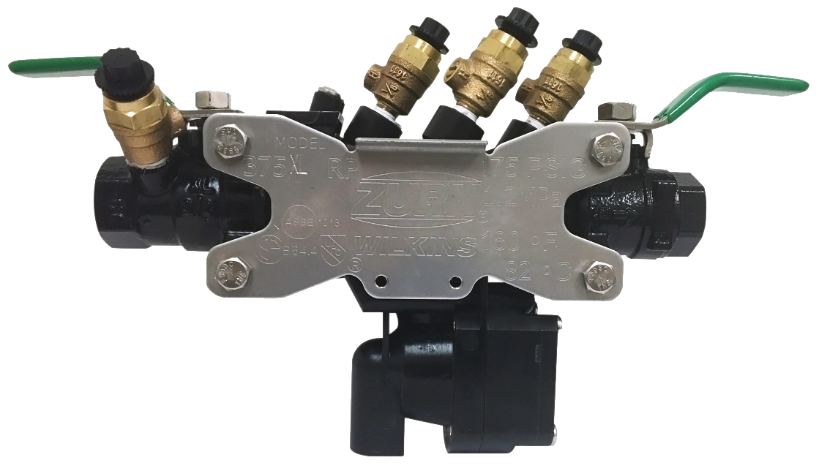
features & benefits 375XLB theft deterrent coating
key features
Provides ultimate backflow protection with theft resistant design
Black fusion epoxy coating camouflages bronze and reduces scrap value by as much as 90%, virtually eliminating theft
Less bronze = less theft
additional theft deterrents
Enclose the valve in a securely fastened enclosure
Use specially designed backflow locks and anchor it in concrete
Paint the valve to camouflage it and reduce its scrap value
375XLB
3:13 Video:
375XL Upgrade

Slide 18
features & benefits BOF fitting tools
 | 375XL or 350XL | 375 or 350 | BOF (Blow Out Flush)
Plumbing Contractor
Irrigation Contractor
375 Series Flush Fitting Tools |  | 350 Series Flush Fitting Tools
1/2"-3/4" | RK34-375BOF | 1/2"-3/4" | RK34-350BOF
1" | RK1-375BOF | 1" | RK1-350BOF
1-1/4”-2” | RK114-350-375BOF | 1-1/4”-2” | RK114-350-375BOF

Slide 19
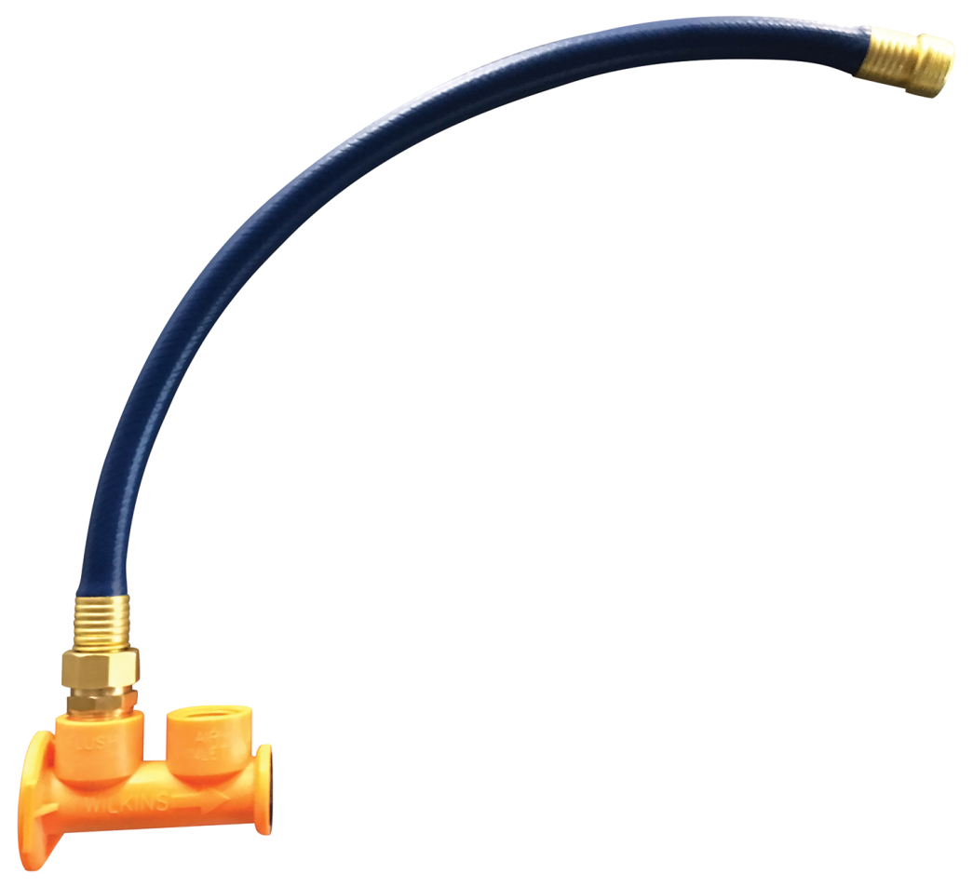
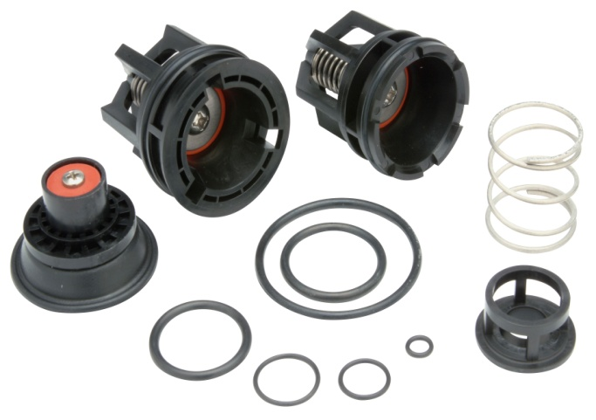
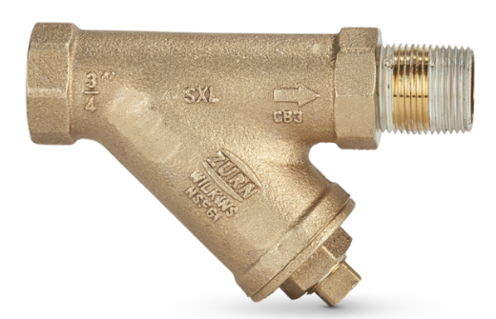
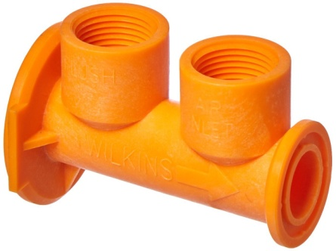
features & benefits accessories
“The 300 Series with Flush Fitting Tool is amazing. I can’t believe how quick and easy it is to install and use. No more fouled checks in new installs.”
– Matt Evangelista, Matt’s Plumbing
RK-375
RK-375FLUSH
Strainer options to prevent against check valve fouling. For use on debris laden water.
Complete repair kit compatible with 1” 375, 375XL, and 375ST
Includes check modules, all relief valve components, o-rings, and lubricant
EZSwap Pressure Vessel is quickly removed and replaced with Flush Fitting Tool (FLUSH) to quickly flush system
Line flushing with Flush Fitting Tool is simple, safe, and easily directed to a safe drain

Slide 20
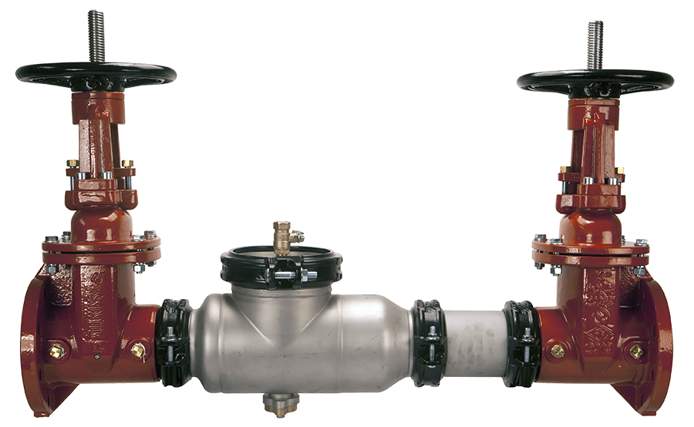
features & benefits retrofit length valve
Insert competitor photo
key features
Stainless steel body options
Corrosion resistant internals
Low-lead law compliant
Drop in replacement for any existing valve
models
350ASTDAR 375ASTDAR
350ASTR (retrofit) 375ASTR
350AR 375AR

Slide 21
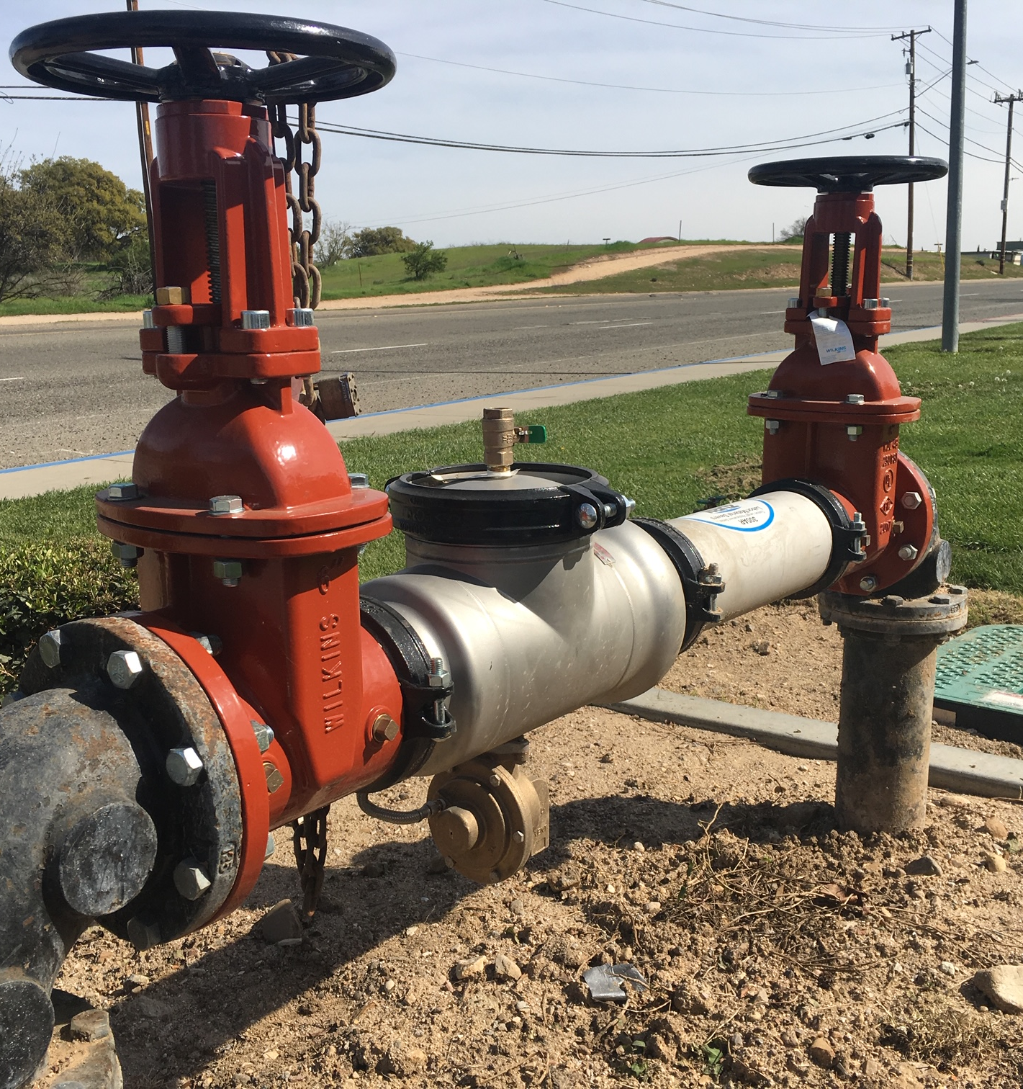
features & benefits stainless steel
corrosion resistant
Ideal for liquids corrosive to copper alloys such as post-mix beverage machines and areas where aggressive drinking water exists
key features
Stainless steel body
Corrosion resistant internals
Low-lead law compliant
stainless models
350AST 375AST 450ST
350ASTDA 375ASTDA 475ST
350ASTDAR 375ASTDAR 450STDA
350ASTR (retrofit) 475STDA
475STV
975XLST 475STDAV

Slide 22
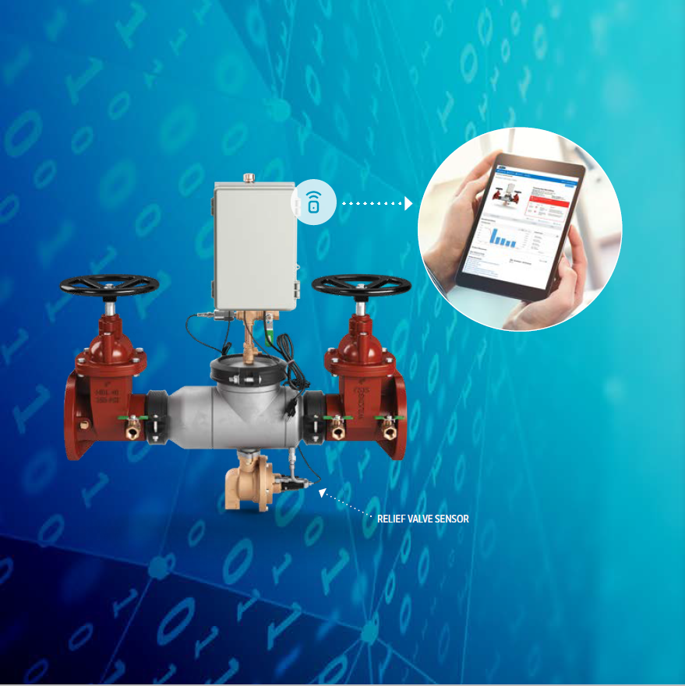
features & benefits connected backflow
catastrophic relief valve discharge
Flooding is the second highest cause of property damage
Connected Backflow identifies water discharge, monitors the system, and notifies building management
key features
Combines 375AST, monitor switch, and system sensors. Plug and play, easy installation
Online web portal
System Monitoring
1:39 Video:
Zurn Connected Backflow Preventers

Slide 23
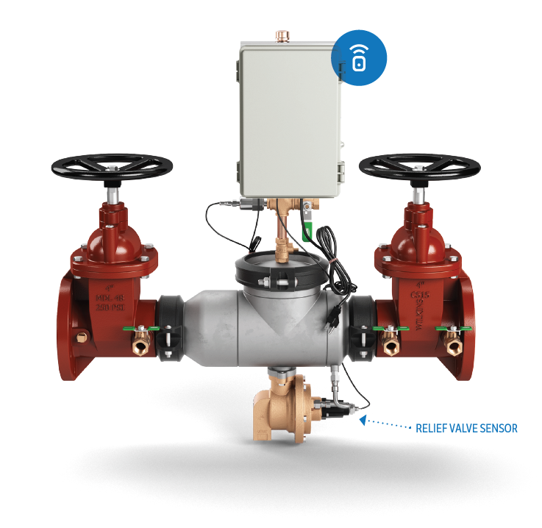
connected products
Connected Backflow Preventer
REAL-TIME DETECTION
Sensor detects minute openings of relief valve and instantly calculates discharge flow rate and volume
PRESSURE MONITOR
Zone pressure sensor monitors system and provides alerts you when the pressure deviates from desired range
Launched Oct. 1, 2018
Connected Backflow Preventer
Model 375ASTW1 shown
Notes:
Thushan Hemachandra

Slide 24
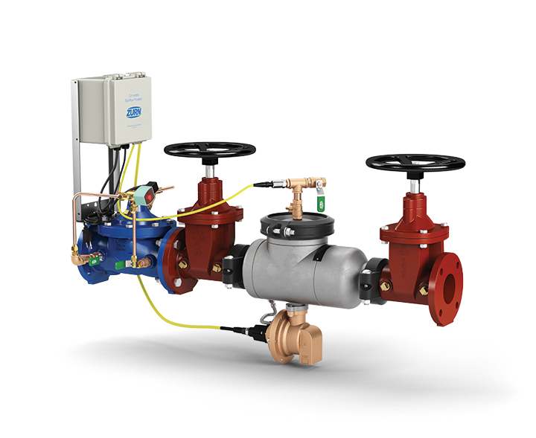
connected products
Connected Flood Control System (FCIS)
REAL-TIME DETECTION
Sensor detects minute openings of relief valve and instantly calculates discharge flow rate and volume
WATER SHUTOFF
System automatically shuts off water if relief discharge is beyond set tolerances to prevent catastrophic flooding
PRESSURE MONITOR
Zone pressure sensor monitors system and provides alerts you when the pressure deviates from desired range
FCIS standard with connectability – June 10, 2019
2-1/2” – 10”
1:50 Video:
Zurn Connected Flood Control System
Connected Flood Control System (FCIS)
Model FCISAST shown
Notes:
Thushan Hemachandra

Slide 25
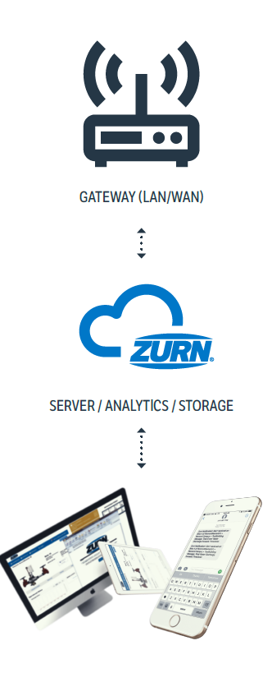
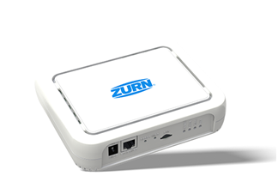
how it works Connected Flood Control System
1
sensors capture and send data to cloud
relief valve position sensor detects for opening of the relief valve and size of that opening, and then transmit these readings multiple times per second wirelessly to the Zurn cloud via Zurn gateway
ZURN GATEWAY
ZURN GATEWAY
2
data analyzed for alerts and insights
relief valve opening size data is then computed in real-time to determine:
current flow rate (gallons per minute)
total volume of water discharged during an event (gallons)
total volume discharged by product in a 24-hr period (gallons)
ZURN CLOUD
ZURN CLOUD
3
alerts sent via web/email/text
if any of these computed results surpasses a threshold for warnings and then severe alerts, they are displayed immediately on plumbSMART™ and notifications are sent to the building owner/facility manager via email/text based on severity with link back to plumbSMART™
4
24/7 access to product info and trends
plumbSMART™ allows customers to view current product status, adjust their alert settings and view historic data trends from any location with an internet connection
IMPORTANT NOTE: Connected technology/electronics DOES NOT CHANGE OR AFFECT the regular functions of the backflow preventer in any way. Only senses for changes.
Notes:
Thushan Hemachandra

Slide 26
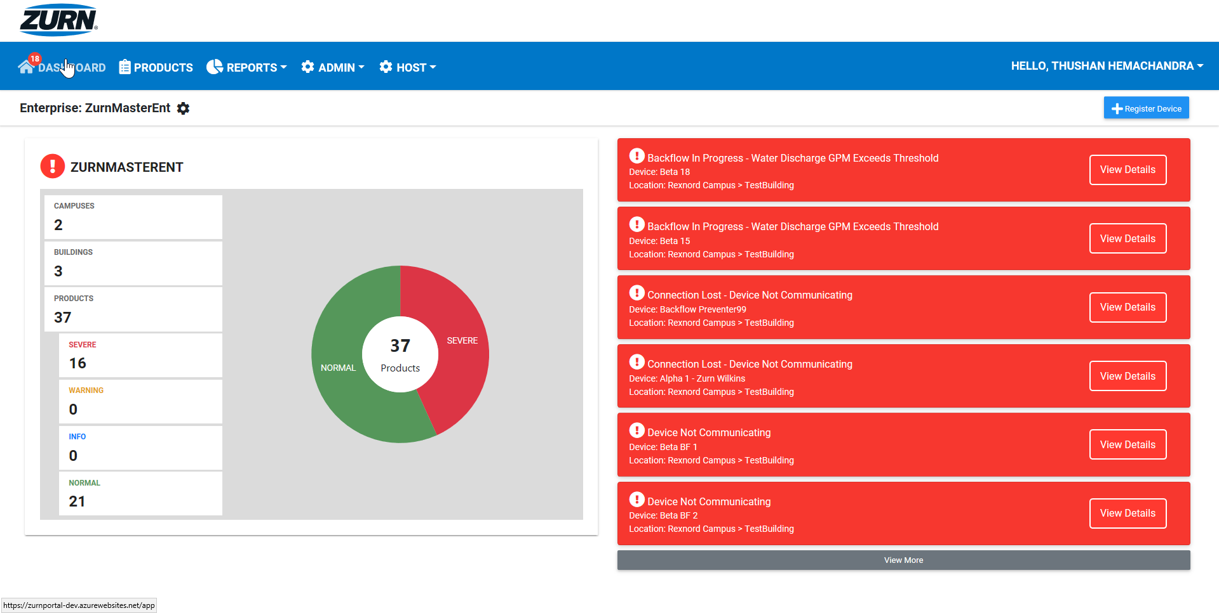
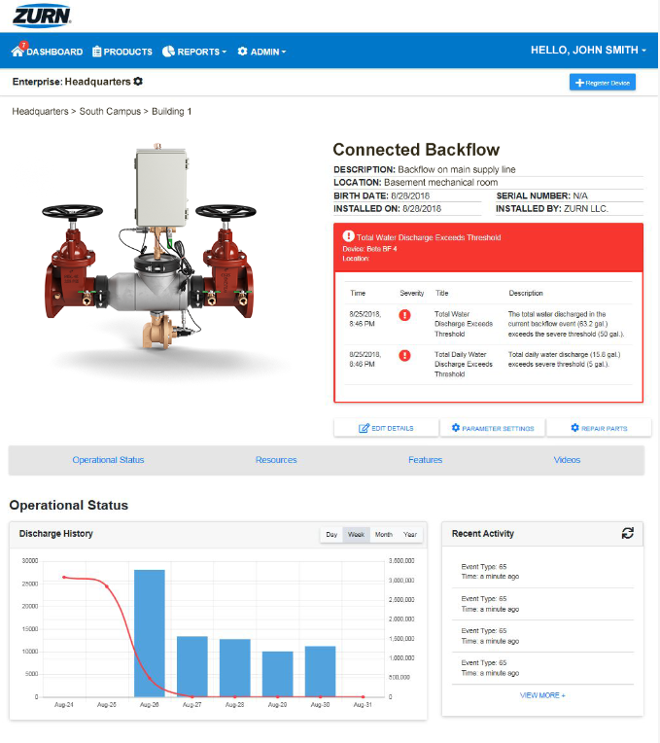
real-time alerts
preventative maintenance insights
historic data/trends
dashboard-style view of enterprise
organized by building and campus
customizable alert parameters
opt-in/out of email and mobile alerts
add/assign sub-users
Step-by-step PlumbSMART™ instructions in less than 15 minutes!
https://zurnportal.azurewebsites.net/app/
Zurn Connected Products – Headquarters – Backflow 3
PLUMBSMART™ ACCESS IS BY INVITATION ONLY; USERS MUST BE AUTHORIZED AND VALIDATED
AUTHENTICATION IS SECURED BY MICROSOFT AZURE ENCYPTION PROTOCOLS
USER PRIVILEGES CAN BE LIMITED TO SPECIFIC ROLES, LOCATIONS & PRODUCTS
Notes:
Complimentary access to the PlumbSMART™ and alerts for 1 year from the time of the first purchase of a Zurn Connected Product. Thereafter, subscription renewal rates are in a tiered format, based on the total number of Zurn Connected Products installed across your enterprise.

Slide 27
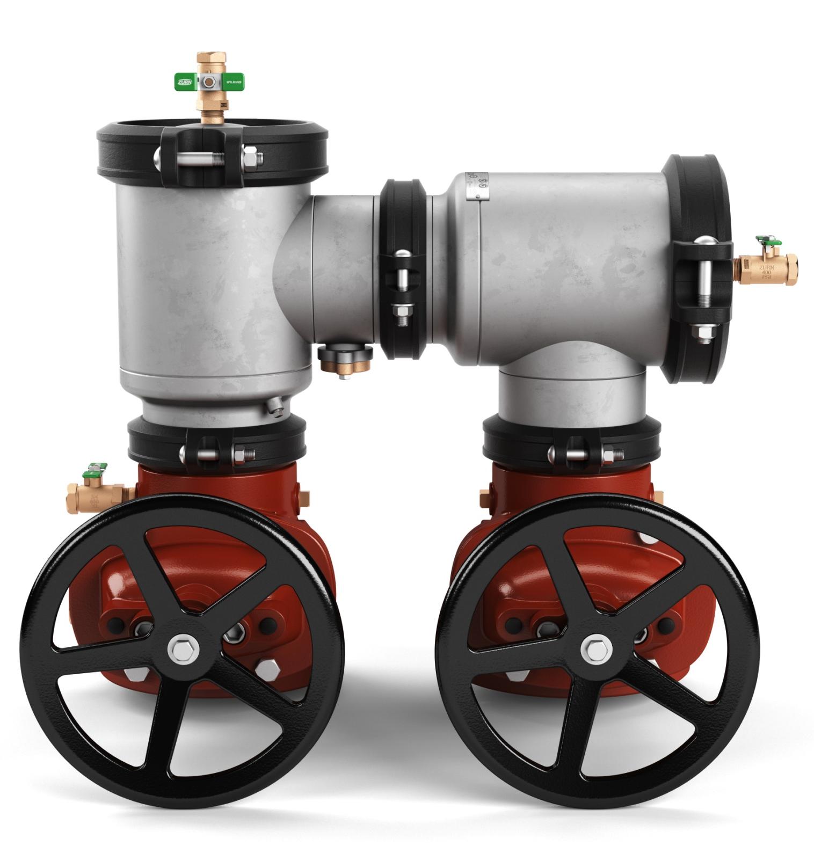
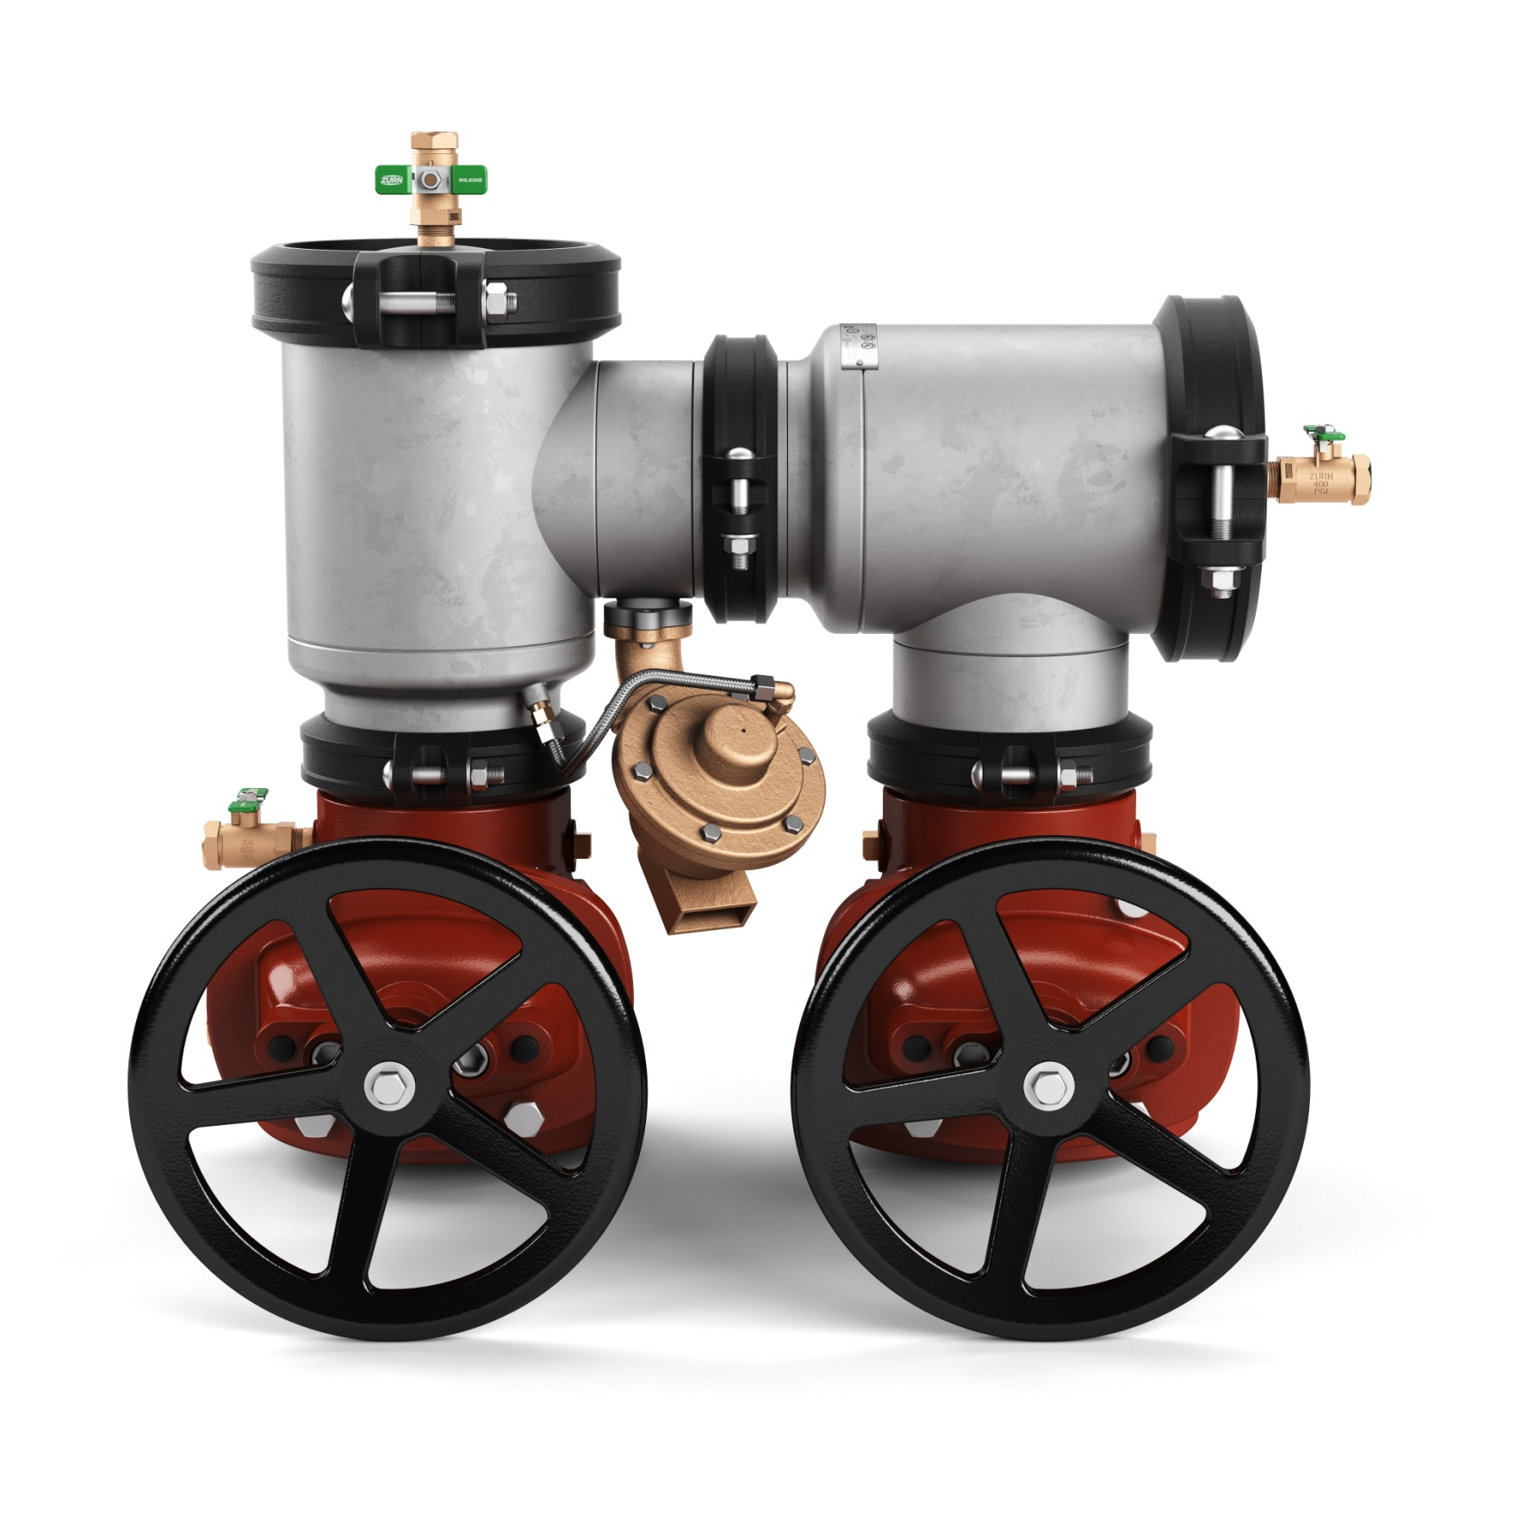
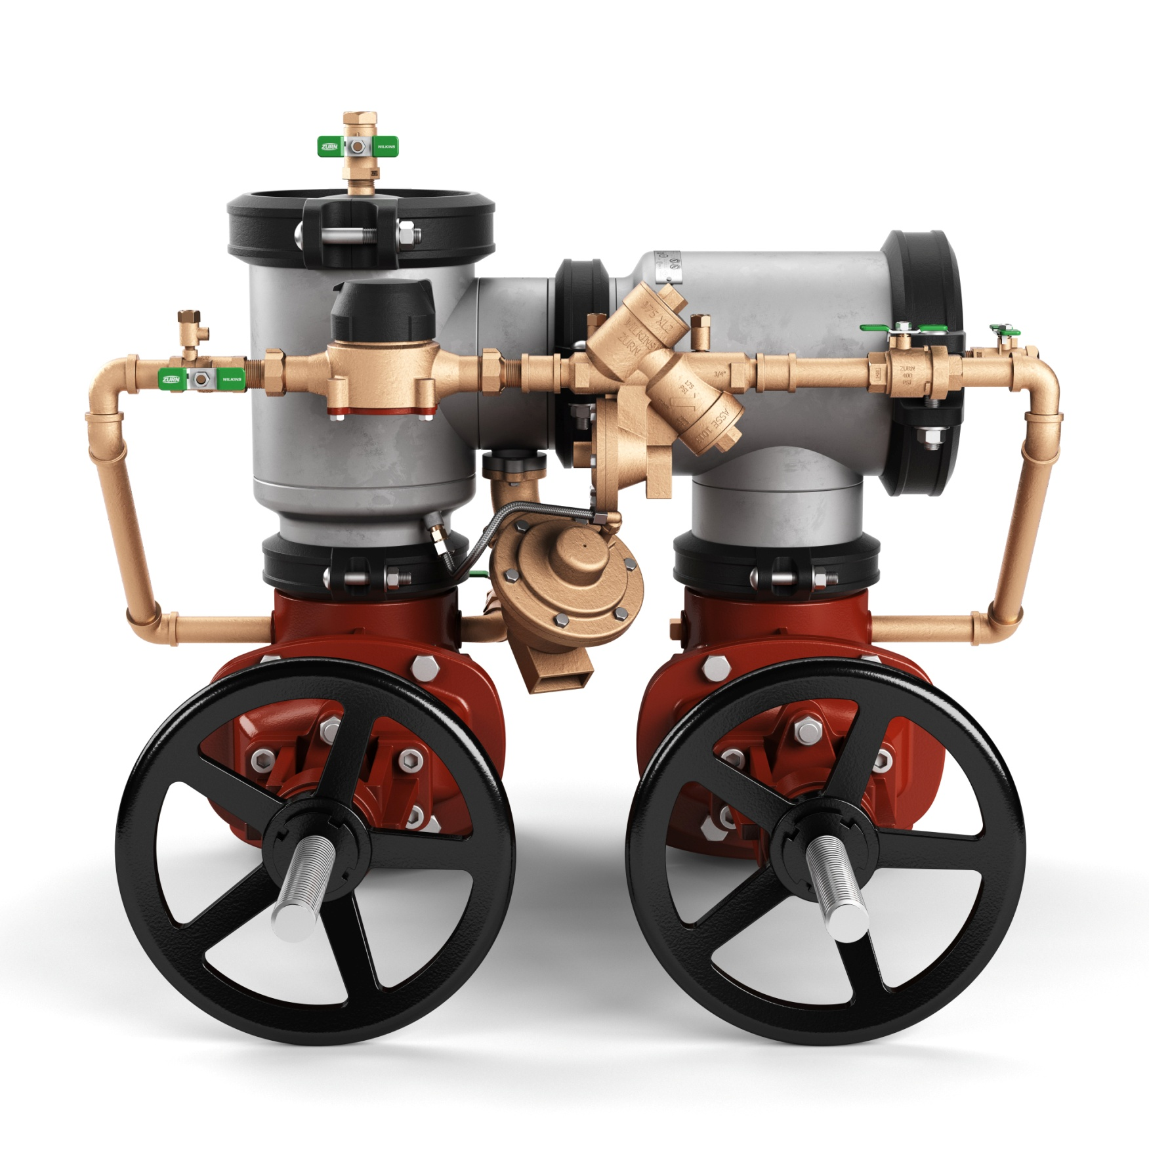
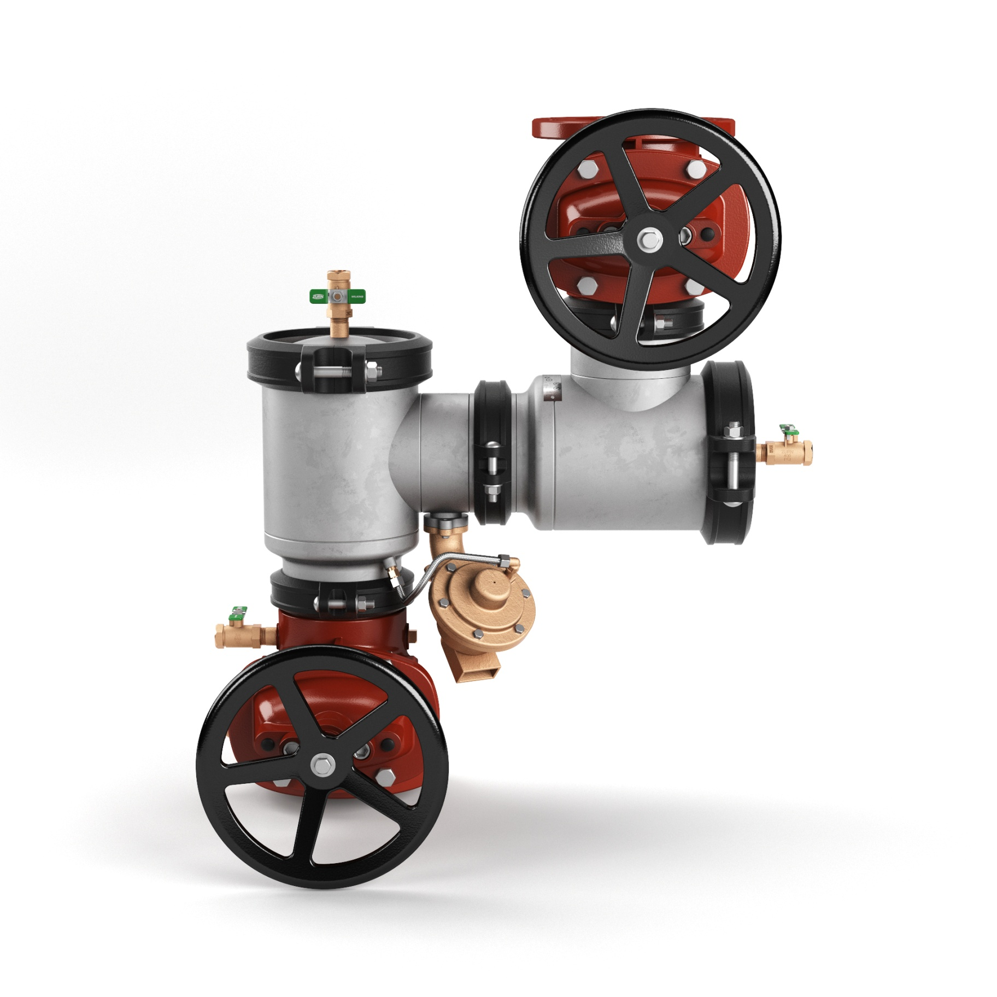
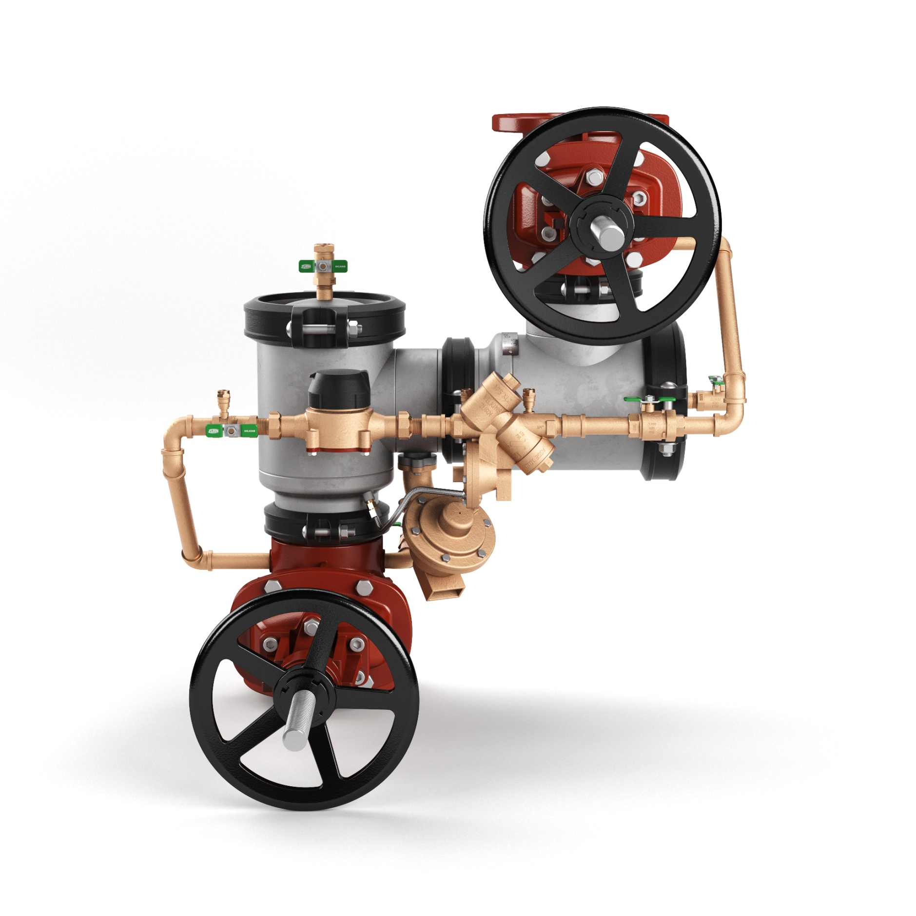
features & benefits 400ST n-Pattern backflow preventer
400ST n-Pattern
Same internal components as the Zurn Wilkins 300 and 400 series ductile iron n-Pattern – field tested and proven for 18+ years
Drop-in-replacement for the Febco n-Pattern
Smaller footprint – new ductile iron setters to fit tighter center line dimensions
description
Stainless steel body (corrosion resistant body and cover)
Sizes: 4” – 10”
Types: DC (double check), RP (reduced pressure), DCDA (double check detector assembly), RPDA (reduced pressure detector assembly)
3:01 Video:
Zurn Backflow Prevention 400ST n-Pattern
Notes:
Fields

Slide 28
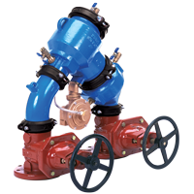
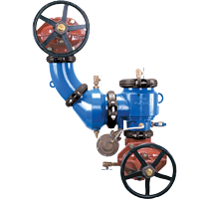
features & benefits 400 Series n-Pattern
475
Sizes 2 1/2” - 10”
Shaped in the “n” pattern”
The Zurn Wilkins 450 Double Check and 475 Reduced Pressure Principle Assemblies (shaped in the “n” pattern or “z” pattern) are ideal for new or retrofit installations in tight locations.
Legacy valve with 18+ years of proven engineered principals
Drop in replacement for
475V
Sizes 2 1/2” - 10”
Shaped in the “z” pattern
for vertical orientation”

Slide 29
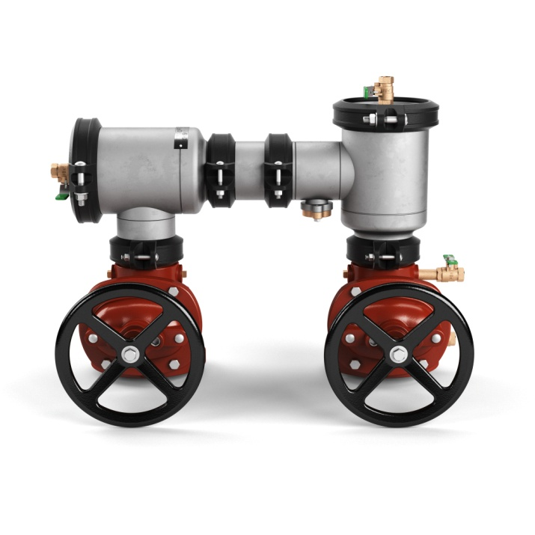
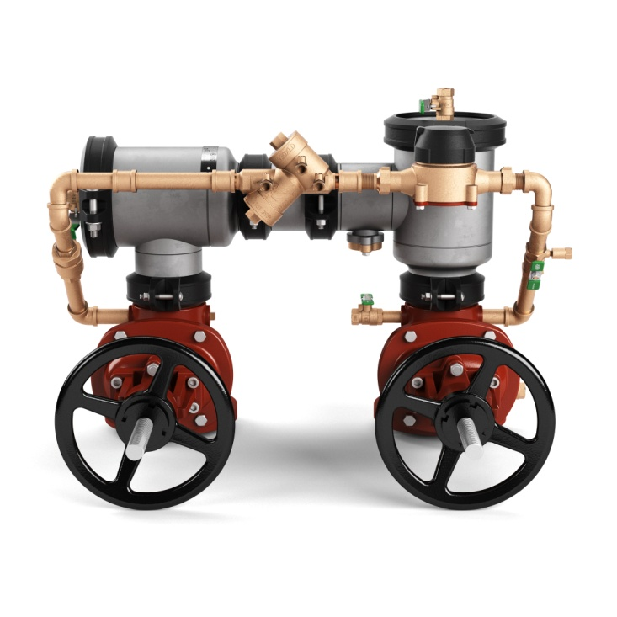
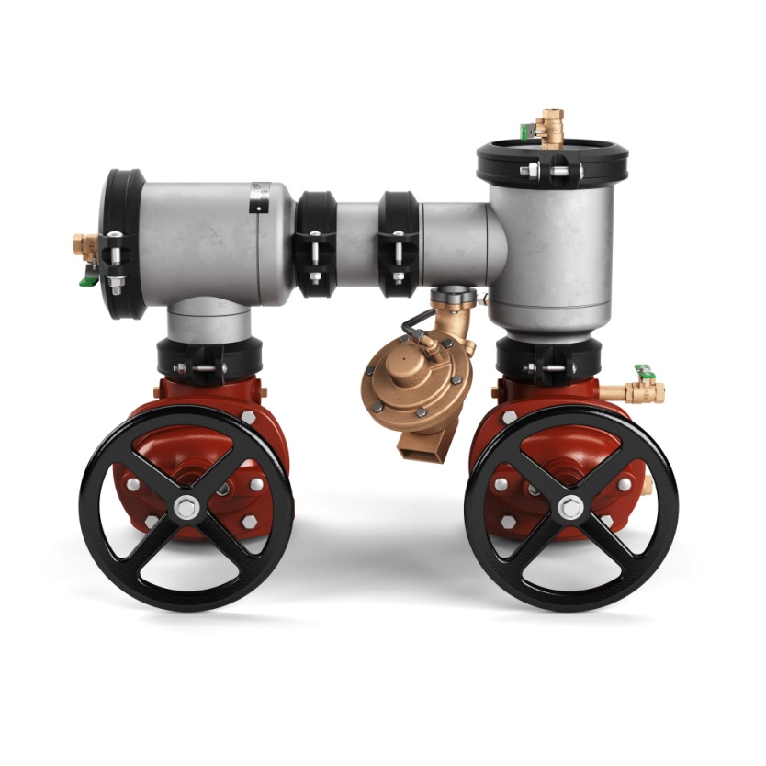
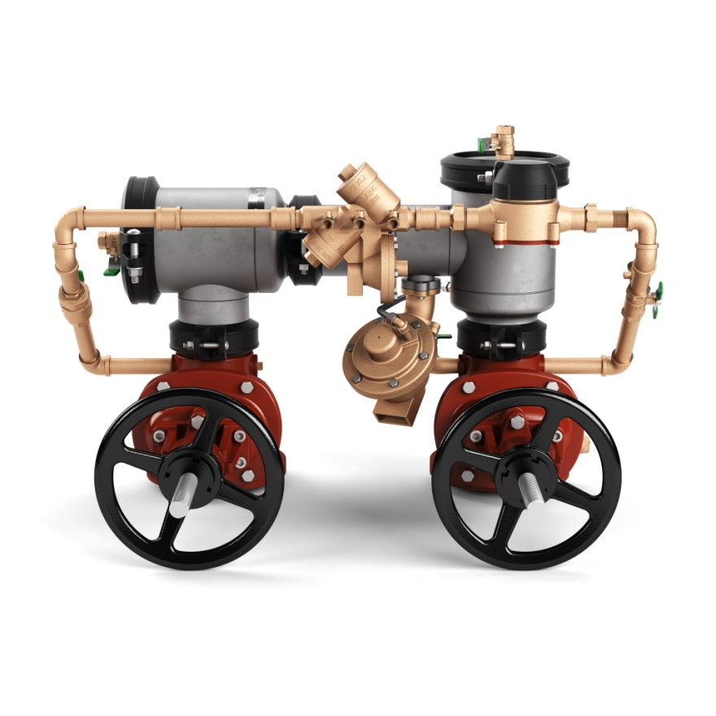
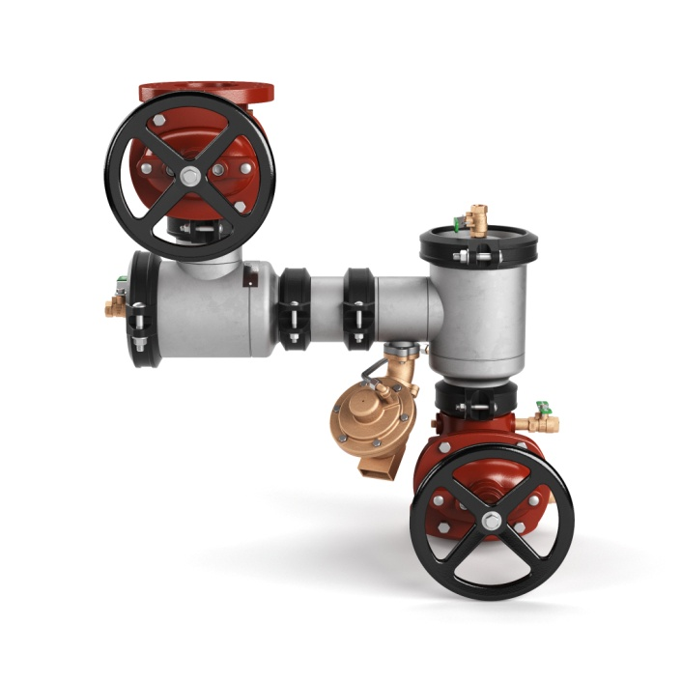
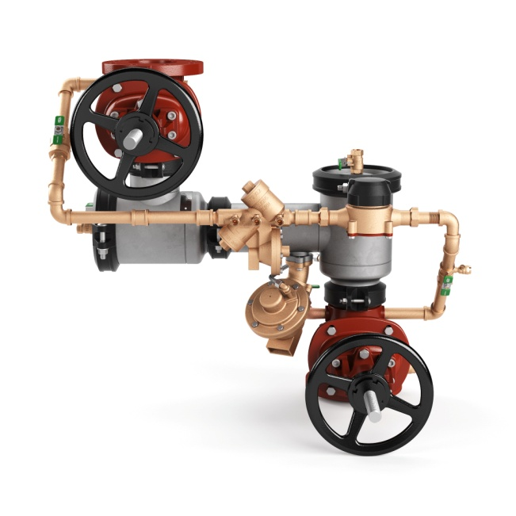
features & benefits drop-in replacements
replacements for Zurn Wilkins assemblies
Model 450STR
Replaces 450
Model 450STDAR
Replaces 450DA
Assemblies are designed for drop-in to reduce installation and system down time
key features
Same center line dimensions as Zurn Wilkins ductile iron n-Pattern Series
Same benefits and functionality
Model 475STR
Replaces 475
Model 475STR
Replaces 475RPDA
R replacement part numbers
450STR
450STDAR
475STR
475STRV
475STDAR
475STDARV
Model 475STRV
Replaces 475V
Model 475STDARV
Replaces 475RPDAV
Notes:
Fields

Slide 30
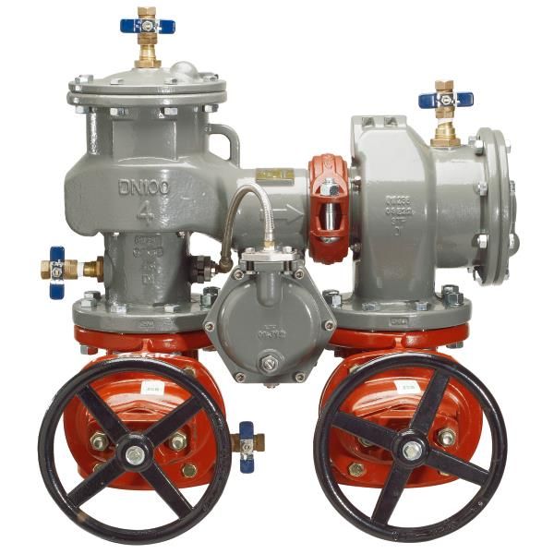
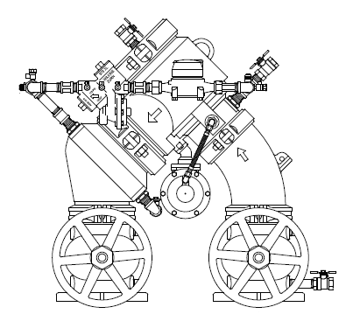
features & benefits replacement field conversion
compliance and approvals
It is ideal to stock 475ST for new construction and Febco replacements and to stock the 475STR for Zurn Wilkins ductile replacements
Field conversion invalidate our approvals and should be avoided
Field conversions must be approved by the authority having jurisdiction over backflow installation
conversion kits
Conversions may require flipping the gate valve, an elbow to rotate the relief valve, and a new sensing line
ST to STR | STR to ST
RK4-475STR-RVELBOW | RK4-475ST-RVELBOW
RK6-475STR-RVELBOW | RK6-475ST-RVELBOW
RK8-475STR-RVELBOW | RK8-475ST-RVELBOW
RK10-475STR-RVELBOW | RK10-475ST-RVELBOW
Model 475ST
Replaces Febco
Model 475STR
Replaces Zurn Wilkins 400 ductile iron series
Notes:
Daniel Alvarez

Slide 31
features & benefits options & accessories
NEW backflow setter
Allows backflow preventer to fit tighter center line dimensions
Simplifies installations
Eliminates the need to pour concrete thrust blocks
Provides for a lower installation cost
Ductile Iron fusion epoxy coated
options
Model FLSST
MJ x Flange (MJFSST)
MJ x MJ (MJSST)
Flange x Flange (FLSST)

Slide 32
features & benefits shut-off valves
Post indicator (PI) gate valve
Provides a visual indication of the valve’s open/closed position when coupled with an indicator post
Non-rising stem gate valve with attachment plate for indicator post
48 outside stem & yolk (OS&Y) gate valve Provides a visual indication of valve’s open/closed position
Resilient wedge gate valve
Flanged, grooved, or flanged x grooved connections
Stand alone or on Zurn Wilkins backflow preventers
49 Butterfly Valve
Integral supervisory switch with visual indicator
Butterfly valve with grooved x grooved connections, grooved x flange connections and flange x groove connections
Notes:
PIV is typically sold along with the backflow preventer, but there are stand alone applications
Researching adding wall and yard post indicators for stand alone

Slide 33
features & benefits ancillary products
Ball Valve Monitor Switch (BVMS)
Mounted on a backflow preventer’s ball valve shutoffs in a fire sprinkler system, it will signal if ball valve handle is moved from an open position
Fixed Air Gaps
Collects water discharge from reduced pressure backflow assemblies, dura-coated cast iron body
Gate Valve Supervisory Switch (OSY-40)
Used to monitor the position of and OS&Y type gate valve.
Setters
Used with 400 series DI and Stainless backflows, valve setters ease installation time and eliminate the need for concrete thrust blocks.
Notes:
Color difference of the two setters – two different sizes for two unique models

Slide 34
features & benefits competition
n-Pattern Backflow Prevention | Zurn 400 | Febco 800 | Apollo 4An
Stainless Steel Body | + | X | +
Sizes: 4” – 10”, Types DC, RP, DCDA | + | + | +
Sizes: 4” – 10” , Type: RPDA | + | X | +
Patented Compound Checks® | + | X | X
Replaces Zurn 400 ductile iron series | + | X | X
Replaces Febco 800 series | + | + | +
Field tested and proven for 18+ years | + | + | X
Patented Relief Valve Monitor Switch (475ST/V, 475STDA/V) | + | X | X

Slide 35
features & benefits 300 Series SBF questions
How long do you need to have your backflow preventer last? | Stainless steel shut-off valve handles, hardware, and struts resist corrosion Cast bronze ball valves UV-resistant, reinforced nylon EZSwap resists corrosion and mineral build-up Engraved serial number on strut is permanent and avoids new backflow registration costs Short lay length allows installation in tight spaces, including valve boxes | Lowest Lifecycle Cost Superior Performance; Long-Term Reliability Corrosion Resistant
How do you ensure you are purchasing the right backflow preventer, based on your needs? | Zurn Online Specification Tools | Zurn Online Tools for Specification
Would solderless connections streamline your installation process? | Z-Press™ and Z-Bite™ solderless connections simplify and speed installation Replaceable housing Blow out and flush fitting | Simplified and Speedy Installation Effective Start Up Flushing
How much time do you spend in maintenance and repair? | EZSwap pressure vessel saves 35 minutes in repair and rebuild time Affordable repair kits Test cocks on top of unit 48-hour shipping | Reduced Labor Costs Easy Repair and Maintenance
Do you have any issues with theft? | Black fusion epoxy coating camouflages bronze and reduces scrap value Housing is composite, with less bronze used | Virtually Eliminates Theft

Slide 36
features & benefits vacuum breaker
The Zurn Wilkins Pressure Vacuum Breaker Assemblies provide high hazard protection for back siphonage conditions only, primarily in irrigation systems.
420XL
460XL
720A
The Zurn Wilkins 420XL Pressure Vacuum Breaker Assembly with integral freeze relief poppet. Primarily for residential irrigation, but can be used in potable water applications
The Zurn Wilkins 460XL Spill Resistant Pressure Vacuum Breaker provides high hazard protection for backsiphonage conditions. Start-up spillage is either eliminated vs. standard pressure vacuum breakers
The Zurn Wilkins 720A Pressure Vacuum Breaker is the workhorse of the Wilkins PVB lineup. The bronze body provides durability under light freeze conditions and is the valve of choice for professional landscape contractors

Slide 37
features & benefits lead-free vs. non potable
 | Composite Body |  | Bronze Body
 | Double check | RP | Double check | RP | PVB
lead-free | 350XL | 375XL | 950XLT2 | 975XL2 | 420XL
non-potable | 350 | 375 | 950XLT | 975XL | 720A
950XL
Sizes 3/4” – 2”
High Hazard Protection

Slide 38
features & benefits backflow devices
In addition to the main backflow prevention assemblies, Zurn offers other backflow preventers including dual checks, dual checks with atmospheric vent, atmospheric vacuum breakers, and single checks

Slide 39
features & benefits competition
Backflow Prevention | Zurn | Watts | Febco | Conbraco
Lowest Lifecycle Cost | + | X | X | X
Z-Press™ and Z-Bite™ Solderless Connections | + | X | X | X
EZSwap Pressure Vessel | + | X | X | X
Black Fusion Epoxy Coating Camouflaged Bronze | + | X | X | X
Zurn Online Specification Tools | + | X | X | X
Flood Control Integrated System (FCIS) | + | X | X | X

Slide 40
Test Your Knowledge
What are Zurn’s 375 backflow prevention valves’ top 3 benefits?
Lowest lifecycle cost
EZSwap pressure vessel saves 35 minutes in repair and rebuild time
Black fusion epoxy coating camouflages bronze and reduces scrap value, virtually eliminating theft
Zurn online specification tools
INSERT PHOTO

Slide 41
how to specify step-by-step
1
application type
Fire protection, plumbing, irrigation, or waterworks
2
hazard level
High hazard, low hazard
3
backpressure or backsiphonage
4
installation
Horizontal installation or vertical installation, inside, or outside

Slide 42
BACKFLOW PREVENTION *All Retrofit | 310 | 350 | 375 | 420 Vacuum Breaker | 450 | 460 Spill Resistant Pressure Vacuum Breaker | 475 | 720 Pressure Vacuum Breaker | 740 Carbonated Beverage Backflow Preventer | 950 | 975
Fire Protection-virtually 100% static | Fire Protection | Fire Protection | Fire Protection |  | Fire Protection |  | Fire Protection |  |  | Fire Protection
Plumbing |  | Plumbing | Plumbing | Plumbing | Plumbing | Plumbing | Plumbing |  | Plumbing | Plumbing | Plumbing
Irrigation-2% flow; 98% static |  | Irrigation | Irrigation | Irrigation | Irrigation | Irrigation | Irrigation | Irrigation |  | Irrigation | Irrigation
Waterworks | Waterworks | Waterworks | Waterworks | Waterworks | Waterworks | Waterworks | Waterworks |  |  | Waterworks | Waterworks
Health hazard level | Low Hazard | Low Hazard | High Hazard Low Hazard | High Hazard Low Hazard | Low Hazard | High Hazard Low Hazard | High Hazard Low Hazard | High Hazard Low Hazard |  | Low Hazard | High Hazard Low Hazard
Backpressure, backsiphonage | Backpressure Backsiphonage | Backpressure Backsiphonage | Backpressure Backsiphonage | Backsiphonage | Backpressure Backsiphonage | Backsiphonage | Backpressure Backsiphonage | Backsiphonage |  | Backpressure Backsiphonage | Backpressure Backsiphonage
Type | Single Check | Double Check Assembly (DC) Double Check Detector (DCDA) | Reduced Pressure (RP) Reduced Pressure Detector Assembly (RPDA) | Pressure Vacuum Breaker (PVB) | Double Check Assembly (DC) Double Check Detector Assembly (DCDA) | Pressure Vacuum Breaker (PVB) | Reduced Pressure (RP) Reduced Pressure Detector Assembly (RPDA) | Pressure Vacuum Breaker (PVB) |  | Double Check Assembly (DC) Double Check Detector Assembly (DCDA) | Reduced Pressure (RP)
Body Material | Epoxy Coated Ductile Iron | Epoxy Coated Ductile Iron / Cast Bronze | Epoxy Coated Ductile Iron / Cast Bronze | Cast Bronze | Epoxy Coated Ductile Iron / Stainless Steel | Cast Bronze | Epoxy Coated Ductile Iron / Stainless Steel | Cast Bronze | Stainless Steel | Cast Bronze | Cast Bronze
Size – 1/8” – 2”, 2-1/2”-12” | 4”, 6” 8”, 10” | ¾”, 1”, 1-1/4”, 1-1/2”, 2”, 3”, 4”, 6”, 8”, 10”, 12’ | ½”, ¾”, 1”, 1-1/4”, 1-1/2”, 2”, 3”, 4”, 6”, 8”, 10” | 3/8”, ½”, ¾”, 1” | 2-1/2”, 3”, 4”, 6”, 8”, 10” |  | 2-1/2”, 3”, 4”, 6”, 8”, 10” | ½”, ¾”, 1”, 1-1/4”, 1-1/2”, 2” | 3/8” | ¾”, 1”, 1-1/4”, 1-1/2”, 2” | ¼”, 3/8”, ½”, ¾”, 1”, 1-1/4”, 1-1/2”, 2”, 3”
Installation criteria – horizontal, vertical (space efficient) | Horizontal | Horizontal Vertical | Horizontal |  | Horizontal |  | Horizontal Vertical |  | Horizontal | Horizontal Vertical | Horizontal Vertical

Slide 43
design & specify options
Shut-Off Options
NRS
OSY
PIV
ZW Butterfly
Flanged
*
OSY
PI
BF
Grooved
G
OSYG
PIG
BG
Grooved x Flanged
GF
OSYGF
PIGF
BGF
Flanged x Grooved
FG
OSYFG
PIFG
BFG
The backflow product offering is a complete Zurn branded package of backflow and shut-off valves

Slide 44
design & specify flow curve

Slide 45
Test Your Knowledge
Place the following specify steps in the correct order:
A. App type
B. Hazard level
C. Installation
D. Required flow (sizes)

Slide 46
design & specify tools
Create unlimited configurations
Solidify your basis of design
Generate your submittal package
Edit, share and copy projects
Zurn.com tools
inSpec | Create configurations, solidify your basis of design, generate your submittal package, edit/share/copy projects
Manufacturer Cross Reference | Select a manufacturer, then product, type, or competitor product number to find the corresponding Zurn Product
ARCAT | Review CAD, BIM, and spec files
BIM/Revit Files | Browse BIM objects
Cross Reference Guides | Review cross reference guides for individual products
Wilkins Backflow Regulator Valve Conversion Charts | Review backflow and regulator charts
Product Warranties | Review One Zurn terms and conditions

Slide 47
features & benefits lifecycle analysis tool

Slide 48
summary what you learned
building owner
architect & engineer
contractor
Lowest Lifecycle Cost Durable, Corrosion-Resistant Materials Minimum Maintenance Downtime Virtually Theft-Resistant 48-Hour Shipping
Durable, Corrosion-Resistant Materials
Lowest Lifecycle Cost
Zurn Online Tools for Specification
Black Fusion Epoxy Coating Camouflages Bronze
48-Hour Shipping
Simplified and Speedy Installation
Safe and Easy Flushing with Zurn Flush Tool
Z-Press™ and Z-Bite™ Solderless Connections
EZSwap Pressure Vessel
Affordable Repair Kits
48-Hour Shipping

Slide 49
summary Zurn overview
For more than a century, Zurn Engineered Water Solutions® has established itself as an innovator and leading manufacturer of highly engineered water product solutions.
Markets We Serve
Zurn Engineered Water Solutions is a recognized leader in commercial, municipal, and industrial markets, delivering sustainable building solutions for new construction and retrofit applications.
Industry Leading Product Lines
The Zurn product offering includes items such as specification drainage products, manual and sensor operated flush valves, radiant heating systems, snow melt systems, linear drainage, backflow and fire protection systems, and much, much more.
Solutions We Provide
At Zurn we are committed to providing smart solutions that save time and money. Our goal is serving the customer through innovation, continuous improvement, and assurance behind every installation.
One Choice. One Zurn.
Choose Zurn for a reliable, recognized manufacturer to supply your entire installation, from behind the wall rough-in, to finished trim product and fixture systems.

Slide 50
resources support
address
phone
online
511 Freshwater Way
Milwaukee, WI 53204
toll-free 1-855-ONE-ZURN
zurn.com
Product Pages | Tools, Specifications, & Resources | Vertical Market Solutions
inSpec | Manufacturer Cross Reference | ARCAT | MasterSpec | SpecBuilder |
Specifiers | BIM/Revit Files
zurn.com/resources/product-training
Zurn Product - Overview
How to Install and Support
linkedin/company/ZurnIndustries
facebook/ZurnIndustries
youtube/ZurnIndustriesLLC
twitter/ZurnIndustries

