Slide 1
Zurn Backflow Prevention- FCIS
August 2019

Slide 2
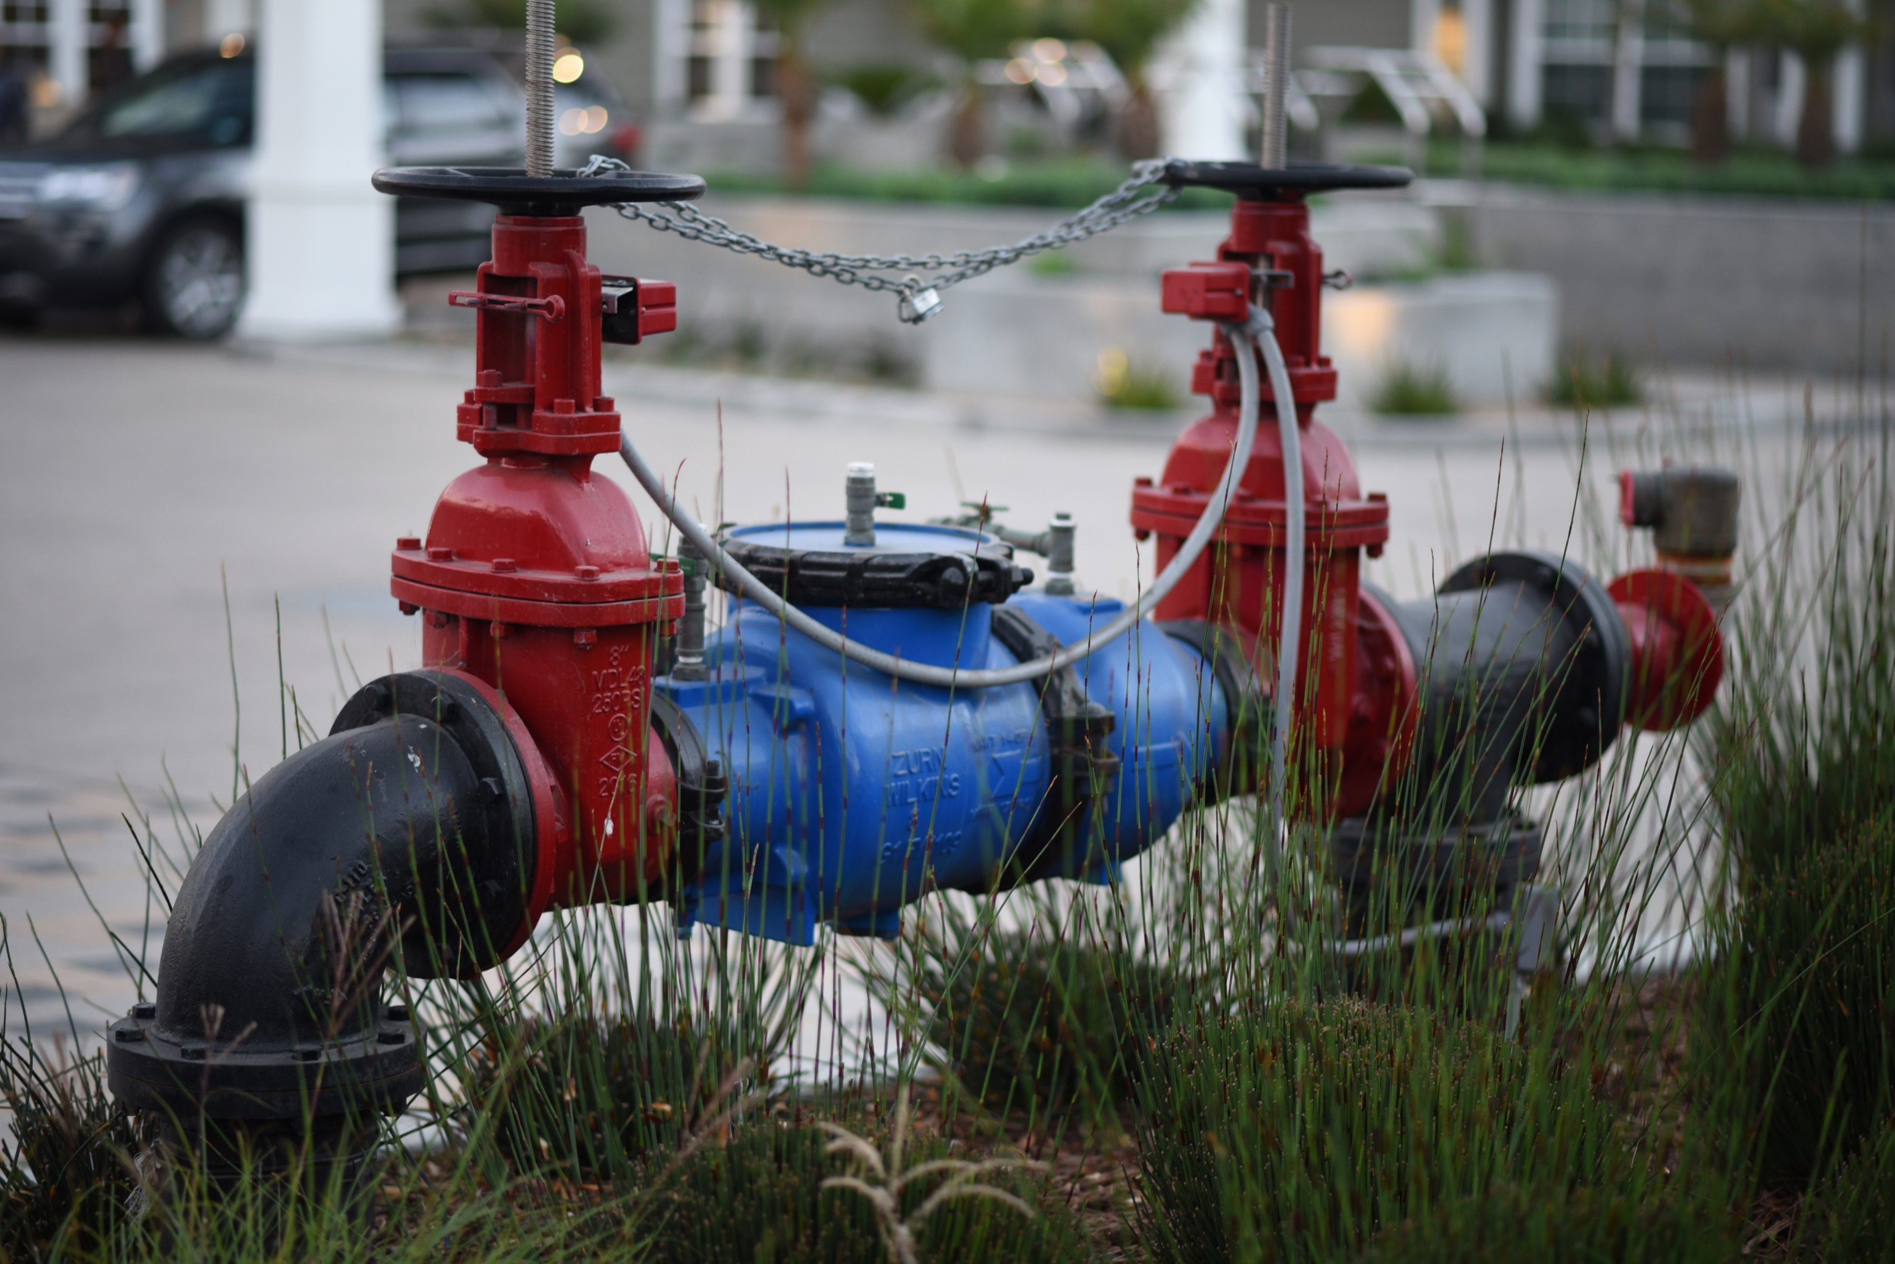
What is backflow?
Backflow is the undesirable reversal of flow of water or mixture of water and/or other substances into the distribution pipes of the potable supply of water from one or more source(s). This can occur with presence of a cross-connection and either backsiphonage or backpressure.
What is a backflow preventer for?
A backflow preventer is a valve designed to prevent the reverse flow of water from the consumers potable system back into the public supply.
4:05 Video
What is Backflow and What is a Backflow Preventer?

Slide 3
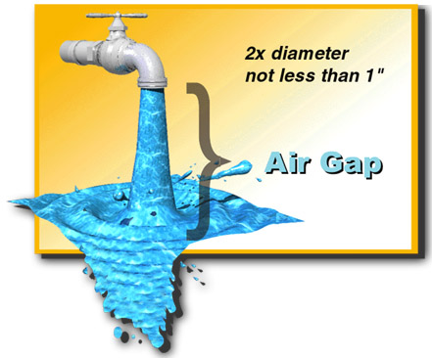
backflow prevention why do you need it?
We cannot eliminate the occurrence of backflow conditions AND
We cannot prevent cross-connections from being created
THUS, we must provide a means of protecting drinking water systems
from the hazards of backflow occurrences through cross-connections
Air gap, the most basic means of backflow prevention
An air gap must be 2X the diameter of the outlet or at least 1” whichever is greater
Although effective, an air gap is not always the most practical means of backflow prevention
A more practical means of protection against
cross-connection hazards are
mechanical backflow prevention devices and assemblies

Slide 4
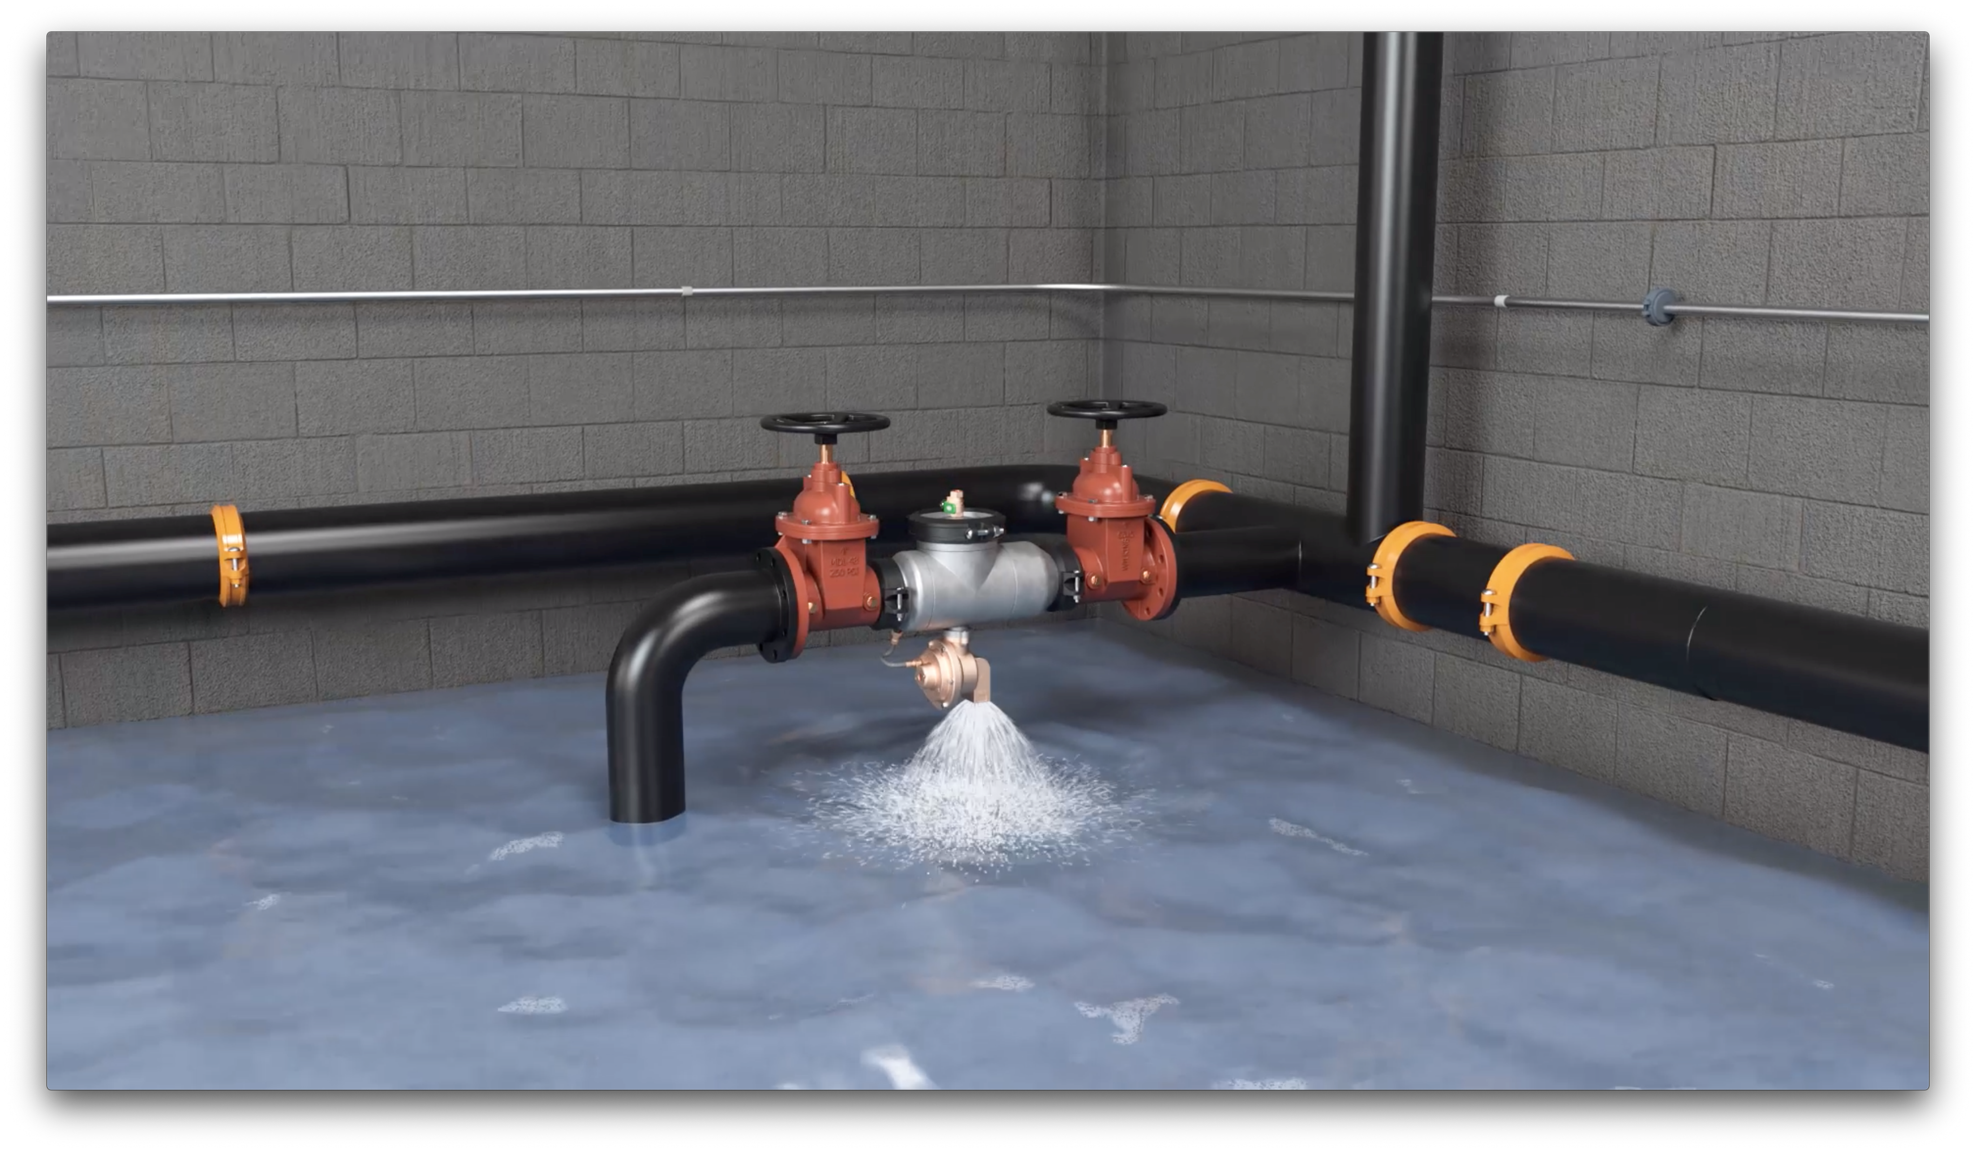
WHAT IF THIS HAPPENS OVER THE WEEKEND?

Slide 5
play it smart to play it safe
Syracuse hospital’s mechanical room discharged 100,000 gallons of water, causing:
Equipment failures
Patient evacuation and casualty
$2 million in unexpected costs
Structural and mold concerns
Added liability
Millions of dollars in cleanup, equipment replacement, and other liability costs

Slide 6
why flood control? design dilemma
cover your liability!
33,000 gallons in 1 hour
High flow is high risk
Auto shutoff saves more
8” backflow preventer at 110 PSI can discharge more than 550 GPM
That’s enough water to fill a 20’ x 20’ x 10’ room in one hour
A typical mechanical room drain can only handle 100gpm
leaving a severely deficient gap when compared to relief valve discharge rates
Proper drainage systems cost more than an upgraded backflow preventer with automatic shutoff valves
Notes:
In 1994, a Syracuse NY hospital’s mechanical room was inundated by 100,000 gallons of water from a backflow discharge
The water filled the room to a height of eight feet and caused extensive equipment failures
Patients were evacuated where one died in transport
The domestic water supply was contaminated as a result
Cleanup and patient transfer costs were put at more than $2,000,000
Today, concerns over mold only add to the liability risk

Slide 7
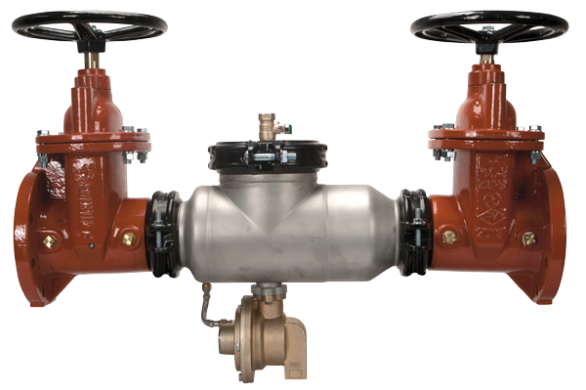
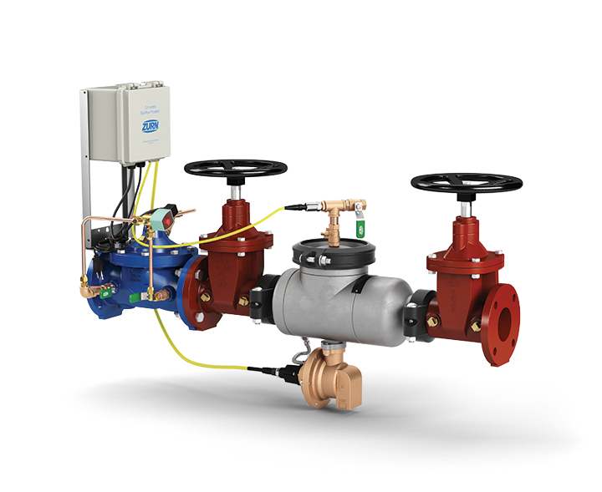
connected products why flood control?
Standard RP-style backflow preventer: $3,500
+ Sewage Ejector: $30,000
+ Larger Drainage System: $15,000
+ Larger Mechanical Room: $30,000
= $18,500 - $78,500
Backflow Preventer with Smart FCIS: $5,500
Extra flood insurance at a fraction of the cost
Notes:
In 1994, a Syracuse NY hospital’s mechanical room was inundated by 100,000 gallons of water from a backflow discharge
The water filled the room to a height of eight feet and caused extensive equipment failures
Patients were evacuated where one died in transport
The domestic water supply was contaminated as a result
Cleanup and patient transfer costs were put at more than $2,000,000
Today, concerns over mold only add to the liability risk

Slide 8
connected products Connected Flood Control System (FCIS)
REAL-TIME DETECTION
Sensor detects minute openings of relief valve and instantly calculates discharge flow rate and volume
WATER SHUTOFF
System automatically shuts off water if relief discharge is beyond set tolerances to prevent catastrophic flooding
PRESSURE MONITOR
Zone pressure sensor monitors system and provides alerts you when the pressure deviates from desired range
FCIS standard with connectability for 2-1/2” – 10”
Connected Flood Control System (FCIS)
Model FCISAST shown
page
08
Notes:
Thushan Hemachandra

Slide 9
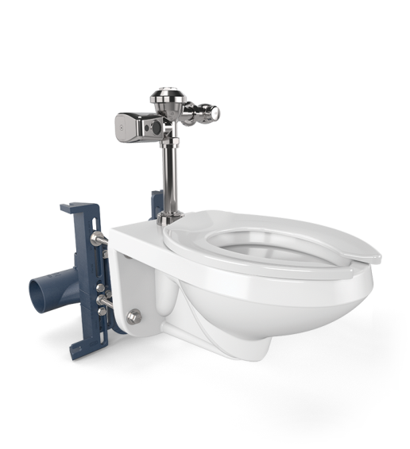
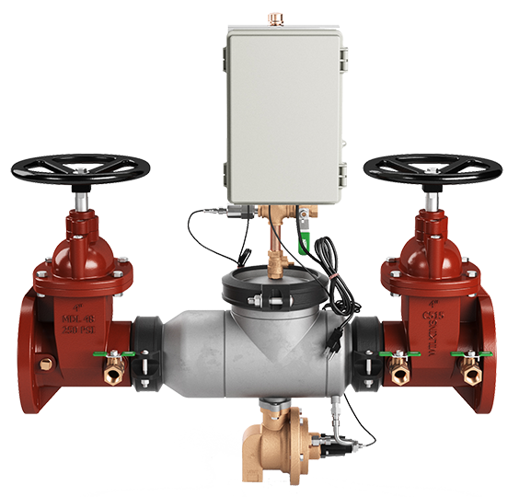
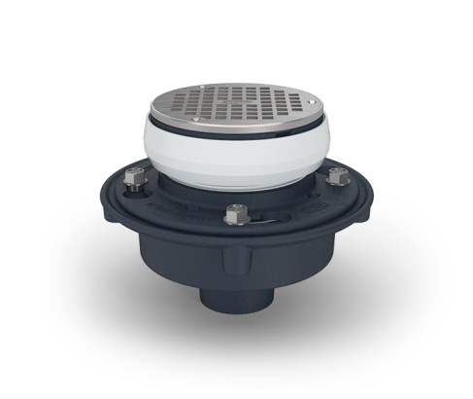
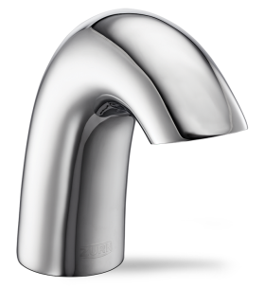
plumbSMART™ how it works
1
Register people and plumbing products on the portal
2
Get customize alerts for your plumbing products via email and/or text
3
Get a product, building or campus-wide view of your connected plumbing system
4
24/7 access to device info, spec sheets, and data trends
Use the existing network connection or a separate cellular connection
Notes:
Each registered device will show up on our web portal zurn.plumbsmart.com where historical data, trends, spec sheets, repair parts and other information is at your fingertips.

Slide 10
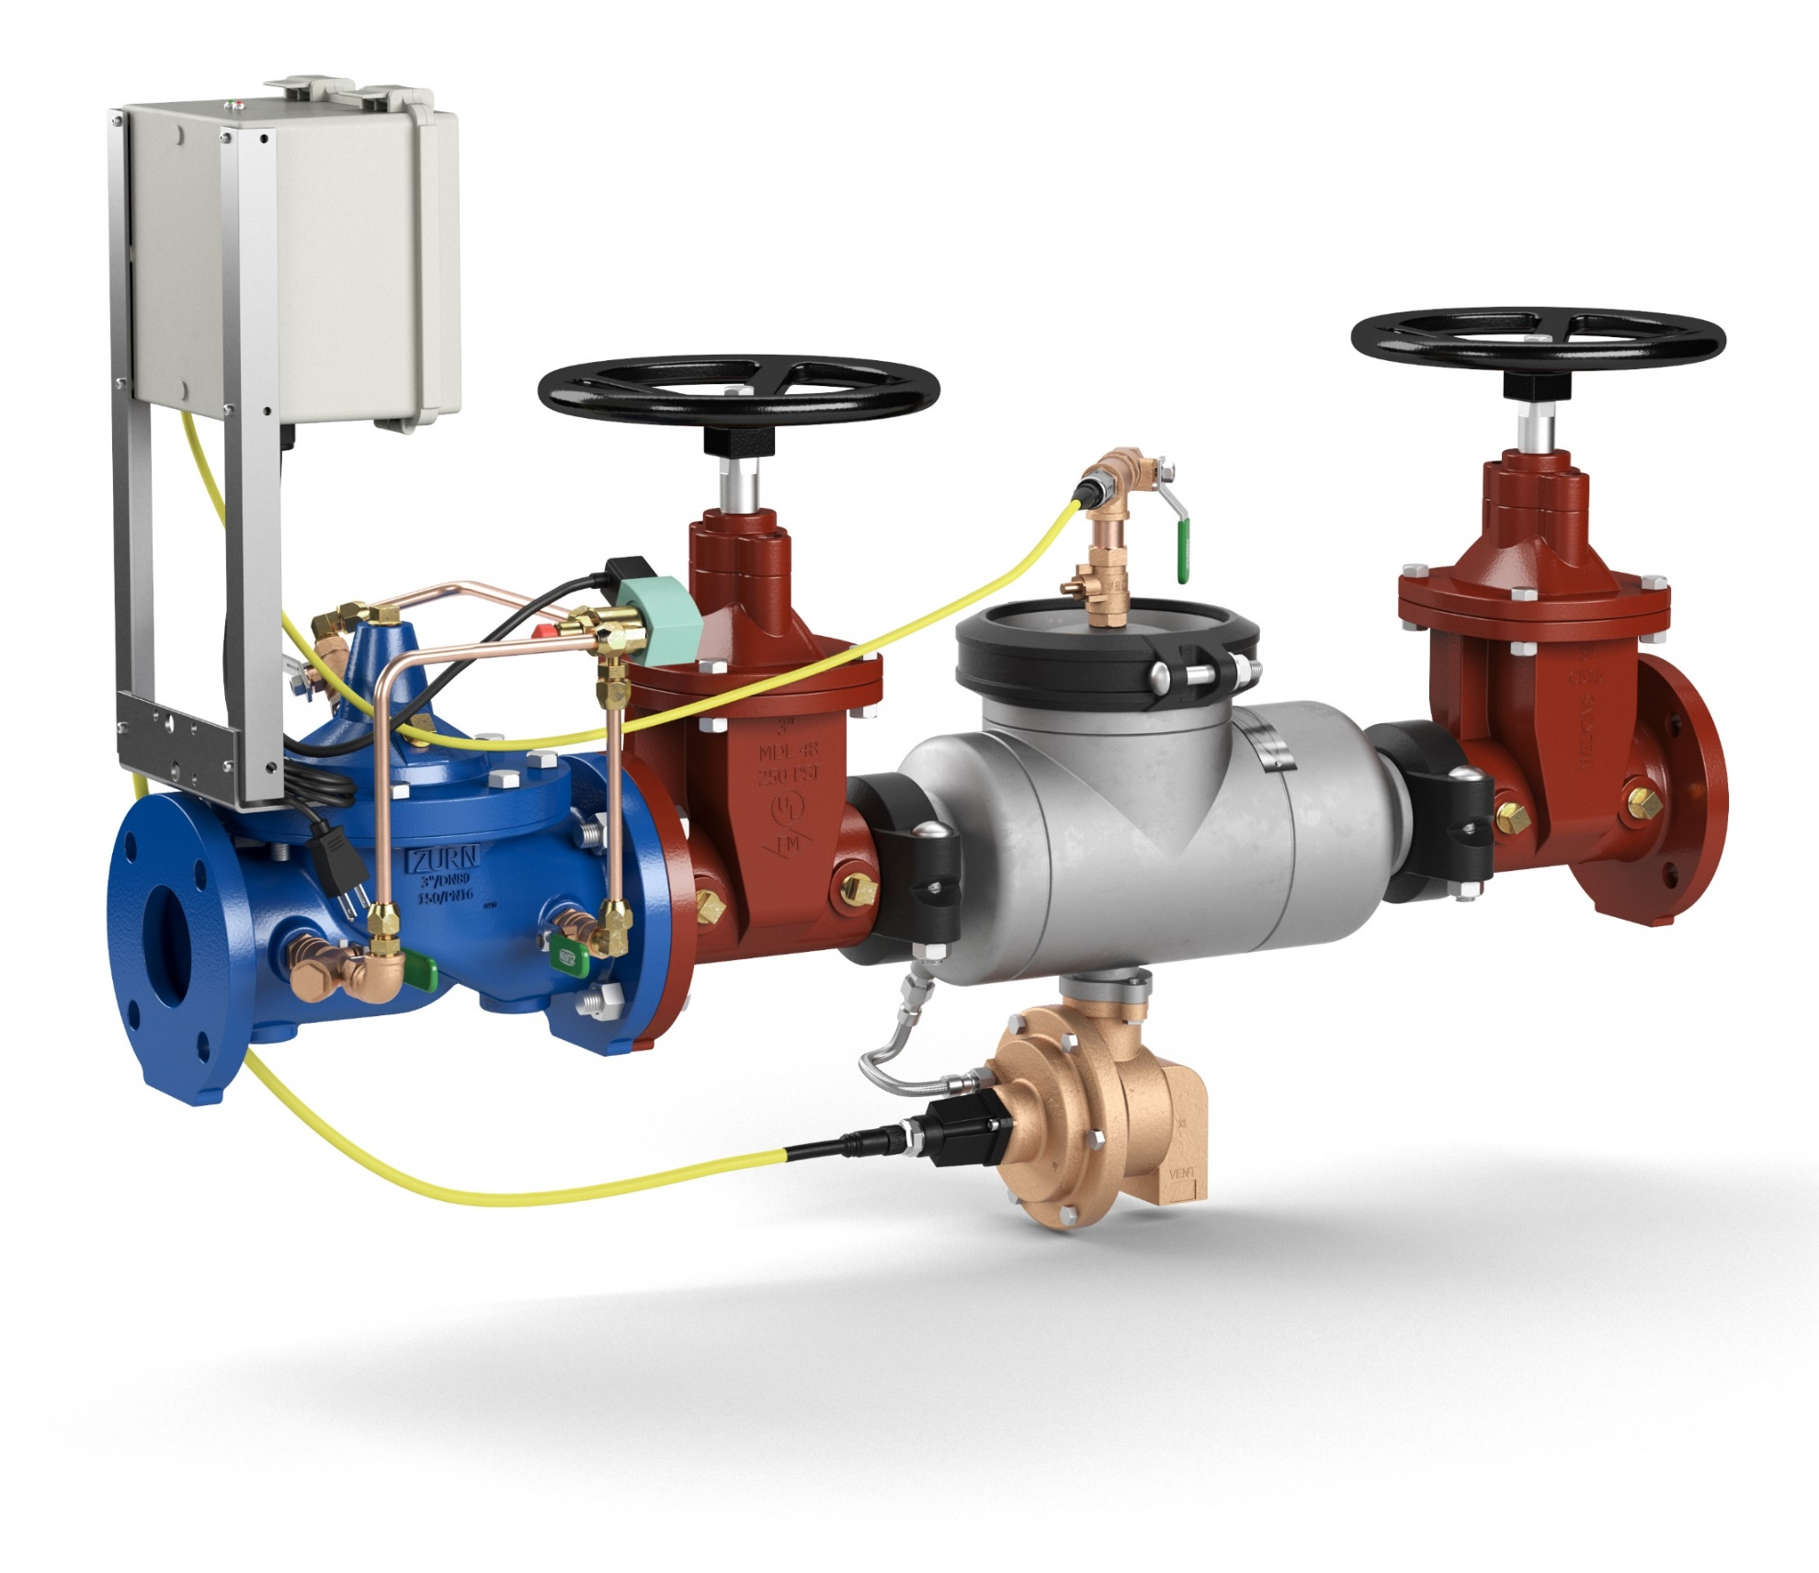
design and specify components Connected Flood Control System
FICSAST
FICSA
FCIS
Stainless Steel, pictured
Ductile Iron Grooved Ends
Ductile Iron Flanged Ends
Relief Valve Monitor detects minute openings and transmits data on size of opening multiple times per second to the end-point
ZW206 Solenoid Control Valve (SCV)
offers customizable shutoff
375 Reduced Pressure Principle Assembly
provides backflow detection and relief valve discharge
+ Floor Drain adequately sized drain MUST be installed to handle initial water discharge from the backflow relief valve
375ASTW1 Stainless Steel Body
375AW1 Ductile Grooved Body
375W1 Ductile Flanged Body

Slide 11
design and specify components Connected Flood Control System
LONG-RANGE (LoRa) ANTENNA
CIRCUIT BOARD
“Plug-and-play” ease of installation for both electronics box and Zurn hub with instant connectivity test via laptop or mobile device
Compact, enclosed and valve-mounted electronics controller that’s NEMA 4 (IEC 60529 IP66) rated
POWER SUPPLY

Slide 12
resources support
address
phone
online
511 Freshwater Way
Milwaukee, WI 53204
toll-free 1-855-ONE-ZURN
zurn.com
Product Pages | Tools, Specifications, & Resources | Vertical Market Solutions
inSpec | Manufacturer Cross Reference | ARCAT | MasterSpec | SpecBuilder |
Specifiers | BIM/Revit Files
zurn.com/resources/product-training
Zurn Product - Overview
How to Install and Support
LinkedIn/Zurn Industries, LLC
Facebook/Zurn Industries, LLC
YouTube/Zurn
Twitter/ZurnInd

