Slide 1
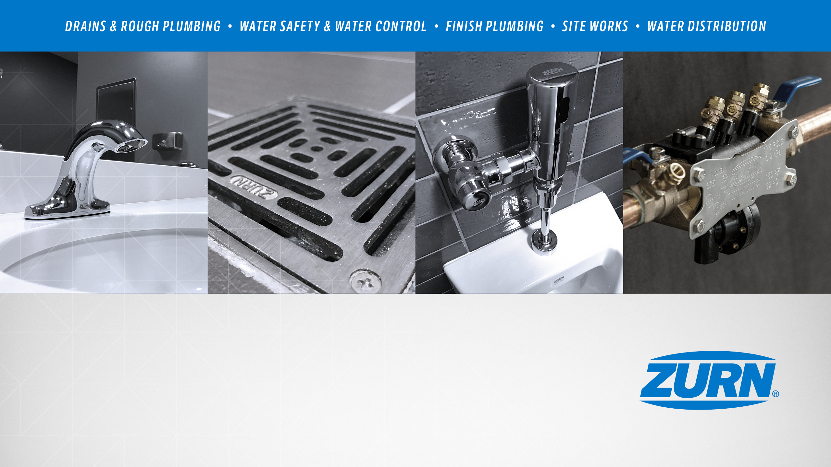
Zurn Interceptors - Overview
January 15, 2019

Slide 2
agenda what you’ll learn
01
value proposition
02
how it works
03
features & benefits
04
design & specify
05
summary
06
resources

Slide 3
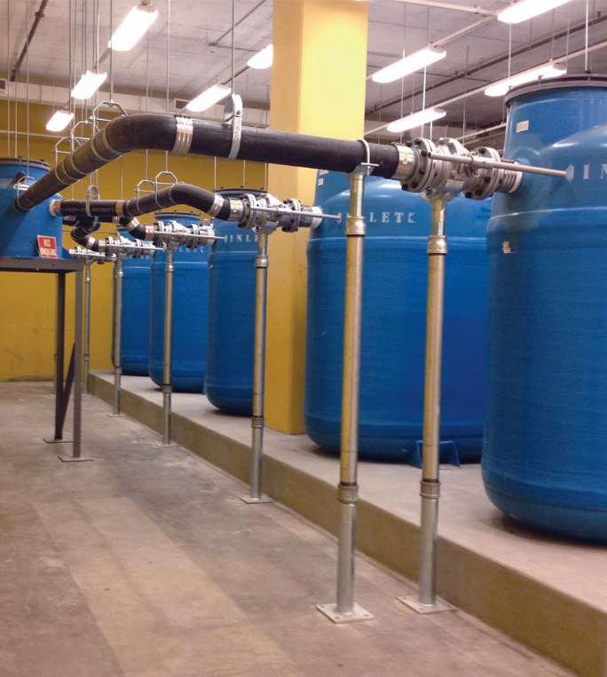
For building owners and facility managers,
Zurn Industries provides interceptors
that offer grease, oil, and sediment separation
unlike any competitor
allowing you to properly dispose and avoid placing harmful waste into pipes, sewers, or the water ecosystem

Slide 4



voice of customer industries
building owner
architect & engineer
contractor
“I need products that are durable and have a low total cost of ownership, help me achieve compliance + require minimum downtime for maintenance.”
“I need products that are
durable and cost-effective.”
“I need products that are easy and cost-effective to install and maintain, that are assembled and packaged in a manner that streamlines labor.”
Healthcare | Retail | Food Service | Hospitality | Restaurants | Institutional/Education | Government

Slide 5
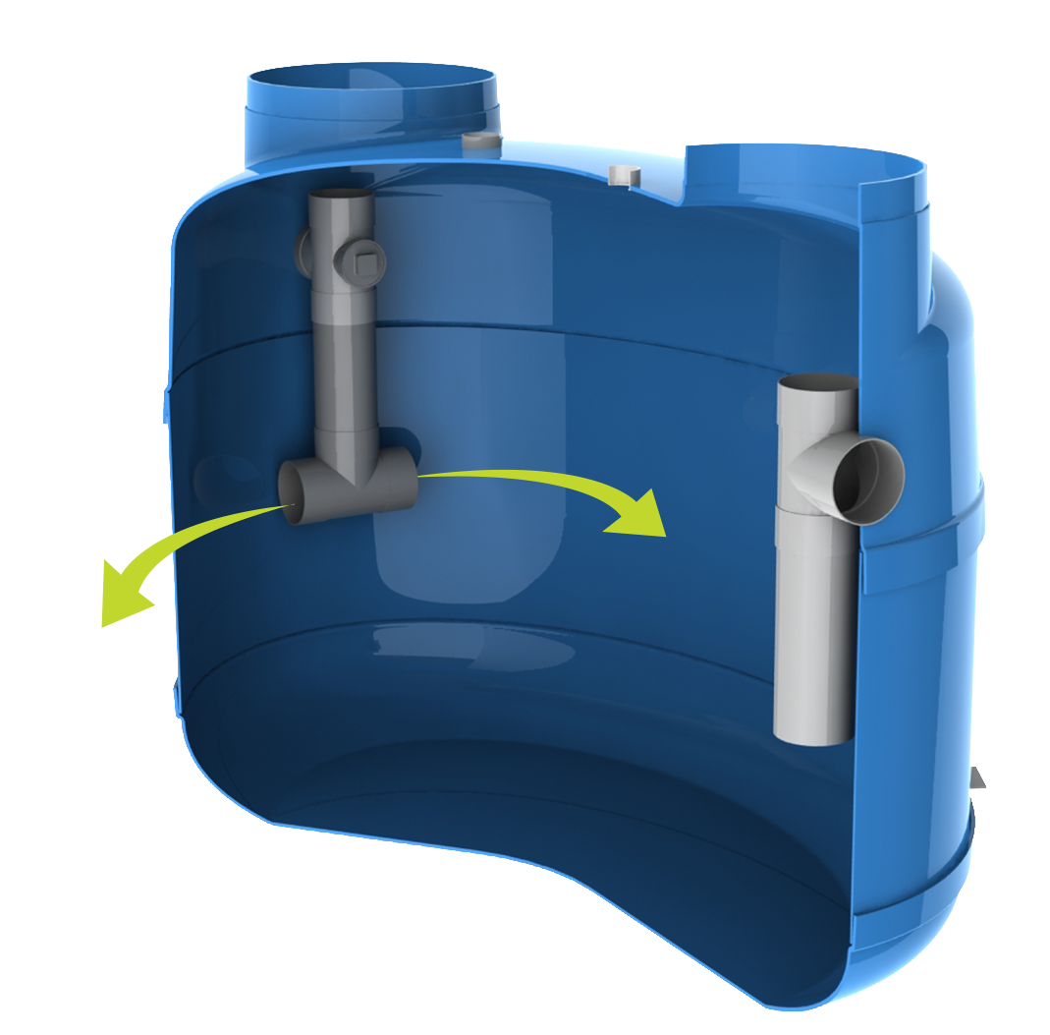
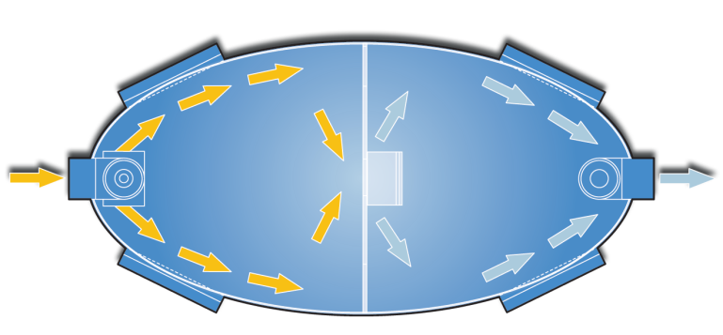
how it works step-by-step - large Proceptors
1
waste flows into chamber
water/grease/debris enters the interceptor chamber via a patented, gentle laminar (vs. turbulent) flow into the separation chamber
1
2
water/oil/debris separate
3
debris/grease separates from the water and remains separate because of a non-turbulent environment with baffling configuration
3
clear water travels through
oil floats to top, debris collects on bottom and remains in the interceptor while water flows through
2
1:21 Video:
Zurn Interceptors Proceptors – How it Works

Slide 6
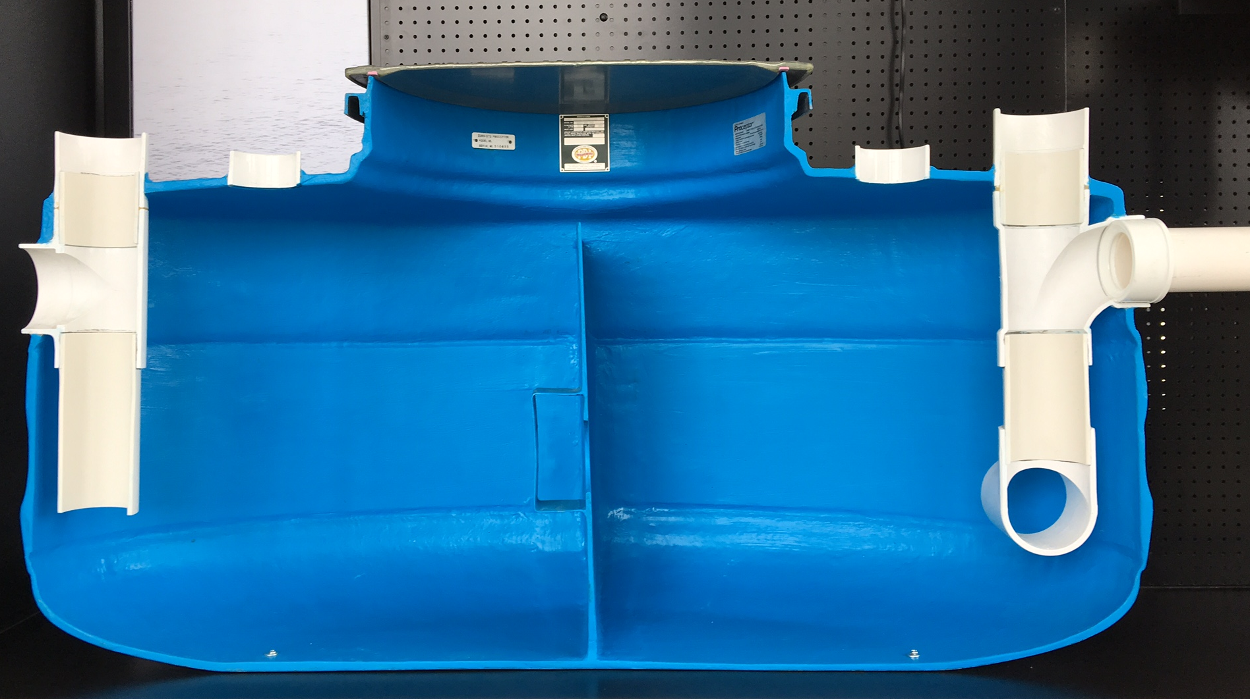
Test Your Knowledge
How do Zurn Proceptors function?
Place the following in the correct order:
Waste flows into interceptor
Water/oil/grease/sediment separates
Clear water travels through

Slide 7
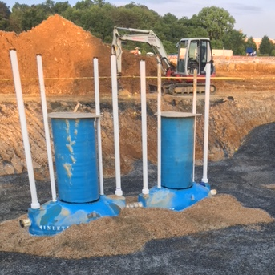
features & benefits interceptors
grease, oil, and sediment interceptors
Properly capture and separate pollutants to avoid placing harmful waste into pipes, sewers, or the water ecosystem
Small, medium, and large capacity options
Zurn is the only company to sell both proceptors and solids interceptors
key features
Unique interceptors designed specifically for unique waste including: grease (food industry), oil (auto and industry), and hair & lint (service industry), with sizes ranging from 4-10,000 gallons
Lowest cost of ownership
Large interceptors are often emptied by a third party who then use the waste materials for a variety of commercial and industrial products including biofuel, biodiesels, and soaps
Proceptor lifetime warranty against corrosion or cracking prevents EPA fines and business down-time
proceptors

Slide 8
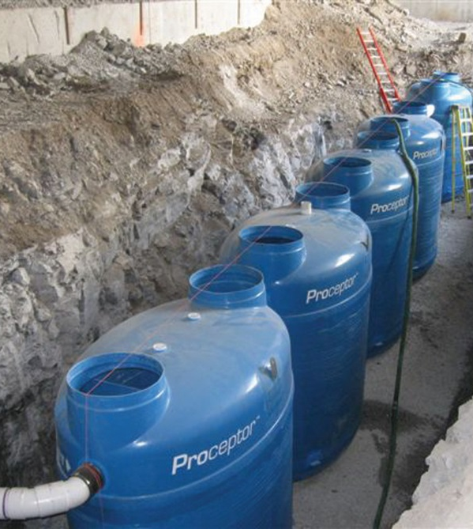
features & benefits mid-sized interceptors
FOG-ceptor
For medium-sized cafeterias and restaurants
key features
Retrofits fats, oil, or grease separators
Fiberglass construction for long service life - backed by a lifetime warranty
Delivered within 24-48 hours
Certified by PDI, IAPMO (UPC), and CSA
Includes two 20” diameter H-20 rated fiberglass bolted and gasketed frames and covers, and two 3’ high x 20” diameter extension collars
Z250H
fats, oil, grease interceptors
(FOG-ceptor)

Slide 9
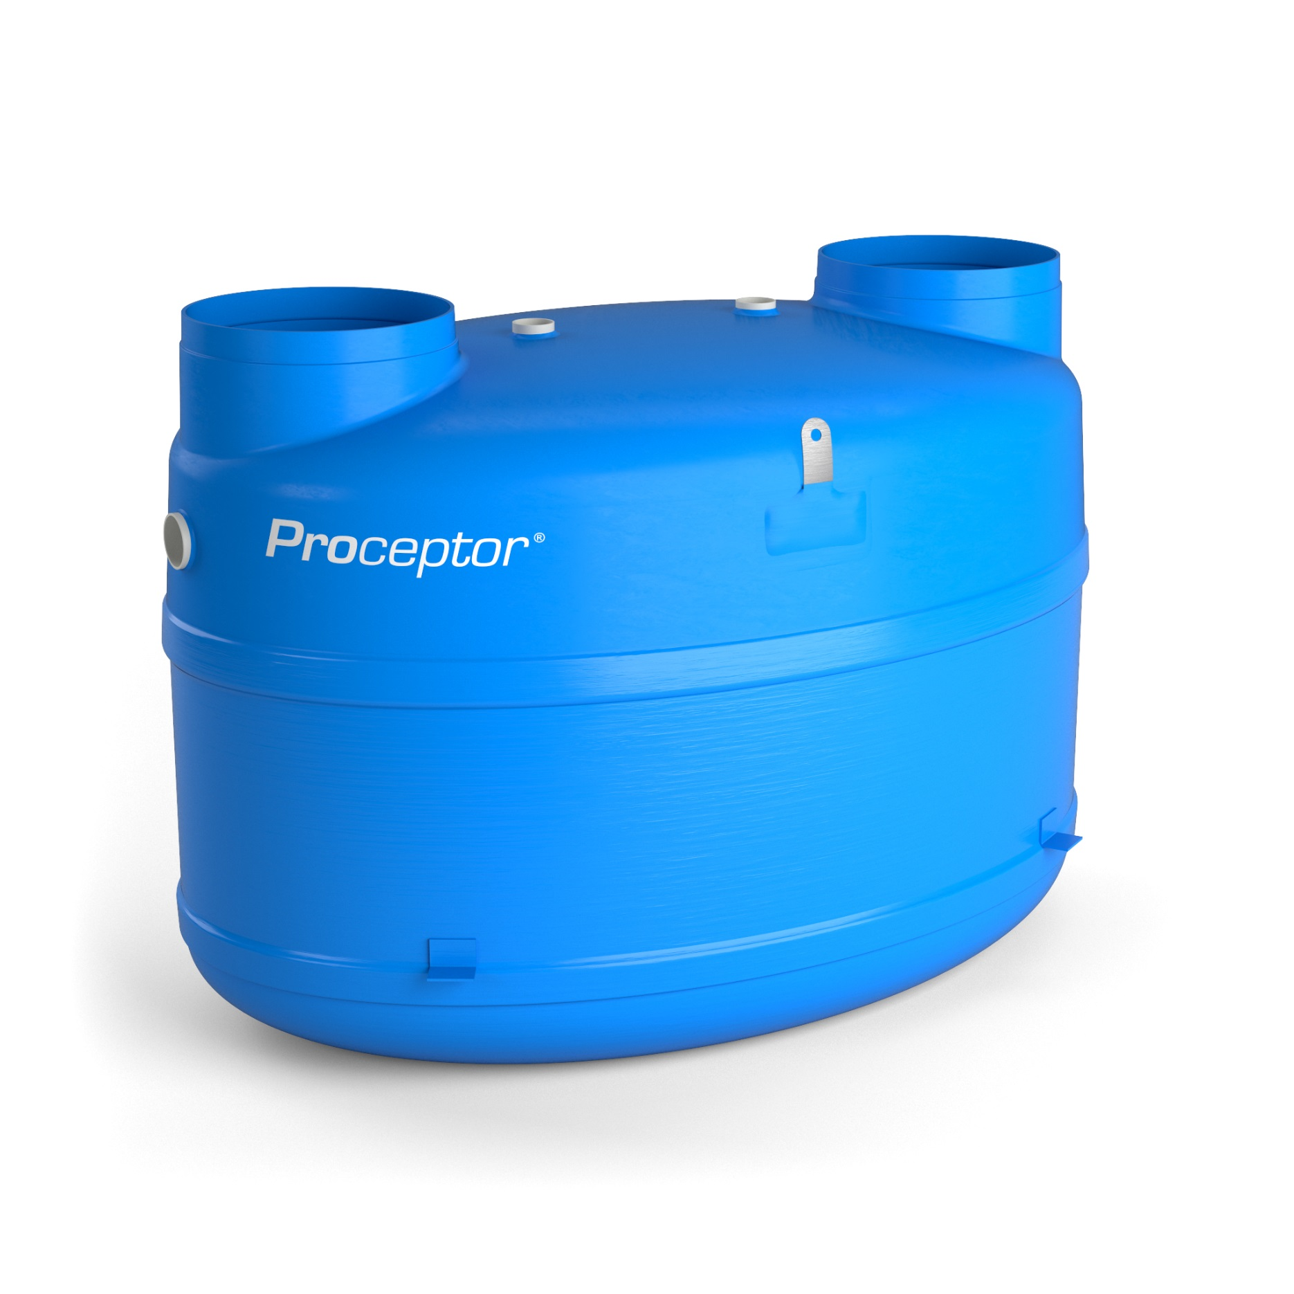
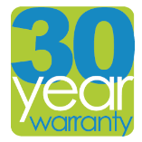

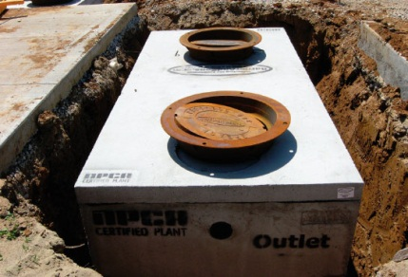
features & benefits large-scale interceptors
Proceptor GMC UPC gravity grease – 2 manway (all sizes)
brand name = Proceptor
For peak kitchen output 100+ GPM and a 10,000 gallon capacity
Unmatched, lifetime warranty against corrosion and cracks
Easy installation in-floor, above ground, or outside burial
Smooth, non-porous fiberglass for easy wash-down and minimal build-up
Engineered to process various effluent flow-rates, pollutant loads, compositions, and temperatures
Easy maintenance for lower costs
Extensive certification approvals for North American acceptance
performance
Patented, gentle laminar (vs. turbulent) flow for incoming flow management into the separation chamber
Engineered baffling
Consistently remove pollutants to comply to levels at or below recommended by local discharge regulations
100-350 ppm for food grease; 350 ppm total suspended solids (TSS); 25% or 30% rule
Ease of sampling, ensuring that effluent tests are representative of separator performance
Pre-piped cleanout and vent ports for easy access and proper venting
Central collection point at bottom for pumper hose access
buried interceptor

Slide 10
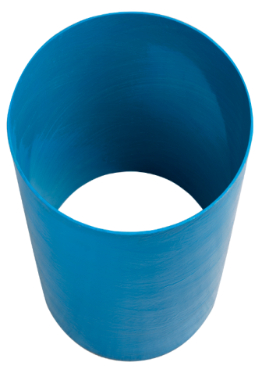
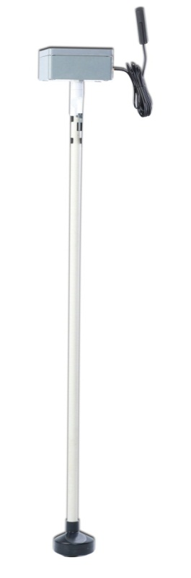
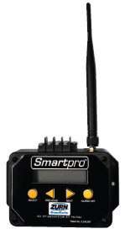
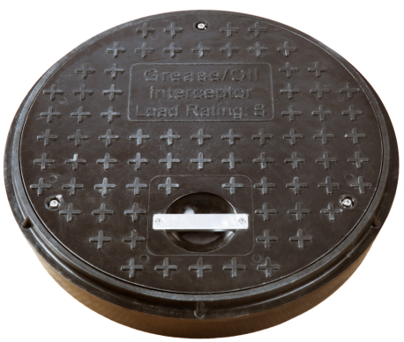
features & benefits options for large-scale Proceptors
electronic monitoring Smartpro
fiberglass cover
extension collar
Wireless system monitors grease and sediment
with the push of a button
H-20 (32,000 lbs) rated and skid resistant
*Included in the Z-250H FOG-ceptor package
3’ height Included in the Z-250H FOG-ceptor package

Slide 11
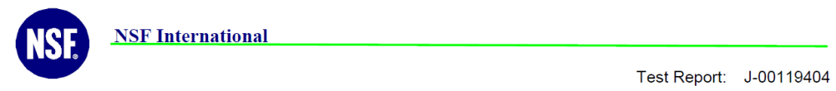
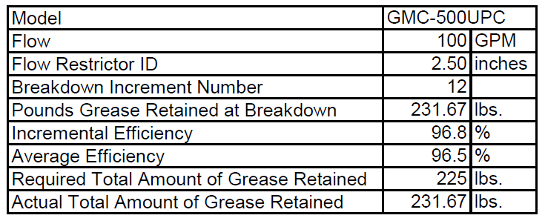
features & benefits incoming flow management performance
96.5% Removal Efficiency
  3rd party tested by NSF International and Chemir Laboratories, and PDI Certified
  to remove 96.5% of incoming FOG (Fats, Oils, and Grease)
99% + Removal Efficiency
Field tested and 3rd party tested by Severn Trent Laboratories
to deliver less than 100PPM FOG (Fats, Oils, and Grease)
  and less than 350 PPM TSS (Total Suspended Solids)

Slide 12
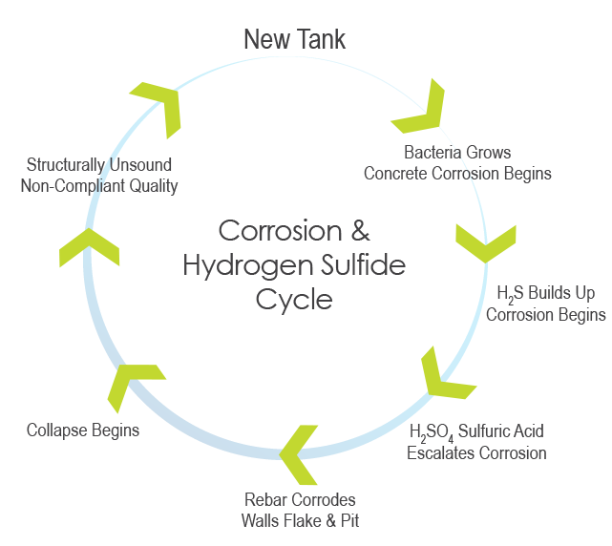
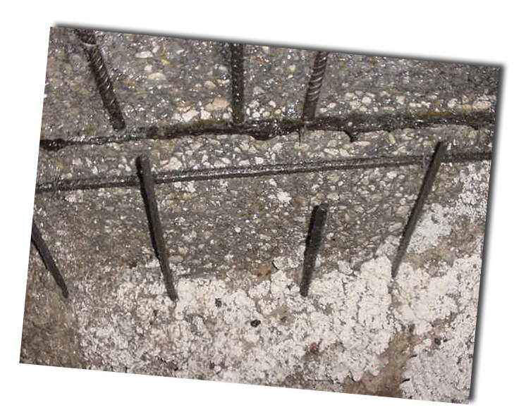
features & benefits concrete corrosion can begin within a few years

Slide 13
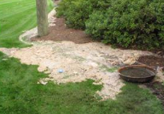
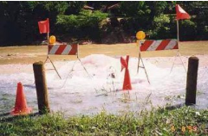
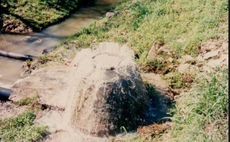
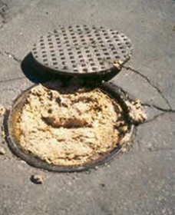
features & benefits sanitary sewer overflows
Sewers discharge up to 10 billion gallons (38 billion liters) of raw sewage, each YEAR!
overflow causes
roots
GREASE + roots
grit, rock, debris
Written Case Study:
Proceptor steps up to the plate to put FOG in its place
GREASE blockages
Written Case Study:
Customers create a stink about failed interceptor

Slide 14
features & benefits total installed cost - Proceptor vs. concrete
 |  | Proceptor GMC 1250 gal. | Concrete in Florida 250 gal.
Pea Gravel (Proceptor) or Sand (concrete) | 1.3yds | $48 | $40
Concrete Anti-Buoyancy | 3.2yds | $315
Cost of Backhoe vs. Crane |  | $260 | $1,500 +
Plumber (concrete requires installation of fittings) |  | $180 | $500
Concrete Relieving slab | 2.0yds | $196
Mason (concrete needs fittings installed) |  | $80 | $150
Excavation |  | $260 | $260
Total Installation Cost |  | $1,339 | $2,450 +
Price 1,250 gal. Separator |  | $8,822 | $3,500 to $5,500
Total Installed Cost |  | $10,161 | 5,950 - $7,950
Corrosion Resistant Epoxy Coating (recommended by Portland C. A.) |  | None needed | $3,388 - $5,082
Grand Total With Corrosion Resistance |  | $10,161 | $9,338 - $13, 032
Cost to line a concrete separator – 1,250 gallon unit is $3388 to $5082 based on 2 part epoxy applied cost of 10-15 $/sq. October 2014

Slide 15
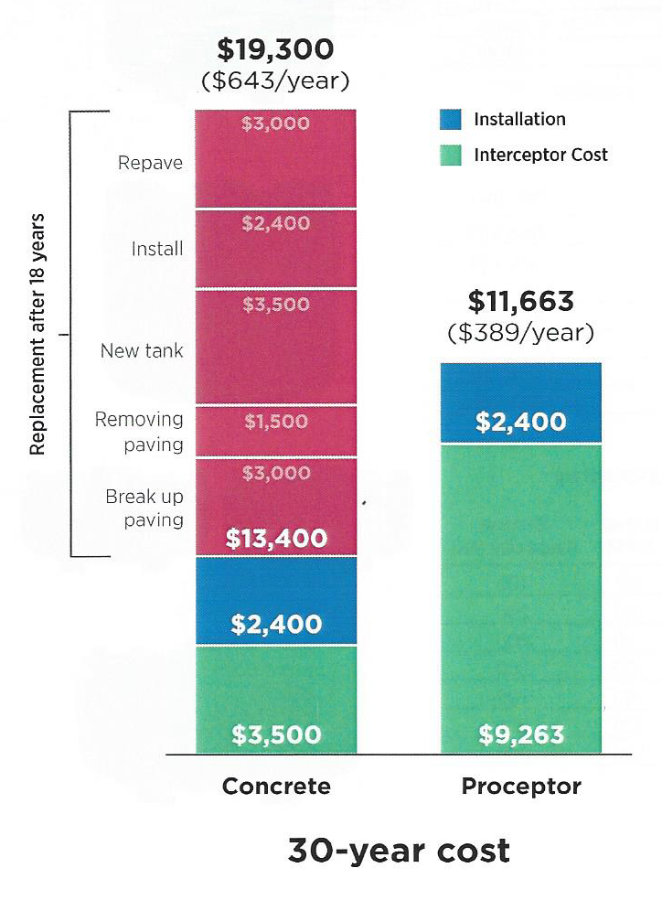
features & benefits lowest total cost of ownership - Proceptor vs. concrete
With the durable fiberglass construction,
Proceptor is guaranteed to last a lifetime
without failure due to corrosion, leaks and/or cracks.

Slide 16
features & benefits lowest total cost of ownership –
Proceptor vs. concrete
$25,000-50,000
$25,000-$50,000 possible daily
business downtime with concrete interceptors
0
business downtime
with Zurn Proceptors
No business downtime,
with the non-corrosive
Zurn Proceptor.

Slide 17
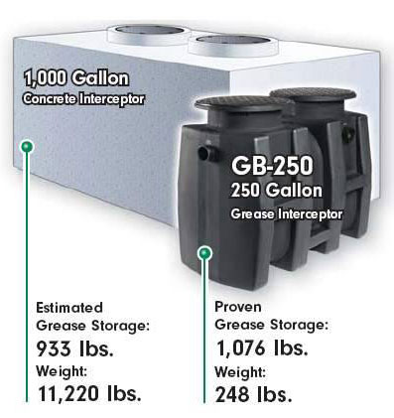
features & benefits grease storage capacity
  Schier states that the GB 250 holds more FOG than a 1000 gallon concrete interceptor.
  A 1000 gallon Proceptor interceptor holds 4,154 pounds of grease
  ~ 4X what Schier claims
1 gallon of FOG = 7.25 lbs.
933 lbs/7.25 = 128.7 gallons
128.7 gallons/1000 gallons =
13% full
1076 lbs/7.25 = 148.4 gallons
148.4 gallons /275 gallons =
  Most codes require interceptors
  be pumped out when 25% full
  of combined FOG & solids.
54% full

Slide 18
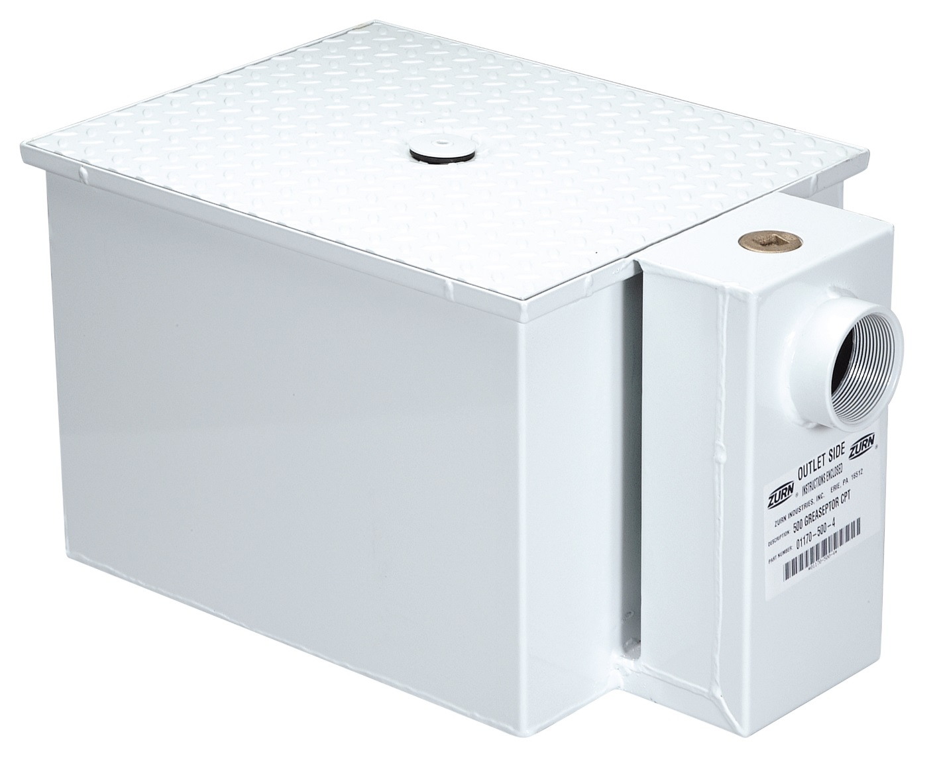
features & benefits smaller, in-kitchen interceptor
hydromechanical
in-kitchen grease trap
For smaller kitchen volumes of 4-75 GPM
Z1170 grease interceptor
key features
Acid-resistant, Dura-Coated steel body with slip resistant cover, flow diffusing baffle, visible double wall trap seal
Regularly furnished with high inlet and outlet connection
Available in stainless steel option
Low profile Z1171 available for under the sink installations
Z1172 available for larger flow capacities up to 500 GPM

Slide 19
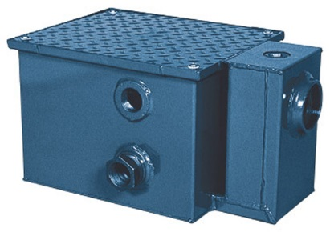
features & benefits oil interceptors
oil collection and separation
For service stations, parking garages, and industrial plants where discharged water contains oil and sediment. Oil is collected and conveniently drained to a storage tank via an adjustable gravity draw-off connection
Z1186 oil interceptor
key features
100% steel construction coated with acid resistant epoxy
Fiberglass oil interceptors available
Bronze cleanout plug
Visible double wall trap seal
Removable combination pressure equalizing/flow diffusing baffle sediment bucket
Various sizes: 300, 400, 500, 600, 700, 800 that provide 10-500GPM flow rates; and 7-1435 gallon water capacities, across all oil interceptor product lines
_Z optional acid resistant coated fabricated steel

Slide 20
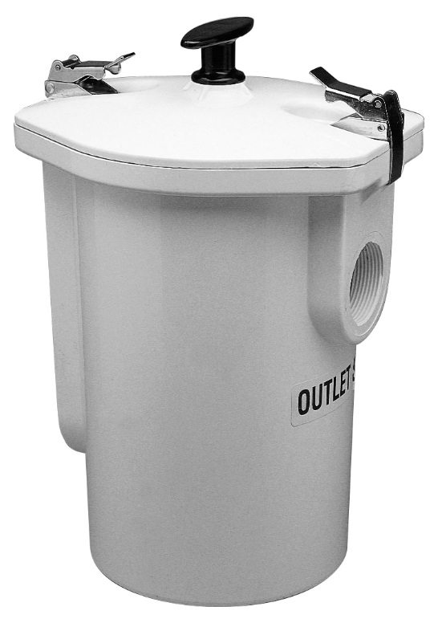
features & benefits sediments & solids interceptors
Z1180 sediments & solids interceptor
sediments & solids collection and separation
Prevents sand, gravel, clay, plaster, metal particles, lint, and other debris from blocking drain lines
key features
Steel, stainless steel, polymer, and fiberglass material options
4-500GPM flow rates
4-1500 gallon water capacities, across all sediment & solids interceptor product lines
Solids interceptors needed before a grease interceptor

Slide 21
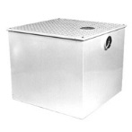
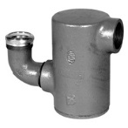
features & benefits hair & lint interceptors
Z1185 hair & lint interceptor
hair & lint collection and separation
Prevents hair and lint from blocking drain lines at hair salons, barber shops, surgery prep areas, and laundromats
key features
Stainless steel and steel material options
20-500 GPM flow options
Z1185 lint receptor has an acid resistant coasted interior and exterior, with aluminum secondary screen assembly and permanent primary straining baffle; can service 3-50 laundry machines
Z1175 can serve in lieu of a fixture ‘P’ trap with 1 ½ slip joint elbow inlet and 1 ½ threaded side outlet, perforated stainless steel basket that is removable from the bottom
Z1175 hair & lint interceptor

Slide 22
features & benefits environmental safety
peace of mind for the owner
  Compliance
  Clean – no bacteria, odors
  Easy maintenance
peace of mind for the general public
  Less SSO & environmental problems
  Less potential rate increases
peace of mind for the municipality
  Properly designed to deliver compliance and long life
  Correctly sized for each facility
long-term, IT’S THE RIGHT, ENVIRONMENTALLY-FRIENDLY THING TO DO

Slide 23















features & benefits questions
Do you want to ensure your business is compliant with current disposal regulations? Do you want to ensure you avoid EPA fines and business downtime? | Use Properly dispose and avoid placing harmful waste into pipes, sewers, or the water ecosystem Grease, oil, sediment, hair, and lint separation Patented, gentle laminar (vs. turbulent) flow into the separation chamber, with engineered baffles Consistently removes pollutants 96.5% or greater to comply to levels at or below recommended by local discharge regulations; 100-350 for food grease; 350 ppm total suspended solids (TSS); 25% or 30% rule performance Proceptor unmatched lifetime warranty against corrosion or cracking Proceptors are often emptied by a third party who then use the waste materials for a variety of commercial and industrial products including biofuel, biodiesels, soaps, cosmetics, and animal feed Effluent flow-rate, pollutant load, composition, and temperature Extensive certification approvals for North American acceptance | Lowest Total Cost of Ownership Corrosion Resistant Beyond Just Code Compliant Avoid EPA fines Avoid Business Down-Time
What size interceptor do you need and for what type of waste will you be collecting? | Design & Specify Specific unique designs for grease (food industry), oil (auto and industry), and hair & lint (service industry) Capacities ranging from 4-10,000 gallons, 100+ GPM Smaller interceptors fit compactly in a kitchen, with some fitting in cabinets, or under sinks Wireless system monitor option with SmartPro RF | Unique interceptors for unique needs Various sizes for all applications
Where do you wish to place your interceptor? | Install Easy installation on-floor, above ground, or outside burial | Best Lead Time = <4 Weeks Ease of Installation
Do you need an interceptor that’s easy to clean and collect samples from? | Support Easy maintenance for lower costs Cleanout and vent ports for easy access and proper venting; central collection point at bottom for pumper hose access Smooth, non-porous fiberglass conducive for easy wash-down and minimal build-up Easy sampling, ensuring that effluent tests are representative of separator performance | Competitively Priced

Slide 24
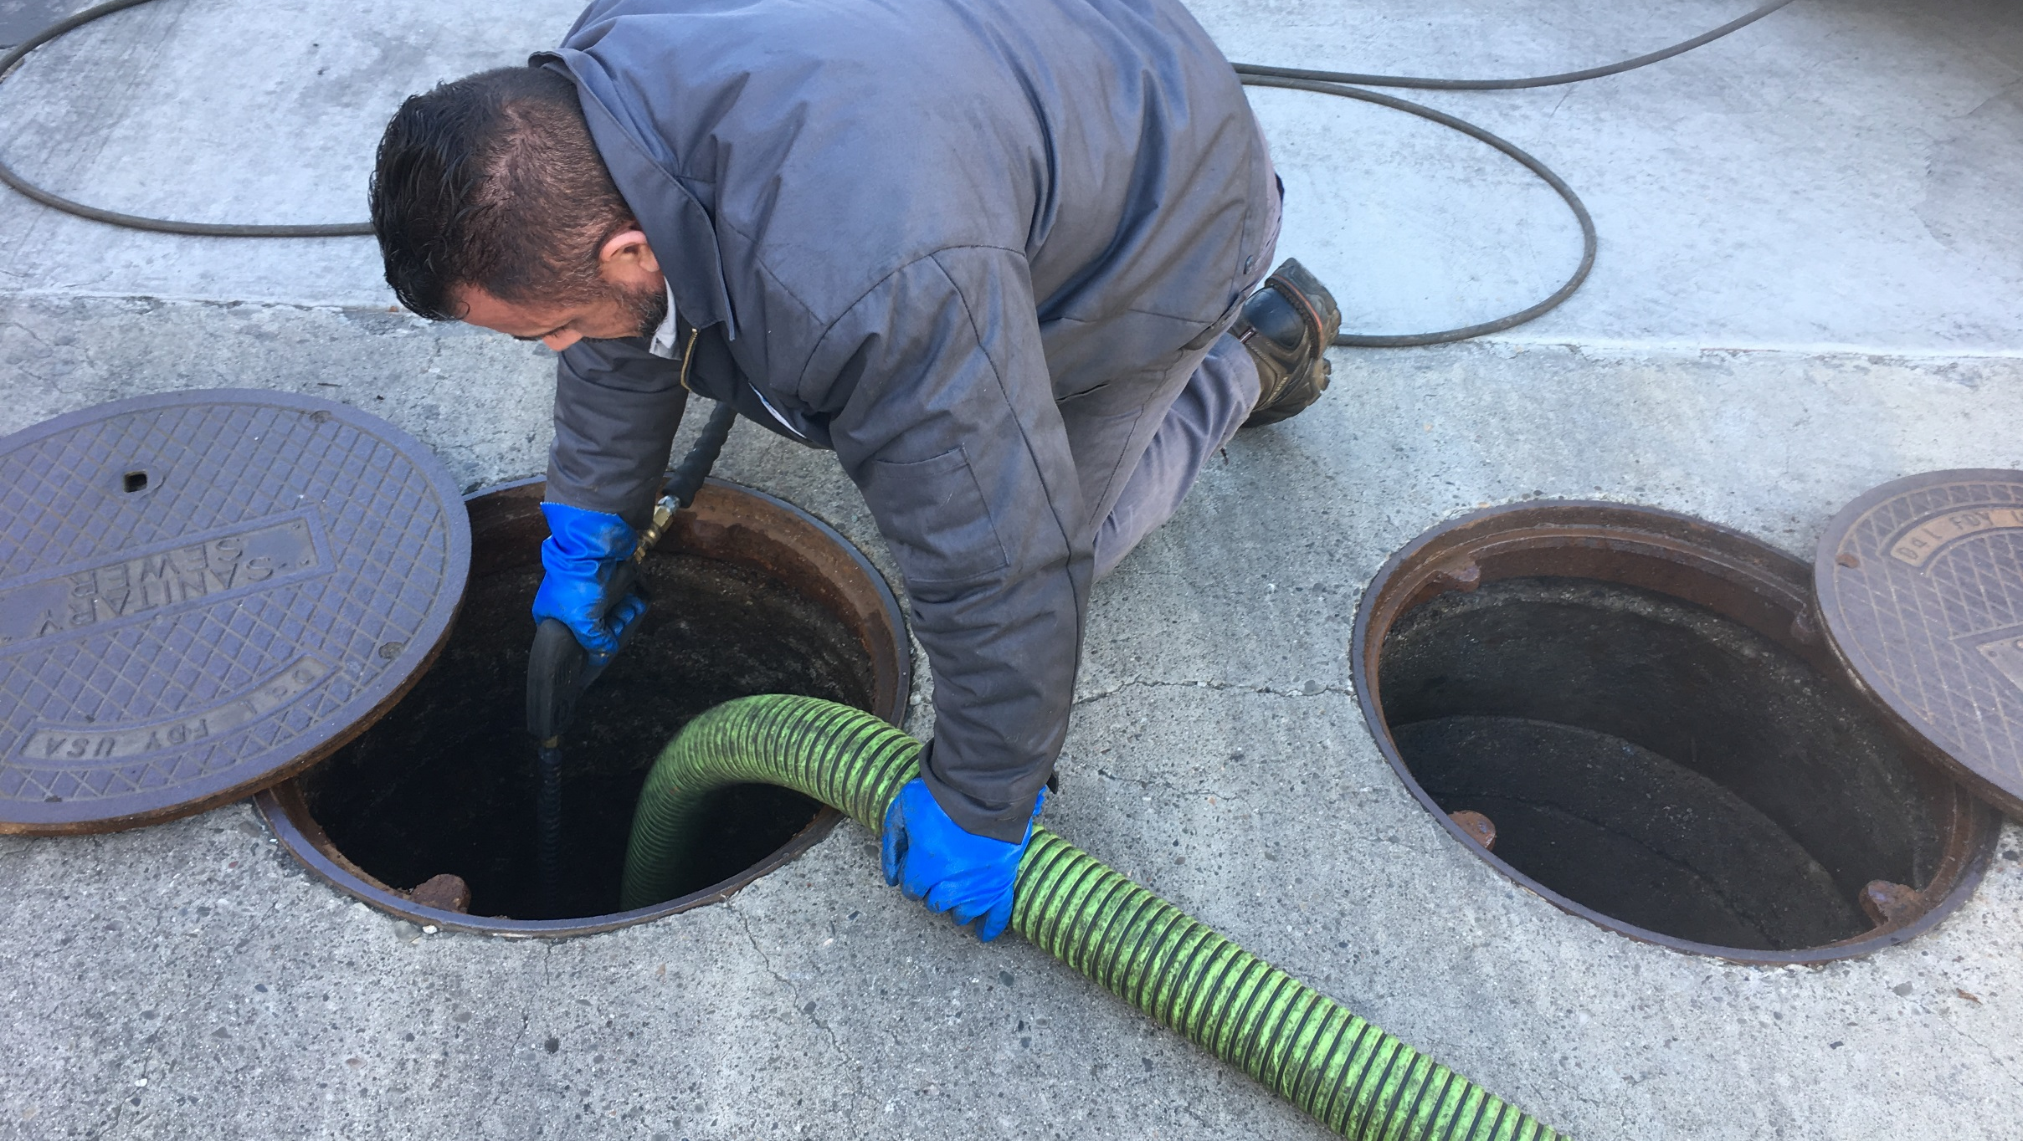
Test Your Knowledge
What are Zurn’s Proceptors’ top 3 benefits?
Lowest total cost of ownership
Lifetime warranty against corrosion and cracks
Easy maintenance, cleaning, and testing
Bright blue color

Slide 25


how to specify step-by-step
1
waste type
2
corrosion resistance
3
coding & regulations
4
sizing

Slide 26
design & specify interceptors
Food Solids or Sediment Waste |  |  | Food Waste |  |  | Hydrocarbon Fluids & Oil Waste
SOLIDS INTERCEPTOR |  |  | GREASE INTECEPTOR |  |  | OIL INTERCEPTOR
Highest Corrosion Resistance High Flow Capacity | Good Corrosion Resistance Medium-Low Flow Capacity | Low Corrosion Resistance Medium-Low Flow Capacity | Highest Corrosion Resistance High Capacity | Good Corrosion Resistance Medium-Low Flow Capacity | Average Corrosion Resistance Medium-Low Flow Capacity | Highest Corrosion Resistance High Flow Capacity | Average Corrosion Resistance Medium-Low Flow Capacity
 | STAINLESS STEEL Corrosion & Rust Resistant | STEEL Extremely Durable and Wear-Resistant | FIBERGLASS Lifetime Warranty Against Failure | STAINLESS STEEL or Polymer Corrosion & Rust Resistant | STEEL Extremely Durable & Wear-Resistant | FIBERGLASS Lifetime Warranty Against Failure | STEEL Extremely Durable & Wear-Resistant
Proceptor SMC series Z1180 FIBERGLASS Lifetime Warranty 50-1500 Gallons | ZS1182 35 GPM | Z1181 30 GPM | Proceptor GMC series IPC, PDI G-101, UPC Can be Buried 50-10000 Gallons w/3 Tanks | ZS1165 PDI G-101 Can be Buried 7-50 GPM | Z1165 PDI G-101 7-50 GPM | Proceptor OMC series 100-10000 Gallons w/3 Tanks | Z1186 300-800 Gallons 10-50 GPM
Z1184 POLYMER Acid-Resistant 15 GPM | ZS1183 100-900 Gallons 4-75 GPM | Z1182 30 GPM | FOG-Ceptor Z250H PDI G-101, UPC 250 Gallons Can be Buried 100 GPM | ZS1170 US/Canada PDI G-101, UPC Can be Buried 4-50 GPM | Z1170 US/Canada PDI G-101, UPC Can be Buried 4-50 GPM | FOG-Ceptor Z250H 250 Gallons 100 GPM | Z1188 75-500 Gallons 75-500 GPM
 | ZS1183-FC 100-900 Gallons 4-75 GPM | Z1183 100-900 Gallons 4-75 GPM |  | ZS1171 US/Canada PDI G-101, UPC Can be Buried 20-50 GPM | Z1171 US/Canada PDI G-101, UPC Can be Buried 20-50 GPM |  | Z1189 12-300 Gallons
 | ZS1183-DF 100-1200 Gallons 4-150 GPM | Z1183-FC 100-1200 Gallons 4-150 GPM |  | ZS1172 US/Canada PDI G-101, UPC Can be Buried 75-500 GPM | Z1172 US/Canada PDI G-101, UPC Can be Buried 75-500 GPM |  | Z1196 300-800 Gallons 10-50 GPM
 |  | Z1183-DF 4-150 GPM |  | ZS1173 PDI G-101, UPC 7-75 GPM | Z1173 PDI G-101, UPC 7-75 GPM |  | Z1198 75-500 GPM
 |  | ZA1184 15 GPM |  | ZS1174 US/Canada Can be Buried 4-50 GPM | Z1174 US/Canada Can be Buried 4-50 GPM |  | Z1198-ST 75-500 GPM With Storage Tank
 |  | Z1187 300-1000 Gallons |  | GT2702 POLYMER PDI-G-101 Can be Buried 4-75 GPM | GT2700 PDI G-101 Can be Buried 4-100 GPM
 |  | 1187SI (Sand Interceptor) Canada 20-500 Gallons 20-500 GPM |  | Retroceptor Polymer Smaller Footprint IPC: PDI G-101 35-50 GPM Can be Buried | GT2701 PDI G-101 Can be Buried 20-50 GPM
 |  | Z1175, Z1176, Z1185 Specialty, Hair and Lint

Slide 27
design & specify coding and regulations for public safety
Environmental Protection Agency (EPA)
The EPA suggests discharge regulations to meet effluent discharge quality
Grease interceptors should consistently remove pollutants to levels at or below EPA recommended discharge regulations
EPA penalties include: fines, supplemental environmental projects, and/or injunctive relief
Clean Water Act (CWA) national enforcement programs pretreatment program
Cooperative effort between federal, state, and local environmental agencies established to protect water quality
Protect Publicly Owned Treatment Works (POTWs) from pollutants that may interfere with plant operation or that may pass through untreated
Recognizes that FOG (Fat, Oil, and Grease) is a “middle of the pipe” problem
Improve opportunities for the POTW to reuse wastewater and sludge that is generated
Unlawful for any person to discharge any pollutant from a point source into navigable waters unless permitted under CWA provisions
sewer use by-law requirements
Maximum FOG concentration in effluent 100-150 ppm; maximum TSS concentration in effluent 350 ppm
Minimum volumetric size of interceptor
Mandatory maintenance requirements
building and plumbing code requirements
Local plumbing codes typically determine design and installation criteria but typically follow Plumbing & Drainage Institute (PDI) guidelines
Plumbing code often has a formula to calculate interceptor flow rates
Type of facility required to have a grease interceptor; type of fixtures required/permitted to go thru a grease interceptor
Venting requirements
Flow control device restrictions and requirements

Slide 28
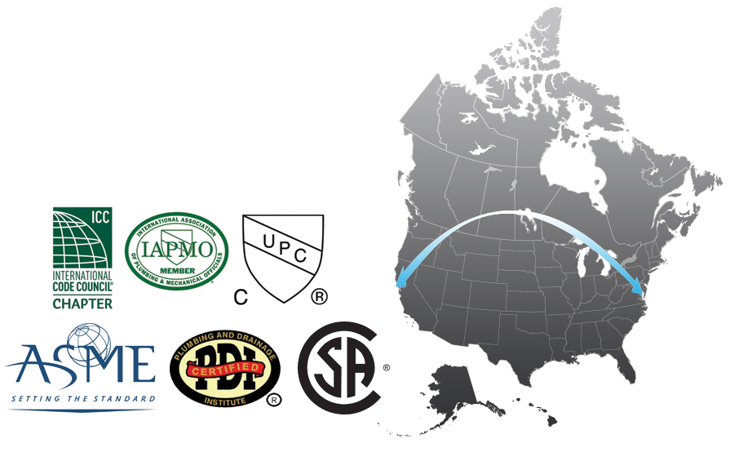
design & specify coding and regulations
sizing requirement differences
throughout North America
PDI sizing
Uniform Plumbing Code sizing
Local or state regulator sizing
Minimum volume sizing
Pipe flow sizing
Supplier/manufacturer sizing
“You Decide” sizing

Slide 29
design & specify sizing grease interceptors
UPC gravity interceptor sizing
Identify all Fixtures feeding into interceptor, such as 3 compartment sinks, hand sinks, Floor drains, mop sinks, etc.
Calculate the number of DFU’s (Drainage Fixture Units) total corresponding to the identified fixtures above
Go to Uniform Plumbing Code Table 10.3 for Gravity Interceptor sizing
Example: 52 DFU’s
35 DFU’s = 1,000 Gallon Interceptor
90 DFU’s = 1,250 Gallon Interceptor
Always Choose next highest DFU Interceptor – Choose 1,250 Gallon Interceptor.
Always round up to the next available size for safety

Slide 30
design & specify sizing grease interceptors
Gravity grease interceptor sizing
flow rate (GPM) x retention time
Retention time for proper grease and sediment separation
30 minutes for emulsified liquid
5 minutes standard
Example: 45 gpm flow rate
45 x 30 = 1350 – Choose 1500 gallon interceptor
45 x 5 = 225 – Choose 250 gallon interceptor
Always round up to the next available size for safety
PDI – Plumbing and Drainage Institute hydromechanical interceptor sizing
Calculate fixture flow in GPM (gallons per minute) multiply by 1 minute retention time = Size in GPM rounded to next highest
Always round up to the next available size for safety
Example: 1 X 3-compartment sink has rated flow of 32 GM
32 x 1 = 33GPM
Choose 35 GPM Interceptor like Retroceptor RC35LP, or Z1170-700, or GT2702-35

Slide 31
design & specify sizing grease interceptors
overview
A grease interceptor or oil water separator should provide a volume sufficient to allow Stokes Law gravity separation to act, given a reasonable estimate of incoming grease or oil pollutant load and retention time to separate.
online sizing guide
http://content.zurn.com/pages/ technicalinformation/Interceptors/GreaseCalcSDODIM(PW).xls
Notes:
Typically any sink that is filled and drained should be sized based on volume. Any sink that is used for rinse or wash down should be sized based on flow rate of faucet. Any floor drain will have minimum addition to the flow rate because it typically doesn’t see any more than mop water. Dishwashers should be piped to an independent interceptor. The size of such an interceptor is dictated by the maximum output of the dishwasher.

Slide 32
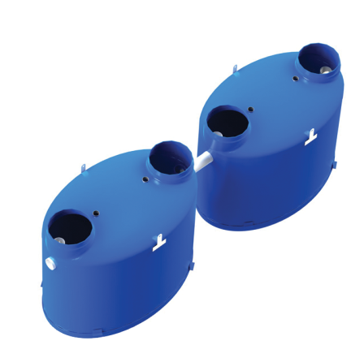
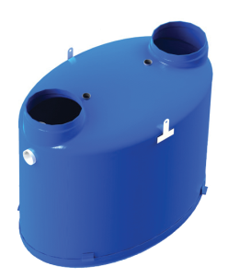
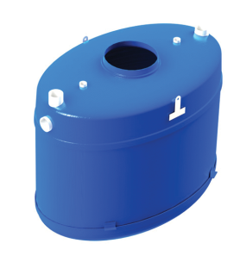



design & specify sizing
Volumes 50-10,000 Gallons Flow Rates 10- 2000 GPM
Proceptor GMC-10000
Volume 10,000 Gallons
Flow rate 2,000GPM
Proceptor GMC-2600
Volume 2,600 Gallons
Flow rate 100-520GPM
Proceptor GMC-1500
Volume 1,500 Gallons
Flow rate 100-300GPM
Proceptor GMC-1000
Volume 1,000 Gallons
Flow rate 100-200GPM
Proceptor GMC-500
Volume 500 Gallons
Flow rate 100GPM
Proceptor GMC-100
Volume 100 Gallons
Flow Rate 20-100GPM
Proceptor GMC-50
Volume 50 Gallons
Flow rate 10-50GPM
Note: All tank sizes over 3,000 gallon volume are round 94” diameter tanks.
Notes:
Proceptor CSA offers six super-capacity models, all certified to 100 GPM, to meet all your facility needs
Example: Actual storage capacity of GMC-500 is 2634 pounds of pollutant

Slide 33
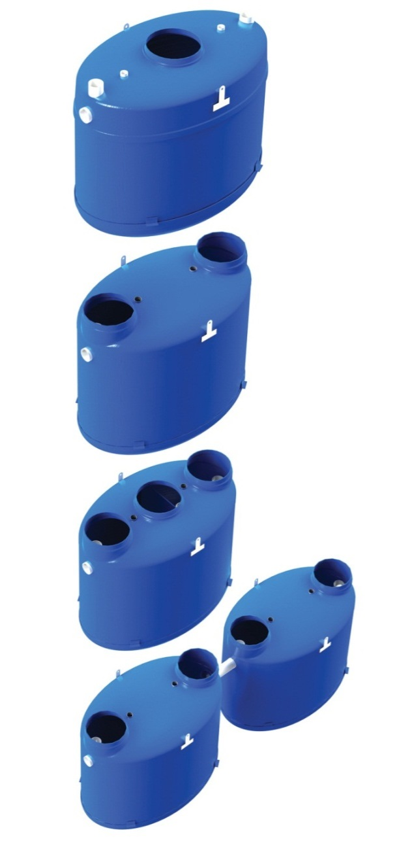
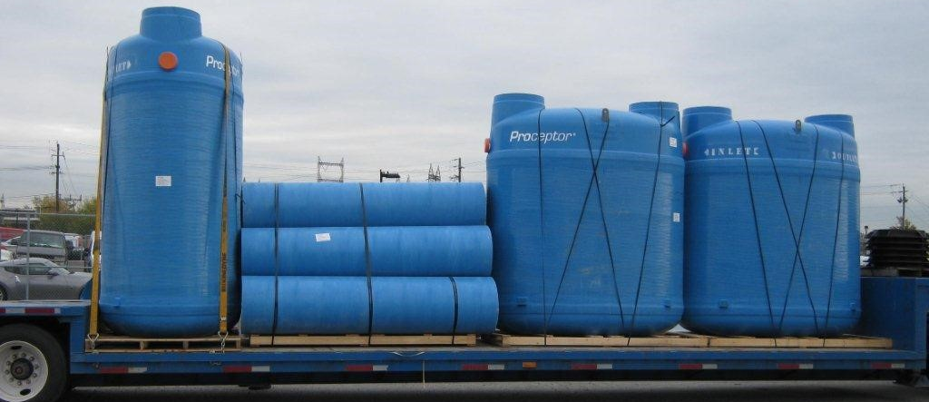
design & specify sizing and design flexibility
highly customizable
Made to order for exact fit (2 week lead time)
Configuration double manway to triple manway and in-series systems
Easily accommodates most engineering, architect, and owner design requirements
Multiple tank configurations can replace impossible to maintain “swimming pool interceptors” that are too large to pump

Slide 34
design & specify sizing grease interceptors
 | Old UPC (Seating Capacity) | New UPC 2006-2009 (DFU’s) | Florida Code (Seating+) | Georgia (IPC Flow) | Manning Formula | On-Site Treatment Sizing | GTA Sizing (Peak Flow)
Grease Interceptor Size | 5000 | 1250 | Four X 1250FL 5,000 gal. | 1500 | 4000 | 3000 | 1300
PDI sizing would result in a 100 gallon unit
typical quick serve restaurant
1 X 3-pot sink
3 X 2-compartment sinks
2 X mop sinks
13 X floor drains
1 X power soak sink or dishwasher
Total DFU’s 49
130 seats
Proximity to a 2 lane road
24 hour operation
Disposable dishes and utensils

Slide 35
design & specify performance variables and controls
variables
Velocity of incoming water
Ratio of grease and solids to water
Specific gravity of the pollutant
Presence of detergents and degreasers in system
Percentage of maximum flow capacity
Location of grease interceptor
controls
Installing a solids interceptor at the source of food or sediment solids
Designing for peak flow from all fixtures
Isolating dishwasher or garbage disposal device to separate interceptor
Increasing the size of the interceptor
Installing interceptor no more than 25’ from fixture
Notes:
1. A higher velocity of water will contribute to a more turbulent mixture. This will slow the grease separation process, thereby reducing efficiency.
2. The higher the ratio of grease particles to the water, the lower the efficiency of the interceptor.
3. Grease has a lower specific gravity than water and will rise to the surface quickly. Grease=ladened food particles having a higher specific gravity than water will linger and accumulate at the bottom, eventually passing out of the interceptor.
4.Grease-cutting detergents will break the liquid grease into minute particles that can cause these liquids to pass through the interceptor.
5. If the maximum recommended flow is exceeded, the efficiency of the interceptor will decrease considerably.
6. The interceptor should be located as close as possible to the source of grease. Waste pipes leading to the grease interceptor may become clogged if liquid cools prior to entering the grease interceptor.

Slide 36
design & specify sizing oil interceptors
flow rate (GPM) x retention time
Retention time for proper oil separation
60 minutes for emulsified liquid
30 minutes for non-emulsified liquid
0 minutes if a coalesce is used
Example: 50 gpm flow rate
50 x 60 = 3000 gallon separator
50 x 30 = 1500 gallon separator
50 x 10 = 500 gallon separator
International Plumbing Code (IPC)
10 gallons per 100 square feet of drainage area plus 100 gallons of baseline separator volume
Example: 6000 square feet wash bay
6000 x .10 = 600 gallons
600 gallons + 100 gallons baseline volume = 700 gallons
Round up to the next available size for safety

Slide 37
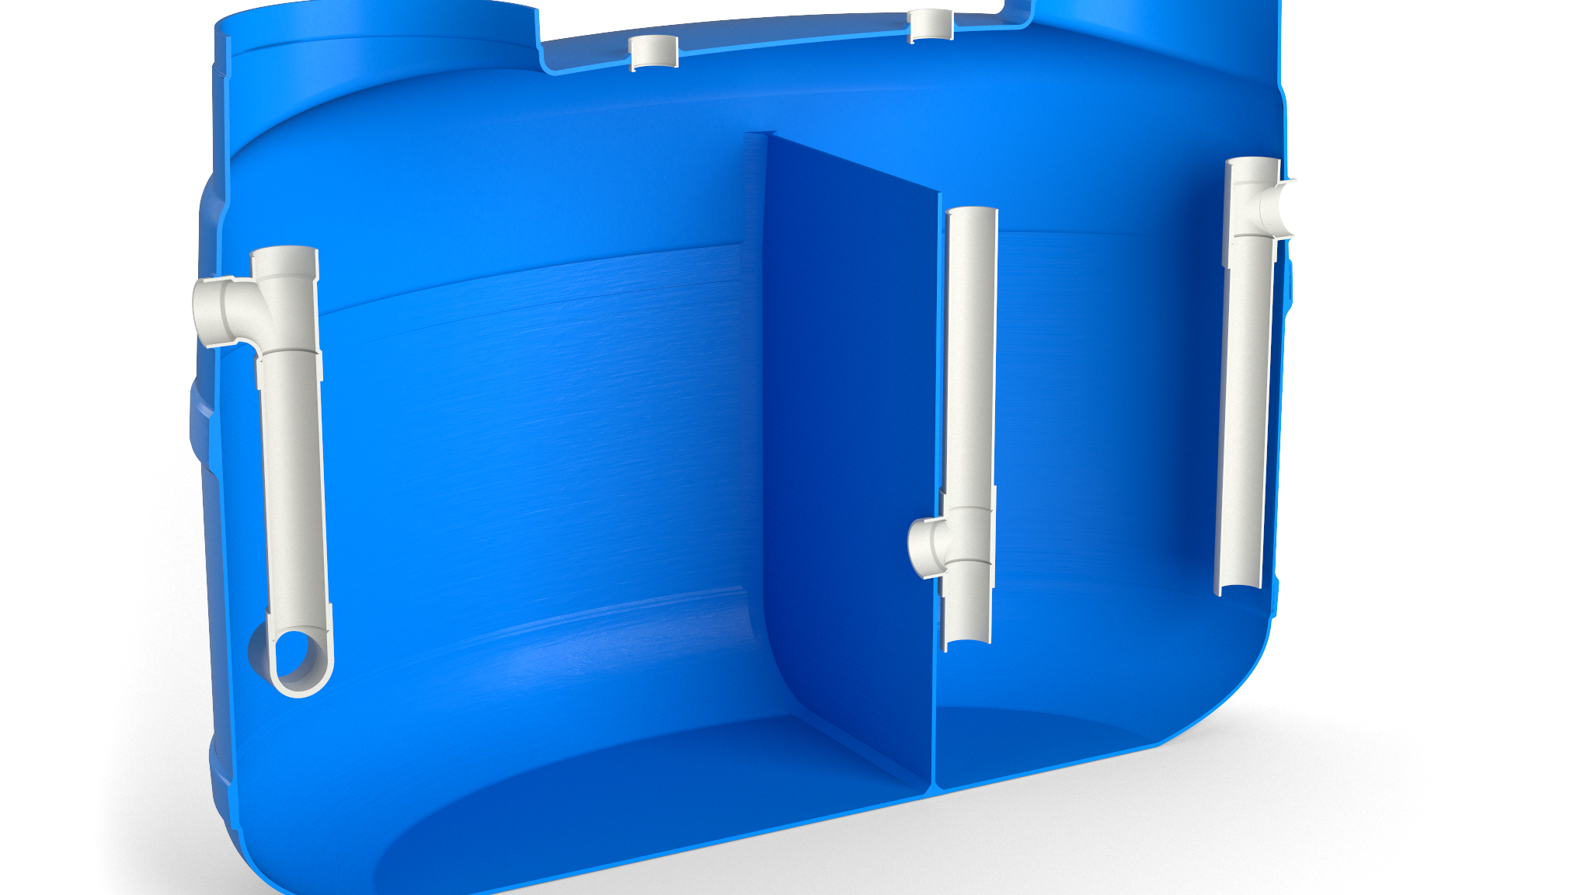
Test Your Knowledge
Place the following specify steps in the correct order:
A. Sizing
B. Coding & regulations
C. Corrosion resistance
D. Waste type

Slide 38
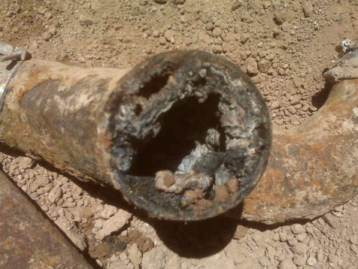
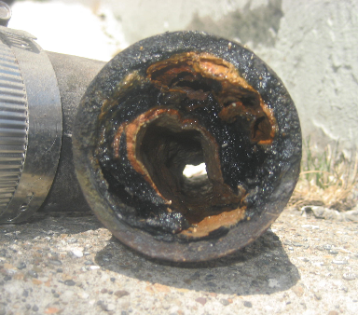
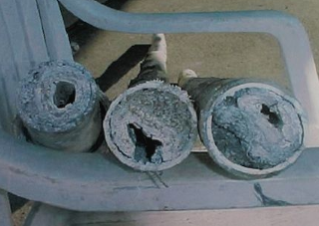
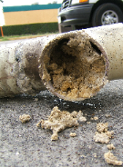
design & specify improper sizing and specification
grease clogs
sanitary sewer overflows
public health issues
damage to environment

Slide 39
features & benefits options for large-scale grease Proceptors
electronic monitoring Smartpro
fiberglass cover
extension collar
Wireless system monitors grease and sediment
with the push of a button
H-20 (32,000 lbs) rated and skid resistant
*Included in the Z-250H FOG-ceptor package
3’ height Included in the Z-250H FOG-ceptor package

Slide 40
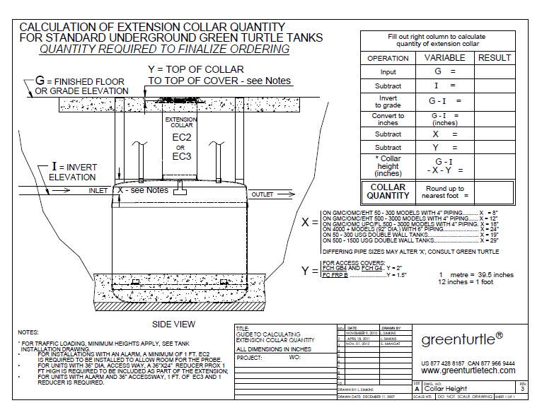
design & specify sizing of extension collar length

Slide 41
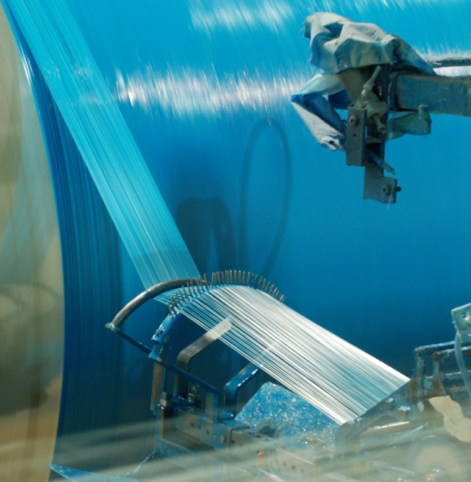
design & specify inventory availability
availability
Mississauga, Ontario, Canada – made to order for project specific requirements
lead times
Two week lead time on standard interceptors
Expedited “rush” shipping” available for extra charge
Custom orders 2-4 week lead time

Slide 42







design & specify tools
Create unlimited configurations
Solidify your
basis of design
Generate your
submittal package
Edit, share
and copy projects
Zurn.com tools
inSpec | Create configurations, solidify your basis of design, generate your submittal package, edit/share/copy projects
Manufacturer Cross Reference | Select a manufacturer, then product, type, or competitor product number to find the corresponding Zurn Product
ARCAT | Review CAD, BIM, and spec files
BIM/Revit Files | Browse BIM objects
Replacement Repair Parts | Review replacement and repair part information
Technical Resources | Review specs, calculation sheets, engineering guides, sizing and selections, materials and finishes, installation +
Product Warranties | Review One Zurn terms and conditions

Slide 43
specify tools
Zurn.com tools | description
Manufacturer Cross Reference | Select a manufacturer, then product, type, or competitor product number to find the corresponding Zurn Product
ARCAT | Review CAD, BIM, and spec files
BIM/Revit Files | Browse BIM objects
Replacement Repair Parts | Review replacement and repair part information
Technical Resources | Review specs, calculation sheets, engineering guides, sizing and selections, materials and finishes, installation +
Product Warranties | Review One Zurn terms and conditions

Slide 44
summary what you learned
building owner
architect & engineer
contractor
Lowest Total Cost of Ownership Lifetime Warranty Against Corrosion or Cracking on Fiberglass Beyond Just Code Compliant
Corrosion-Resistant
Wide Array of Functions and Sizes
Best Lead Time = <4 Weeks
Lightweight Design for Easy Installation
Easy to Clean and Collect Test Samples
Low Cost Maintenance

Slide 45
summary
Zurn overview
For more than a century, Zurn Engineered Water Solutions® has established itself as an innovator and leading manufacturer of highly engineered water product solutions.
Markets We Serve
Zurn Engineered Water Solutions is a recognized leader in commercial, municipal, and industrial markets, delivering sustainable building solutions for new construction and retrofit applications.
Industry Leading Product Lines
The Zurn product offering includes items such as specification drainage products, manual and sensor operated flush valves, radiant heating systems, snow melt systems, trench drain systems, backflow and fire protection systems, and much, much more.
Solutions We Provide
At Zurn we are committed to providing smart solutions that save time and money. Our goal is serving the customer through innovation, continuous improvement, and assurance behind every installation.
One Choice. One Zurn.
Choose Zurn for a reliable, recognized manufacturer to supply your entire installation, from behind the wall rough-in, to finished trim product and fixture systems.

Slide 46
resources support
address
phone
online
511 Freshwater Way
Milwaukee, WI 53204
toll-free 1-855-ONE-ZURN
zurn.com
Product Pages | Tools, Specifications, & Resources | Vertical Market Solutions
inSpec | Manufacturer Cross Reference | ARCAT | MasterSpec | SpecBuilder |
Specifiers | BIM/Revit Files
zurn.com/resources/product-training
Zurn Product - Overview
How to Install and Support
facebook.com/ZurnIndustries
twitter.com/ZurnIndustries
linkedin.com/company/ZurnIndustries
youtube.com/ZurnIndustriesLLC

