Slide 1
Zurn New Product Launches
July 2018
Notes:
Wurster

Slide 2
agenda what you’ll learn
01
past launches
02
present launches
Lean construction point drain “C” market
EZCarry product enhancements
Wilkins building riser product line extension
Fire Protection breakout business (Group 1 products)
inSpec digital specification tool
Marketing update
03
future launches
04
resources
Solid surface sink systems
Fire Protection breakout business (Group 2 products)
Smart connected backflow
400ST n-Pattern Series (USC Launch)
First fit PRV
Product training
Notes:
Wurster

Slide 3
past launches 2018
Notes:
Wurster

Slide 4
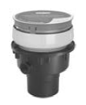
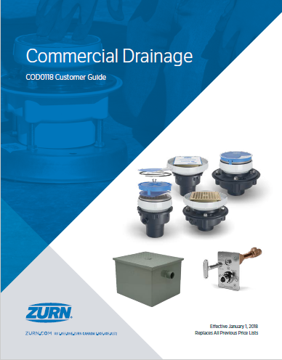
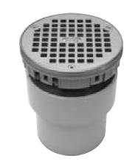
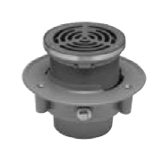
past launch plastic drainage
commercial drainage:
keeping the contractor in mind
EZ-PV2
New nomenclature for ease of doing business
Simplified product offering with cross reference
Discontinuation in process
FD-PV3
FD1-PV3
FD2-PV2
Notes:
Nagg

Slide 5
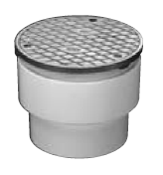
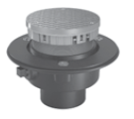
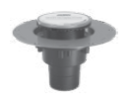
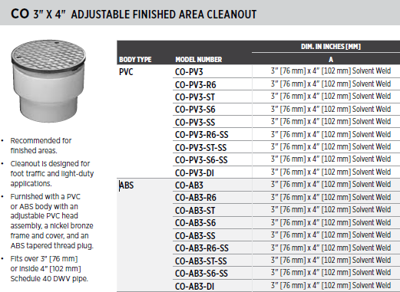
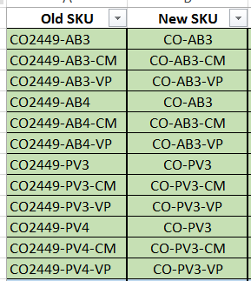
past launch commercial drainage
CO-PV3
CO1-PV3
CO2-PV2
driving with the customer in mind
Notes:
Nagg

Slide 6
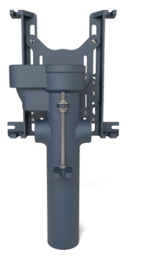
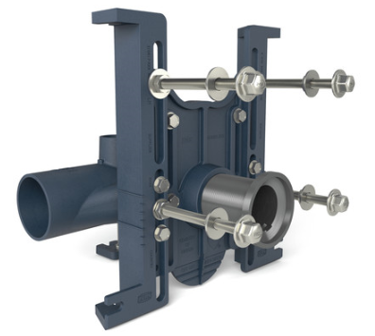
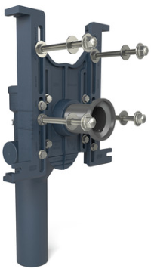
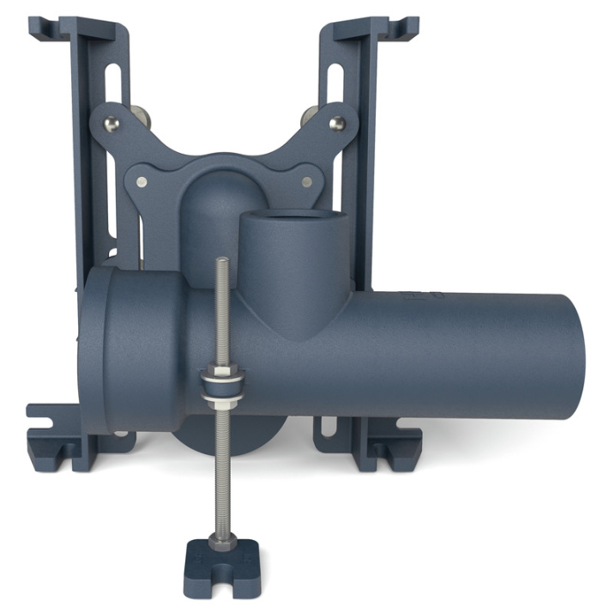
past launch carriers
EZCarry® product enhancements
More versatile foot that can be used in a wider range of apps
Designed to cater to pre-fab contractors
New box for easy identification
Simplifies connection of flush valve support brackets
Universal foot designed to allow for strut attachment on the top of the foot
Service Center Phased Launch
Notes:
Nagg

Slide 7
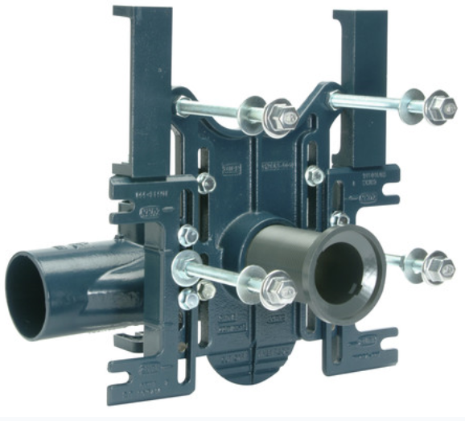
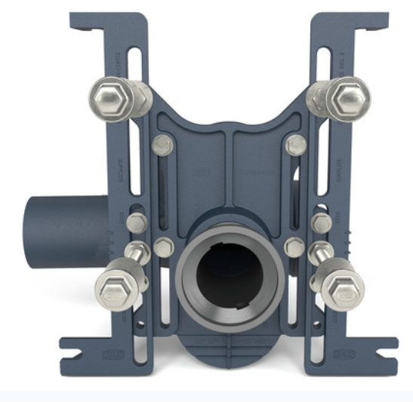
past launches carriers - ryk
EZCarry® trim kit discontinuations
P1201-RYK-TRIM
P1201-CONTR-KIT-RYK
PQ1201-RYK-TRIM-KIT
P1201-RYK-15.75
P1201-TRIM-KIT-9-TD
Z1201-NR4-RYK
EZCarry convert or alert
Utilizing the new versatile trim kits to finish the conversion to Z1201/Z1202’s by the end of Q2
Z1201-NR4
Notes:
Nagg

Slide 8
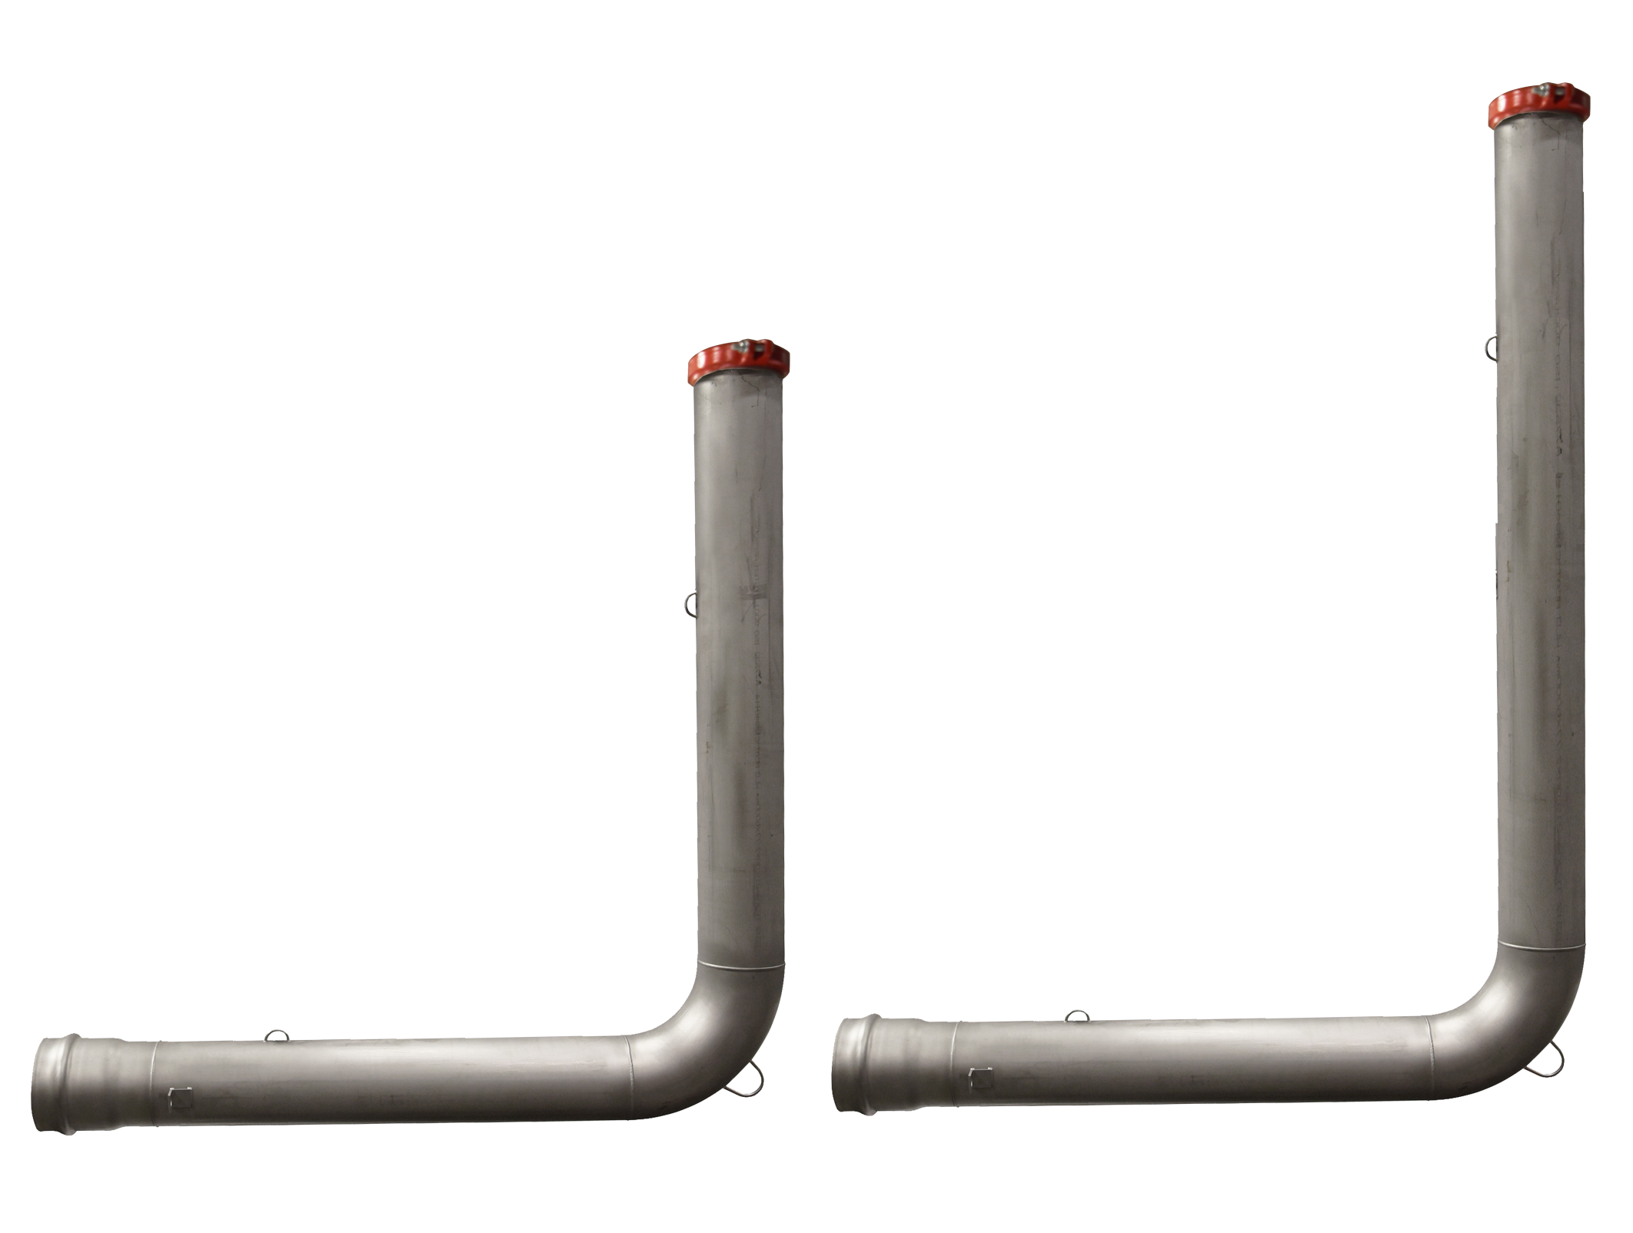
past launches fire protection
Wilkins building riser (WBR)
line extension 6’ x 8’6”
8-WBR
8-WBR-6X8.5
Required by Fire Protection and Underground Utility Contractors for ESFR Fire Sprinkler Systems in cross-dock warehouse loading dock installations requiring a deeper pipe bury
Transitions horizontal run of pipe to vertical run for fire sprinkler riser, terminating above concrete slab
6’ long by 8’6” high, adding 2’6” to riser height
Stainless steel construction
Lifting rings and thrust block anchor exclusive to Zurn is standard
4”, 6”, 8” and 10” pipe diameters
Push on (C-900 or DIP) by groove ends with test cap and coupling
Inventory in stock at Wilkins facility
Net pricing included on National Net Sheets available on ZIX and list prices are loaded in Axapta
Added to Wilkins building riser specification sheet on Zurn.com
By adding the new heights, Zurn Wilkins will be able to increase market penetration by 25%
72”
102”
72”
72”
Notes:
Fields
Expand existing WBR offering by four new SKU’s 6’ long by 8’6” high
Standard WBR is 6’ long by 6’ high
4”, 6”, 8” and 10”pipe diameters
Added 2’6” to riser height
Push on inlet by grooved outlet
Required for installations that need a deeper bury for the pipe
Warehouse loading dock locations
By adding the new heights, Zurn Wilkins will be able to cover 75% of market demand

Slide 9
present launches July 2018
Notes:
Fields

Slide 10
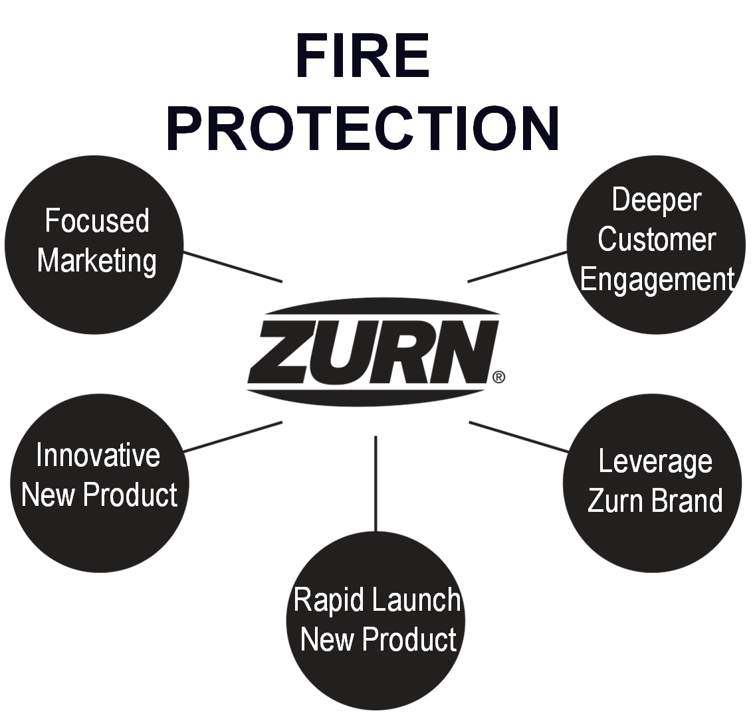
present launch fire protection
Fire Protection breakout business
Be the leader in differentiated fire protection valves and related products that provide installation labor savings and the lowest fire sprinkler system cost
Solid base of business in Fire
Leverage strong Zurn brand recognition
Add resources to grow in Fire by:
Driving deeper customer engagement
Selling more of current products
Rapidly sourcing and launching new products
Developing new products
Fire protection focused marketing including:
Fire specific website enhancements and collateral
Engaging Fire Sprinkler contractors and engineers
Rep resource commitments to join Zurn’s Fire growth plans
Notes:
Fields
Focused Marketing
Establish Zurn as a fire protection brand, improve website, collateral and digital marketing capabilities, supporting selling efforts to hit our targets
Innovative New product
Develop five new product categories
Next Gen LBF, LBF with integral flow switch
Deluge Valve
Easy Adjustable Fire Valve FY19 Q4 launch
Extended Length WBR
Rapid Launch New Product
4 stage sourcing launch plan rollout – 17 categories
Opening up $170 million total available market
Leverage Zurn Brand
FY19 – Sell More Current FP Products
Deeper customer engagement
Add Selling Resources
Hire 2 Business Development /Sales
Add or improve resources 18 US territories (6 east, 7 central, 5 west) 3 Canada (2 east, 1 west)
7 existing product categories (Backflow, ACV, Fire Valves, Relief Valves, In-Building Risers, Butterfly Valves, OS&Y Valves)

Slide 11
present launch fire protection
Fire Protection Solutions – Group 1
Advantage the Zurn brand strength, established by backflow and fire valves, with contractors, engineers and distributors by adding products to provide a simple and economical purchase solution from order to delivery, and one-touch project problem resolution.
Group 1 Products:
Fire Valves
Hose valve (F100, F100G)
Restricting hose valve (F105)
Test and Drain Valves (FTD)
Shut-Off Valves
Powerball butterfly valve (F49BR, F49BRG)
Commercial Risers (FEZR)
Net pricing sheet available on ZIX and list prices are loaded in Axapta
New products specification sheets and digital sell sheet available on zurn.com/fire
Notes:
Fields

Slide 12
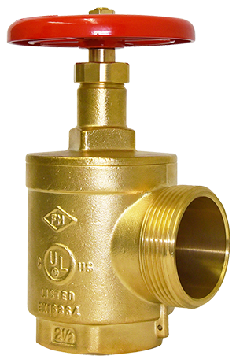
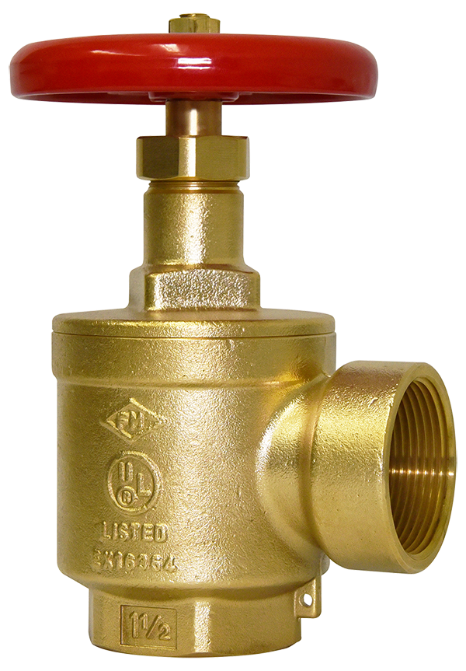
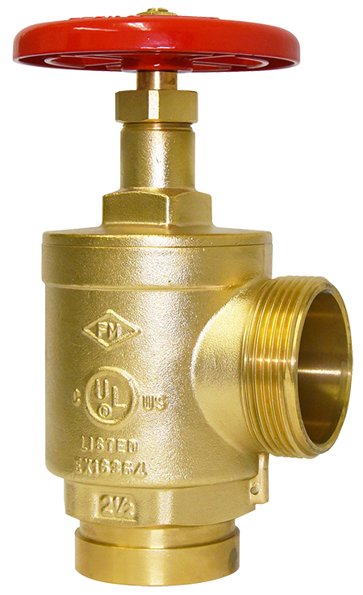
present launch fire protection
fire valves – hose valve
Model F100 and F100G
Standpipe valve listed for use on fire hose rack assembly, or as a fire department outlet connection
Sizes: 1-1/2” and 2-1/2”
Maximum inlet pressure: 300 psi
Inlet connection: FNPT or Grooved
Outlet connection: NH, FNPT or Special Thread (2-1/2”)
2-1/2” available rough chrome plated (request lead time)
Standards Compliance:
UL® Listed
C-UL®, ULC® Listed (2-1/2” only)
FM® Approved
No special order forms necessary
212-F100
112-F100F
112-F100G
Notes:
Fields

Slide 13
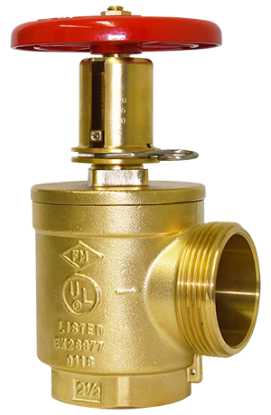
present launch fire protection
fire valves – restricting hose valve
Model F105
Standpipe valve for hose stations.
Regulates pressure under FLOW conditions only.
Can be adjusted and set in the field while flow testing the standpipe riser.
Sizes: 1-1/2” and 2-1/2”
Maximum inlet pressure: 175 psi
Inlet connection: FNPT
Outlet connection: NH, FNPT or Special Thread (2-1/2)
Standards Compliance:
UL® Listed
FM® Approved
No special order forms necessary
212-F105
Notes:
Fields

Slide 14
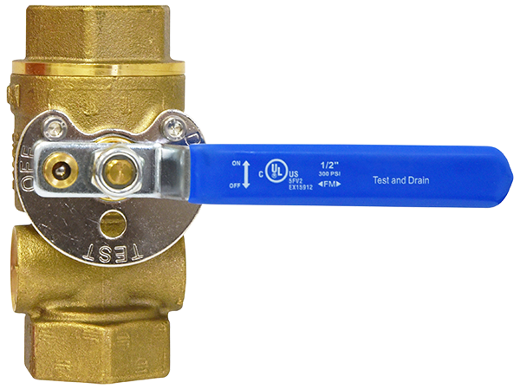
present launch fire protection
test and drain valves
Model FTD
Provide for required water flow testing and draining of a sprinkler system with one valve.
In the test position this valve simulates flow of a single sprinkler with a 5.6 K-Factor orifice.
The drain position allows unrestricted flow for rapid draining of the system.
Clear sight glass plugs facilitates visual inspection of water flow through the valve.
Sizes: 1”, 1-1/4”, 1-1/2” and 2”
Maximum inlet pressure: 300 psi
Inlet connection: FNPT
Outlet connection: FNPT
Standards Compliance:
UL® Listed,
C-UL®
FM® Approved
114-FTD-K56
Angle style test and drain valve in development
Future launch Q4
Notes:
Fields

Slide 15
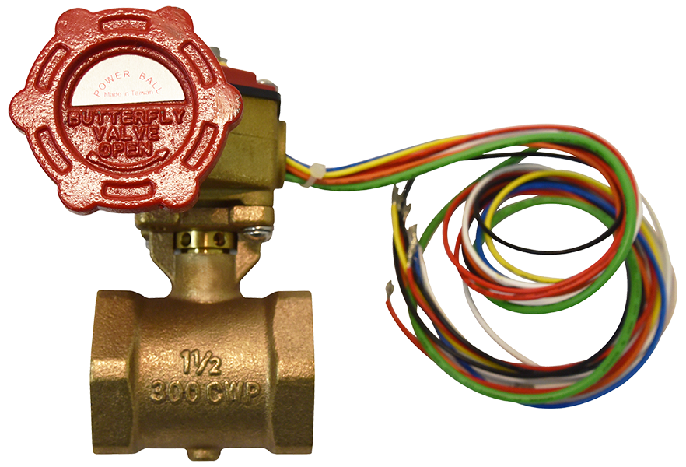
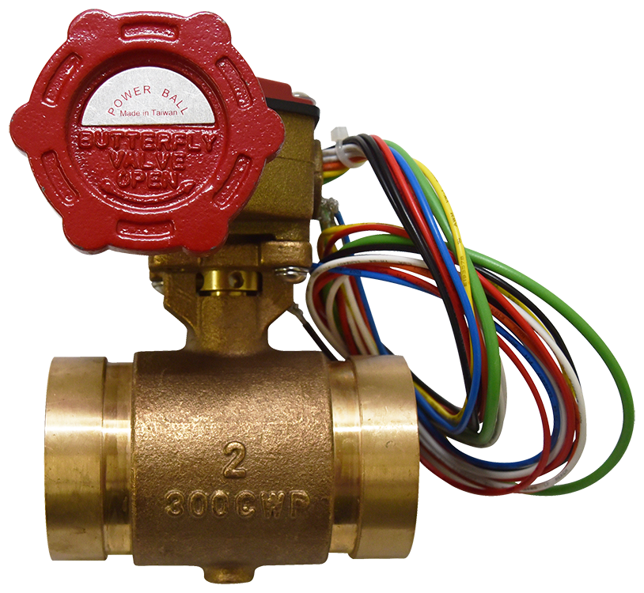
present launch fire protection
shut-off valves – powerball butterfly valve
Model F49BR and F49BRG
Provide for system shutoff to facilitate repair and maintenance.
Operated with a slow closing ¼ turn anti-water hammer valve.
Tamper switches signal movement of the valve from the full open position to an alarm control panel, and to auxiliary equipment such as an indicating light or audible alarm in the area of the valve installation.
Sizes: 1”, 1-1/4”, 1-1/2”, 2” and 2-1/2”
Grooved connections sizes: 1-1/4”, 1-1/2”, 2” and 2-1/2”
Maximum working water pressure: 300 psi
Standards Compliance:
UL® Listed
C-UL®
FM® Approved
112-F49BR
2-F49BRG
Notes:
Fields

Slide 16
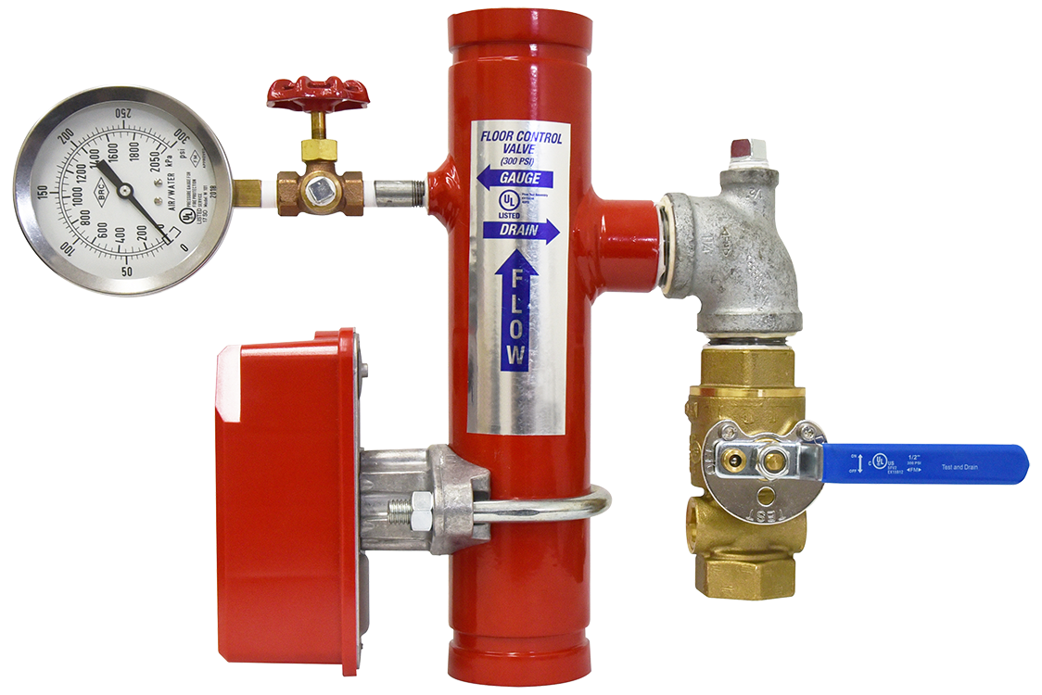
present launch fire protection
commercial fire risers
Model FEZR
Vertically mounted assemblies designed to connect a water supply line to a fire sprinkler system.
Each unit consists of a Test and Drain Valve, a Water Flow Detector Switch, and a Pressure Gauge providing for the required system flow testing, alarm triggering upon activation of a fire sprinkler, draining of the system, and monitoring of the system water pressure.
Sizes: 2”, 2-1/2”, 3”, 4” and 6”
Maximum inlet pressure: 300 psi
Inlet connection: Grooved
Outlet connection: Grooved
Standards Compliance:
UL® Listed
FM® Approved
Listed by California State Fire Marshall
212-FEZR-TD
Notes:
Fields

Slide 17
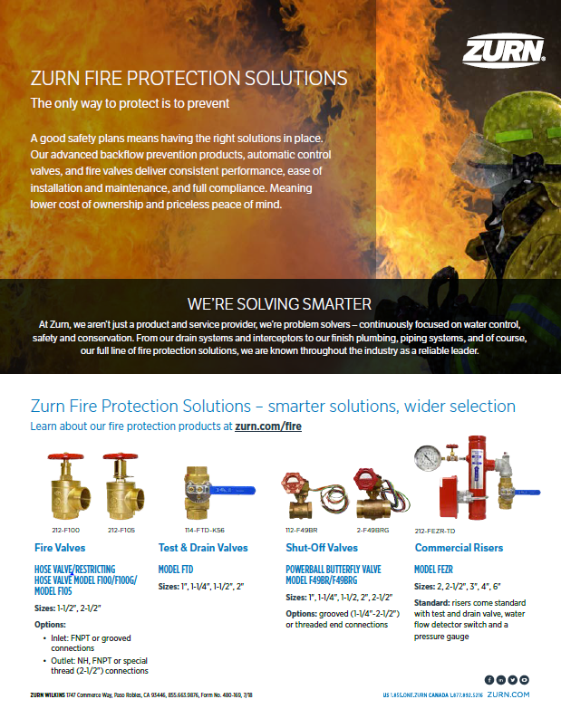
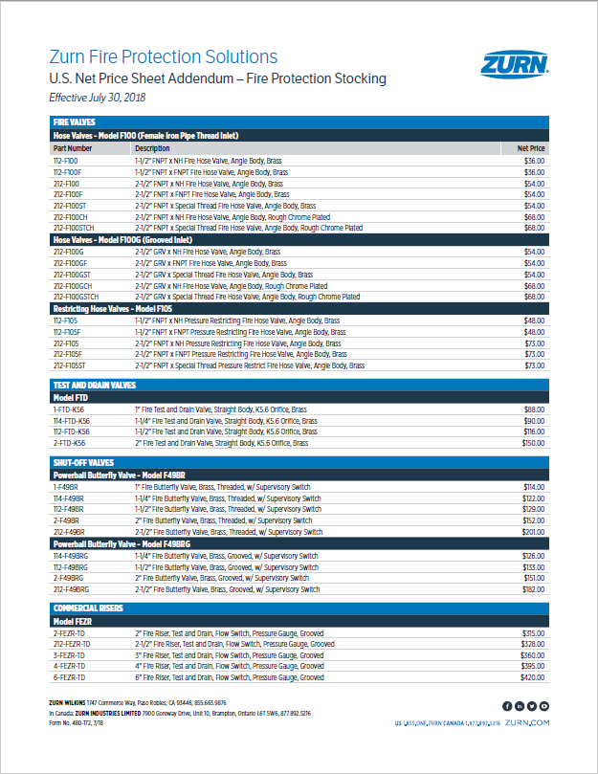
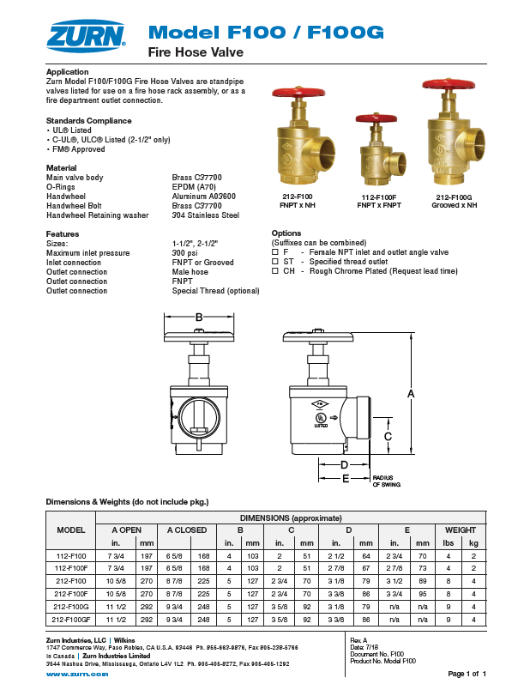
present launch marketing materials
Net Pricing Sheet
available on ZIX
Specification Sheets
available on zurn.com
Sell Sheet available on zurn.com and ZIX
Postcard available for order on ZIX Literature Fulfillment
Notes:
Fields

Slide 18
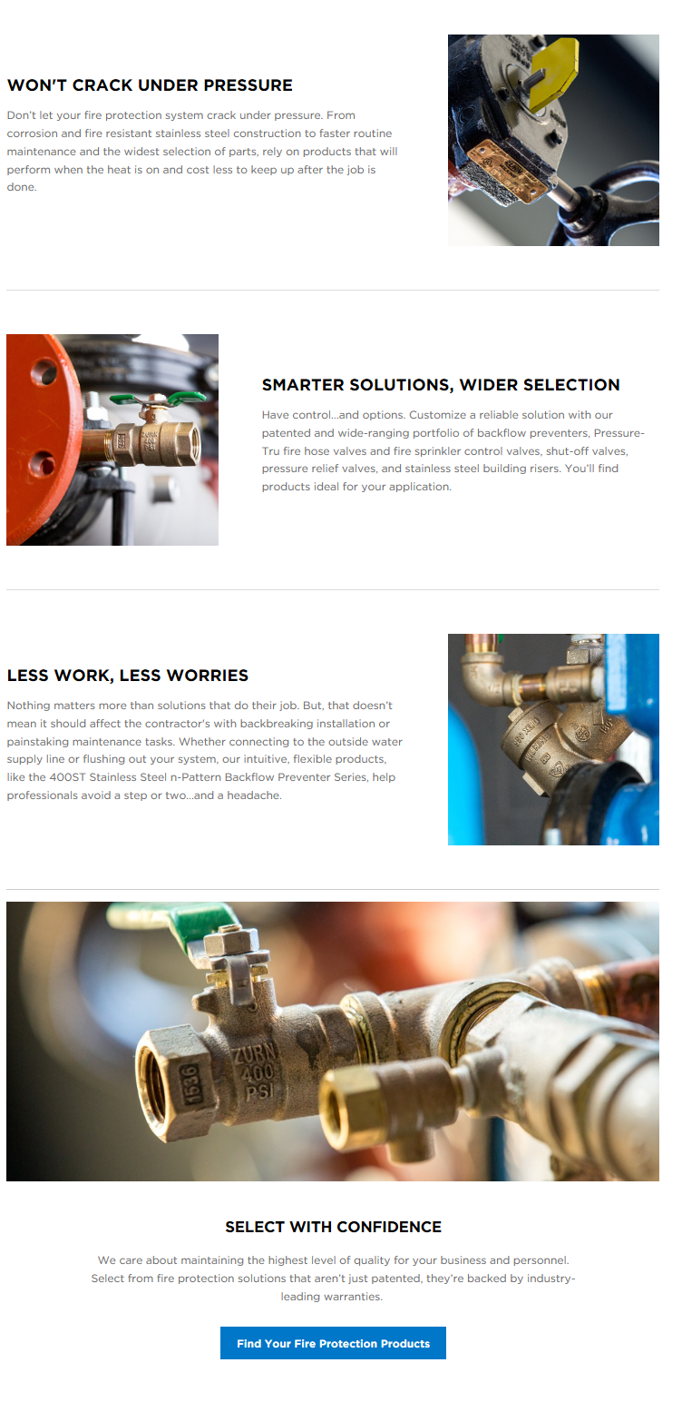
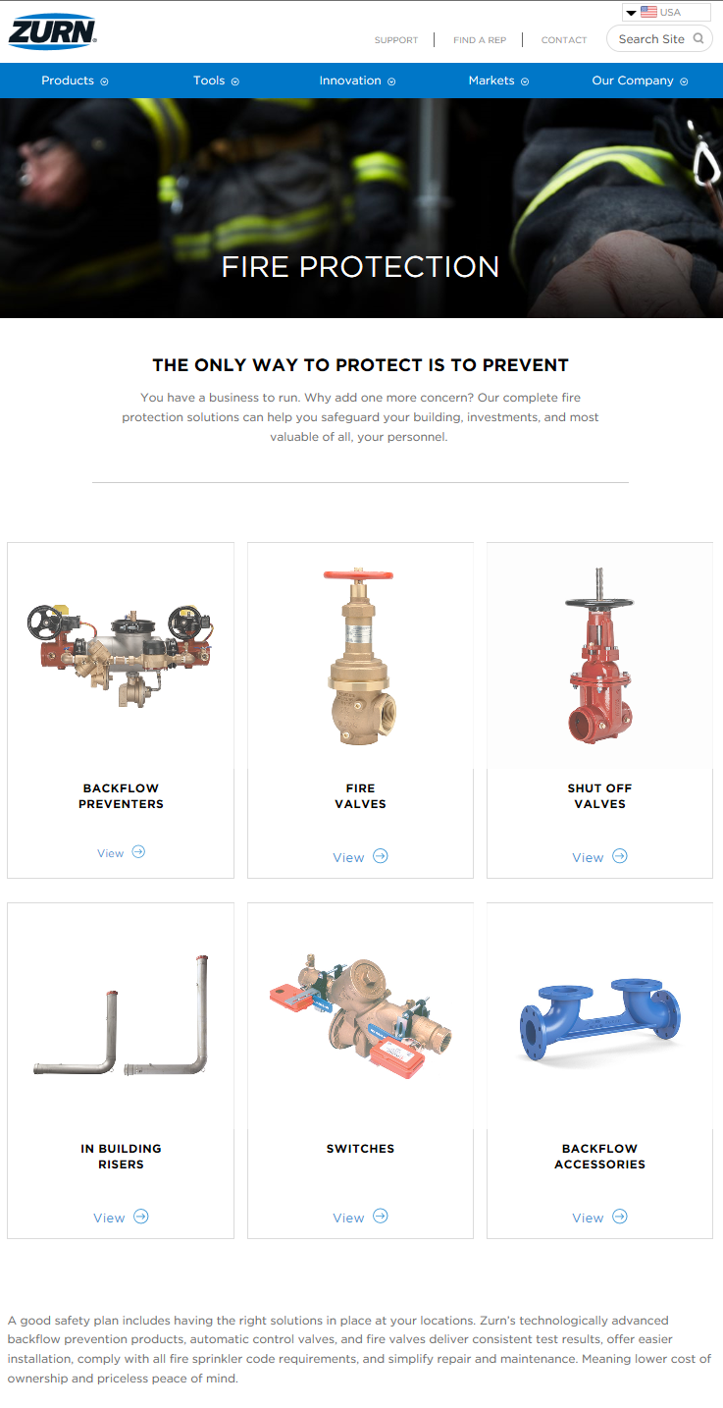
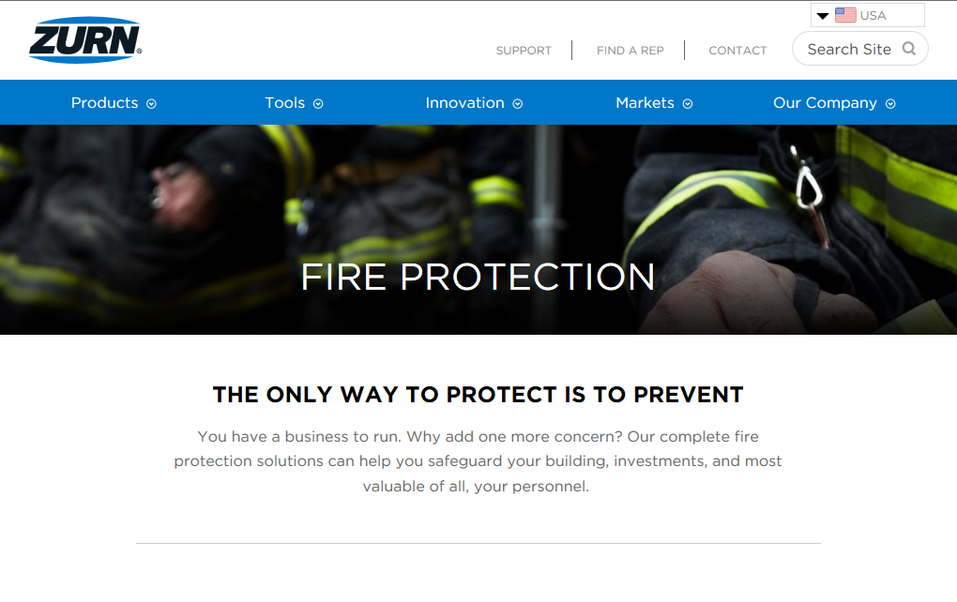
present launch www.zurn.com/fire
Fire Protection microsite on zurn.com/fire
Also accessible on zurn.com under Markets/Fire Protection
Notes:
Fields

Slide 19
present launch fire protection
Fire Protection Solutions – Group 1
Inventory Plan
Phase 1 (launch – Oct. 31):
Wilkins facility (Paso Robles) distribution for Dallas and Ontario service areas
Atlanta Service Center distribution for Philadelphia and Chicago service areas
Phase 2 (Nov. 1 – Jan. 31):
Expansion to all service centers
Phase 3 (Feb. 1):
Inventory at rep stocking locations
Total available market $48 million
Notes:
Fields

Slide 20
Notes:
Krohn

Slide 21
Notes:
Krohn

Slide 22
Notes:
Krohn

Slide 23
present launches marketing
product overview brochure
Running a business doesn’t leave a lot of time to catch your breath. Let us ease your workload and worries with products that do the job as promised. Every water solution in our portfolio is engineered to satisfy your requirements and expectations for years to come. You also have options in specs and materials.
Order copies on ZIX
PDF
Notes:
Wurster

Slide 24
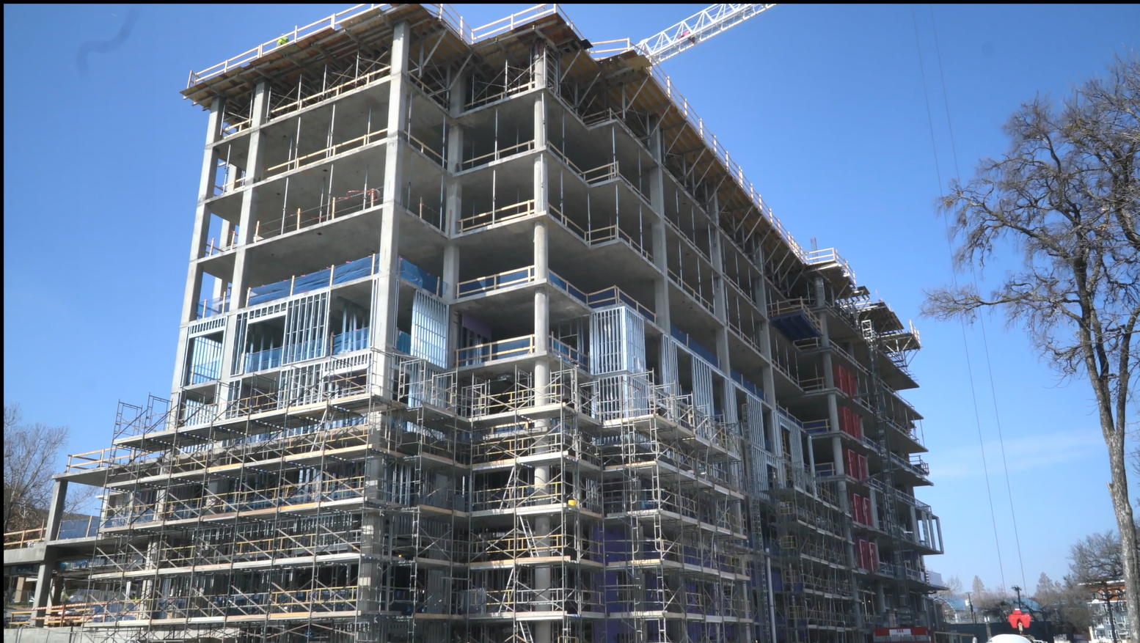
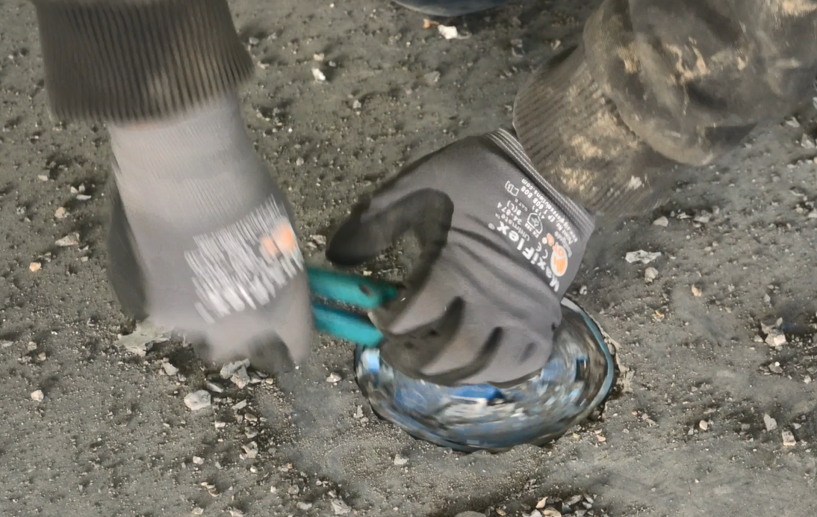
present launches marketing
EZ1 case study
Polk Mechanical wears many hard hats on its projects, providing both plumbing and mechanical services across commercial, industrial, maintenance and risk management. The firm leads in healthcare construction and continues to achieve outstanding growth with record-low incidents.
Notes:
Wurster

Slide 25
present launches marketing
Content
Notes:
Wurster

Slide 26
present launches marketing
https://www.worlddryer.com/
https://www.worlddryer.com/
https://www.worlddryer.com/
Content
Notes:
Wurster - The capabilities of our new website go beyond a new look and feel. Once you start clicking away, here are some improved features to check out.
-New Savings calculator to add up your return on investment -Buying tool that asks a series of 4 questions to recommend the best dryer based off your environment -Customer persona pages for info critical to each of the different target audiences (architects, distributor, contractors, business owner) -Improved product pages with easy to read benefits and new product overview videos -Customer stories to give you a real perspective of what our customers have to say

Slide 27
future launches post-July 2018
Notes:
Wurster

Slide 28
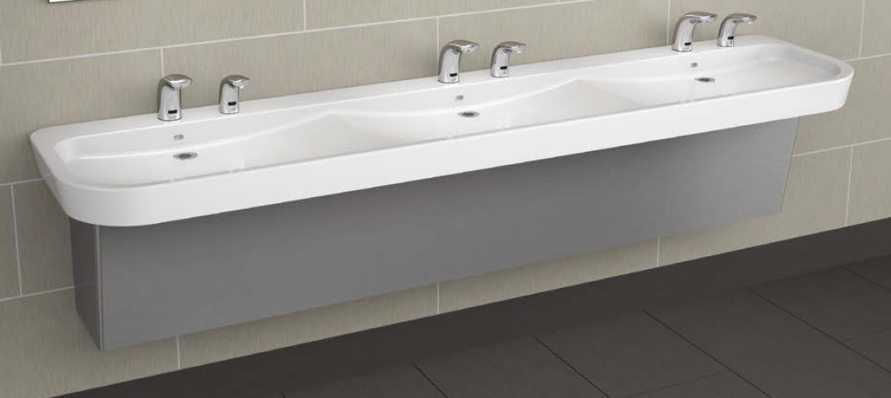
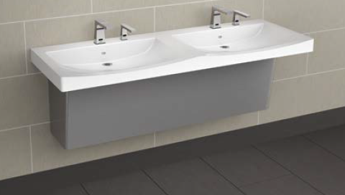
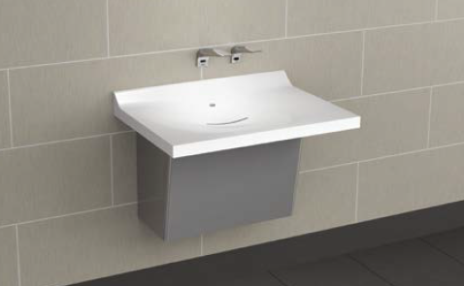
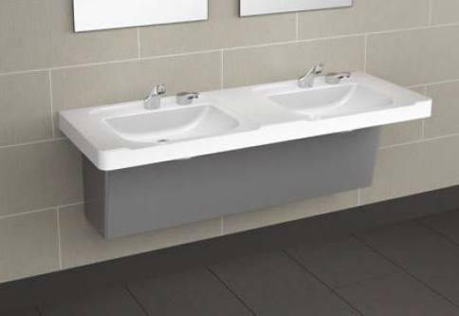
future launch finish plumbing
Ceramic Faucets
Sundara Handwashing System – Phase 2
Expand Zurn’s solid surface product offering to reach architects and design engineers who specify Class A and high traffic restroom areas.
Three architecturally inspired designs
Seven color options
Pairing with Zurn’s offering of architectural sensor faucets and soap dispensers
Pairing with select offering of manual faucets
Available to market Fall 2018
Notes:
Fairley

Slide 29
future launch fire protection
Fire Protection Solutions – Group 2
Advantage the Zurn brand strength, established by backflow and fire valves, with contractors, engineers and distributors by adding products to provide a simple and economical purchase solution from order to delivery, and one-touch project problem resolution.
Group 2 Products:
Fire Department Connections
Untapped OSY Shut-off
Check Valves – Riser and other
Butterfly Valve (Short Pattern)
Grooved Couplings – Flex and Rigid
Grooved Fittings
Total available market $102 million
Notes:
Fields

Slide 30
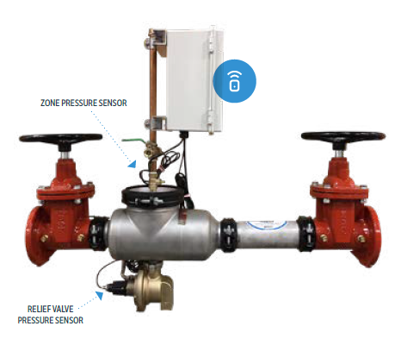
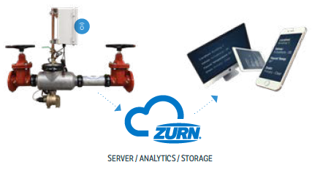
future launches Zurn connected products
Smart Connected Backflow
Our connected products deliver insight in real time, so customers can make the rules, no assumptions. Whether it’s preventing damage from the unexpected or setting up maintenance as planned – take control into your hands and connect the dots to decisions.
Know More – Zurn Connected Products
A backflow preventer that works smarter
Receive up-to-the-minute notifications when there’s water discharge in the event of a backflow
Check your system with the click of a button 24/7 from anywhere
Prevent potential damage with warning alerts and maintenance reminders
Notes:
Mankins

Slide 31
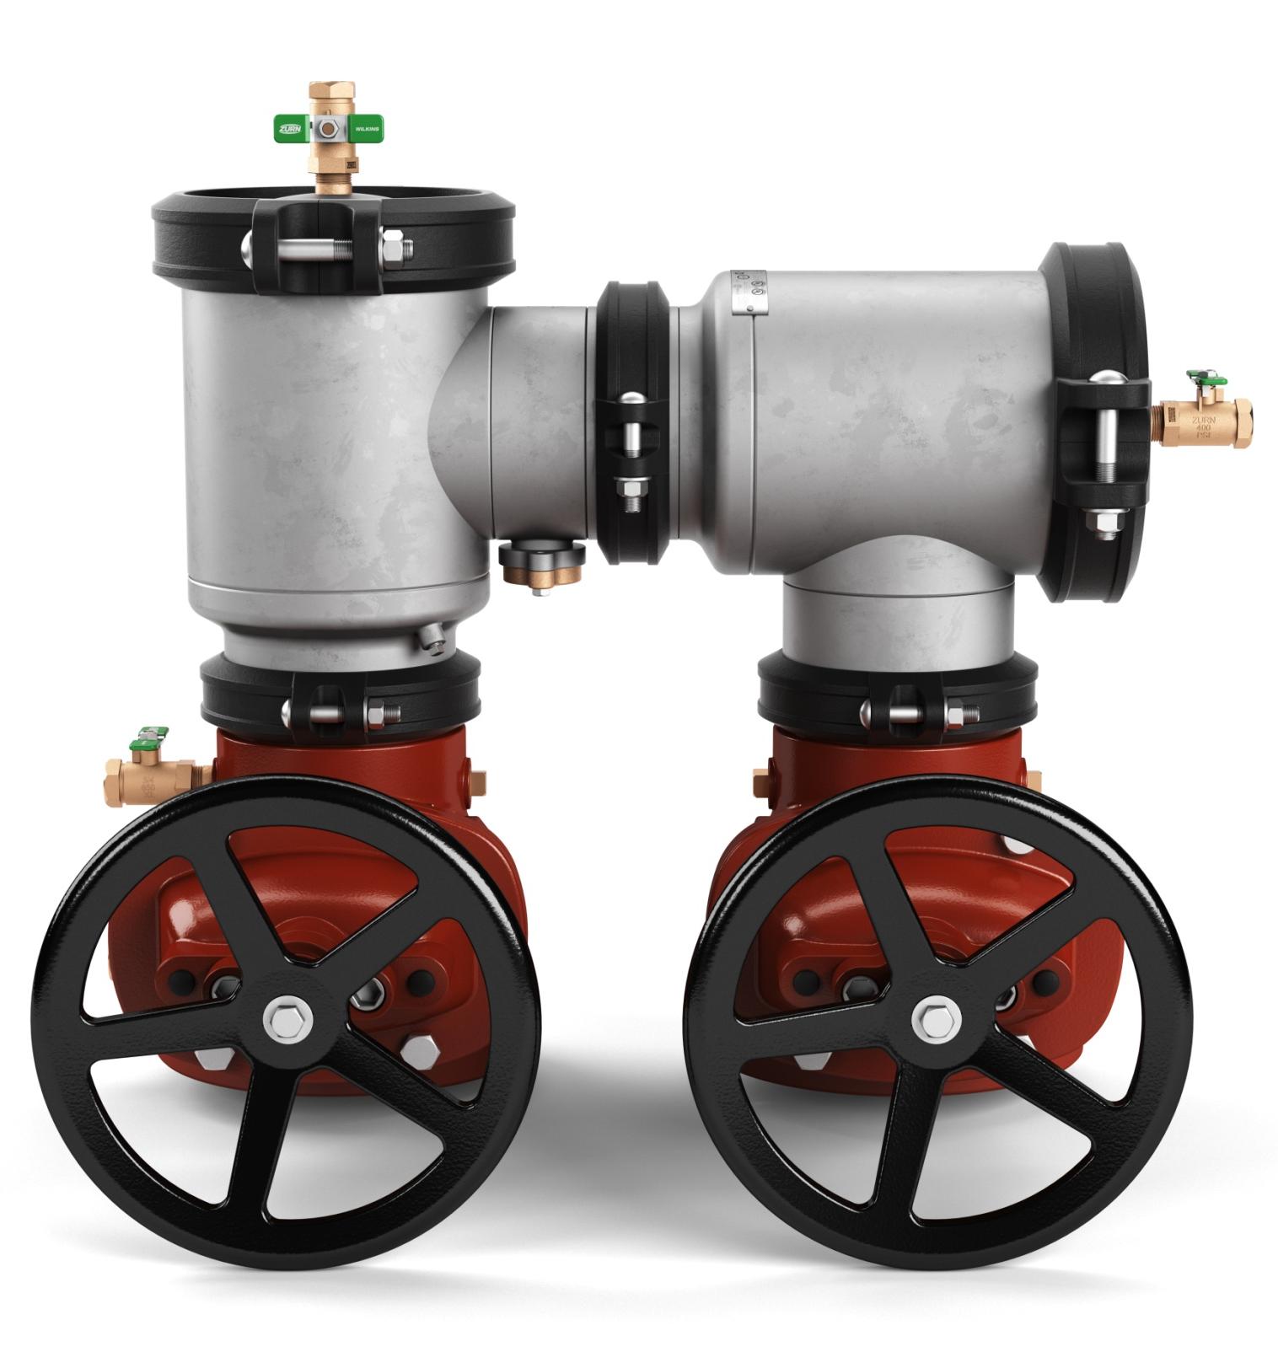
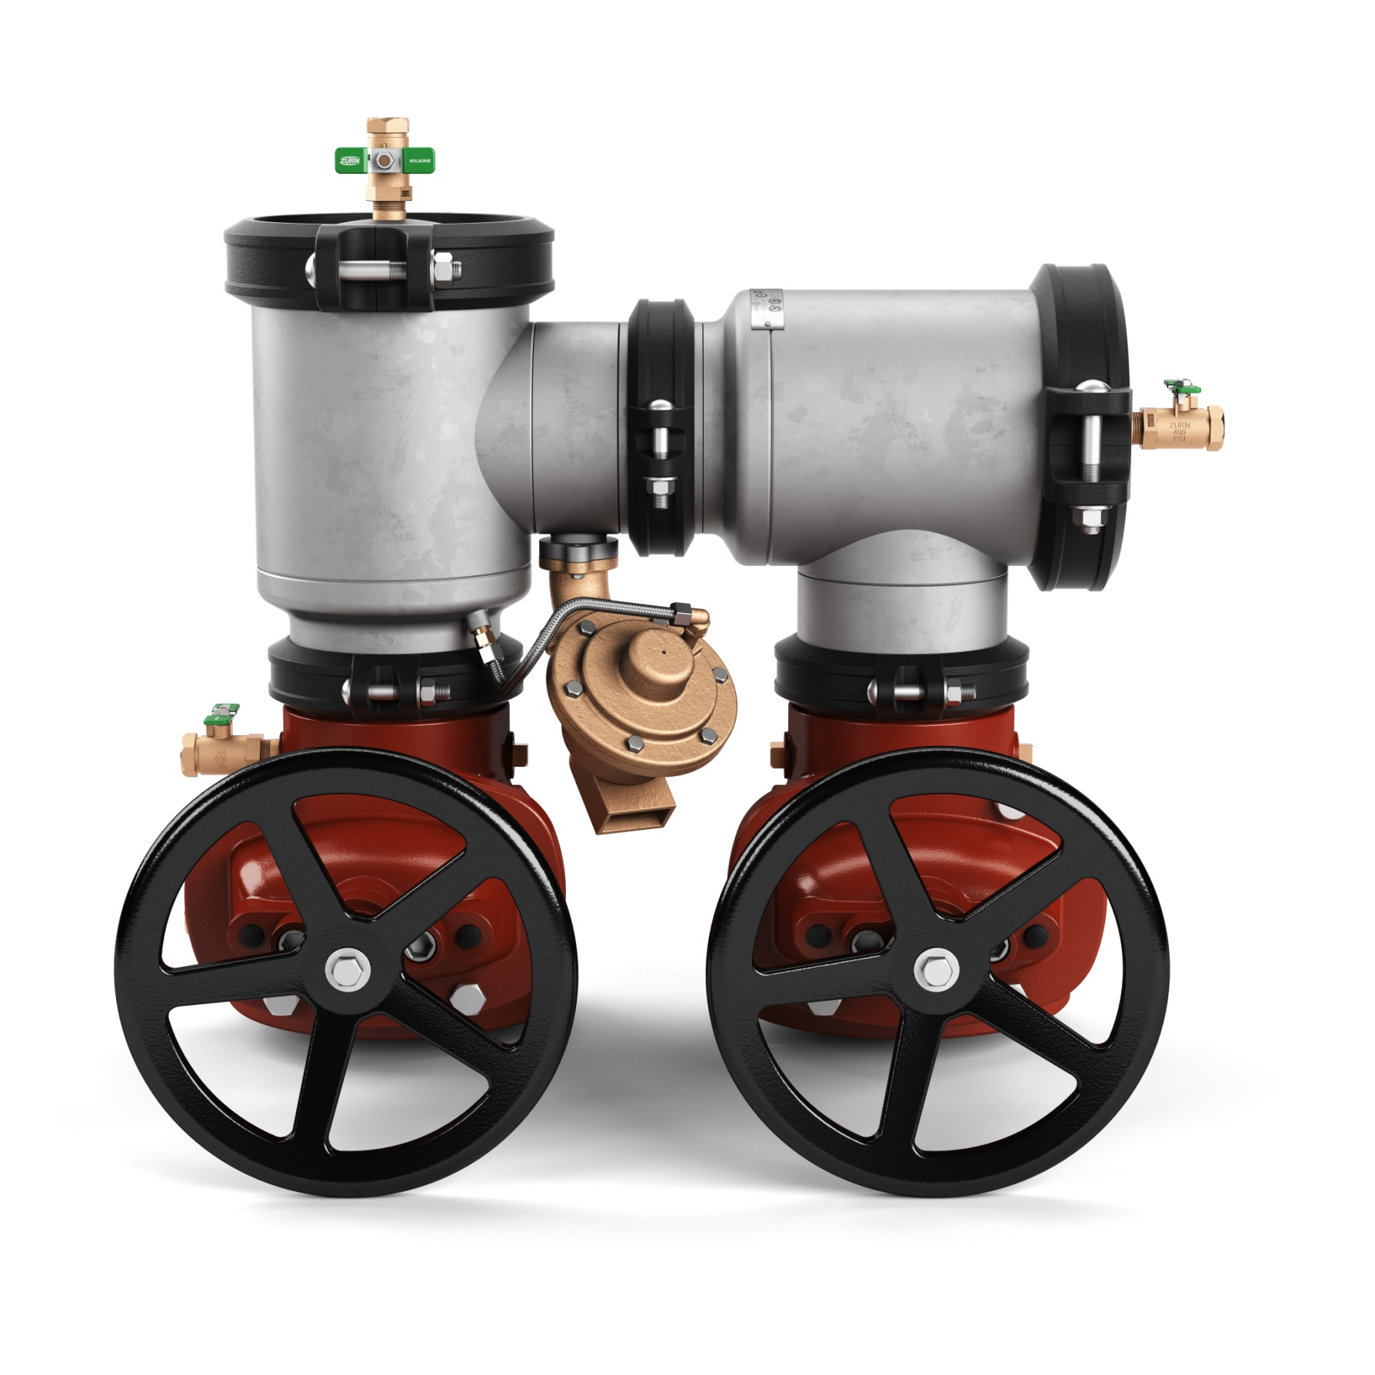
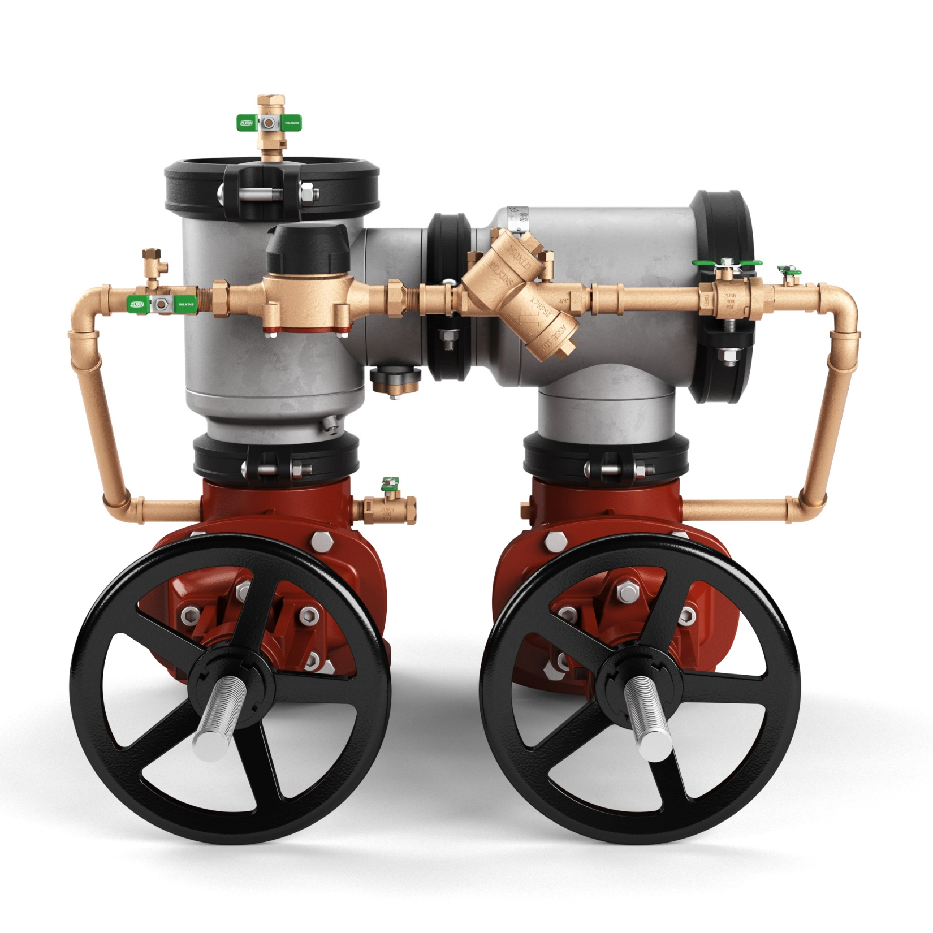
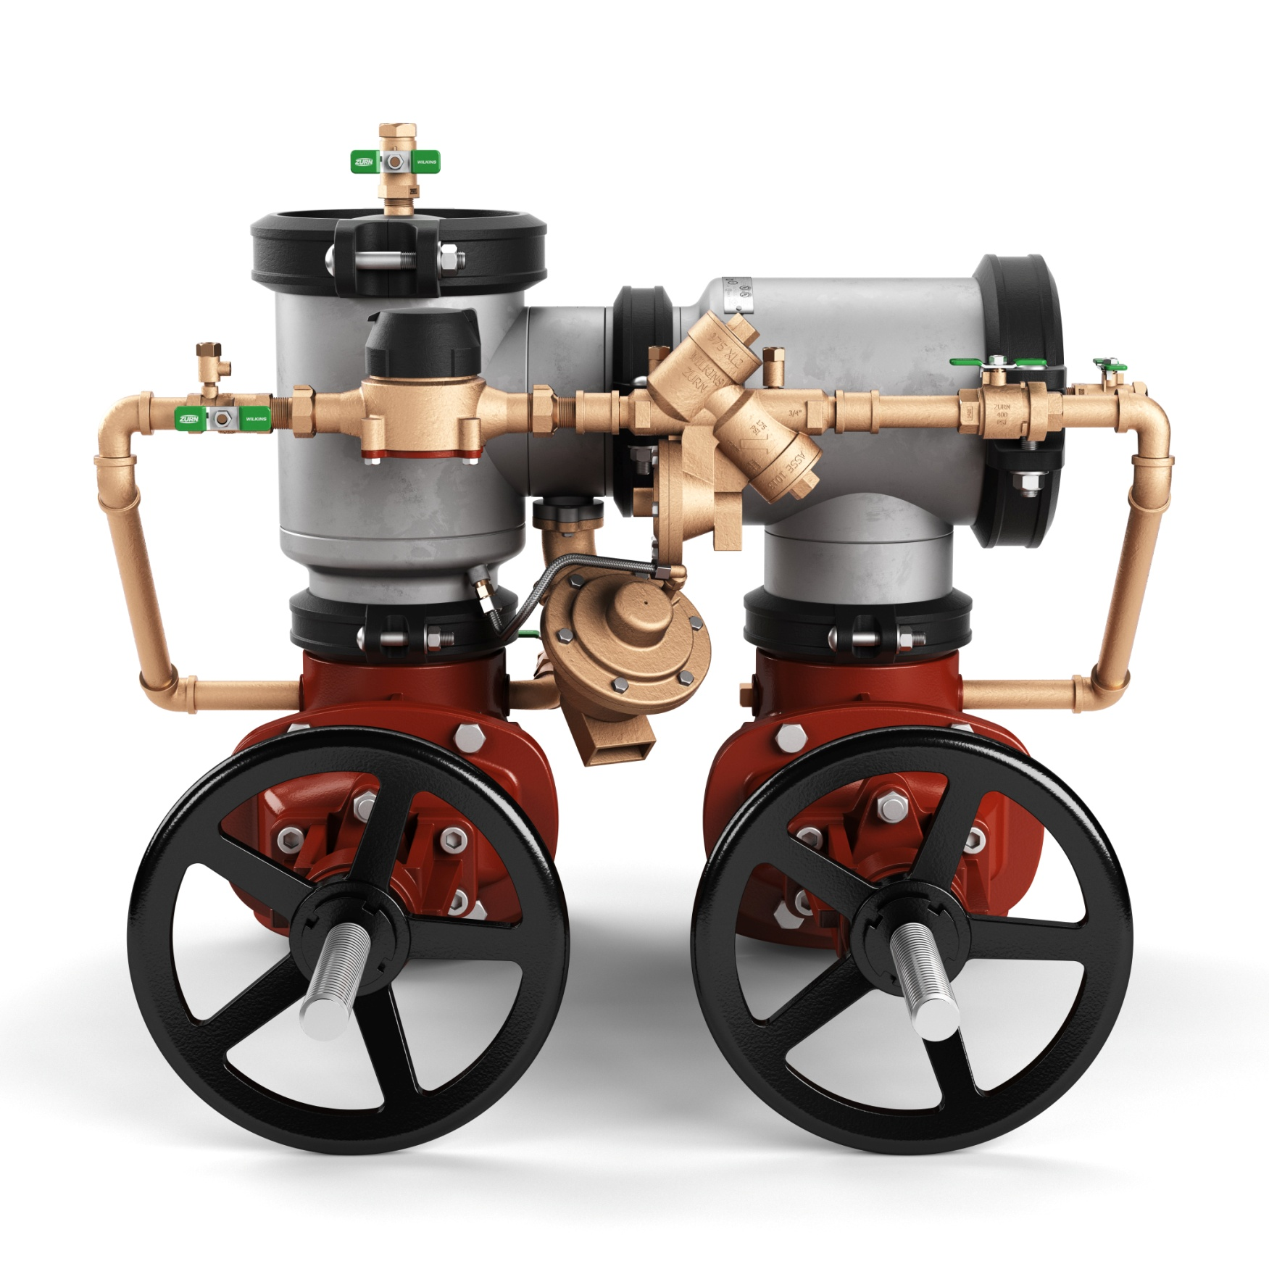
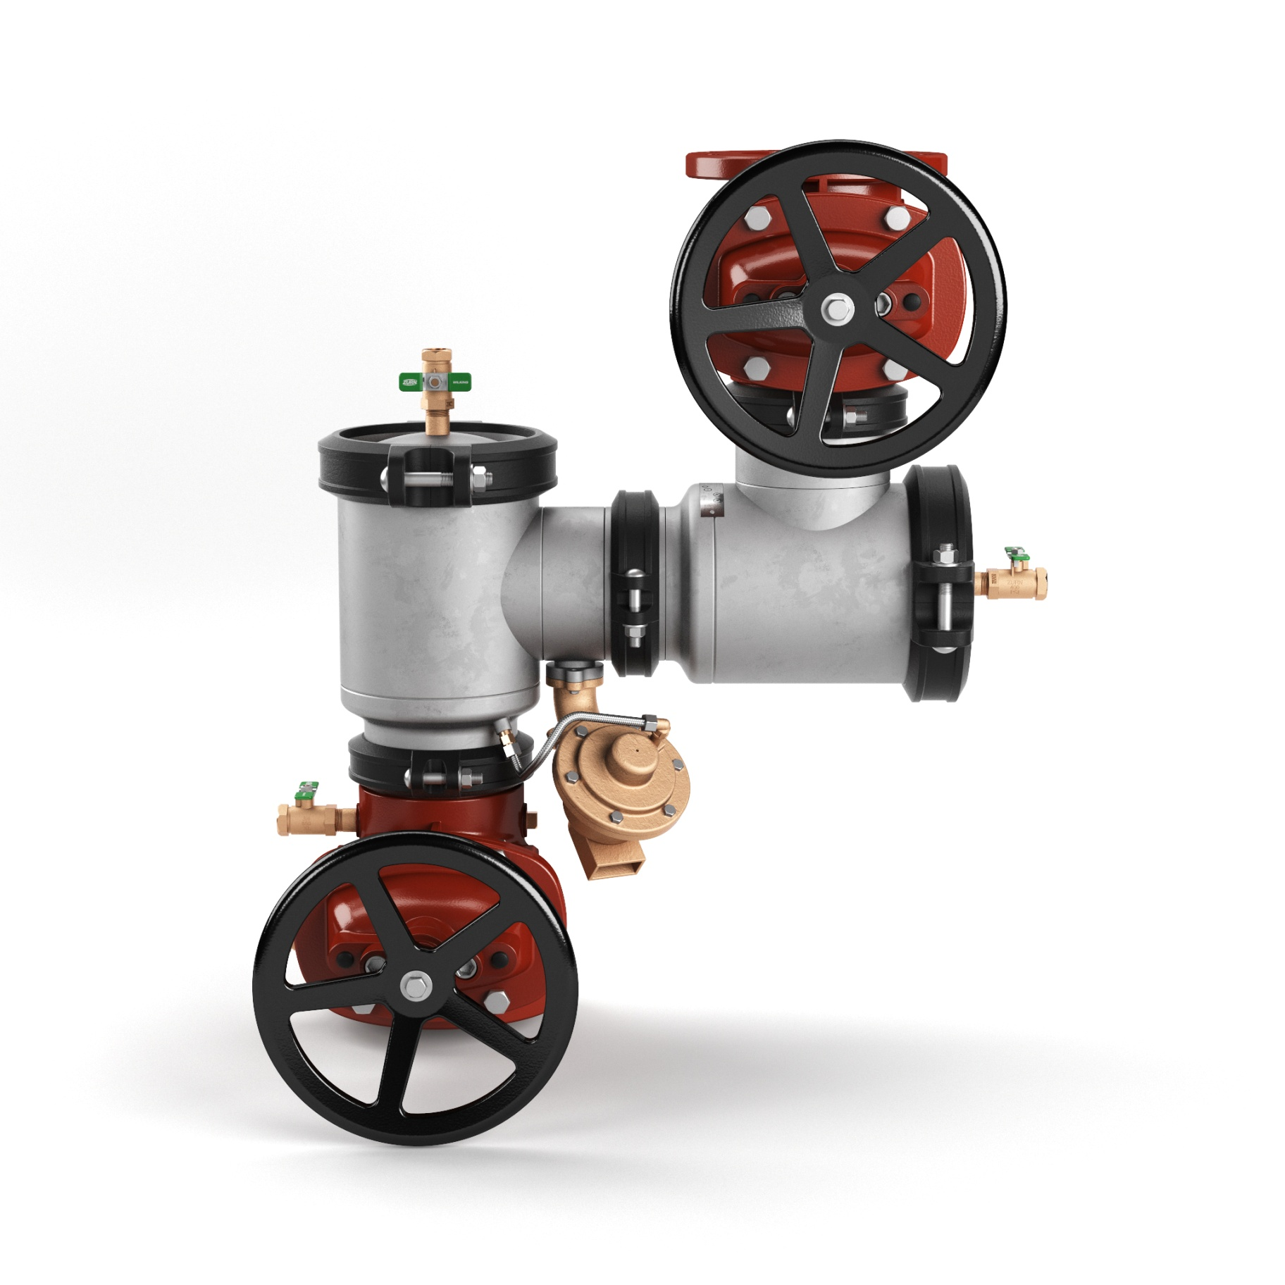
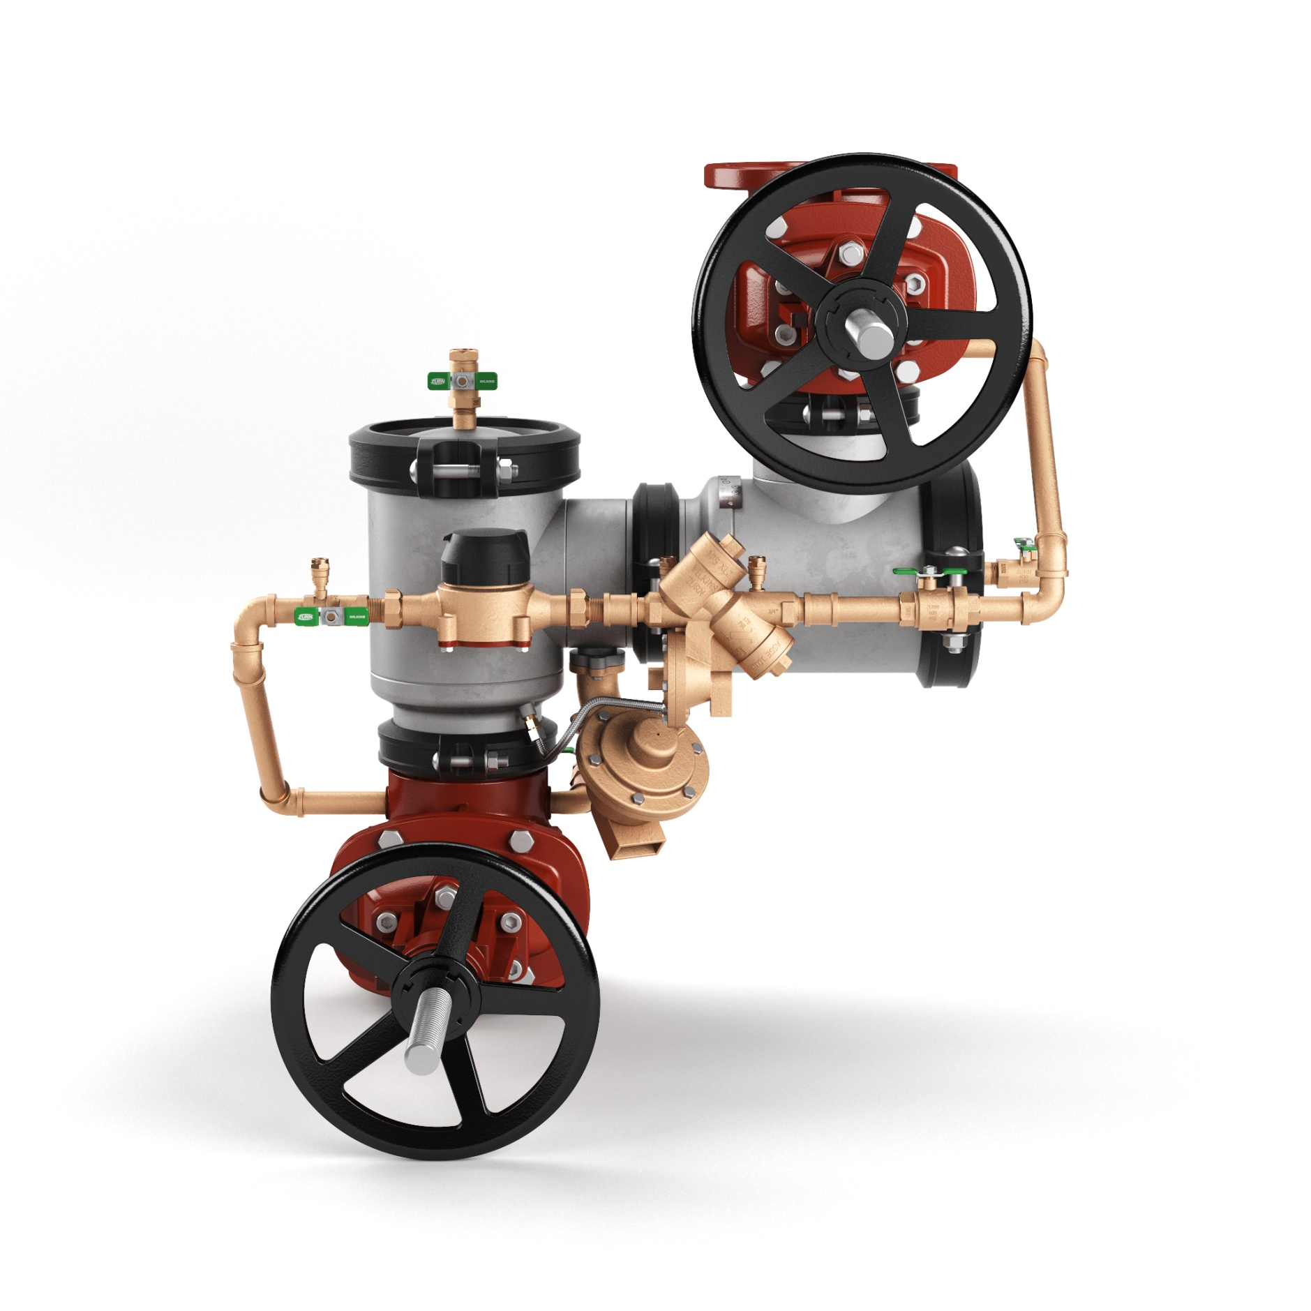
future launches backflow prevention
400ST n-Pattern Series (USC Launch)
Same internal components as the Zurn Wilkins 300 and 400 series ductile iron n-Pattern – field tested and proven for 18+ years
Drop-in-replacement for the Febco n-Pattern
Smaller footprint – new ductile iron setters to fit tighter center line dimensions
Includes R replacements of Zurn Wilkins 400 series ductile iron n-Pattern
Launched October 2017 in ASSE territories
USC approval by end of this year
description
Stainless steel body (corrosion resistant body and cover)
Sizes: 4” – 10”
Types: DC (double check), RP (reduced pressure), DCDA (double check detector assembly), RPDA (reduced pressure detector assembly)
3:02 Video:
Zurn Backflow Prevention 400ST n-Pattern
Notes:
Mankins
Drop-in replacement for the Febco n-Pattern
Launched October 2017 in ASSE territories,
Sales are growing, including in USC only territories
USC approval by end of this year
Fantastic product video available on zurn.com and OneZurn Youtube channel – use it as a sales and specification tool (reinforce that all attendees should subscribe to the channel)

Slide 32
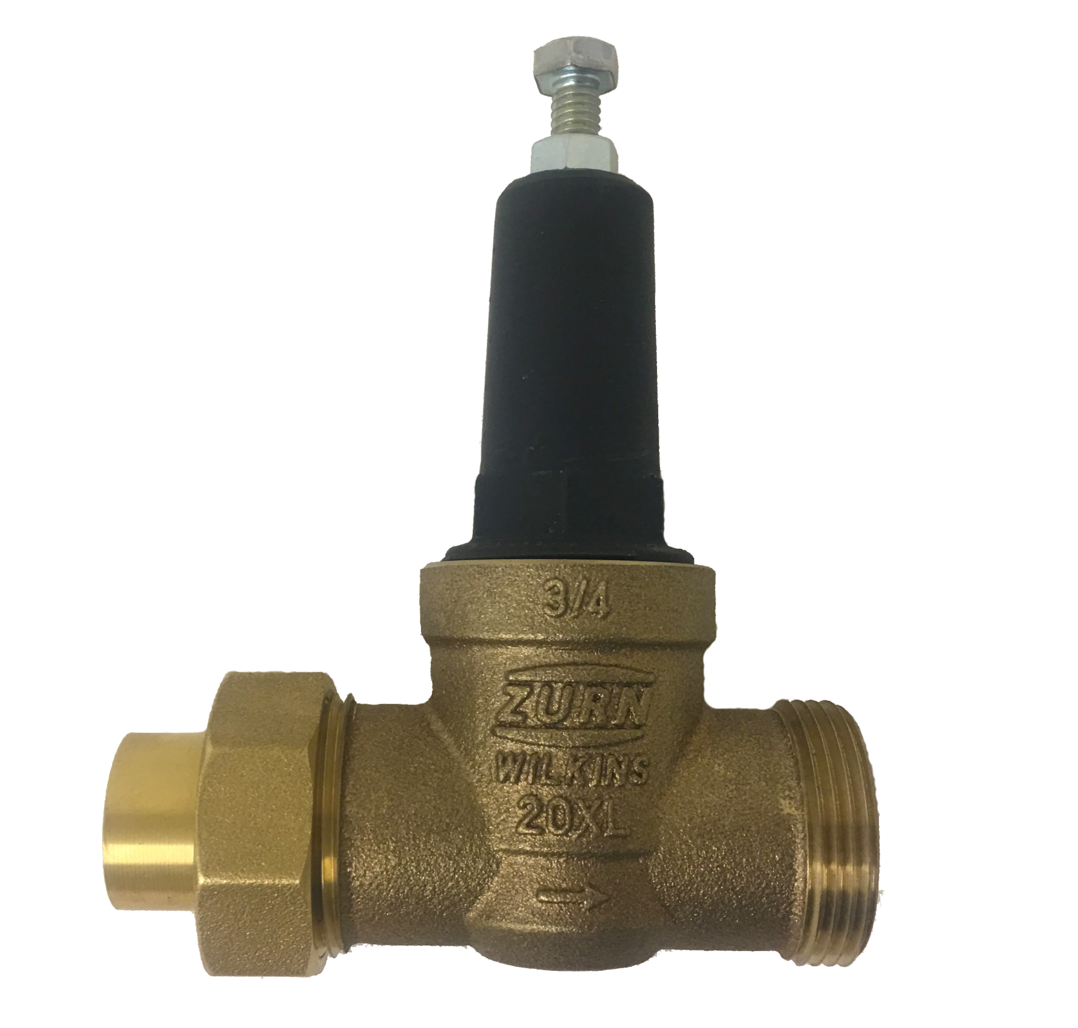
future launches pressure reducing valves
First fit pressure reducing valves
Compact design for ease of installation
Short lay length to fit into the tightest spaces
Economical and ideal for residential construction
Sizes: 3/4” and 1”
Body connections options:
Single Union
Double Union
Integral PEX Connections
F1960 expansion style
F1807 crimp style
Notes:
Mankins

Slide 33
future launches product training
2018 product webinars, most Mondays
10AM & NOON Central Time
Backflow Prevention | September 10
Pressure Reducing Valves | September 17
Automatic Control Valves | September 24
Fire Protection | October 1
Thermostatic Mixing Valves | October 8
Chemical Drainage | October 15
PEX Plumbing | October 22
NEW PRODUCT LAUNCH | October 29
Sundara Handwashing System | November 5
Lavatories & Sinks | November 12
Faucets | December 3
Hand Dryers | December 10
Toilets | December 17
Product training dates/times + WebEx links can always be found on
the Zurn Product Training page
Notes:
Wurster

Slide 34
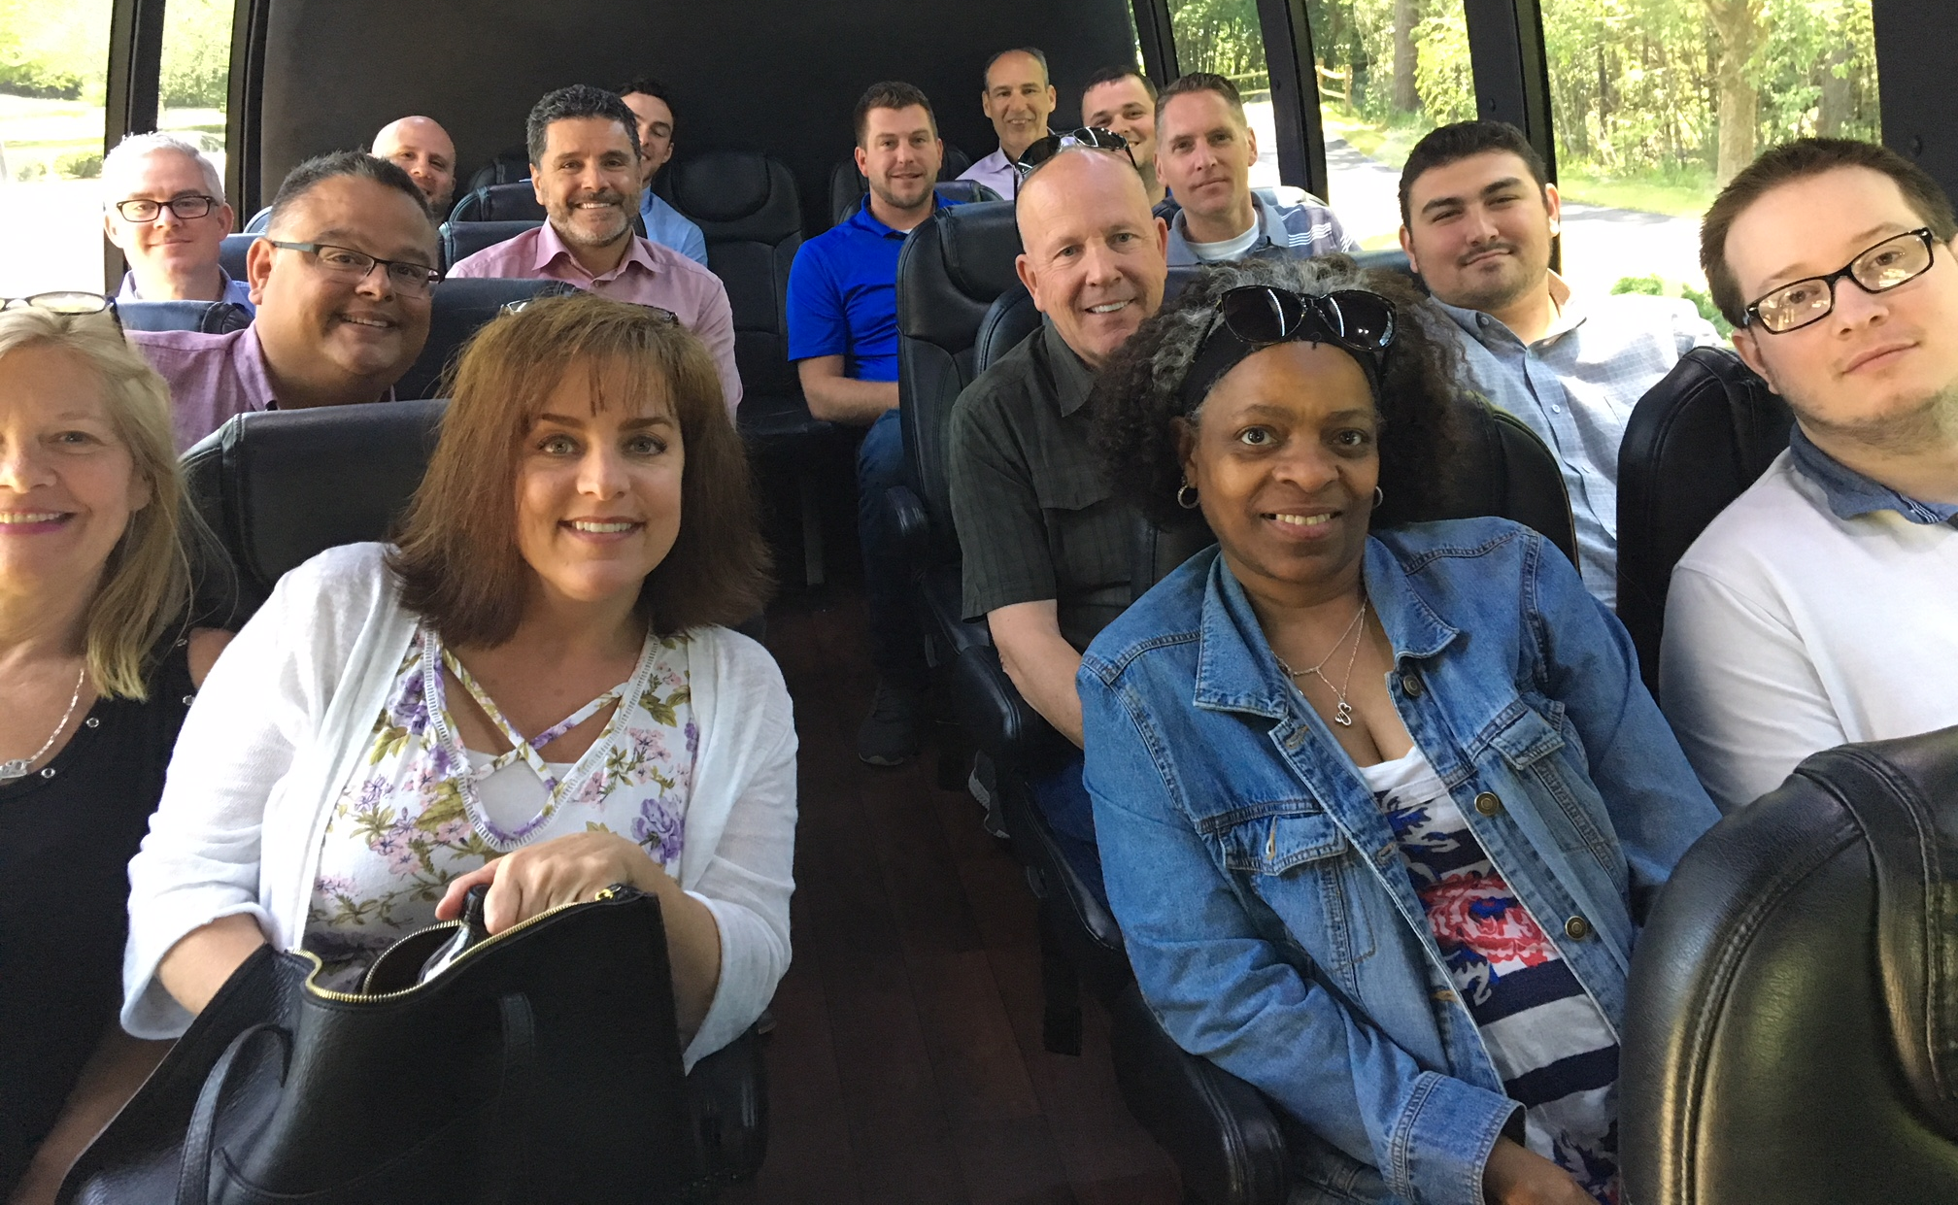
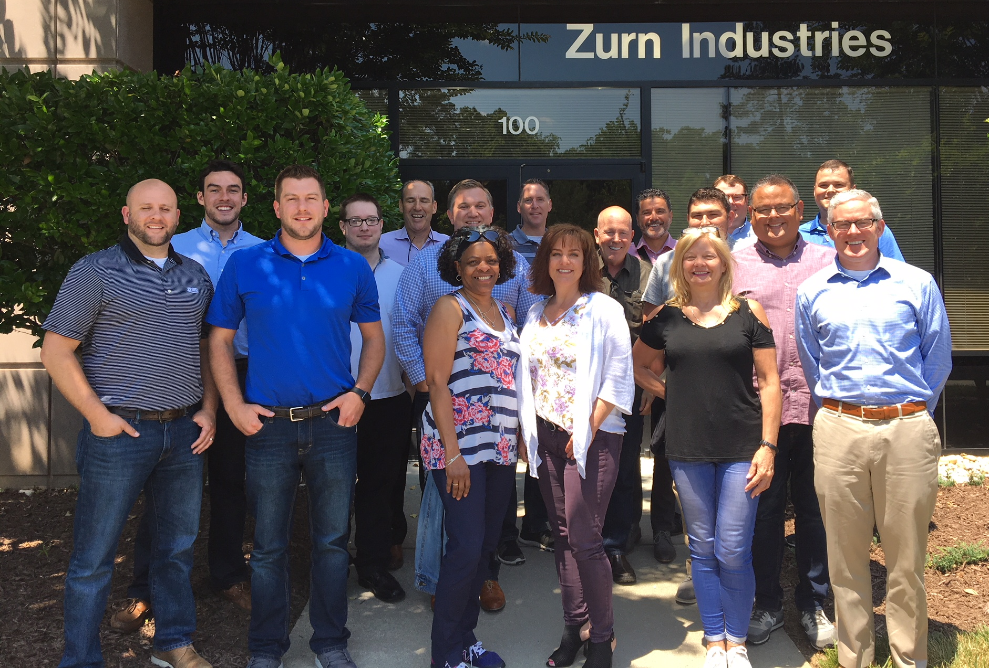
future launches product training
Live product training
Zurn Headquarters, Milwaukee, WI
Tuesday, October 9 – Thursday, October 11
Learn from our Zurn product experts:
Product Value Proposition
How it Works
Top Features & Benefits
Design & Specify
Additional Resources
36 student capacity
For Zurn sales and rep sales
Zurn customer care and rep customer care
Other Zurn employees and rep employees
Look for your email invite, in August!
Live product training
June 2018
Cary, NC
Notes:
Wurster

Slide 35
resources support
address
phone
online
511 Freshwater Way
Milwaukee, WI 53204
toll-free 1-855-ONE-ZURN
zurn.com
Product Pages | Tools, Specifications, & Resources | Vertical Market Solutions
Manufacturer Cross Reference | ARCAT | MasterSpec | SpecBuilder |
Specifiers | BIM/Revit Files
zurn.learn.com
Zurn Product - Overview
How to Install and Support
linkedin/Zurn Industries, LLC
facebook/Zurn Industries, LLC
youtube/Zurn
twitter/ZurnInd
Notes:
Wurster

