Slide 1
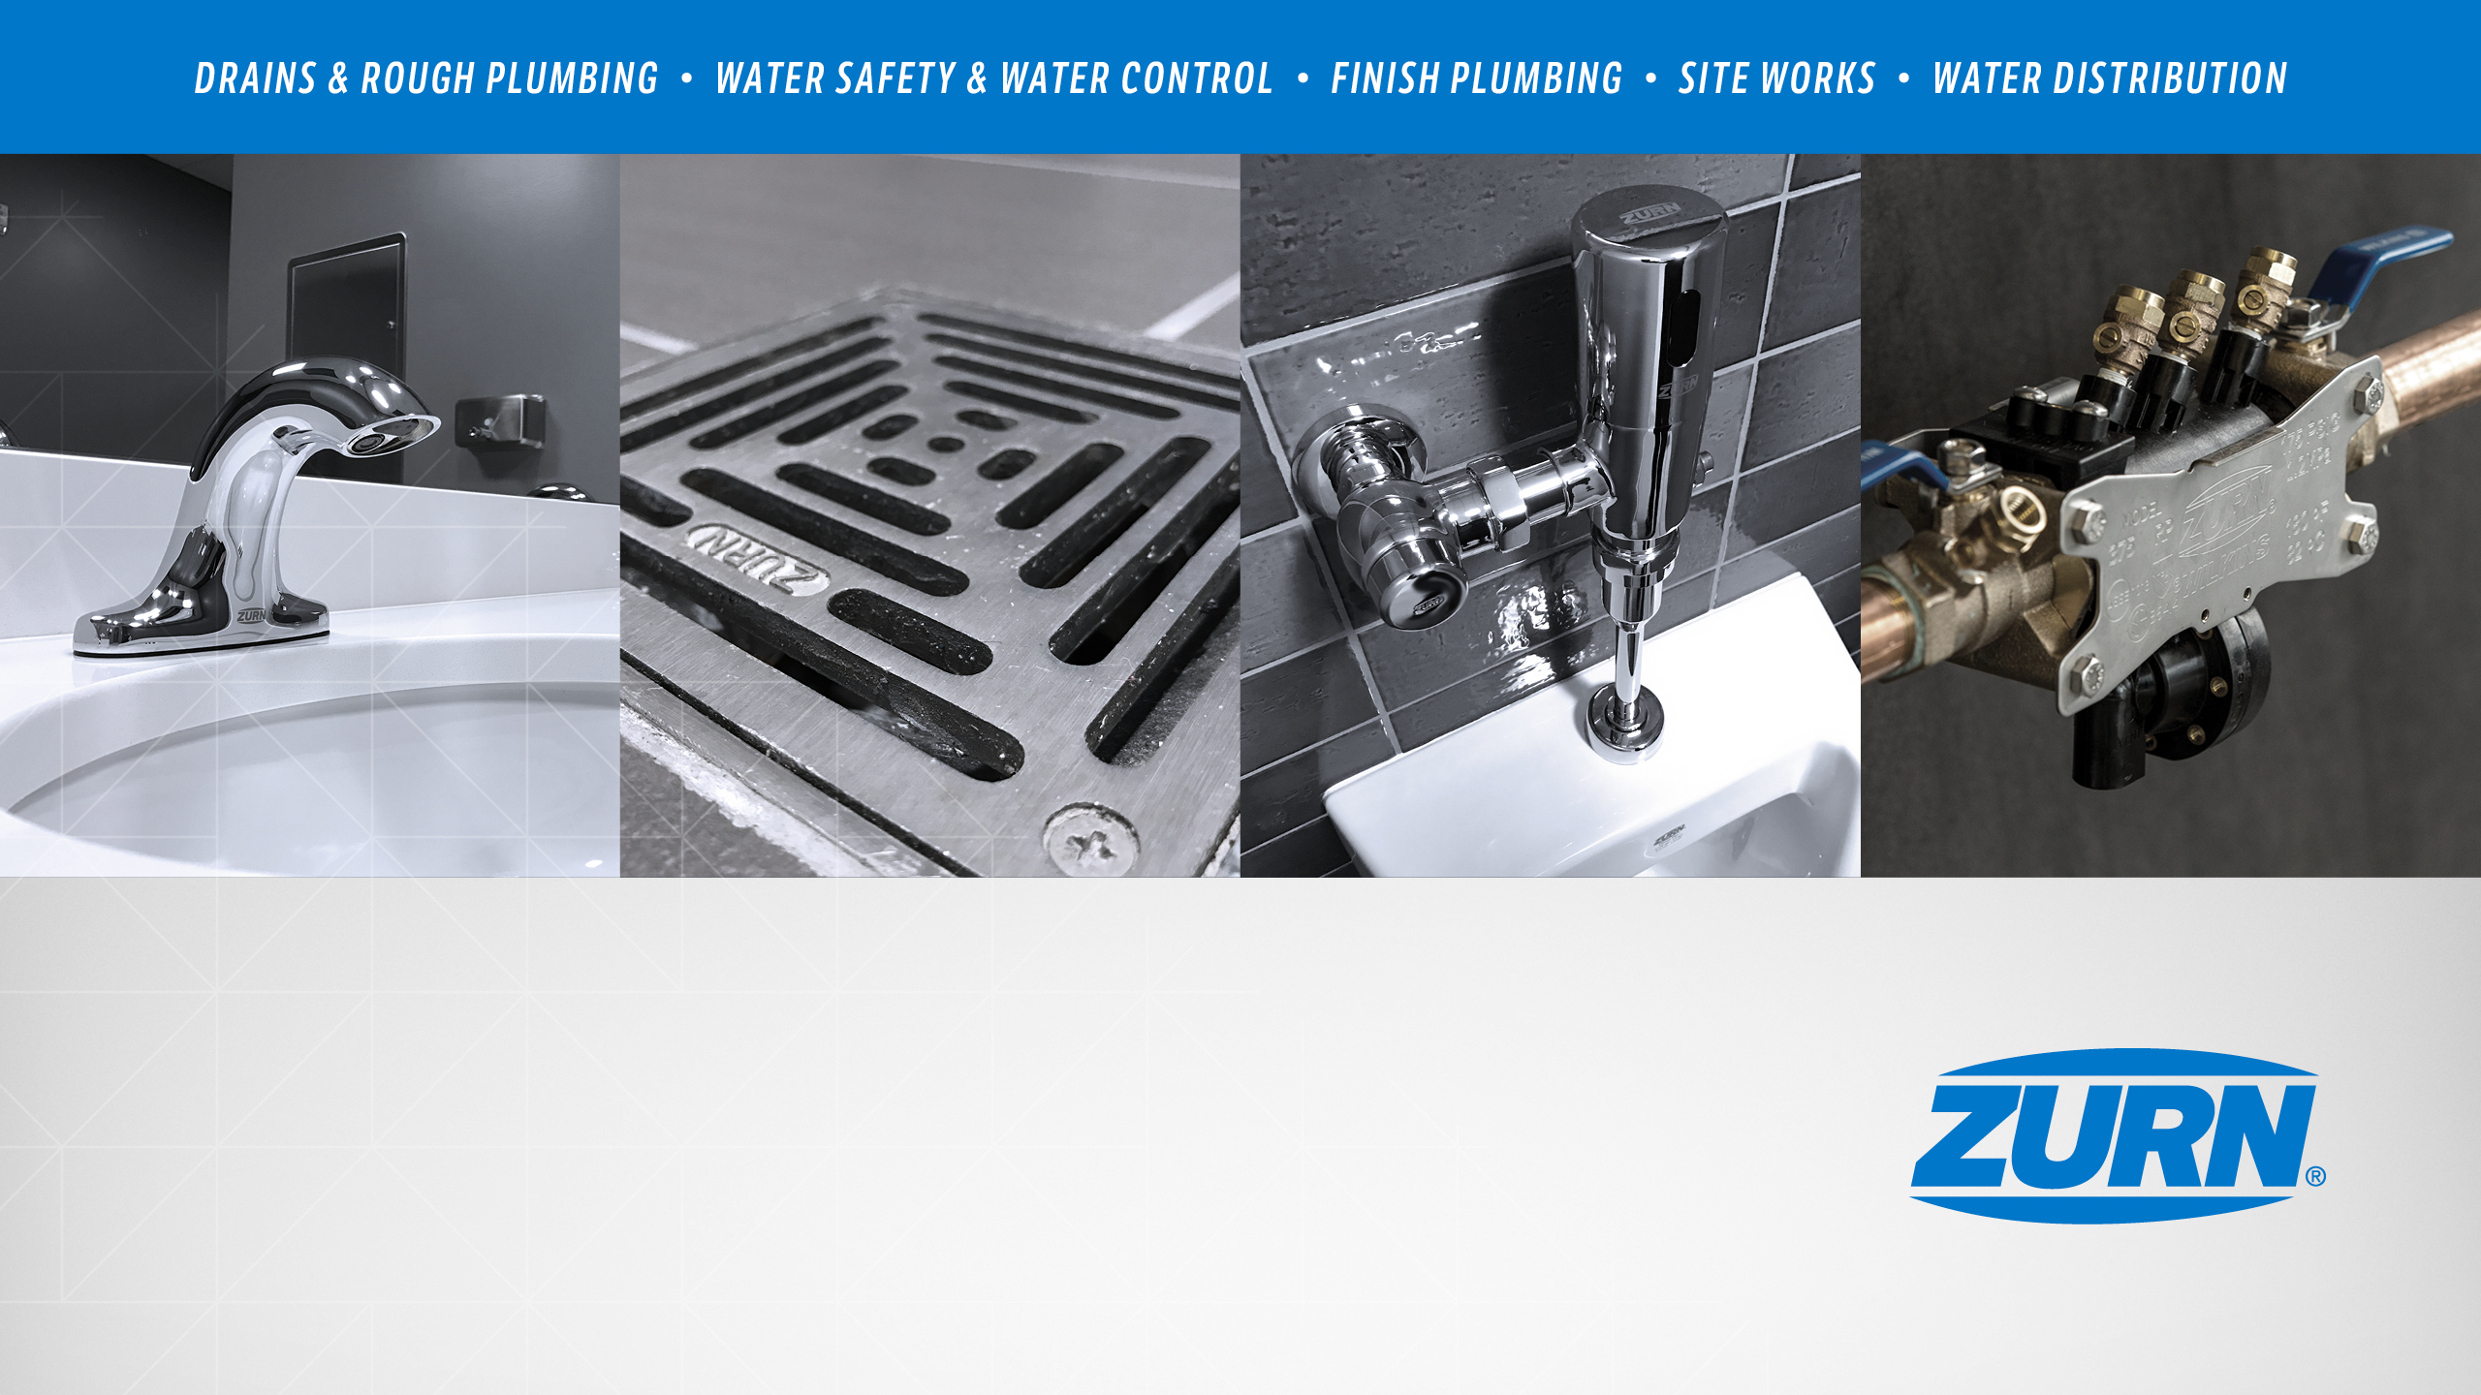
Zurn New Product Launches
October 2019
Notes:
Cassandra Wurster

Slide 2
agenda what you’ll learn
01
past launches
02
present launches
Stainless products – StainlessDrains.com acquisition
VMax V2 hand dryers
ZIX fulfillment site
Fire valves - ZW5000/5004 Pressure-Tru® field adjustable
Pressure reducing valves – 20XL
Zurn One Systems
Interceptors
19-9 product simplification
Marketing
03
future launches
04
resources
Connected faucet/ flush valve retrofit kits
plumbSMART 3.0
710 pressure vacuum breakers
Flush valves - EZ gear-driven sensor flush valves
Finish plumbing repair parts program
World Dryer/American Dryer rebranding
Product training
Notes:
Cassandra Wurster

Slide 3

past launches
October 2019
Notes:
Cassandra Wurster

Slide 4
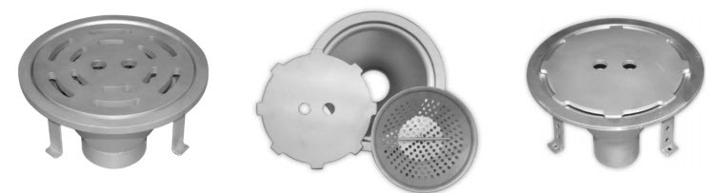
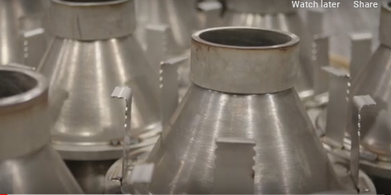
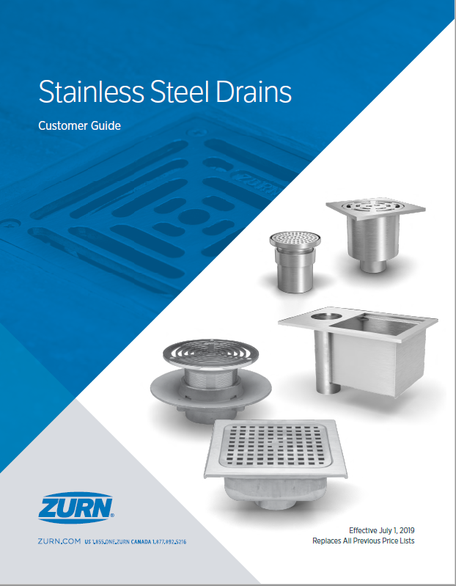
past launches stainlessdrains.com acquisition
value proposition
product
stainless steel product offering
sanitary drainage
Improved lead times
area drainage & cleanouts
linear drainage
complete custom capability
custom
promotion
order / shipment
located in Dallas region
stainless catalog
select SKU’s AX09
samples in process to REP’s
Spec Drain => Dan Hause
Linear Drain => Chris Brink
Notes:
Jill Nagg

Slide 5
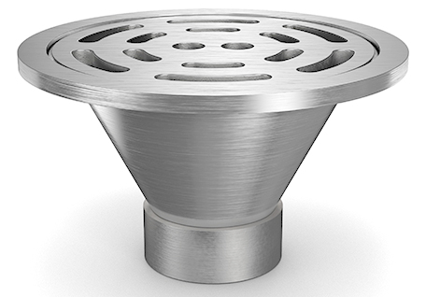
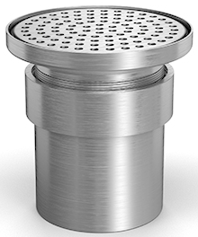
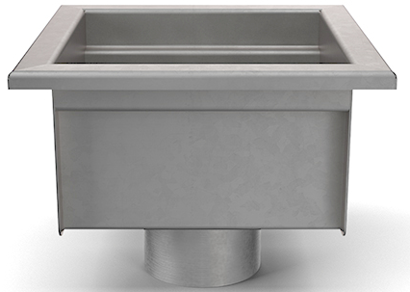
past launches
stainless drains
Sanitary Drainage
Area Drainage
Floor Sinks
Standardize on Stainlessdrains.com as new Z1800 products
Example
Z1800-12B
6”, 8”, & 10” sizes
Example
Z1706 – 6” Round
Unique Products
(i.e. Magnetic Lock & Butterfly Valve)
Example
Z1750-SDC
Notes:
Jill Nagg

Slide 6
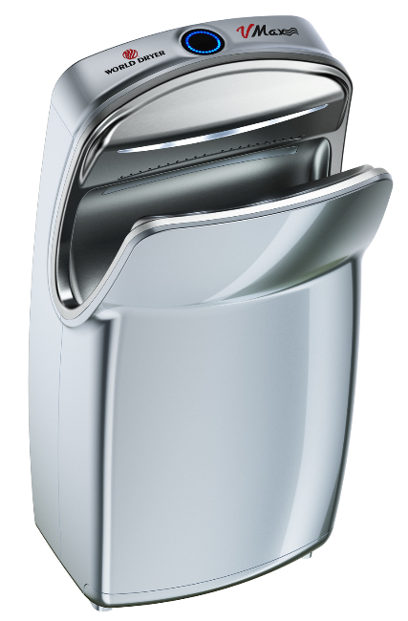
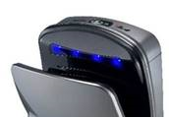
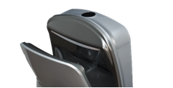



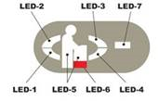

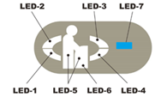

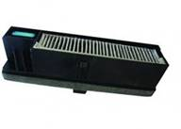
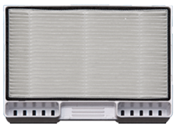
past launches
World Dryer VMax V2
 | VMax | VMax V2 (brushless motor)
Model | V-639A | V-649A
LED Information Display & Cavity Accent Lighting
Operating Display
Water Collection Empty
HEPA Filter Replacement
HEPA Filter
3X longer filter life (1-3 yrs expected depending on washroom traffic)
Notes:
Alejandra Edwards-Garcia

Slide 7
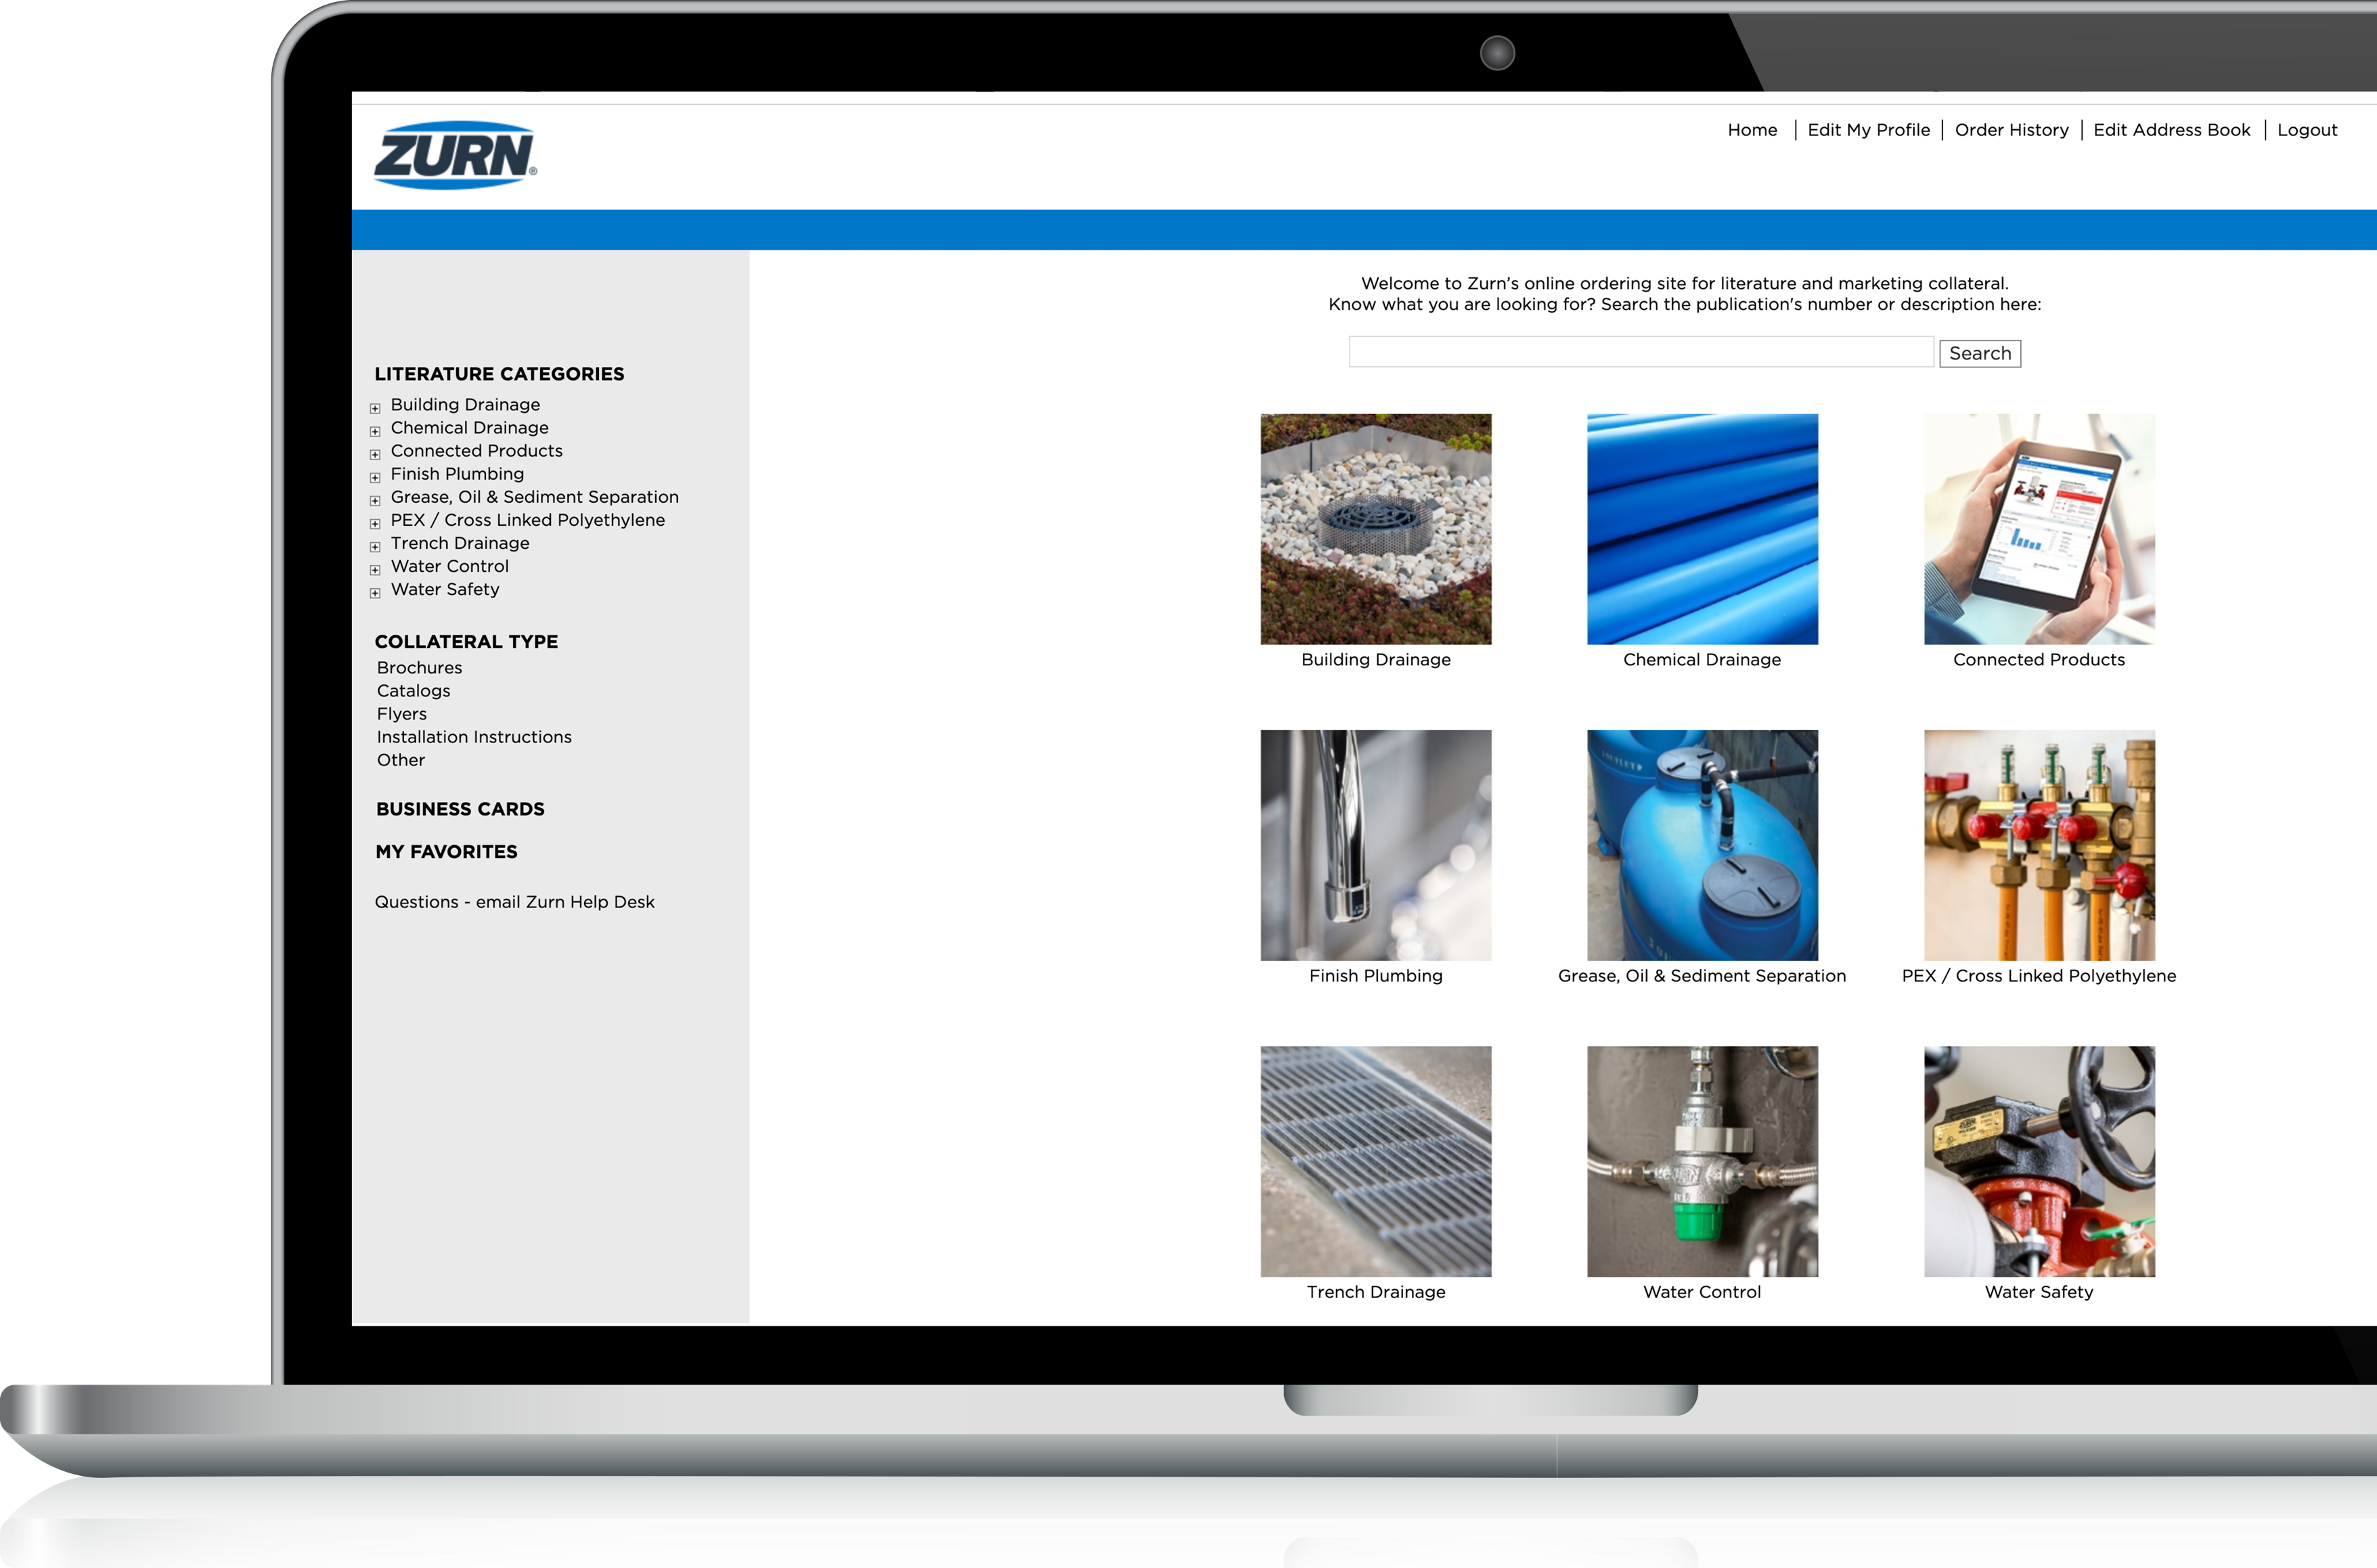
past launches
ZIX literature fulfillment site
Redesigned literature fulfillment site – organized and visually appealing
New left-hand navigation that improves usability, filtering and provides easy access to the materials you need
Sort by category or collateral type
Larger thumbnails for easier selection
Searchable
Business card ordering system
for Zurn associates
New Favorite Items
All current ZIX users have access to this page. Any user without access may register and request access at zix.zurn.com
Notes:
Adam Nye

Slide 8

present launches October 2019
Notes:
Cassandra Wurster

Slide 9
present launches fire valves
Notes:
Will Allgood

Slide 10
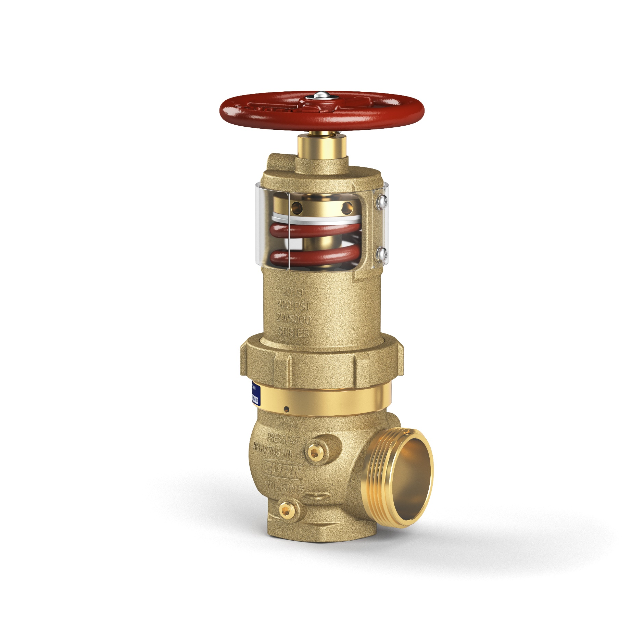
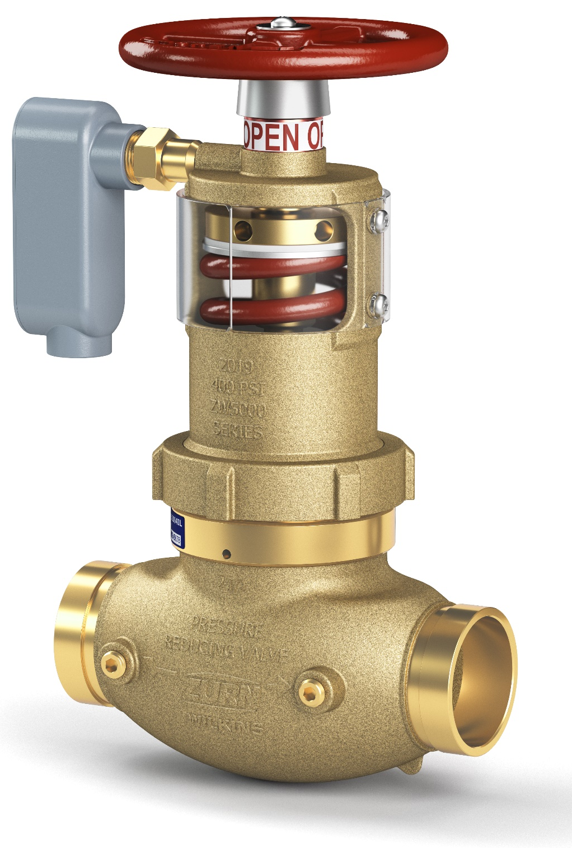
present launches fire valves
Pressure-Tru® ZW5000 Series
Pressure Reducing Valve
field adjustable fire valves (hose and floor control)
Widest range of flow performance allows for replacement of any competitor valve
Low torque – only 9ft lb of torque to field adjust
Compact - designed to fit in tighter spaces
Tamper proof shield (standard)
  New Construction – drops out of way for ease of in field adjustments
  Fire Fighting – breakaway for quick in field adjustments
Larger handwheel for ease of operation
Lightweight aluminum adjusting rod included
Angle or inline globe body with grooved or threaded connections
Regulates pressure under both FLOW and NO-FLOW conditions
Tamper resistant integral supervisory switch (standard) on all floor control valves
UL® and cUL® Listed
ZW5000 Pressure-Tru®
Field Adjustable Hose Valve
ZW5004 Pressure-Tru®
Field Adjustable Floor Control Valve
Notes:
Will Allgood

Slide 11
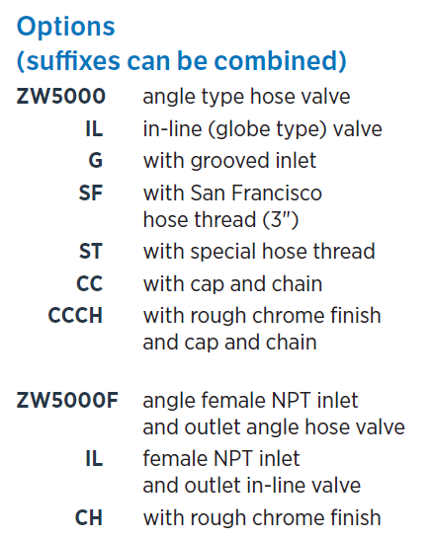
present launches fire valves
ZW5000 Pressure-Tru®
Field Adjustable Hose Valve
ZW5000 Pressure Reducing Valve
field adjustable fire hose valves
Listed as a standpipe valve for individual hose stations in CLASS I and CLASS III systems
UL® and cUL® Listed
Factory or Field Set
Maximum inlet pressure: 400psi
Inlet connection:
  (ZW5000): FNPT or Grooved
  (ZW5000F): FNPT
Outlet connection:
  (ZW5000): Male hose
  (ZW5000F): FNPT
Tapped and plugged inlet and outlet for pressure gauge
Notes:
Will Allgood

Slide 12
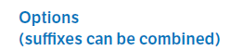
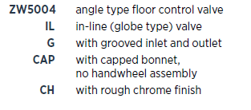
present launches fire valves
ZW5004 Pressure-Tru®
Field Adjustable
Floor Control Valve
ZW5004 Pressure Reducing Valve
field adjustable floor control valve
Listed as a floor control valve, an indicating valve, and a check valve in automatic sprinkler systems as well as a standpipe valve for CLASS I and CLASS III systems
UL® and cUL® Listed
Factory or Field Set
Maximum inlet pressure: 400psi
Inlet connection: FNPT
Outlet connection: FNPT
Tapped and plugged inlet and outlet for pressure gauge
Integral supervisory switch contact rating of 3 amps at 125VAC and a tamper resistant cover
Notes:
Will Allgood

Slide 13
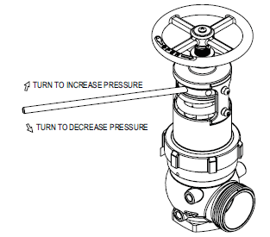
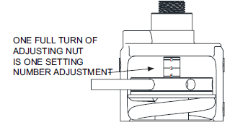

present launches fire valves
Low Torque
Low Torque takes only 9 ft lb. of force to field adjust under flow or no-flow conditions
Closest competitor Elkhart URFA is 15 ft./lbs. torque
Each complete revolution is one complete setting
0-15 adjustment settings
Lightweight aluminum adjusting rod included
Notes:
Will Allgood

Slide 14
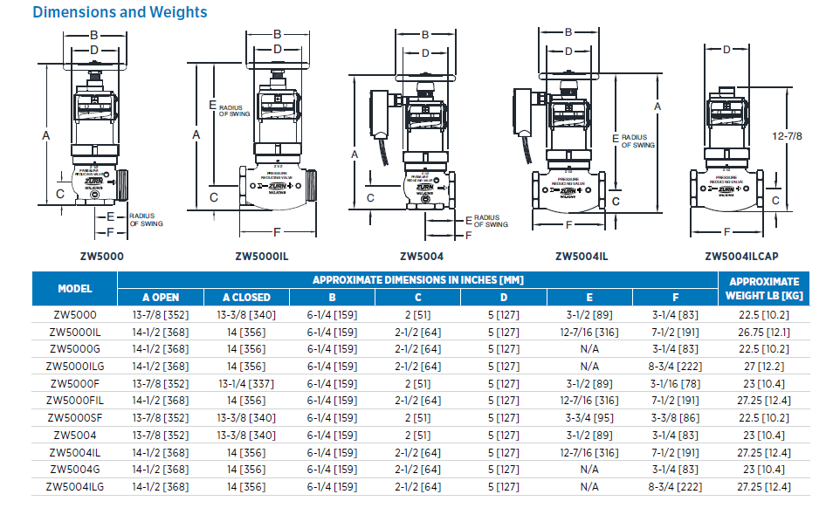
present launches fire valves
Compact
Designed to fit in tighter spaces
3 inches shorter in height from our Z3000 and 4-1/2 inches shorter from our Z3004 in the open position
Lightest and most compact valve on the market

Slide 15
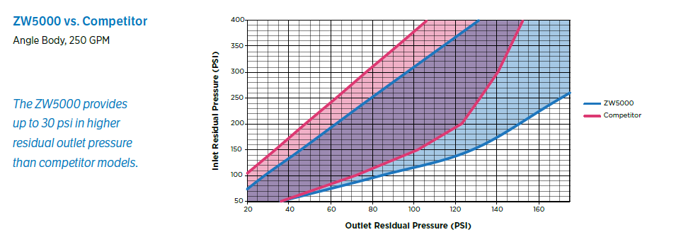
present launches fire valves
Flow Performance
Widest range of flow performance satisfies virtually any application or replacement of any competitor’s valve
Provides up to 30 psi in higher residual outlet pressure than competitor models
Regulates pressure under both FLOW and NO-FLOW conditions
Notes:
Will Allgood

Slide 16
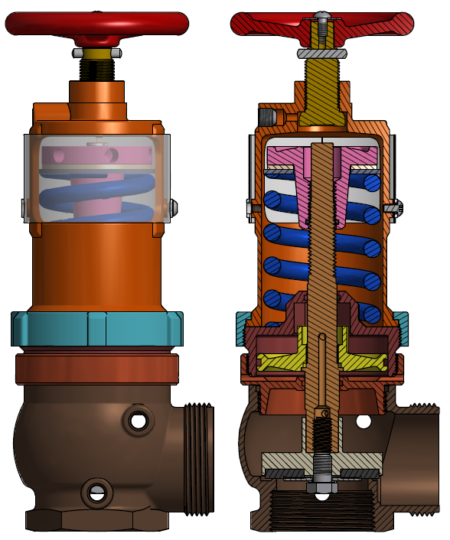
present launches fire valves
Design Features
O-ring on adjusting nut to prevent vibration from changing valve setting at low settings
Ultra low friction washer to make valve adjustment easier
Tapped and plugged inlet and outlet for pressure gauge
Larger handwheel for ease of operation
Notes:
Handwheel closes the valve or allows it to open as needed to regulate downstream pressure

Slide 17
present launches fire valves
Tamper Shield
For Contractor:
      Drops out of way for easy start-up adjustments in the field for new construction
For Fire Ground Force:
      Breaks away for on-the-fly adjustments in cases of emergency
Notes:
Will Allgood

Slide 18
present launches fire valves
Pricing and Distribution
Pricing
      Net Pricing and List Pricing available on ZIX
      For job quotes reach out to Will Allgood and Mike Mallas
      List Price loaded in Axapta
Distribution
      Inventory to build 400+ in Paso Robles, CA
      Building and shipping AVAILABLE NOW
ZW5000 Pressure-Tru®
Field Adjustable Hose Valve
ZW5004 Pressure-Tru®
Field Adjustable Floor Control Valve

Slide 19
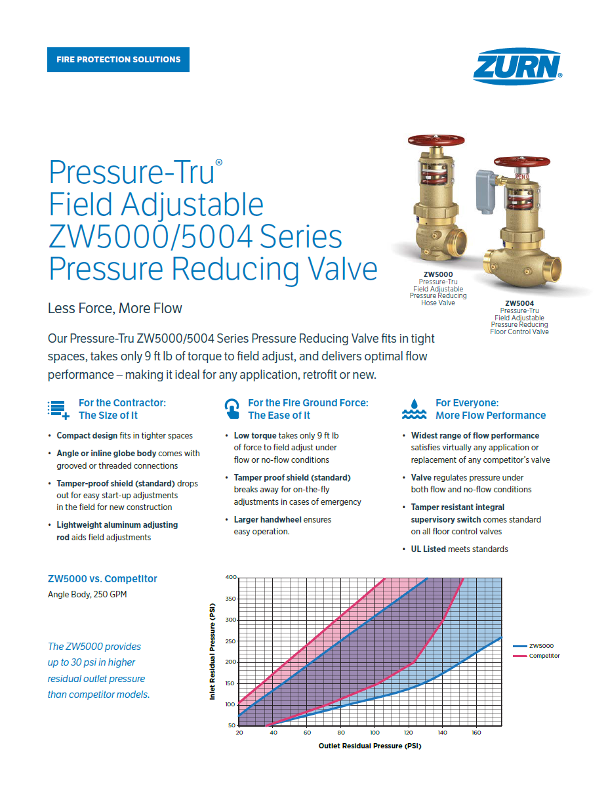
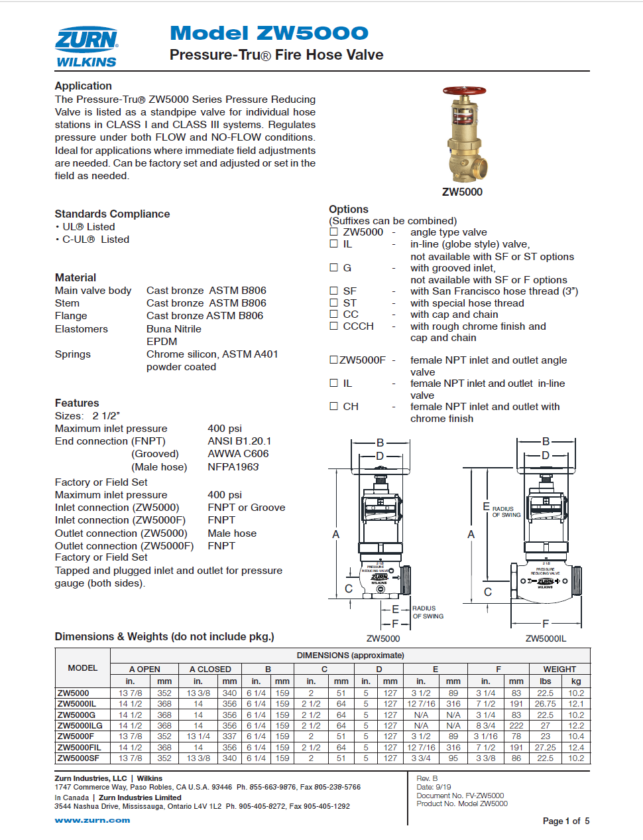
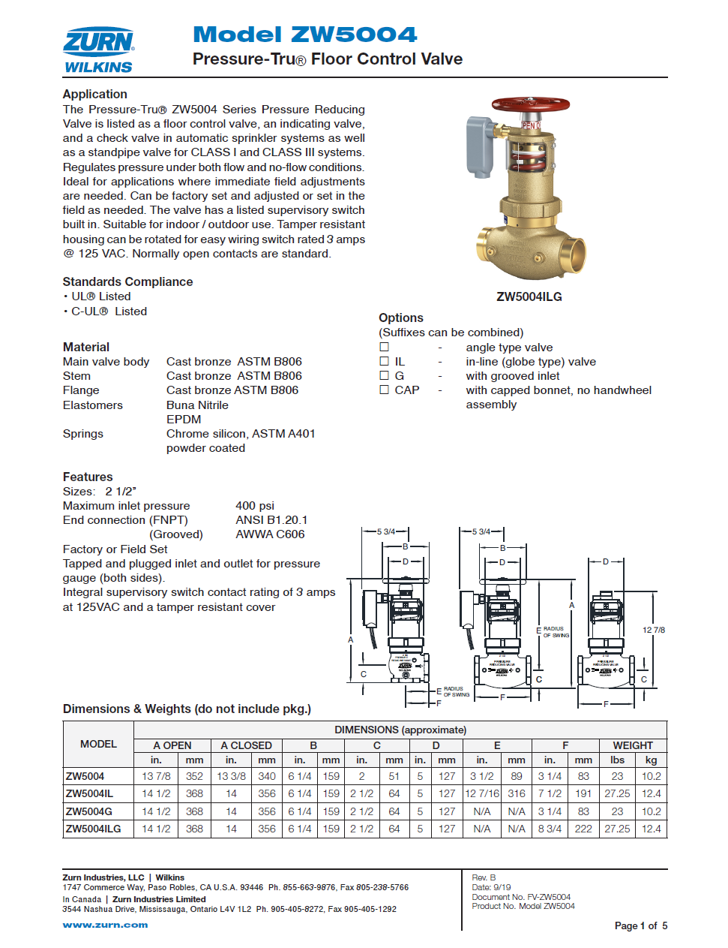

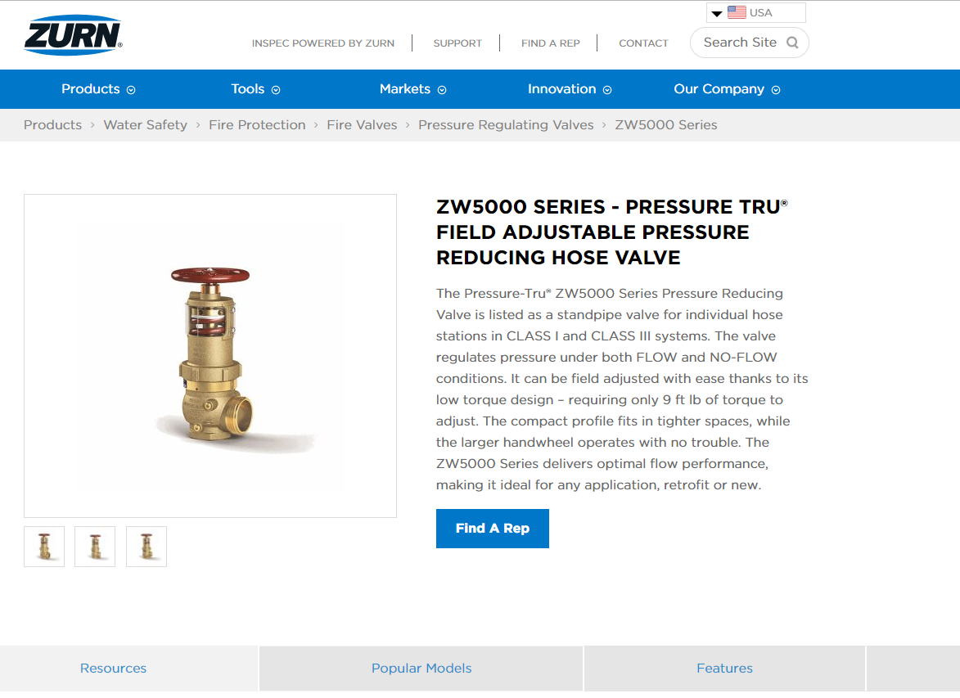
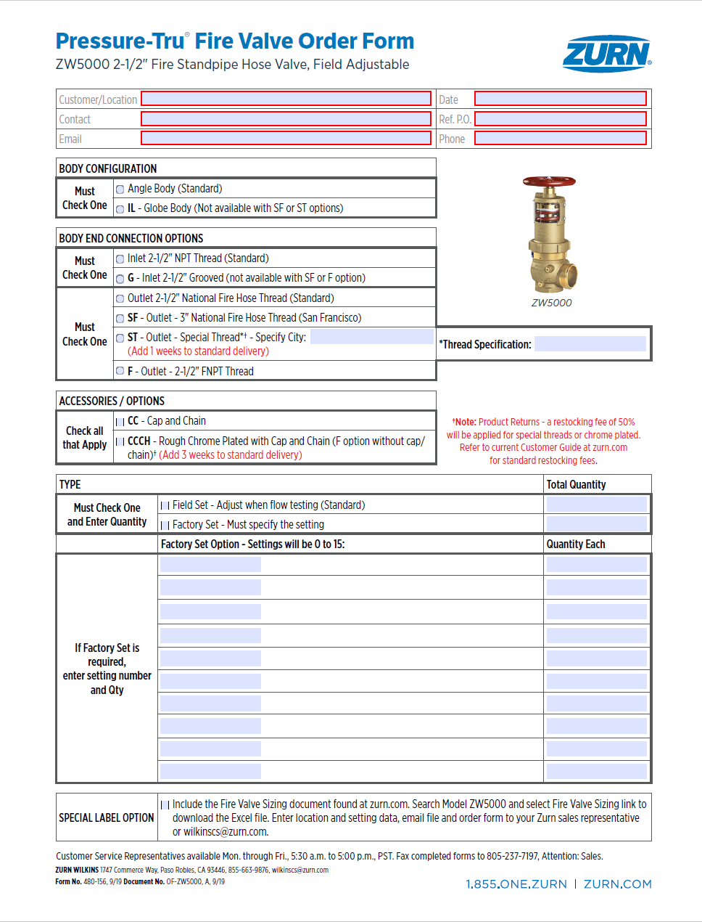
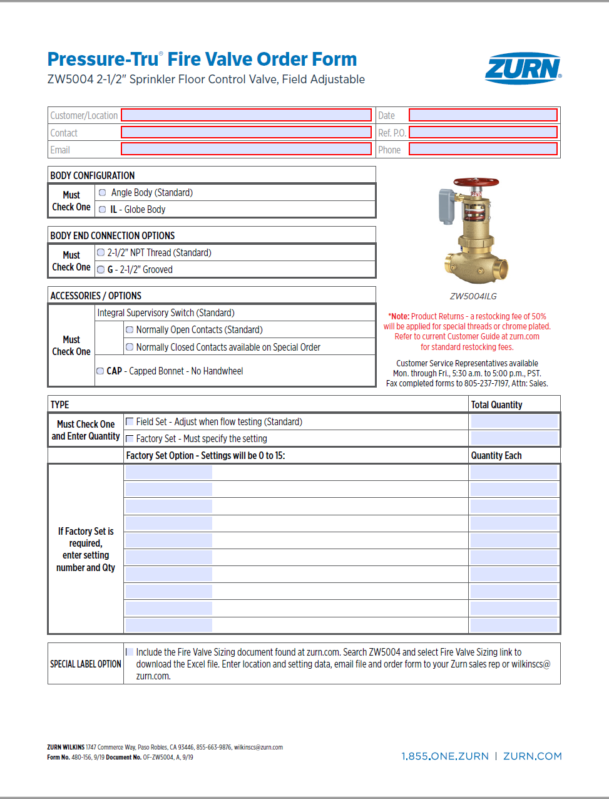
present launches fire valves
Pressure-Tru® Field Adjustable
ZW5000/5004 Series Pressure Reducing Valve
Marketing materials
One Sheet
Spec Sheet
Installation Instructions
Product Pages
Fire Protection Brochure
One Sheet
zurn.com and ZIX fulfillment through Delzer
Spec Sheet
zurn.com product pages
Fire Protection Brochure
Product Pages on zurn.com
Order Forms
zurn.com product pages
Notes:
Will Allgood/Nicole Raftery

Slide 20

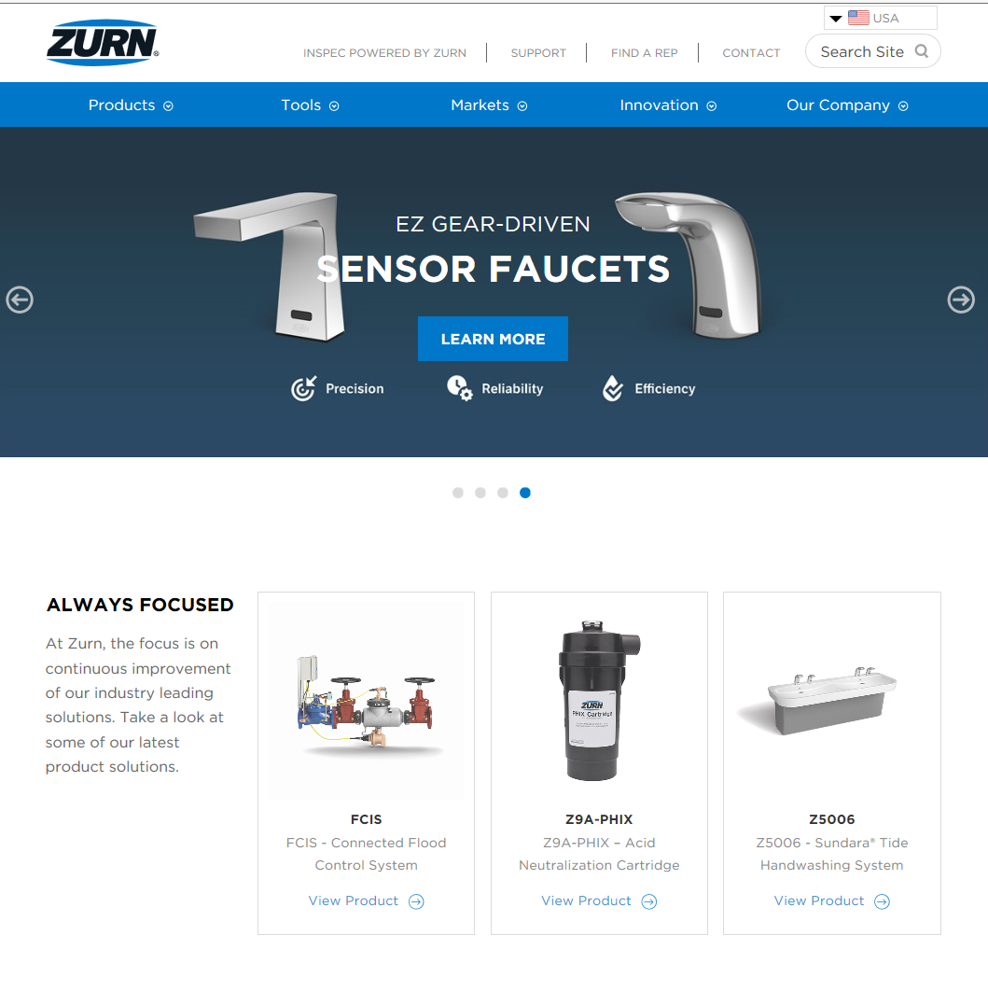

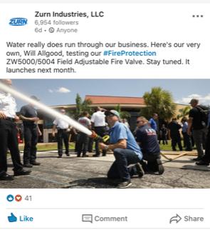
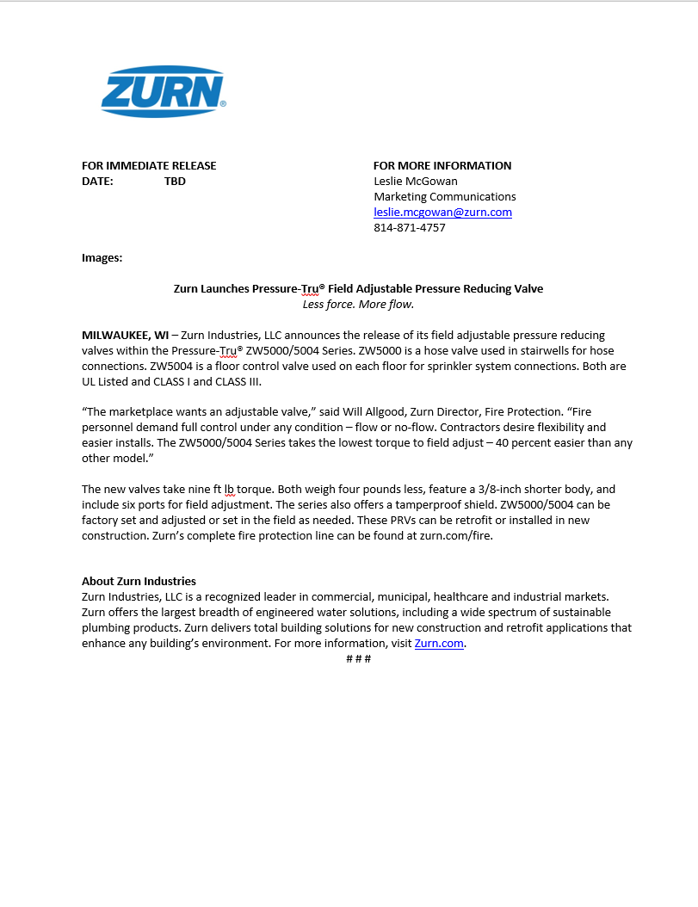
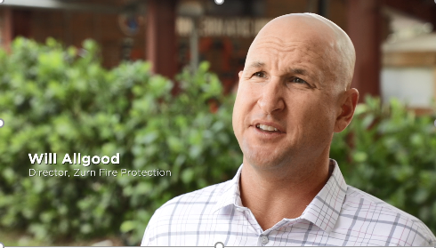
present launches fire valves
Pressure-Tru® Field Adjustable
ZW5000/5004 Series Pressure Reducing Valve
Marketing materials
Teaser Product Video
Print Ad
Web Banner on zurn.com
Social Media Posts
Press Release
Web Banner on zurn.com
Print Ad
Social Media posts
Teaser Product Video
zurn.com and Zurn YouTube
Press Release
Notes:
Will Allgood/Nicole Raftery

Slide 21
present launches pressure reducing valves
Notes:
John Mankins/Nicole Raftery

Slide 22
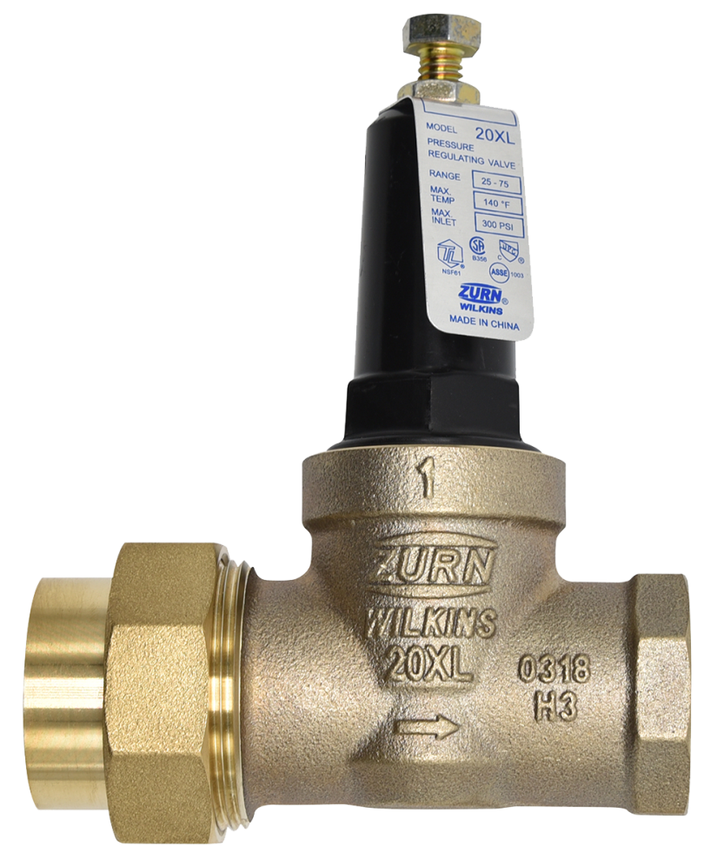
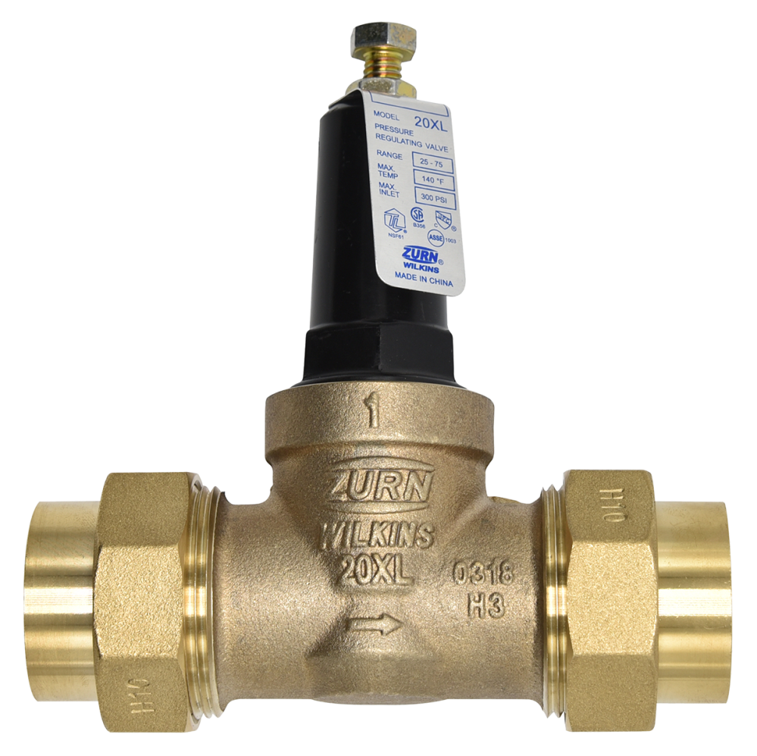
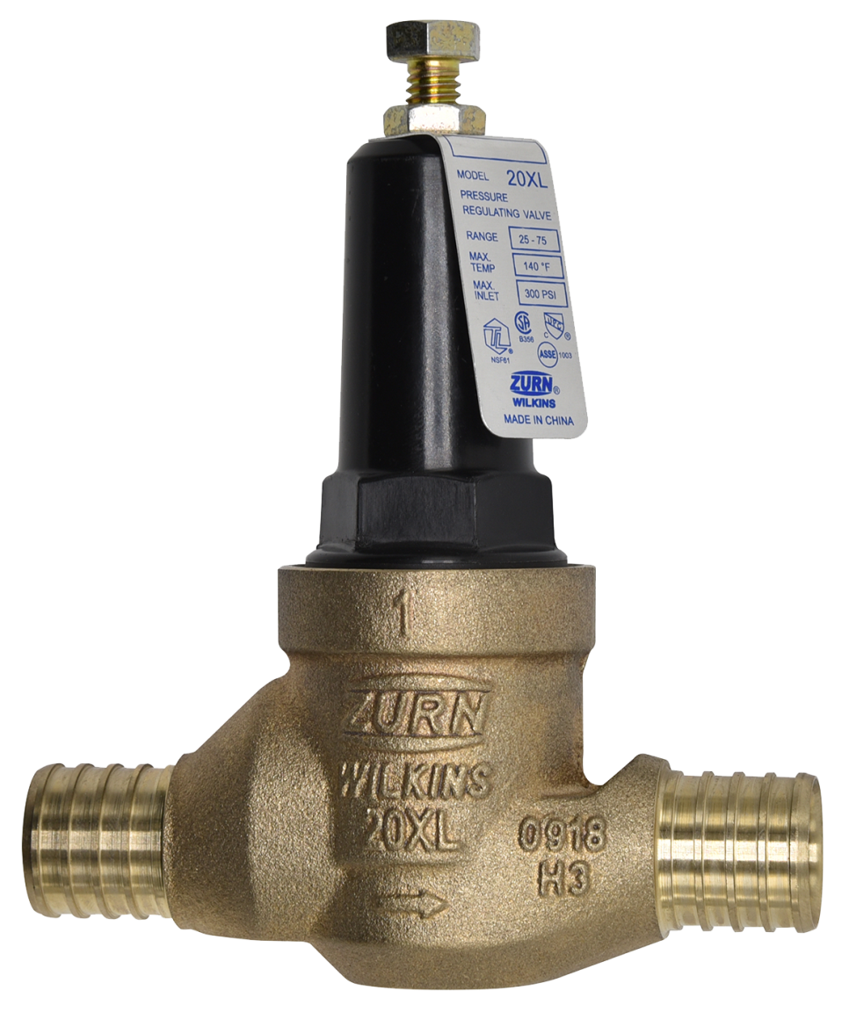
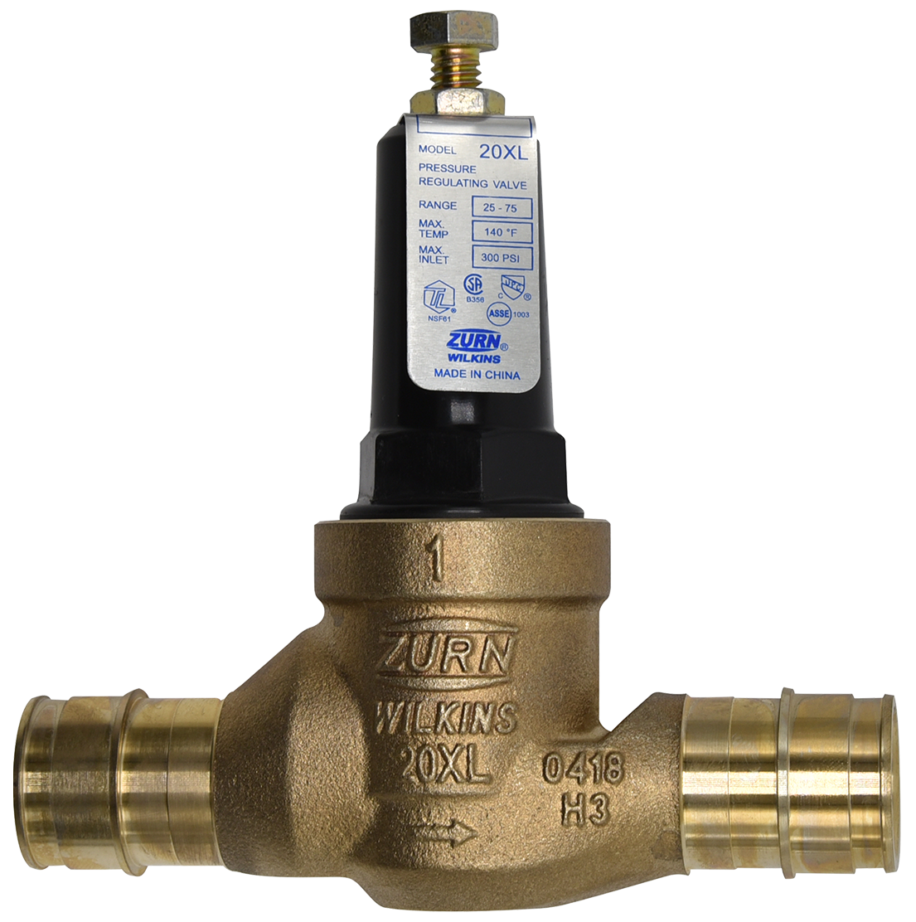
present launches pressure reducing valves
20XL First fit pressure reducing valves
Compact design for ease of installation
Short lay length to fit into the tightest spaces
Economical and ideal for residential construction
Sizes: 3/4” and 1”
Body connections options:
  Single union
  Double union
  Integral PEX connections
    F1960 expansion style
    F1807 crimp style
Approvals:
  ASSE® Listed 1003
  IAPMO® Listed
  CSA® Certified B356
  Meets the requirements of NSF/ANSI 61
20XL
Single Union
20XLDU
Double Union
20XLEPEX
F1960 Expansion PEX
20XLPEX
F1807 Crimp PEX
Notes:
John Mankins/Nicole Raftery

Slide 23
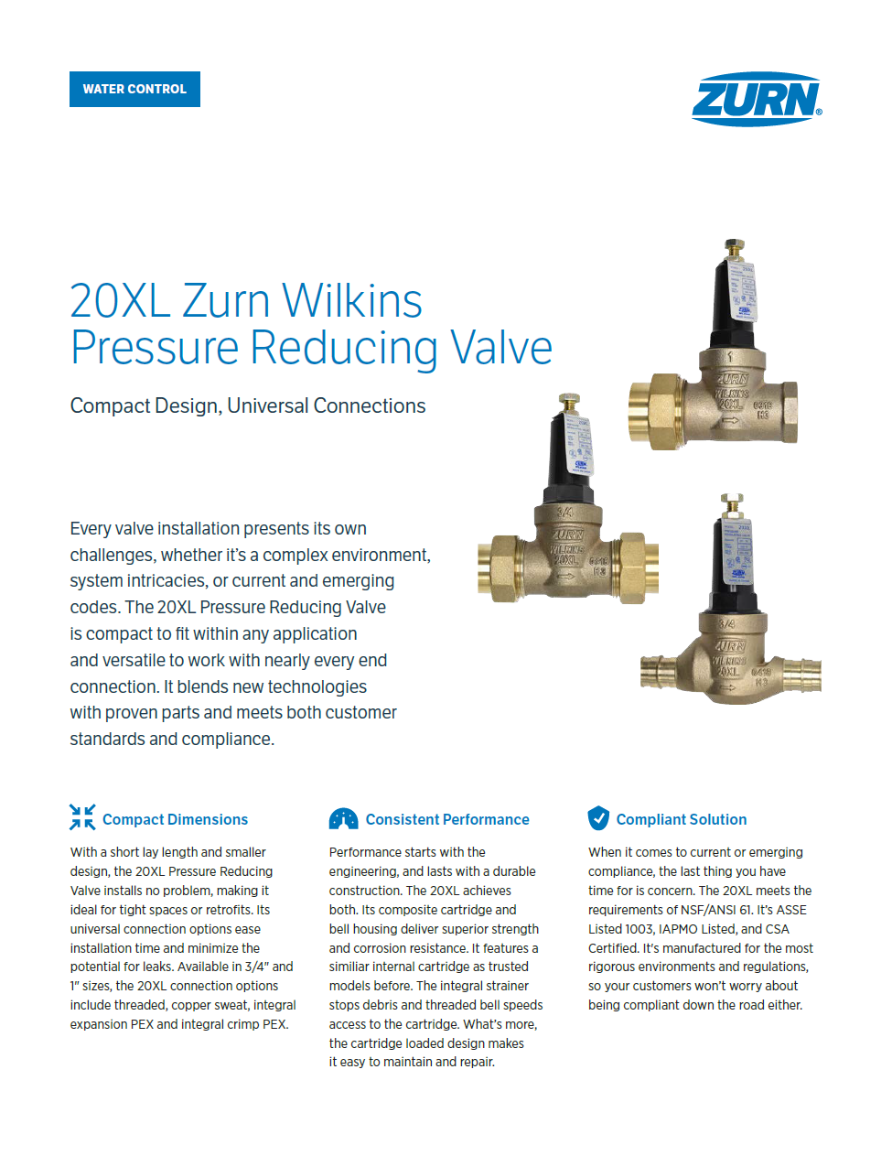
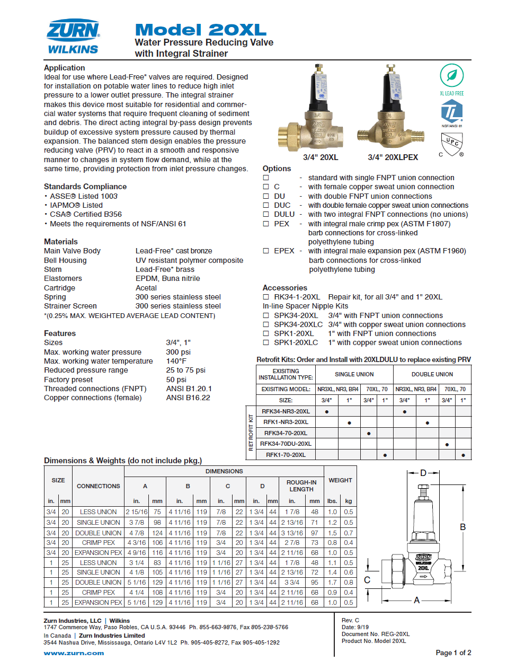
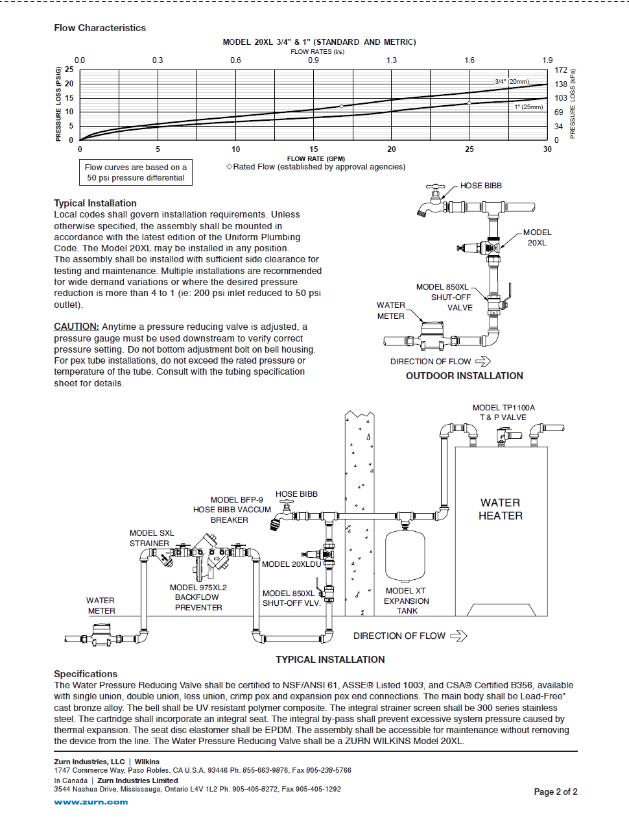
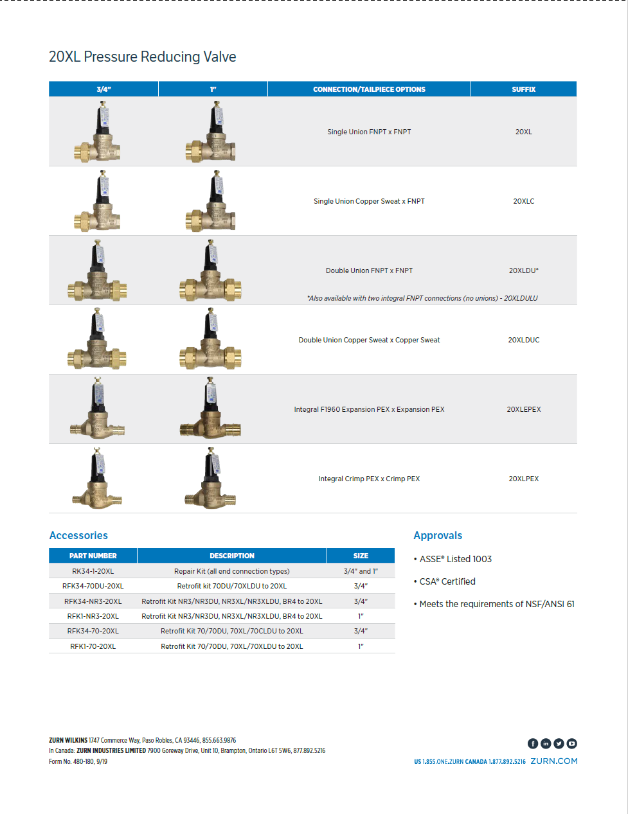
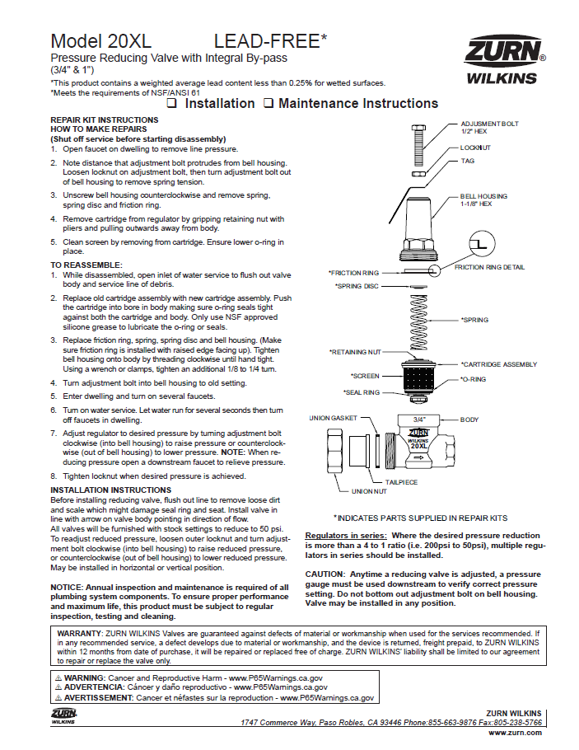
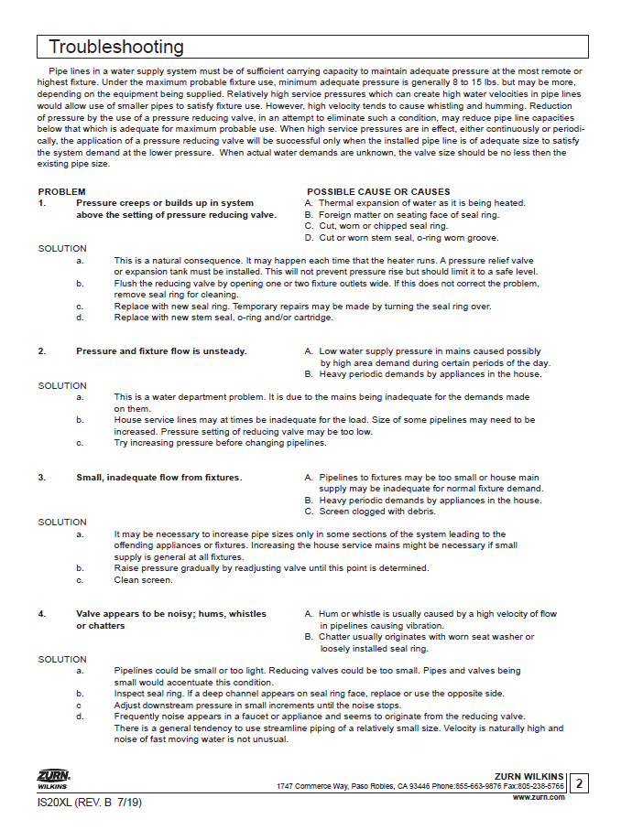
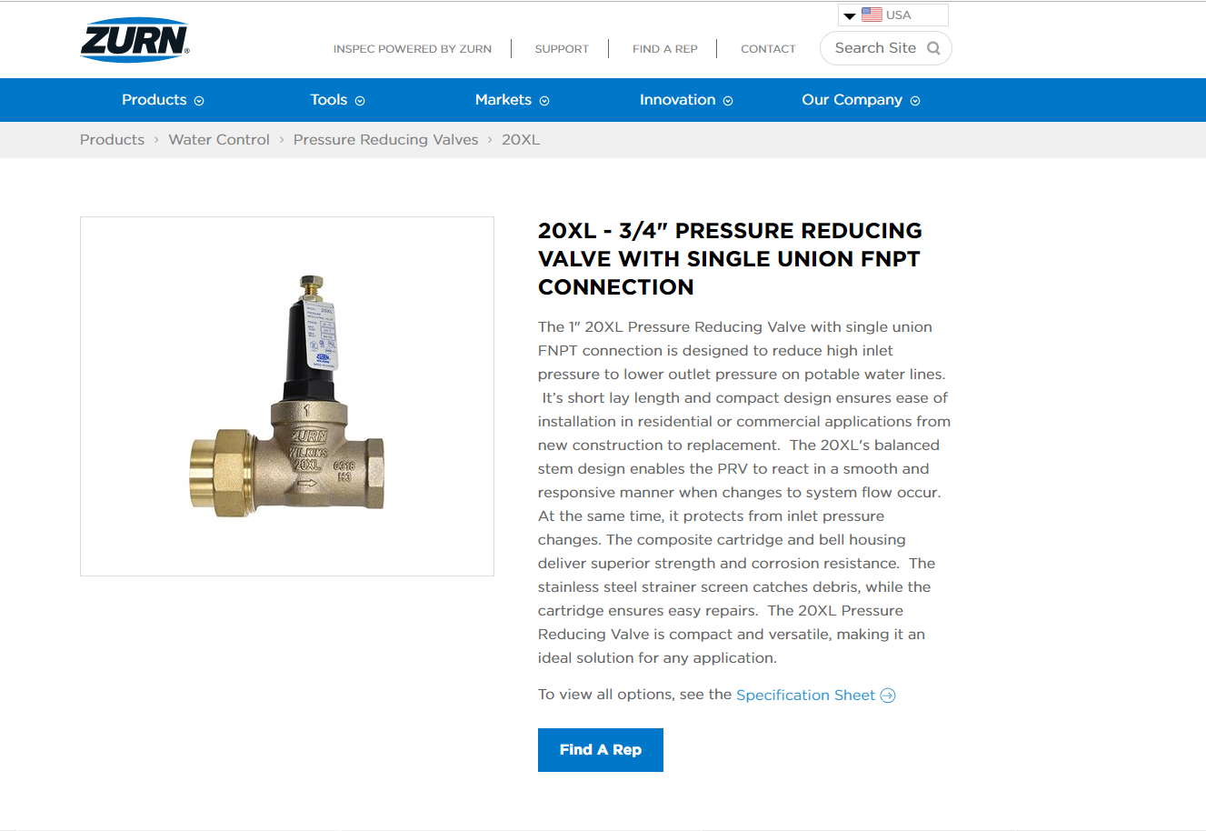

present launches pressure reducing valves
20XL Pressure Reducing Valve
Marketing Materials
One Sheet
Spec Sheet
Installation Instructions
Product Pages
Press Release
Product intro video
One Sheet
zurn.com and ZIX fulfillment through Delzer
Spec Sheet
zurn.com product pages
Product Pages on zurn.com
Product Video – COMING SOON
Installation Instructions zurn.com product pages
Notes:
John Mankins/Nicole Raftery

Slide 24
present launches pressure reducing valves
Pricing and Distribution
Pricing
      Net Pricing and List Pricing available on ZIX
      List Price loaded in Axapta
Distribution
      1000 units available in Paso Robles, CA
      600 units in transit to Atlanta Service Center
      For stocking request reach out to your local inventory control manager or John Mankins
Notes:
John Mankins/Nicole Raftery

Slide 25
present launches
Zurn One Systems
Notes:
Kim Fairley

Slide 26
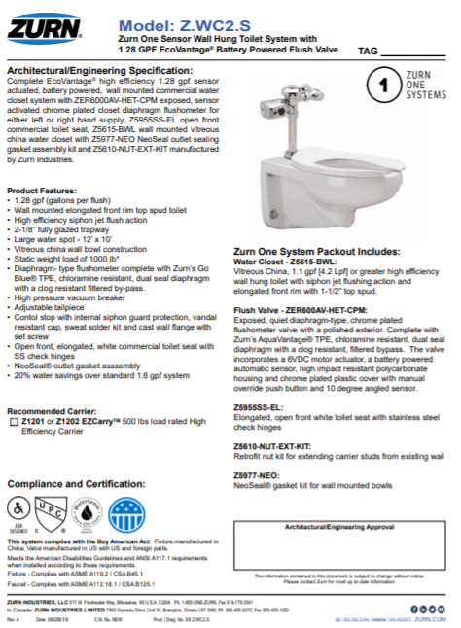
present launches
Zurn One Systems Relaunch
Key Features & Benefits
Streamlined Offering:
Top selling water closets, urinals & sinks paired w/flush valves, faucets & accessories
for paired performance in a complete system / single shipment.
Smarter Numbering:
Single model number w/ less characters & shorter descriptions for easy specification and ordering.
Old Number: Z5615.043.01.12.0
New Number: Z.WC1.M
Recommended InSPEC Systems – Improving ease of specification
Increased Service Levels:
Top 42 SKU’s shipping < 5 days
Other Improvements:
Labeling & packaging to save contractors/wholesaler time
Buy America Act Compliance listed on spec sheet & final labeling
Complete list of components inside
System Pricing – Avg 5% less than purchasing components separately
Notes:
Kim Fairley

Slide 27
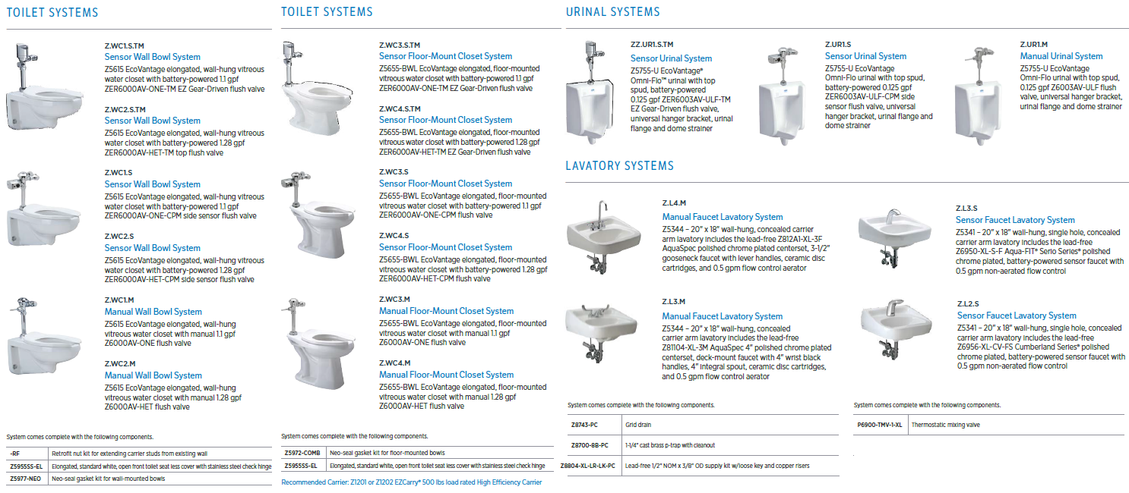
present launches
Zurn One Systems re-launch

Slide 28
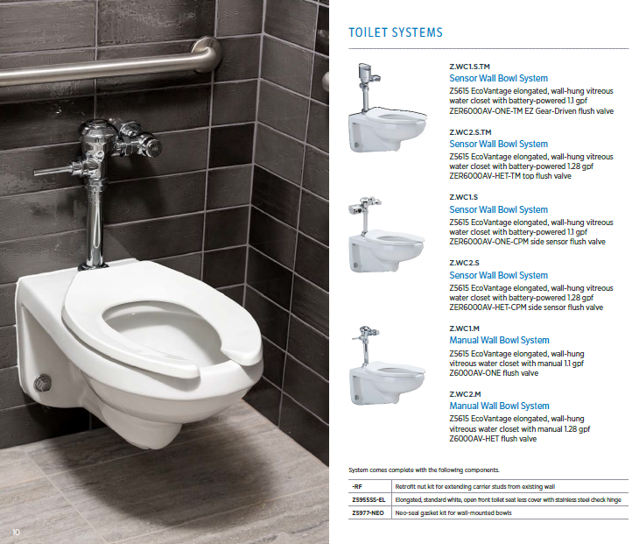
present launches
Zurn One Systems
Wall Mounted FV Water
Closet Systems
Fixture
Z5615 Wall Bowl
Flush Valve Options:
Top Mount EZ Gear Sensor - ZER6000AV-TM
Side Mount - ZER6000AV-CPM
Manual - Z6000AV
Flow Volumes
1.1 or 1.28 GPF
Trim
Seat – Z5955SS-EL
Retrofit nuts
NeoSeal gasket

Slide 29
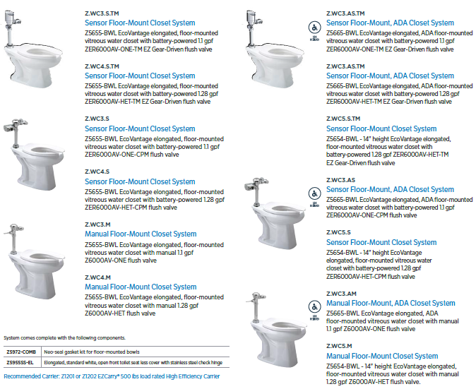
Present launches
Zurn One Systems
Floor Mounted FV WC Systems
Fixture
Z5655 / Z5665 / Z5654 Floor Bowls
Flush Valve Options:
Top Mount EZ Gear Sensor – ZER6000AV-TM
Side Mount - ZER6000AV-CPM
Manual - Z6000AV
Flow Volumes
1.1 or 1.28 GPF
Trim
Seat – Z5955SS-EL
Bolt / Washer Combo - Z5972-COMB

Slide 30

present launches
Zurn One Systems re-launch
Urinal Flush Valve Systems
Fixture
Z5755 Omni Flow Urinal
Flush Valve Options:
Top Mount EZ Gear Sensor
Side Mount EZ Flush
Manual AV
Flow Volumes
0.125 or 0.5 GPF
Trim
None – Univ. Mounting Bracket

Slide 31

present launches
Zurn One Systems re-launch
Manual Lavatory Systems
Fixture
Z5344 / Z5844
Faucet Options:
Z81000, Z7440, Z81104
Z812A1, Z812B1, Z86500 Series
Trim
Grid Drain – Z8743-PC
P Trap – Z8700-8B-PC
Supply Stop – Z8804-XL-LRLK-PC
Notes:
Kim Fairley

Slide 32

present launches
Zurn One Systems re-launch
Sensor Lavatory Systems
Fixture
Z5341 / Z5344 / Z5844
Faucet Options:
Z6950, Z6951, Z6955
Z6915, Z6920 & Z6956 Series
Trim
Grid Drain – Z8743-PC
P Trap – Z8700-8B-PC
Supply Stop – Z8804-XL-LRLK-PC
TMV – P6900-TMV-1-XL

Slide 33

present launches
Zurn One Systems re-launch
Clinical Sink Systems
Fixture
Z5410 or Z5420
Flush Valve Options:
Z60843AV-BWN
Z6000AV-BWN1
Trim
Z5977-NEO
or Z5972-COMB

Slide 34


finish plumbing product marketing
Zurn One Systems marketing
Refreshed Zurn One Systems brochure available on ZIX
  Highlighting new EZ Gear Flush Valve Systems
New Zurn One Systems product category on Zurn.com
  featuring new model numbers and Best Sellers

Slide 35
present launches interceptors
Notes:
Silvano Ferrazzo

Slide 36
present launches interceptors
FOG-ceptor family is growing
FOG-ceptor Z-250H is in stock at all Zurn Service Centers
FOG-ceptor Z75H and Z-50H
  Same excellent design as the original FOG-ceptor
  Same great performance
  Shipped with fiberglass frames and covers and flow control device
FOG-ceptor Z50H
FOG-ceptor Z75H
Notes:
Jill Nagg

Slide 37
present launches interceptors
FOG-ceptor family Z250H, Z75H, Z50H
Will be stocked in Ontario, Dallas, Atlanta
Small footprint ideal for stocking at local wholesalers
Sold as complete package to include multi-use fiberglass covers
FOG-ceptor Z75H
FOG-ceptor Z50H
Notes:
Jill Nagg

Slide 38
present launches
19-9 product simplification
Notes:
Jill Nagg

Slide 39
present launches
19-9 simplification
The product listed below will include the Z100 body as standard:
Z503
Z509
Z521
Z526
The product listed below will include the Z508 body as standard:
Z507
Z520
Z551
In addition, Zurn will be standardizing on suffix options (-DG Grates, -P Frame (region specific) & -Y Buckets) across select product lines to driving toward customer demand.
DATE FOR FULL PRODUCT TRANSITION: November 1, 2019

Slide 40
present launches marketing
Notes:
Cassandra Wurster

Slide 41

present launches marketing
New Customer Story
Baylor Scott & White
Featuring Zurn:
Backflow Prevention
Floor Drains
Faucets
Flush Valves
Toilets
Urinals
Floor Drains
Linear Floor Drain Systems
https://youtu.be/-hA6QxHI1ss
Notes:
Cassandra Wurster

Slide 42


present launches case studies
Notes:
Cassandra Wurster

Slide 43

future launches post-October 2019
Notes:
Cassandra Wurster

Slide 44





future launches connected faucet/ flush valve retrofit kits
P6950/55-RK-W1
Compatible with: Z6950 and Z6955
Faucets. Hardwired only.
Connect your faucet or flush valve to a gateway for real time connected data
Customizable alert parameters for usage, water consumption and preventative maintenance
Opt into real-time notifications via email or text
View dashboard-style device alerts, performance data and trends via a secure web portal with 24/7 access
PEMS6000-RK-W1
Compatible with: ZEMS skus except for ZEMS-IS
Notes:
Krystal Pesch
Allow a user to easily add their existing compatible faucet to a gateway
Modernize without full replacement when products haven’t reached full depreciation age

Slide 45



future launches plumbSMART 3.0
Modular data
  Customizable to fit user preference
Scalable
  Hundred of products
  Multiple floors
  Multiple buildings
Easy to use
  Simple navigation
  Clean format
Actionable insights into data
  Graphs display actionable insights into your operations
  Maintenance calendar
Mobile app version
  Installer version / maintainer version
Coming November 28
Notes:
Krystal Pesch
Scalable- hundreds of products across many different buildings or floors

Slide 46

future launches backflow prevention
710 Pressure Vacuum Breaker
Compact design for ease of installation
Small footprint for minimal installation impact
Economical and ideal for residential irrigation construction
Sizes: 3/4” and 1”
Competitive price
Low cost repair kits
One repair kit covers both sizes
Notes:
John Mankins/Nicole Raftery

Slide 47


future launches flush valves
EZ-gear driven sensor flush valves
Reliability
  Motor gear-driven ceramic actuating platform is tested to withstand over 1,000,000 cycle tests – backed with a limited lifetime warranty.
Precision
  Next generation IR sensor delivers precise forward and downward angled sensor range for better user detection.
Efficiency
  Comes standard chemical resistant parts that last 8-10 times longer than traditional rubber components. Zurn diaphragms, gaskets, and seals save building owners maintenance and water cost.
key features
Motor gear- driven ceramic operation
Labor saving- easy access to batteries and controls
Modern aesthetics – cast brass body
Waterproof – IP65 compliant
Notes:
Kim Fairley

Slide 48

future launches flush valves
Notes:
Kim Fairley

Slide 49

future launches flush valves
EZ Gear driven sensor flush valve launch plan
Launching in December
  600+ units in stock
15% Commission Structure
  Commission structure good for 18 months…
  Incentivized to get specs in place and have time for jobs to come through!
  Get specification / job input to DCRM to protect 15% commission
EZ Flush Price Matching
  Flip existing EZ flush orders to ZER-TM Top Mount and we will match price
Complete Valves
  ZER6000AV-WS1-TM 1.6 Closet
  ZER6000AV-HET-TM 1.28 Closet
  ZER6000AV-ONE-TM 1.1 Closet
  ZER6003AV-ULF-TM 0.125 Pint Urinal
  ZER6003AV-EWS-TM 0.5 Urinal
  ZER6003AV-WS1-TM 1.0 Urinal
Universal Retrofit Kits (Zurn Ring Std w/ Sloan included)
  ZERK-C-WS1-TM
  ZERK-C-HET-TM
  ZERK-C-ONE-TM
  ZERK-U-ULF-TM
  ZERK-U-EWS-TM
  ZERK-U-WS1-TM
    Optional –S for Sloan ring installed for retrofit
Complete Top Mount
EZ Gear Driven Sensor FV
ZER6003AV-HET-TM
Notes:
Dan Danowski

Slide 50


future launches finish plumbing
Finish Plumbing Parts Re-launch plan
Packaging
  New parts packaging developed for Ferguson
  New packaging developed for Zurn Diaphragm Kits
Marketing
  Refreshed Parts Counter mats, Flush Valve/ Faucet Brochures and Sell Sheets available for order on ZIX
  New Parts Board for Counters
  Parts Category added to Zurn.com
  Updated A+ content on Zurn.com and Ecommerce channels
Promotions
  A variety of sales promotions and a sales competition to be announced
Training
  Parts Relaunch Webinar Monday, Nov. 4
  Parts Training Presentation Added to Zurn.com training site

Slide 51









future launches hand dryers
Product Focus Change: (Drive-for-five now Elite 7)
+
American Dryer is now an official World Dryer brand.
How will this change impact our business?
Brand impact:
  WD’s brand standards
Digital impact:
  Managed under one website
Business impact:
  From brand to product category
  Product focus shift
  Price fighting focus
Notes:
Alejandra Edwards-Garcia

Slide 52

future launches product training
live product training
Zurn, Paso Robles, CA
February, 2020
Learn from our Zurn product experts:
Product Value Proposition
How it Works
Top Features & Benefits
Design & Specify
Additional Resources
36 student capacity
For Zurn sales and rep sales
Zurn customer care and rep customer care
Other Zurn employees and rep employees
Live product training
July 2019
Zurn Headquarters
Milwaukee, WI
Notes:
Cassandra Wurster

Slide 53
resources support
address
phone
online
511 Freshwater Way
Milwaukee, WI 53204
toll-free 1-855-ONE-ZURN
zurn.com
Product Pages | Tools, Specifications, & Resources | Vertical Market Solutions
inSpec | Manufacturer Cross Reference | ARCAT | MasterSpec | SpecBuilder |
Specifiers | BIM/Revit Files
zurn.com/resources/product-training
Zurn Product - Overview
linkedin/Zurn Industries, LLC
facebook/Zurn Industries, LLC
youtube/Zurn
twitter/ZurnInd
Notes:
Cassandra Wurster

