Slide 1
Zurn Industries, LLC

Slide 2
agenda
01
what we do
02
markets
03
products
04
value

Slide 3
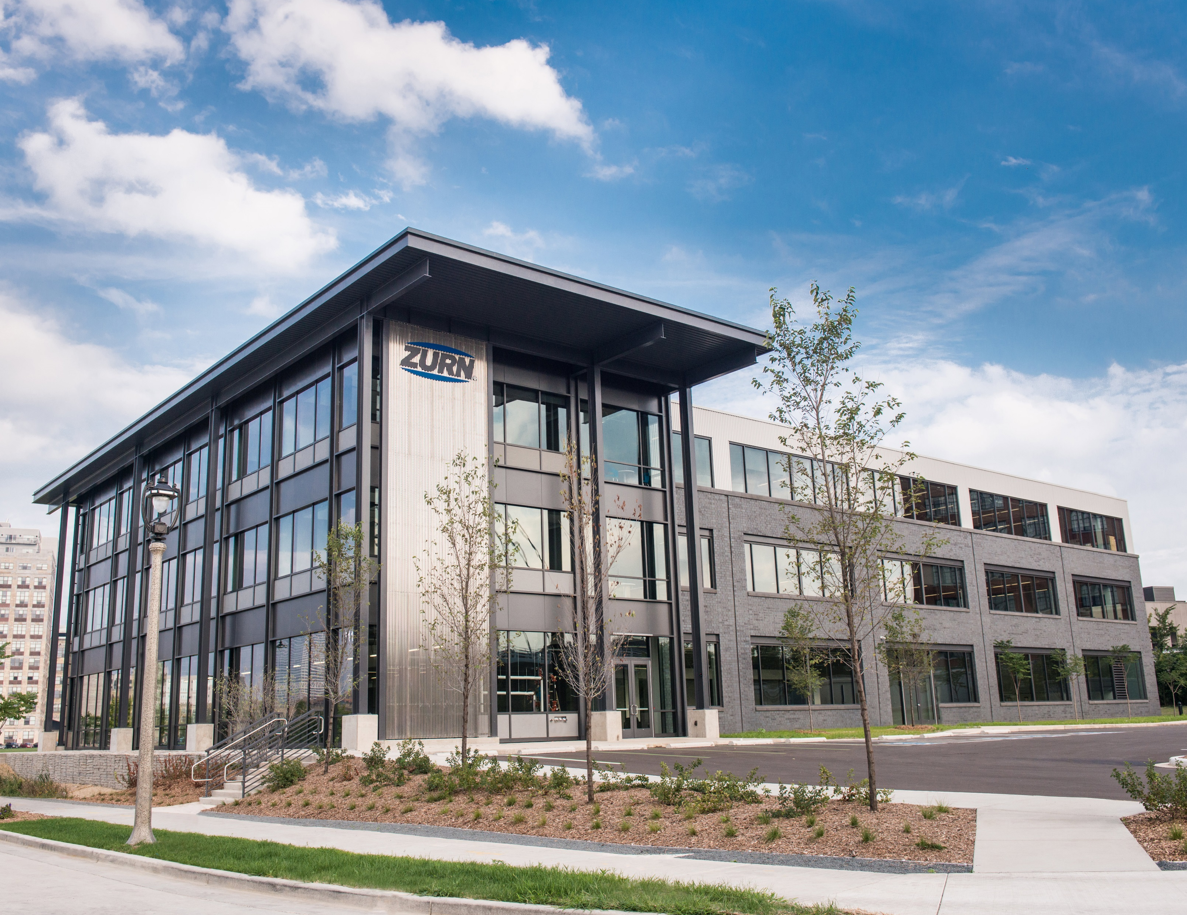
Zurn manufactures the industry spectrum of advanced water solutions – spanning building water safety, site drainage, behind-the-wall systems, and front-of-wall fixtures and trim.
We’re focused on solving smarter for the customer through continuous improvement.
Our innovative thinking keeps us forging ahead in customer service, specification and design expertise, lean construction, and products that provide low lifecycle costs.

Slide 4
Our customers and markets
building owner
architect & engineer
contractor
“I need products that are aesthetically pleasing, durable and have a low total cost of ownership + require minimum downtime for maintenance.”
“I need products that are aesthetically pleasing, durable and cost-effective.”
“I need products that are easy and cost-effective to install and maintain, that are assembled and packaged in manner that streamlines labor.”
Healthcare | Retail | Food Service | Hospitality | Restaurants | Institutional/Education | Government

Slide 5
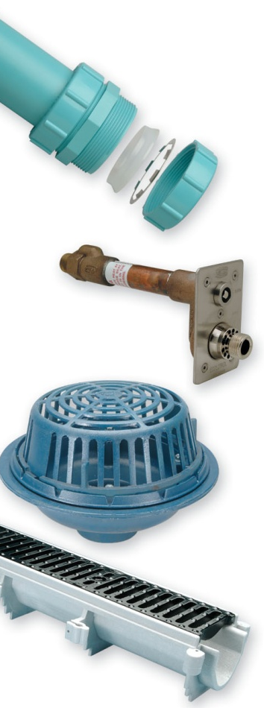
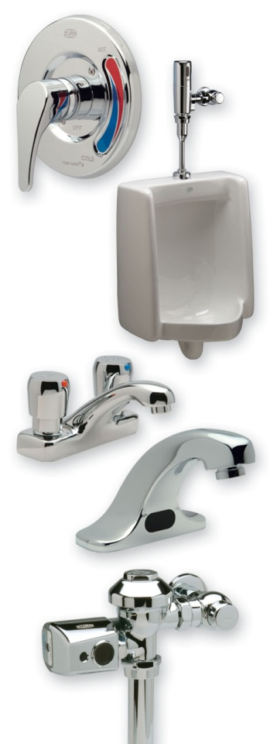
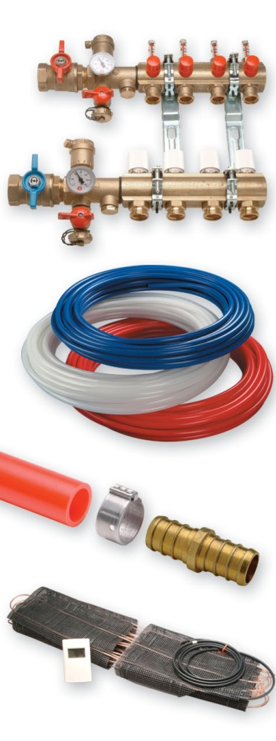
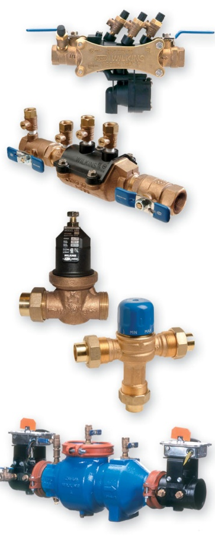
Zurn Products

Slide 6
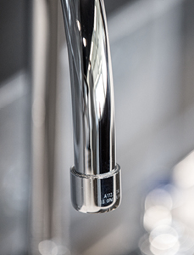
With product systems designed to work better together, Zurn simplifies commercial plumbing through our breadth of high-quality, low-maintenance products.
Finish Plumbing
_____________________________________________________________________________________________
Zurn One Systems
Fixtures
Faucets
Flush Valves
Showering
Tubular Brass

Slide 7
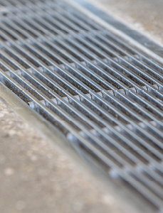
Engineered for easy layout and installation, Zurn’s trench drain systems deliver the industry’s lowest total installed cost to the site owner.
Trench Drain Systems
_____________________________________________________________________________________________
Trench Drains
Catch Basins
Separators
Frame & Grates

Slide 8
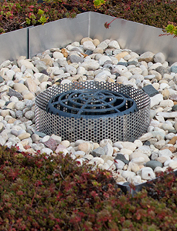
Zurn’s complete package of building drainage and rough plumbing products drive efficiencies while reducing labor throughout the construction process.
Building Drainage
_____________________________________________________________________________________________
Roof Drains
Floor Drains
Cleanouts
Carriers & Fixture Supports
Floor Sinks
Stainless Steel Drainage
Backwater Valves
Traps Primers & Specialties
Hydrants
Water Hammer Arrestors
Light Commercial

Slide 9
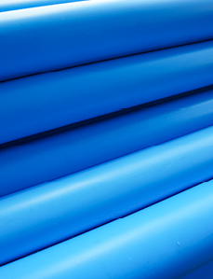
Zurn’s chemical drainage products are made with polypropylene and plenum-rated PVDF components for dependable chemical resistance and a leak-free drainage line.
Chemical Drainage
_____________________________________________________________________________________________
Pipe
Fittings
Drains & Cleanouts
Neutralization Products
Tools
Specialties

Slide 10
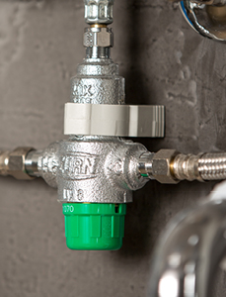
Zurn water control products are designed to be easily installed, easy to maintain and to last for the life of the system, saving time and money.
Water Control
_____________________________________________________________________________________________
Automatic Control Valves
Pressure Reducing Valves
Thermostatic Mixing Valves
Dielectric Unions
Water Hammer Arrestors
Relief Valves
Security
Shut Off Valves
Wye Strainers
Thermal Expansion

Slide 11
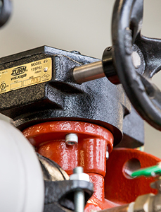
Zurn’s product reliability is critical for worldwide drinking water systems. Our backflow preventers are tried and tested to protect people from potentially life-threatening potable water contamination events.
Water Safety
_____________________________________________________________________________________________
Backflow Prevention
Fire Valve

Slide 12
Zurn’s PEX pipe fittings and accessories are secure, reliable and quickly installed. Our products are manufactured to the highest industry standards and certified for the highest UV and chlorine resistance in the industry. All Zurn PEX products are backed by an industry-leading 25-year warranty.
PEX / Cross Linked Polyethylene
_____________________________________________________________________________________________
Plumbing
Radiant Heating Snow Melting & Turf Conditioning
Residential Fire Safety

Slide 13
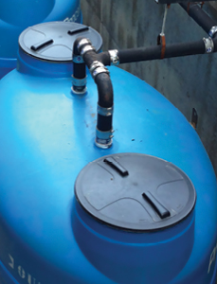
Zurn’s interceptors keep you in compliance with the lowest total cost of ownership, best warranty in the industry, and highest peace of mind.
Grease, Oil & Sediment Separation
_____________________________________________________________________________________________
Grease Interceptor
Oil & Solids Interceptor
Sediments & Solids Interceptor
Hair & Lint Interceptor
Options

Slide 14
Zurn specification strategy from project start through occupancy

Slide 15
Zurn value to our customers
Building Owner
Architect & Engineer
Contractor
Water efficiency, sustainability, & lowest total cost of ownership
Ease of specification through digital tools and world-class sales & service
Lean construction
ease of maintenance & support

