Slide 1
Zurn Wilkins Pressure Reducing Valves – Overview
February 18, 2019

Slide 2
agenda what you’ll learn
01
value proposition
02
how it works
03
features & benefits
04
design & specify
05
summary
06
resources

Slide 3
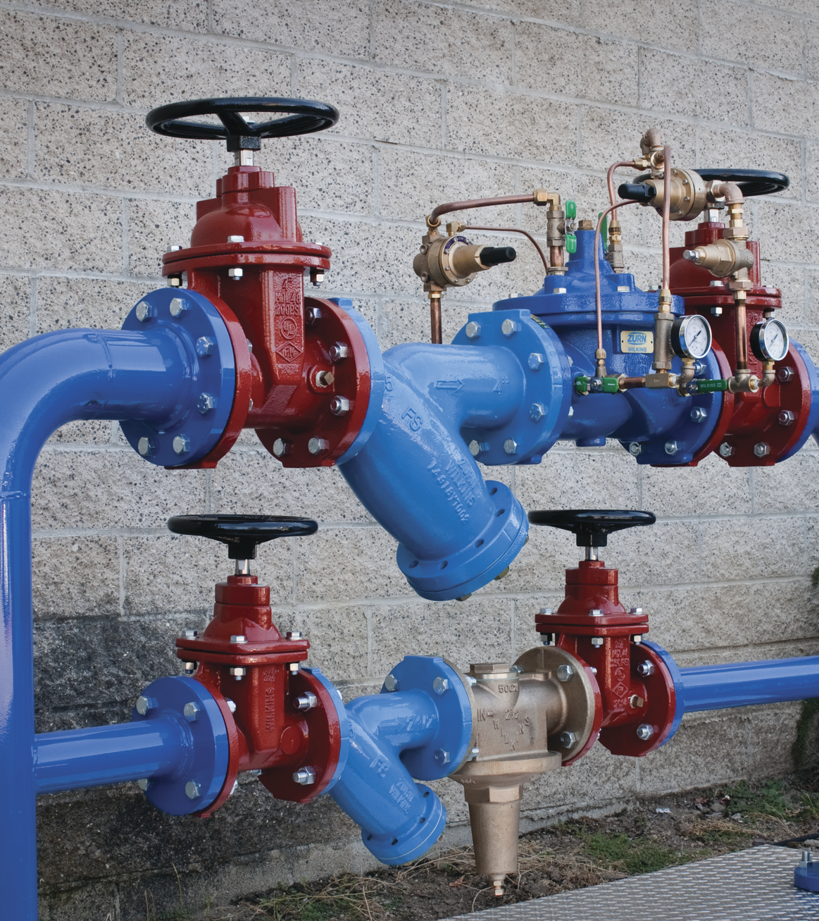
For building owners, engineers, and contractors,
Zurn Wilkins provides time tested, contractor favored pressure reducing valves that reduce high inlet pressure from the municipal water supply to a lower outlet pressure, to protect plumbing systems and meet code requirements while providing the lowest total cost of ownership with corrosion resistant designs and materials

Slide 4
voice of customer industries
building owner
architect & engineer
contractor
“I need products that are durable and have a low total cost of ownership + require minimum downtime for maintenance.”
“I need products that are durable, cost-effective and perform.”
“I need products that are easy and cost-effective to install and maintain, and always function properly to minimize call backs”
Healthcare | Retail | Food Service | Hospitality | Restaurants | Institutional/Education | Government

Slide 5
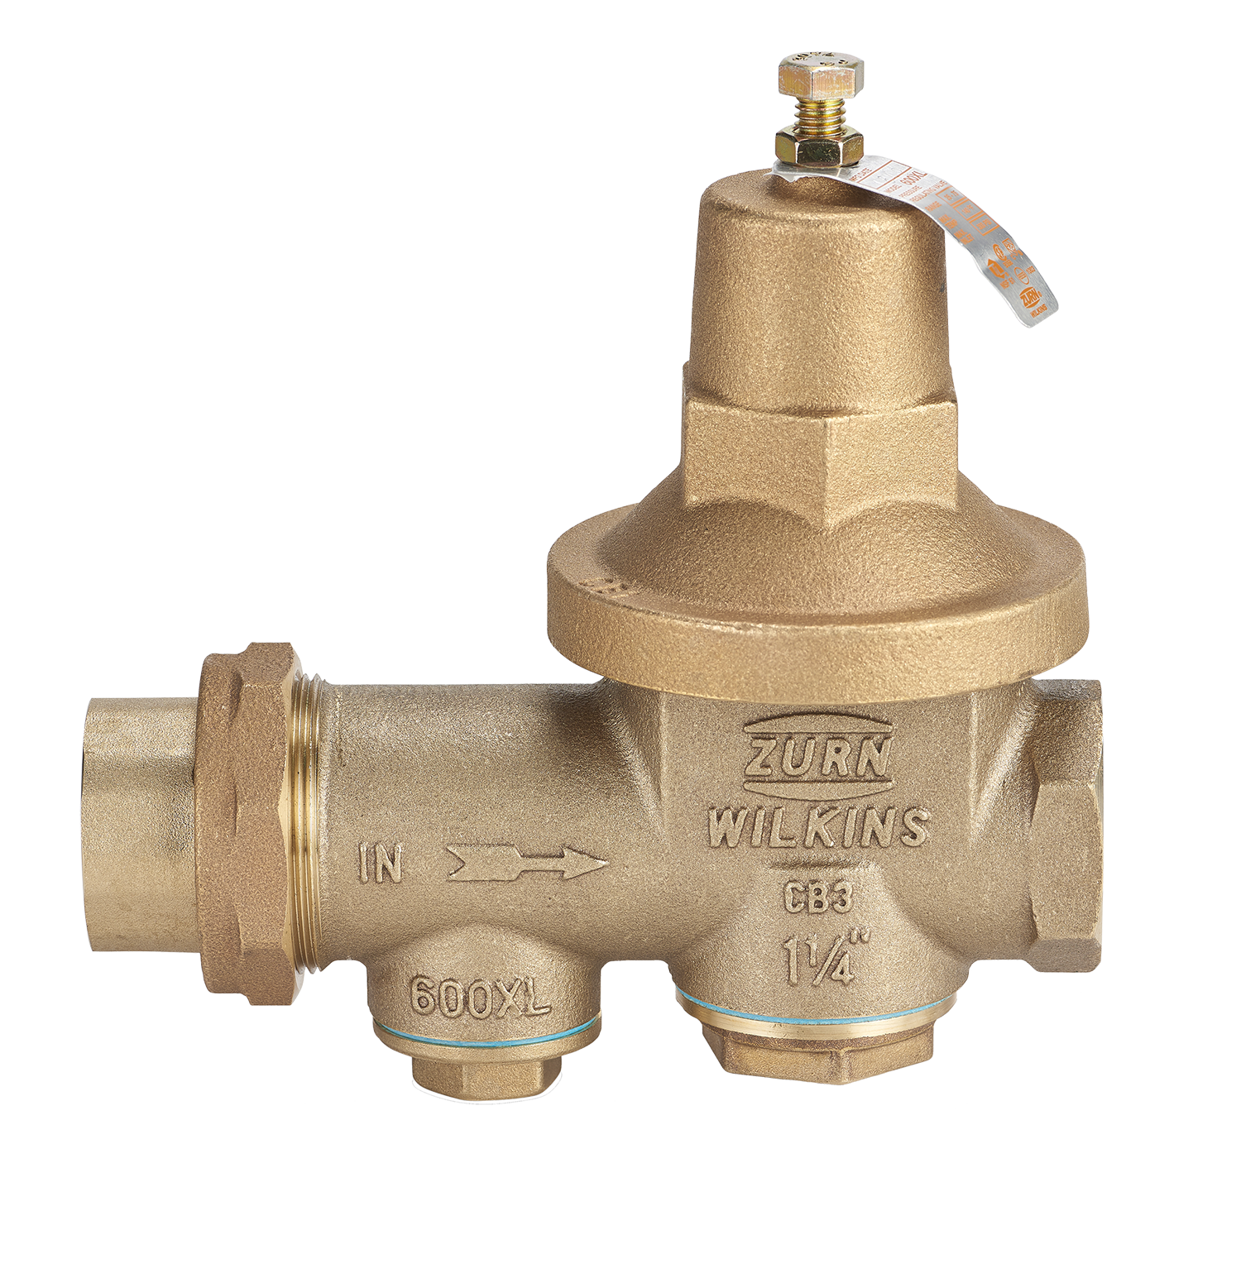
benefits of installation pressure reducing valves
key benefits
plumbing code compliance (UPC)
PRVs are required by code if the incoming pressure is 80 PSI or above
water conservation
An average home can save 30,000 to 40,000 gallons a year by reducing pressure from 100 PSI to 50 PSI
energy conservation
As less water is used, less water is heated by the water heater, thus saving energy
protection of the water system
Reducing system pressure decreases the frequency of catastrophic line bursts by maintaining manageable pressure
Lower pressure also leads to increased longevity of all other components in the water system
safety
High pressure can lead to dangerous situations such as water hammer
NEW PHOTO

Slide 6
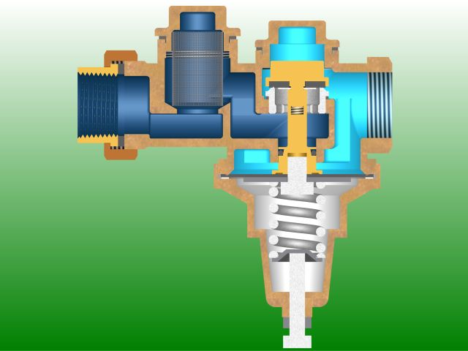
how it works step-by-step
Adjustment Bolt
static (no) flow
When demand ceases, the downstream pressure rises, counter-balancing the spring force, and the valve closes
Note: inlet pressure has nothing to do with the pressure of the valve
Spring
(loading element)
Diaphragm
(sensing element)
Stem o-ring
Stem
Seat
Seal Ring
Plunger

Slide 7
how it works step-by-step
normal flow
A drop in downstream pressure due to demand, allows the spring to push the plunger off the seat, allowing flow to occur
Spring
Flow Direction >>
Seat
Plunger

Slide 8
how it works step-by-step
increased downstream demand
Again, the drop in pressure due to the increase in demand causes the plunger to move farther away from the seat. Thus, the increase in demand is satisfied
Seat
Plunger

Slide 9
how it works step-by-step
integral bypass closed
The o-ring is pushed to the narrow section
of the gland by the inlet water pressure,
thereby closing the bypass
integral bypass open
The o-ring is moved to the wide section
of the gland and is no longer able to seal when downstream pressure exceeds inlet pressure,
thereby opening the bypass
o-ring
All PRVs are required to have a bypass that allows excess pressure created within the system from thermal expansion to push back through the PRV. With backflow preventers, this bypass will not work but is still in the standards for PRVs. Zurn uses a patented O-ring bypass that is less susceptible to corrosion than other brands

Slide 10
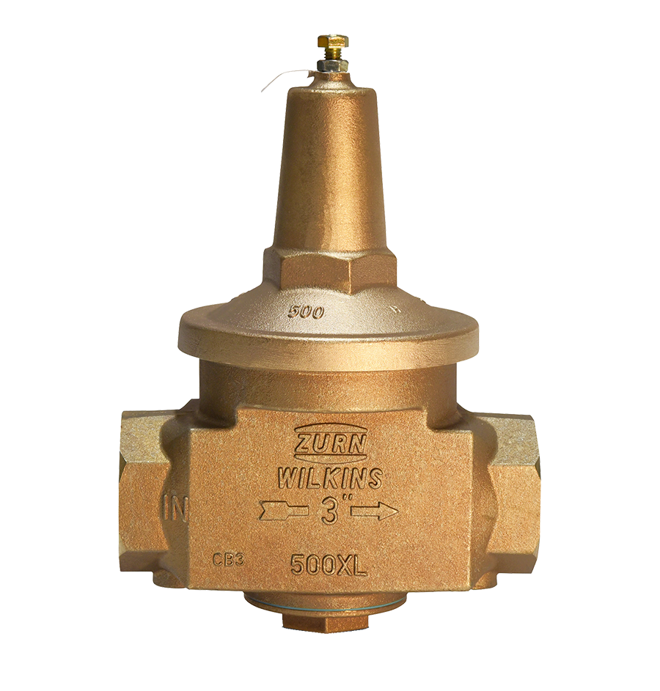
Test Your Knowledge
How do Zurn pressure reducing valves function when a faucet or other fixture is used?
Place the following in the correct order:
When demand ceases, the valve senses rising pressure on the downstream side of the valve and closes
A drop in pressure is sensed on the downstream side of the valve by the diaphragm allowing the spring to push the plunger off the seat and the valve opens
Increased demand causes a drop in pressure on the downstream side of the valve and the spring pushes the plunger and seal ring farther away from the seat allowing the valve to open more to satisfy demand

Slide 11
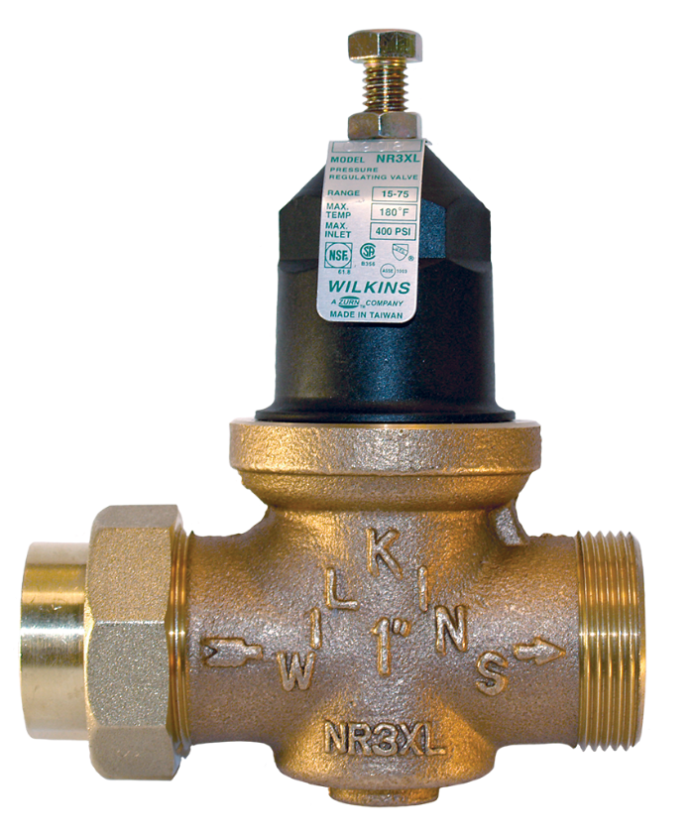
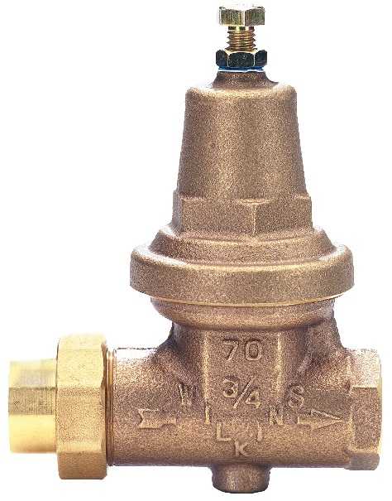
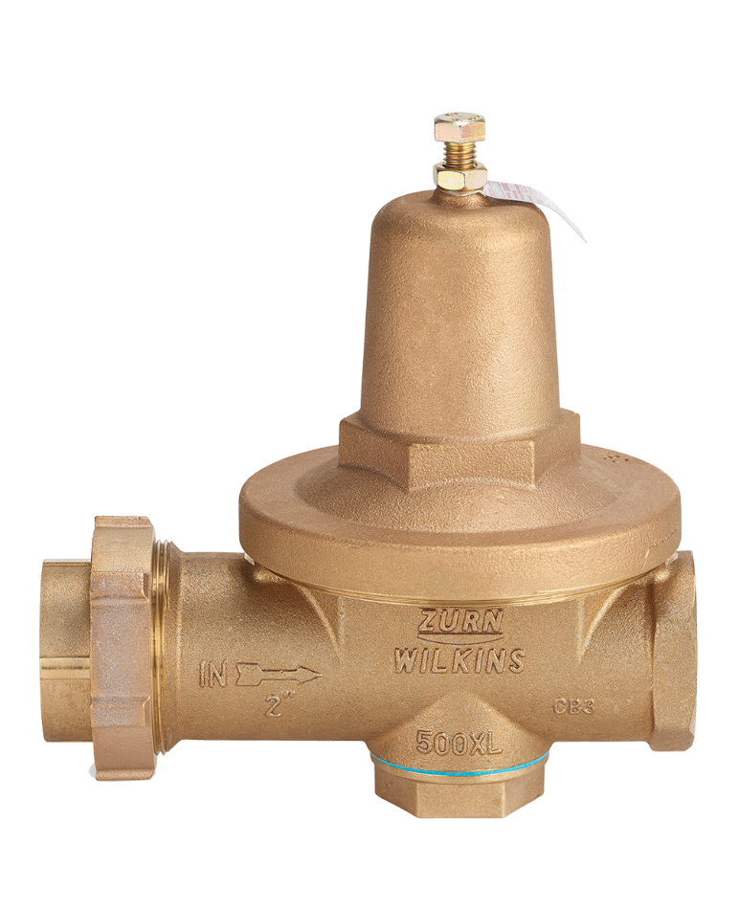
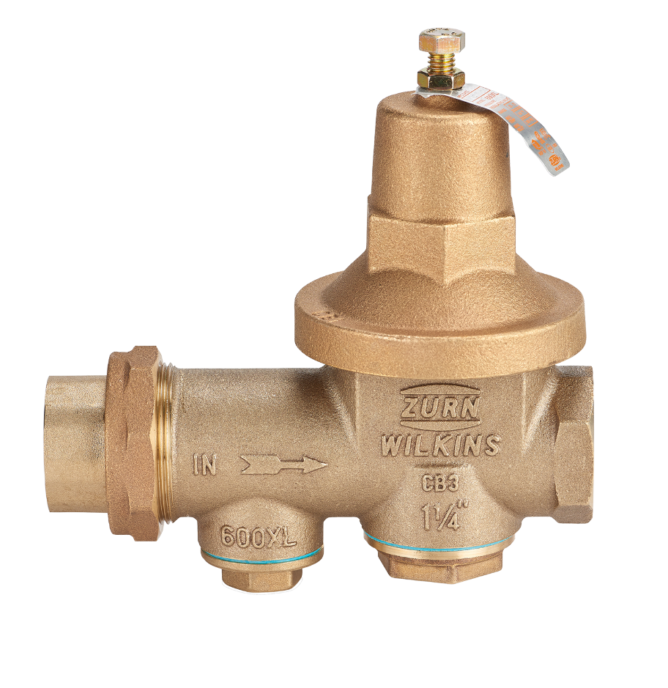
features & benefits for all Zurn pressure reducing valves
key features
Corrosion-resistant lead-free bronze or
reinforced nylon composite construction (stronger than bronze)
Zurn manufactured the first threaded bell and uses this extensively
Hex on bell, for greater repair access
Widest range of end connections
Horizontal or vertical installation
Retrofit specific models
*a.k.a. pressure regulators
2:59 Video:
Zurn Wilkins Pressure Reducing Valves

Slide 12
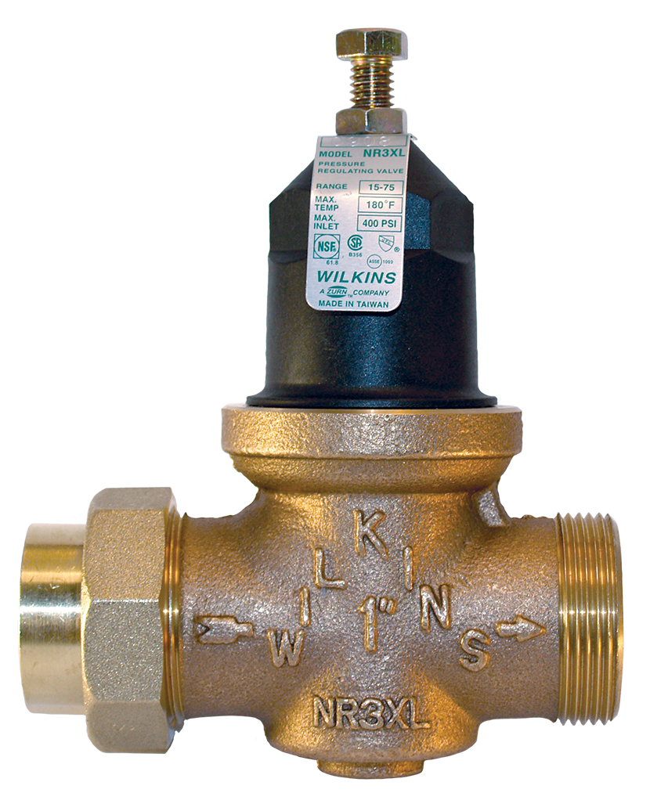
features & benefits NR3XL series
NR3XL pressure reducing valve with
reinforced nylon composite bell (stronger than brass)
for residential and light commercial applications
for residential applications
Durable composite bell housing resists corrosion;
Threaded bell + cartridge design is easy to repair
key features
½”, ¾”, 1”, 1 ¼”, 1 ½”, 2” sizes
Compact design with short lay length allows installation in tight spaces
Labor saving tailpiece options ease installation, including crimp PEX, expansion PEX, threaded, copper sweat, CPVC connections.
Stainless steel strainer screen to catch debris

Slide 13
features & benefits 70XL pressure reducing valve
70XL pressure reducing valve
contractor favorite for 40+ years
For residential and commercial customers
with extreme stability, ruggedness, and ease of repair
key features
¾”-1” sizes
Cast bronze body and bell with stainless steel components
20 mesh stainless steel strainer screen
single union or double union connections

Slide 14
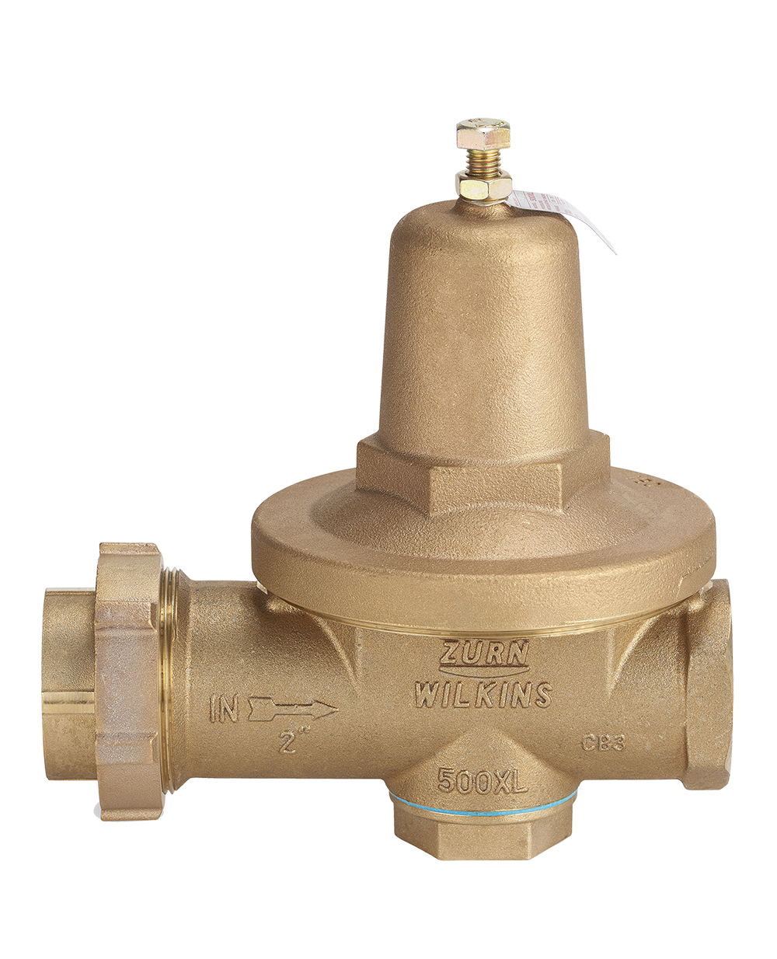
features & benefits 500XL series
500XL pressure reducing valve, with high flow rates and low fall-off
for high flow rates and low fall-off
For commercial or industrial pressure reduction applications + commercial irrigation
key features
½”-3” connections; 2½” and 3” are flanged for heavy duty commercial use
Balanced design enables the regulator to react in a smooth and responsive manner to changes in system flow + provide protection
Cast bronze body and bell with stainless fasteners
Often paired with a wye strainer and sold as a 500XLYSBR. There is no internal strainer for improved flow

Slide 15
features & benefits 600XL series
600XL has a superior corrosion resistant, bronze threaded bell speeds access to internals, reducing labor by 50% compared to competitor bolted style
for sandy, debris laden systems
Integral strainer cap allows for frequent and easy cleaning;
for high flow capacity in residential and commercial applications
key features
½”, ¾”, 1”, 1 ¼”, 1 ½”, 2” sizes
Balanced design enables the regulator to react in a smooth and responsive manner to changes in system flow demand + provides protection from inlet pressure changes
Cast bronze body and access covers, with stainless steel fasteners
Separate port with stainless steel strainer screen to catch debris
3:37 Video:
Zurn Wilkins Pressure Reducing Valves 600XL and 625XL

Slide 16
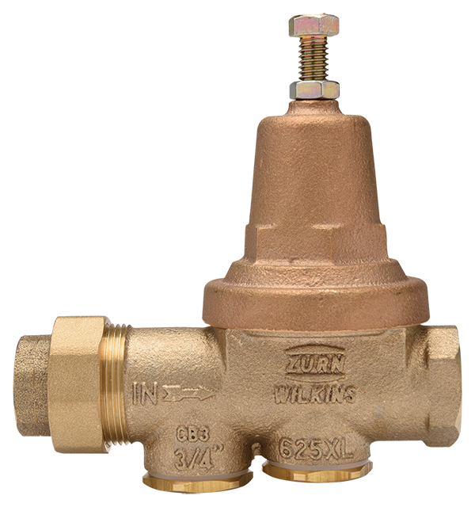
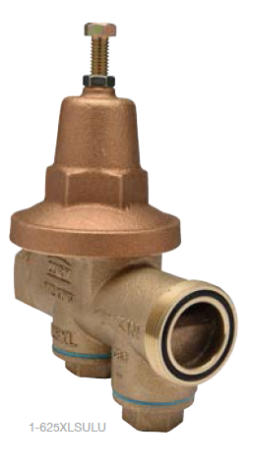
features & benefits 625XL
The 625XL is a direct competitor drop in replacement and offers all the benefits of the 600XL.
for competitor replacement
Direct drop-in replacement eliminating re-piping
Integral strainer cap allows for frequent and easy cleaning; for high flow capacity in residential and commercial applications
key features
Direct drop-in replacement to the Watts 25AUB allowing you to eliminate re-piping providing significant savings in material, time, and total installation cost
½”, ¾”, 1”, 1 ¼”, 1 ½”, 2” sizes
Cast bronze body and access covers, with stainless steel fasteners
Separate port with stainless steel strainer screen to catch debris
34-625XL pressure reducing valve drop-in replacement
for the Watts 25AUB
34-625XLSULU pressure reducing less union assembly replacement using the existing Watts 25AUB union nut
Notes:
Raftery
Direct drop-in replacement for the Watts 25AUB
Watts 25AUB is their#1 selling PRV so many are out in the field
In the past like-for-like has been most replacements an prior to the 625XL this would have required re-piping
Huge opportunity to take over the market with a superior product due to ease of the 625XL as a direct drop-in replacement
Launched January 2017

Slide 17
features & benefits item

Slide 18
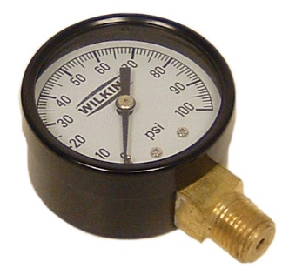
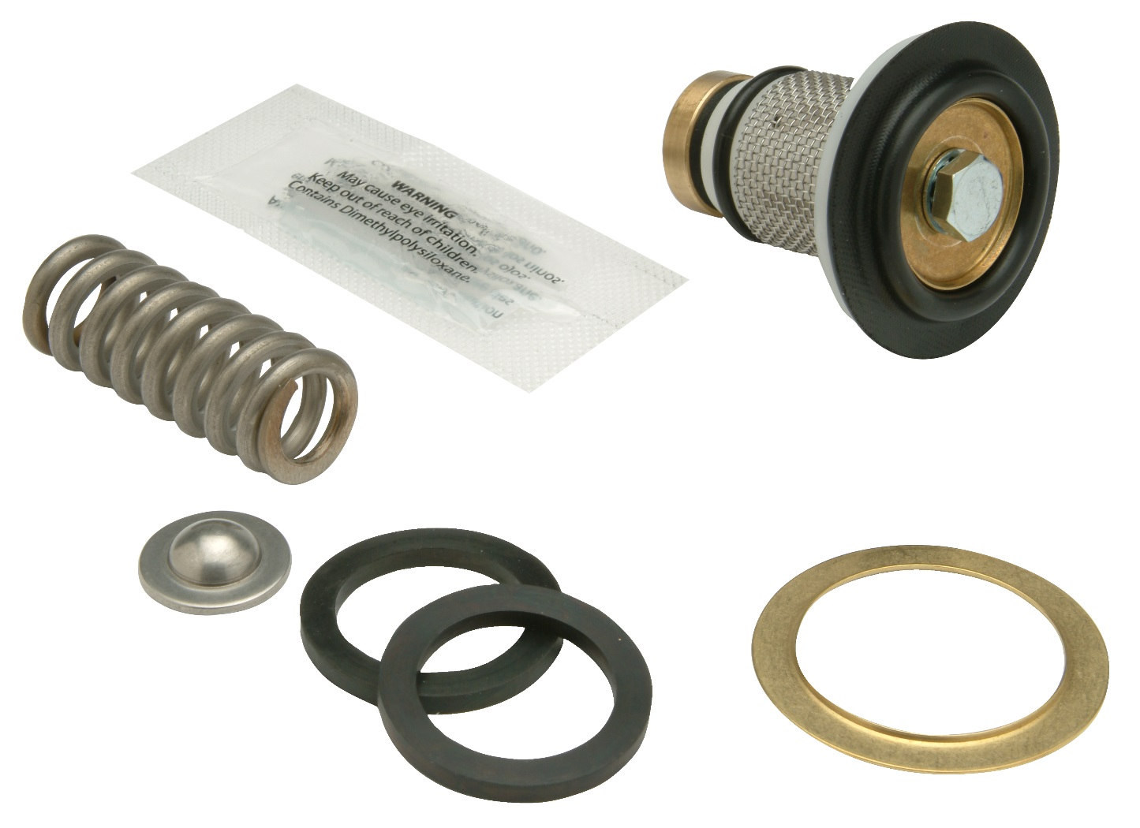
features & benefits options
92-95 and 92-95A pressure gauges, to monitor and set system pressure of Zurn Wilkins pressure reducing valves
Complete repair kits, available for all models
2”-4” dial sizes
Ranges 0-400

Slide 19
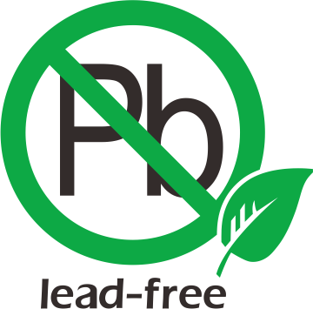
features & benefits questions
How do you ensure that you have the most dependable pressure reducing devices? | Use Effectively reduces high inlet pressure Protects plumbing system Meets code requirements Water conservation | Dependable Pressure Reduction Water Savings
What makes Zurn pressure reducing valves a contractor favorite for 40+ years? | Design & Specify Zurn Online Specification Tools Durable bronze and composite construction Residential, commercial, industrial Time tested, contractor favored Lead-free Customizable tailpieces | Highly Durable Superior Corrosion Resistance Contractor Favored
How important is ease of installation? | Install Zurn One Systems/ease/speed/quick shipping availability/affordability [component name/specification] Horizontal or vertical installation Retrofit | Ease of Installation
How important is ease of maintenance & repair? | Support Repair ease Threaded on bell with hex Complete repair kits | Ease of Maintenance & Repair

Slide 20
Test Your Knowledge
What are Zurn pressure reducing valves’ top 3 benefits?
Ease of installation and maintenance with superior corrosion resistance
Highly durable construction, contractor favored
Prevents back siphonage
Dependable, code-compliant pressure reduction

Slide 21
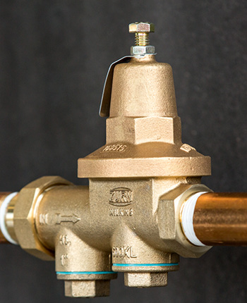
how to specify step-by-step
1
desired flow
Multiple valves in parallel?
2
pressure
Inlet and outlet; allowable fall-off
3
application
Outdoors or high temperature…
4
other factors
Corrosion resistant, ease of repair and maintenance…

Slide 22
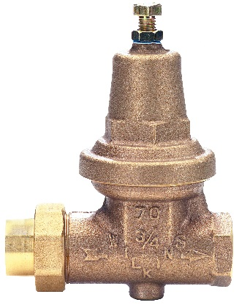
design & specify pressure reducing valves
PRESSURE REDUCING VALVES | 70XL | 500XL For high flow rates and low fall-off | 600XL / 625XL For sandy, debris laden water requiring frequent cleaning | NR3XL Corrosion resistant plastic cartridge
Residential | Residential |  | Residential | Residential
Light Commercial | Light Commercial |  | Light Commercial
Commercial |  | Commercial | Commercial
Industrial |  | Industrial
Potable Line Options | For Potable Water | For Potable Water | For Potable Water | For Potable Water
Size ½”, ¾”,1”, 1-1/4”, 1/2”, 2” or greater | ¾”, 1” | ½” – 3” | ½” – 2” | ½” – 2”
Max Working Pressure | 300 psi max | 300 psi max | 300 psi max | 400 psi / 300 psi max
Reduced Pressure Range | 25 psi – 75 psi; factory set to 50 psi | 25 psi – 75 psi | 25 psi – 75 psi | 15 to 75 psi; factory set to 50 psi
Connections | Single Union Female NPT (Standard) + DUC, DU, DULU and Copper options | Single Union Female NPT (Standard) | Single Union Female NPT (Standard) | Single Union Female NPT (Standard) CPVC, PEX
Max Working Water Temperature | 140 °F max | 140 °F max | 140 °F max | 140 °F max
Ease of Repair | Easy repair |  |  | Easy repair
Other | Replaceable cartridge Integral stainless steel strainer | Corrosion-resistant internal parts | For quick, easy competitor replacement. separate integral stainless steel strainer cap with separate access cover | Replaceable acetal cartridge with integral stainless steel strainer; short lay length for easy retrofit

Slide 23
design & specify installation configurations

Slide 25
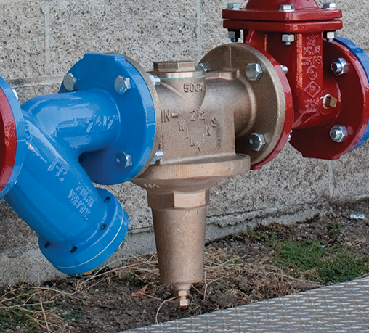
Test Your Knowledge
Place the following specify steps in the correct order:
A. Application
B. Desired flow
C. Other factors
D. Pressure

Slide 26
design & specify tools
Create unlimited configurations
Solidify your basis of design
Generate your submittal package
Edit, share and copy projects
Zurn.com tools
inSpec | Create configurations, solidify your basis of design, generate your submittal package, edit/share/copy projects
Manufacturer Cross Reference | Select a manufacturer, then product, type, or competitor product number to find the corresponding Zurn Product
ARCAT | Review CAD, BIM, and spec files
MasterSpec | Review spec files
BIM/Revit Files | Browse BIM objects
Cross Reference Guides | Review cross reference guides for individual products
Product Warranties | Review One Zurn terms and conditions

Slide 27
summary what you learned
building owner
architect & engineer
contractor
Highly Dependable Pressure Reduction Durable, Lead-Free Materials Water Savings
Reliable and Durable Devices
Space-Saving Devices
Code Compliant
Contractor Favored
Easy Installation, Maintenance, and Repairs
Corrosion Resistant

Slide 28
summary Zurn overview
For more than a century, Zurn Engineered Water Solutions® has established itself as an innovator and leading manufacturer of highly engineered water product solutions.
Markets We Serve
Zurn Engineered Water Solutions is a recognized leader in commercial, municipal, and industrial markets, delivering sustainable building solutions for new construction and retrofit applications.
Industry Leading Product Lines
The Zurn product offering includes items such as specification drainage products, manual and sensor operated flush valves, radiant heating systems, snow melt systems, trench drain systems, backflow and fire protection systems, and much, much more.
Solutions We Provide
At Zurn we are committed to providing smart solutions that save time and money. Our goal is serving the customer through innovation, continuous improvement, and assurance behind every installation.
One Choice. One Zurn.
Choose Zurn for a reliable, recognized manufacturer to supply your entire installation, from behind the wall rough-in, to finished trim product and fixture systems.

Slide 29
resources support
address
phone
online
511 Freshwater Way
Milwaukee, WI 53204
toll-free 1-855-ONE-ZURN
zurn.com
Product Pages | Tools, Specifications, & Resources | Vertical Market Solutions
inSpec | Manufacturer Cross Reference | ARCAT | MasterSpec | SpecBuilder |
Specifiers | BIM/Revit Files
zurn.com/resources/product-training
Zurn Product - Overview
How to Install and Support
facebook.com/ZurnIndustries
twitter.com/ZurnIndustries
linkedin.com/company/ZurnIndustries
youtube.com/ZurnIndustriesLLC

