Slide 1
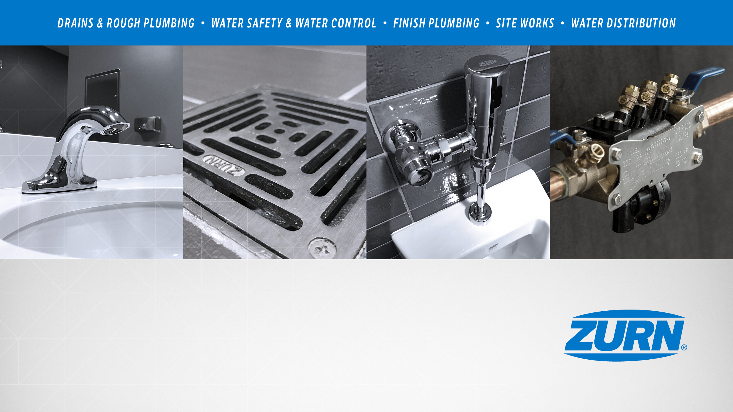
Zurn Trench Drain Systems - Overview
July 25, 2019

Slide 2
agenda what you’ll learn
01
value proposition
02
how it functions
03
features & benefits
04
design & specify
05
summary
06
resources

Slide 3
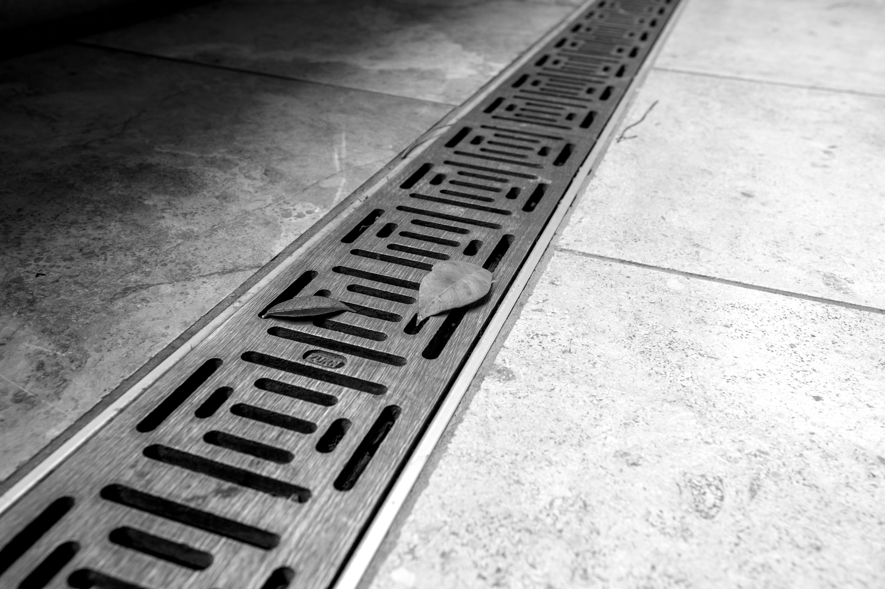
Zurn Industries provides trench drain systems
for the collection, storage, and conveyance of storm water, chemical and processing wastewater discharge, and nuisance runoff. All systems feature upfront design consultation, simplified installation, and quality performance.

Slide 4



voice of customer industries
building owner
architect & engineer
contractor
“I need products that are aesthetically pleasing, durable and have a low total cost of ownership + require minimum downtime for maintenance.”
“I need products that are aesthetically pleasing, durable, cost-effective, and meet specifications.”
“I need products that are easy and cost-effective to install, that are assembled and packaged in a manner that streamlines labor.”
Areas of Recreation, Hospitality, Healthcare – Collection and Removal of Water
Areas of Transportation – Collection and Removal of High Capacity Water
Chemical Processing Plants – Chemical Resistant Requirements
Food Processing Plants – Collection and Removal of Water and Processed Materials
Energy / Power Plants – Large Width / High Capacity
Waste Water Treatment Plants – Containment, Storage, Sludge, Compost
General Processing Facilities and Plants – Collection and Removal of Nuisance Water

Slide 5
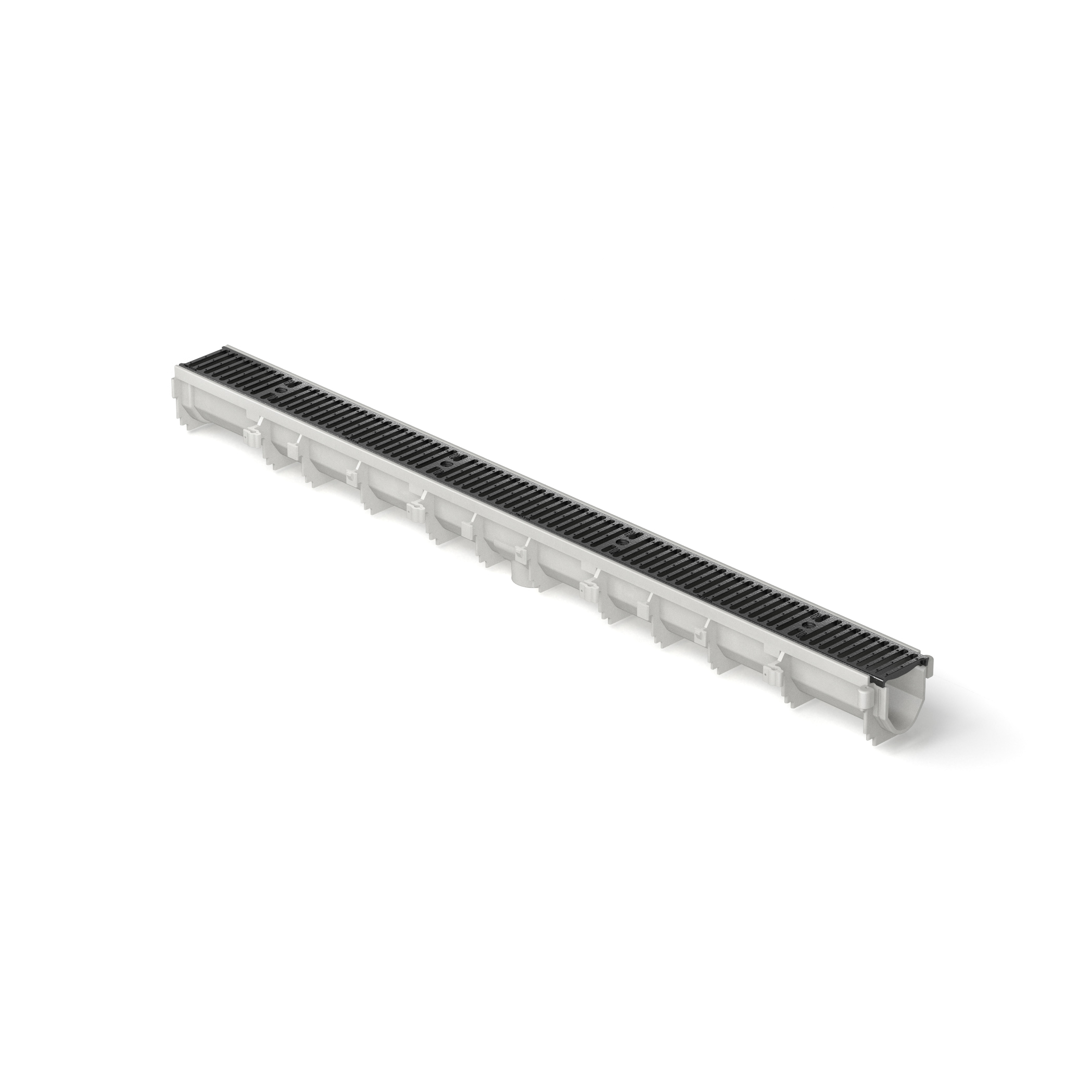
how it works step-by-step
1
collect
material (water, processing/chemical wastewater) enters the trench drain system through a grate
2
flow
material travels down the pre-sloped trench drain system via gravity and flow
Z886 Perma-Trench®
3
redirect
material reaches municipal pipelines or collection areas
:53 Video:
Zurn Trench Drain Systems

Slide 6

Test Your Knowledge
What are the functions of Zurn trench drains?
Choose one or more of the following:
Collect fluid runoff
Convey fluids by gravity and hydraulic flow
Transfer fluids to storage or to discharge piping

Slide 7
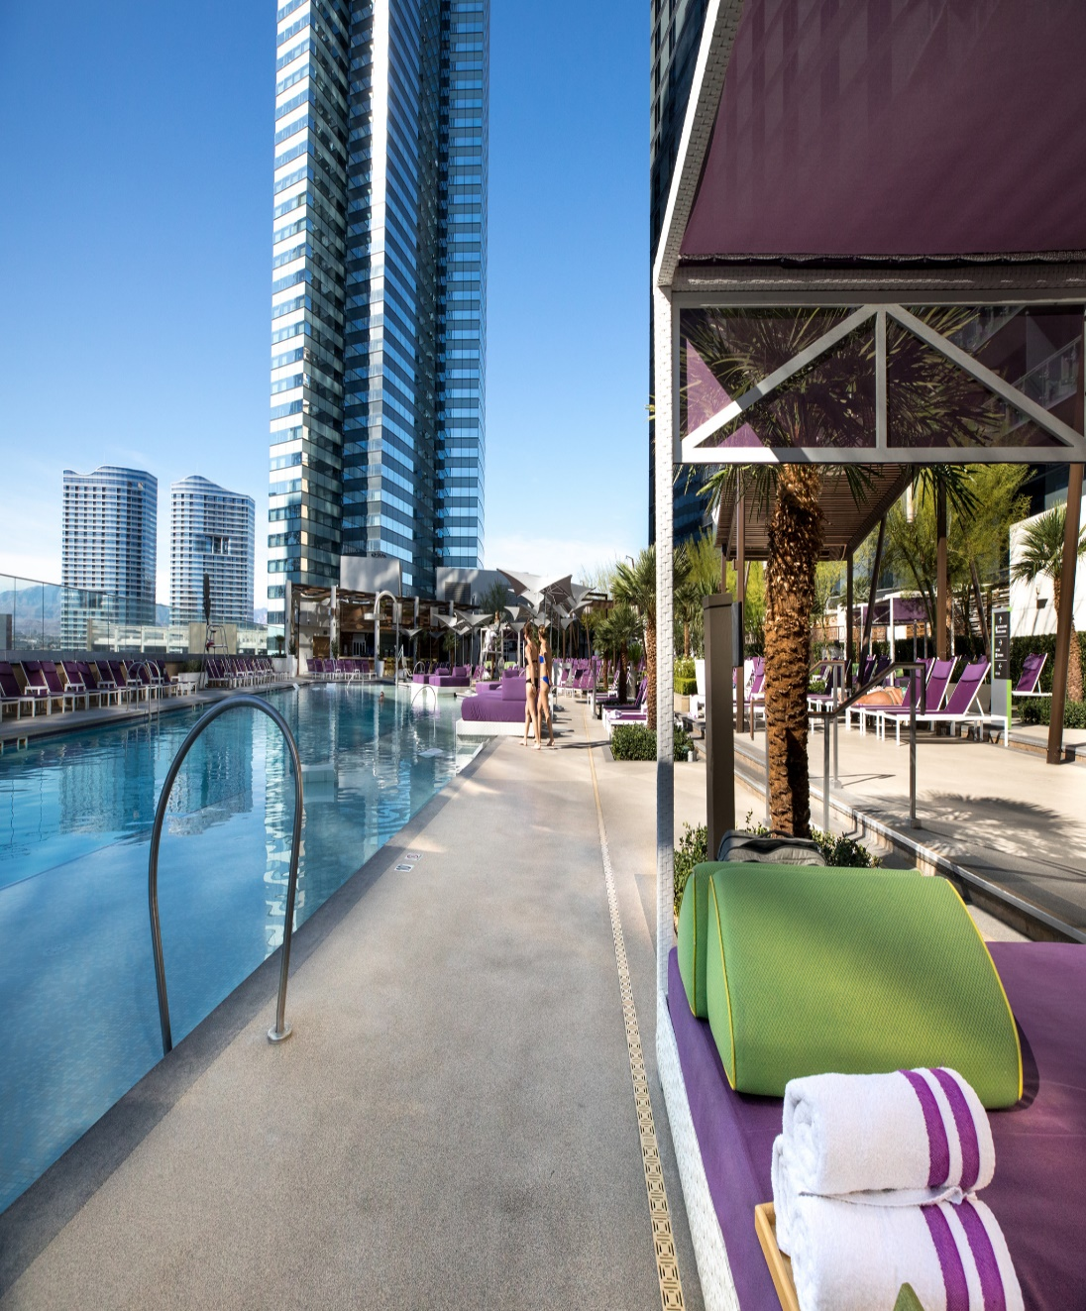
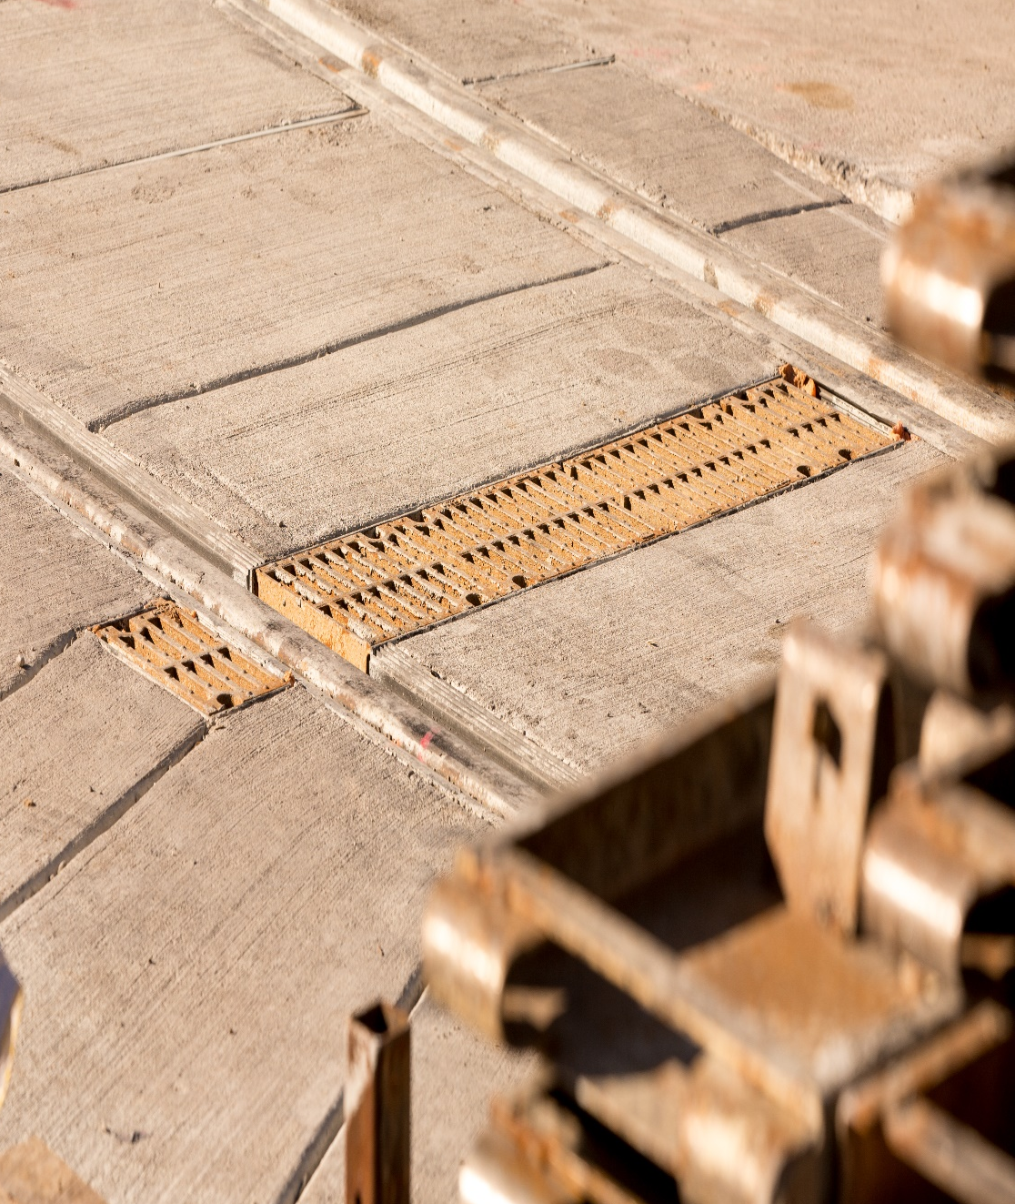
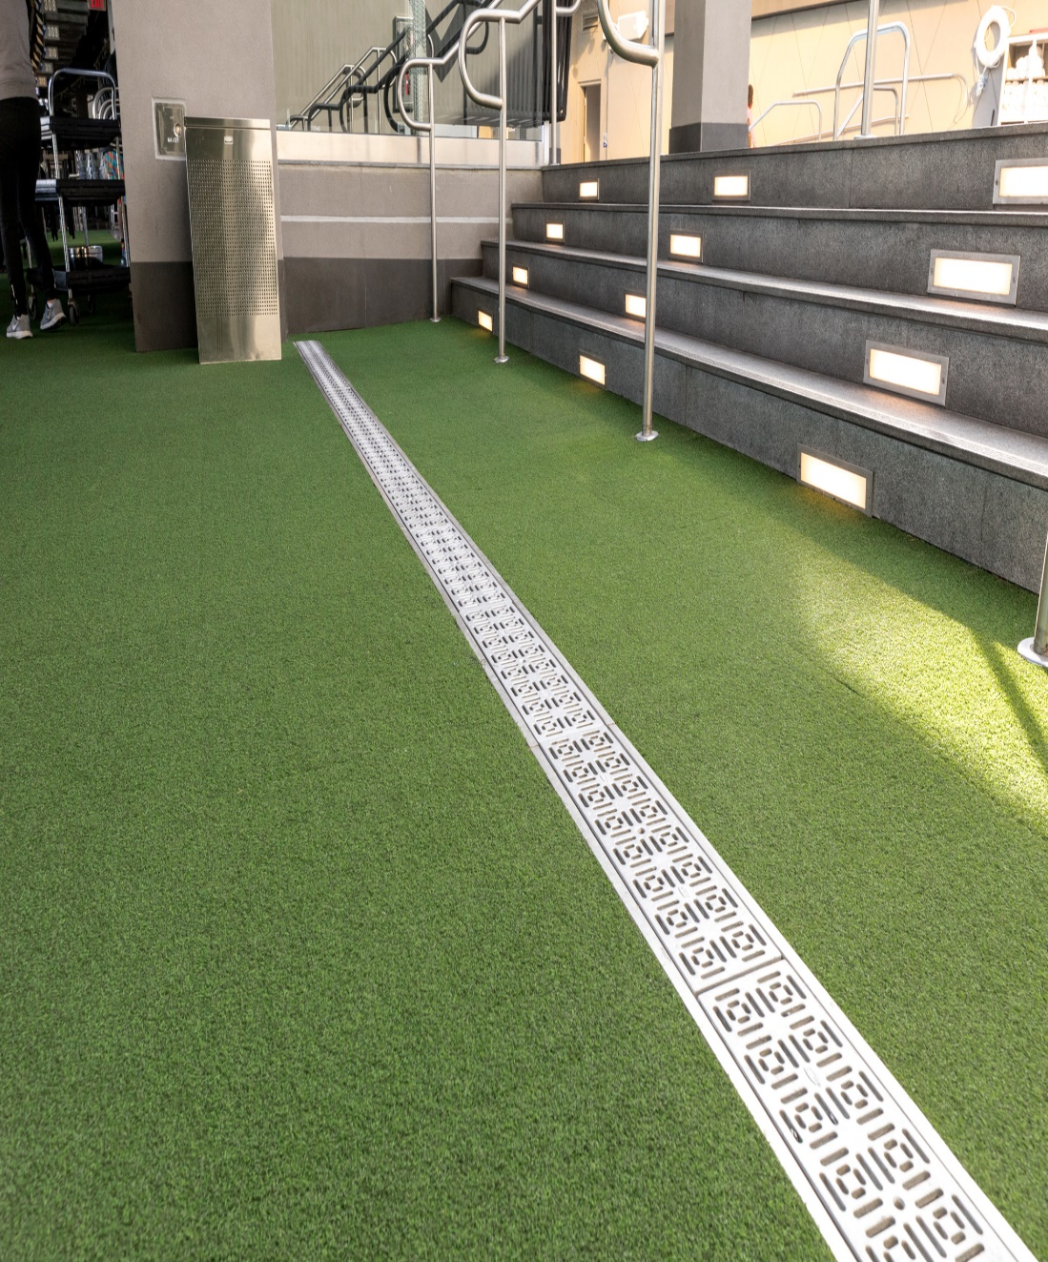
Flo Thru markets
RECREATIONAL/RESIDENTIAL | INDUSTRIAL | CIVIL/TRANSPORTATION | COMMERCIAL

Slide 8
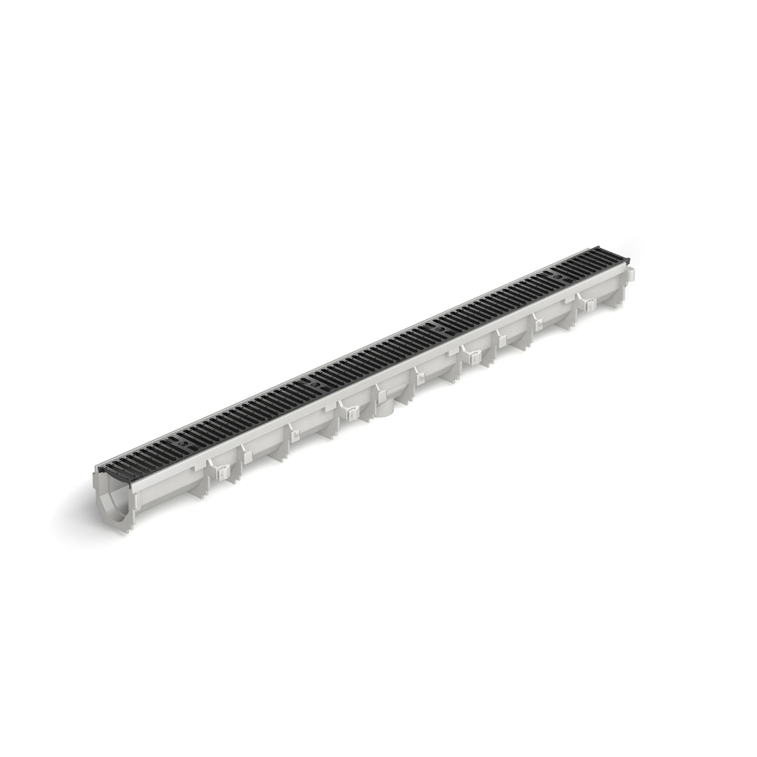
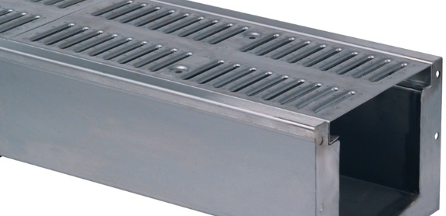
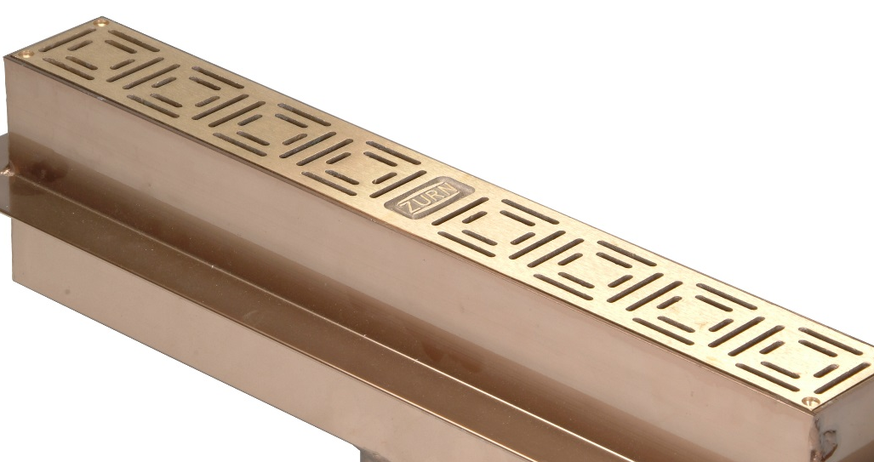
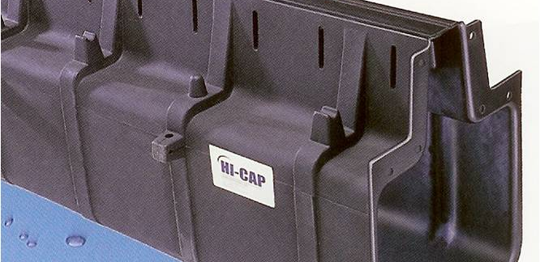
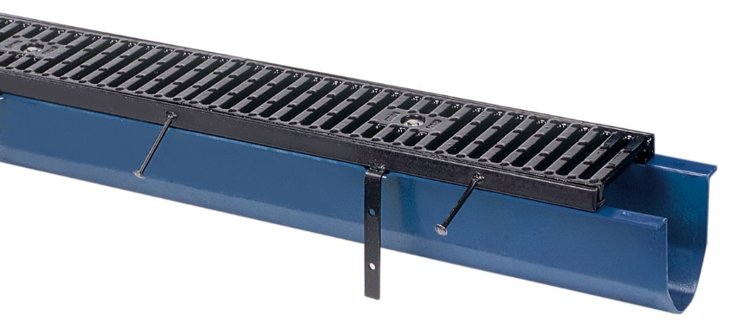
Flo Thru breadth of line
HDPE (HIGH DENSITY POLYETHYLENE)
STAINLESS
ALUMINUM
LLDP (LINEAR LOW DENSITY POLYETHYLENE)
FIBERGLASS
Pre-engineered, modular trench systems designed for ease of installation, load bearing strength, hydraulics, chemical resistance, and structural integrity

Slide 9
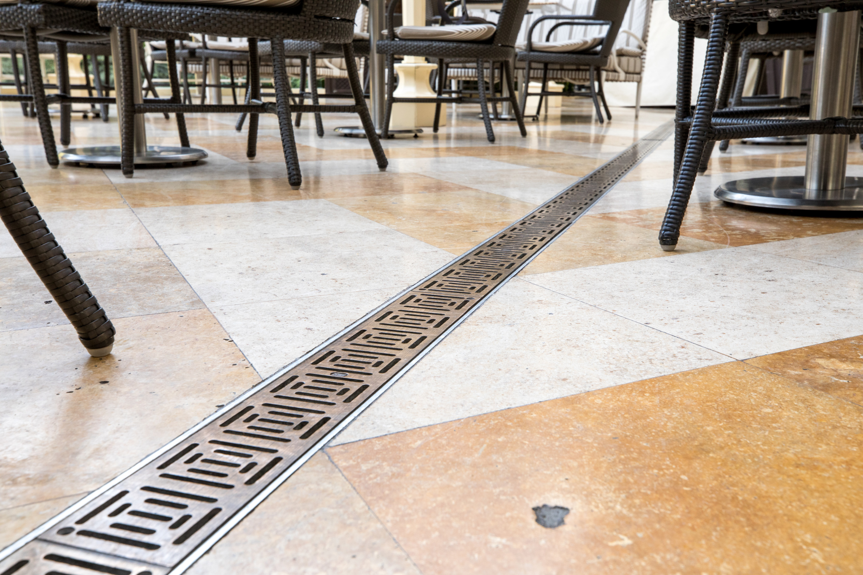




COMPATABILITY | SAVINGS | QUALITY | AESTHETICS
Multiple Sizes and Materials Custom Designs and Fabrications Compliance to Specifications | Minimal Manpower Reduced Installation Time Lower Total Project Costs | Proven Product Performance Optimized System Designs | Wide Range of Styles Visual Statements Enhanced Designs

Slide 10
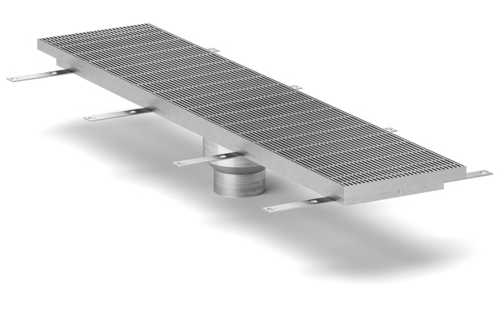
features & benefits trench drain system
Lean construction is about doing more with less. Our goal is to save you time, money, and resources on the job. We engineer our systems to deliver structural strength, while still being lightweight. The longer, modular assembly and formulated material allow contractors to handle our trench drains without heavy lifting, alignment hardware, or extra manpower.
Z899
elevator/ threshold drain
internal and/or external use
collection and disposal of water and chemical waste
advantages over traditional cast-in-place or on-site fabrication trench forming systems
EASE OF INSTALLATION
preassembled system delivery
custom designs and fabrications
key features
various trench widths, depths, and lengths
various corrosion-resistant materials including HDPE high density polyethylene, stainless steel, cast iron, and fiber reinforced polyester and vinyl ester
features including adjustable anchoring legs for easy installation, built in slope, mechanically locked joints, etc.
numerous grate options – from heavy duty to decorative in a variety of materials including cast iron, stainless steel, brass…

Slide 11
features & benefits trench drains
 |  |  | 0% water absorption; corrosion resistant | transportation | food & beverage, chemical | recreation | residential
664 | in & out | 6” | dura-coated cast iron heavy duty body |  |  |  | residential
665 | in & out | 12” | dura-coated cast iron heavy duty body |  |  |  | residential
667 | in & out | 6” | dura-coated cast iron heavy duty body |  |  |  | residential
806 | in & out | 4” | general purpose-fiberglass reinforced polymer
880 | in & out | 2.5” | HDPE high density polyethylene, stainless steel, or aluminum |  | food & beverage | decorative | decorative
883 | in & out | 6” | stainless veneer frame |  |  | decorative | decorative
884 | in & out | 4” | lightweight polypropylene structural composite |  |  | decorative | decorative
886 | in & out | 4” | HDPE high density polyethylene; durable and lightweight; overlapping quick connect | yes | yes | decorative | decorative
888 | in & out | 4” - 36” | slot LLDPE linear low-density polyethylene | yes |  | yes
882 | in & out | 9¼” | wide reveal lightweight water absorbent HDPE | transportation-decorative
874 | in & out | 4” - 21” | utility trench with galvanized or stainless steel frame | transportation
889 | out | 12” 18” 36” | hi-cap cleanout port low density polyethylene | Transportation
812 | in & out | 9.25” | glass-filled polyester fiberglass, chemically resistant |  | food & beverage, chemical
890 | in | 6” | stainless steel |  | food & beverage, chemical
891 | in | 3.75” | slot-lightweight stainless steel |  | food & beverage, chemical
893 | in | 12” | floor receptor with bar grate-lightweight stainless steel |  | food & beverage, chemical
894 | in | 24” | stainless steel |  | food & beverage, chemical
895 | in | 12” | stainless steel |  | food & beverage, chemical
898 | in | 18” | stainless steel |  | food & beverage, chemical
899 | in | 11.5” | elevator trench drain to protect against the effects of cascading water during emergency egress |  |  | decorative

Slide 12
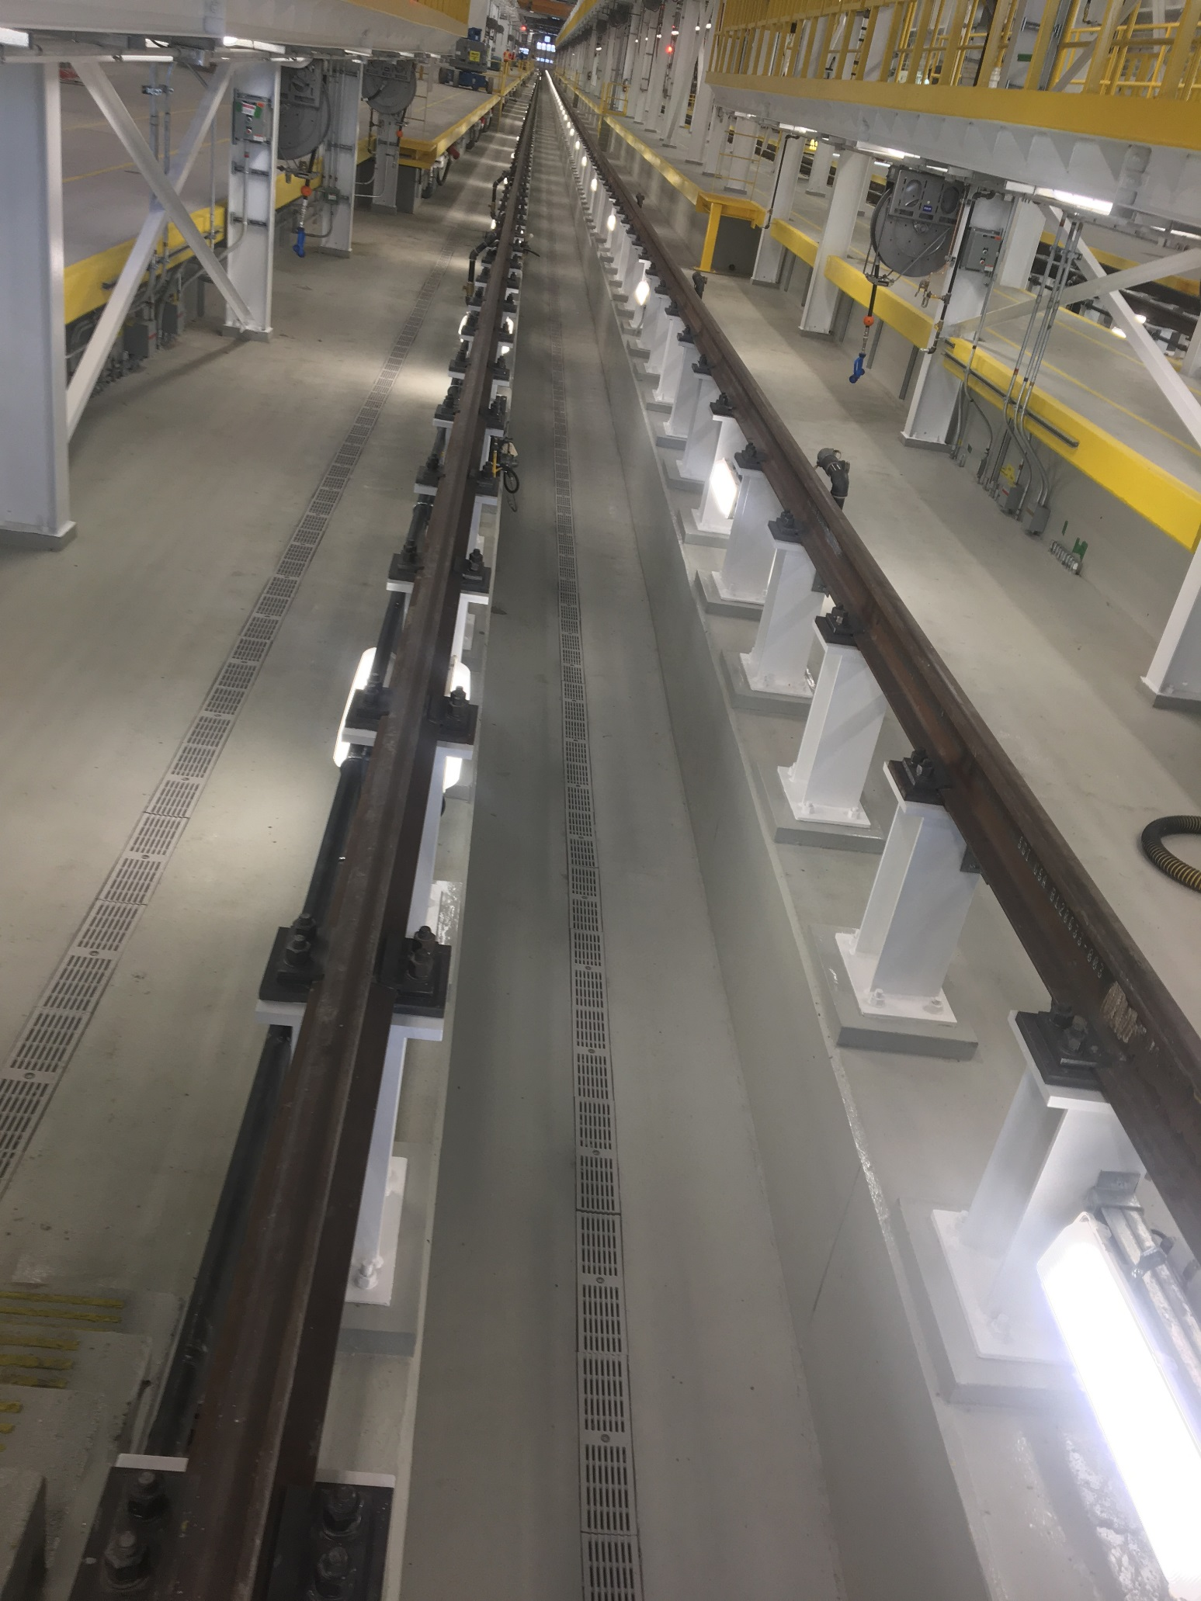
features & benefits trench drains for transportation areas
airports, highways, ports, and intermodal facilities
collection, storage, and conveyance of runways, medians, docks, and terminals
key features & benefits
large diameters and depths to handle high volume drainage
ASHTO H20 and FAA load rating for ability to handle truck traffic to heavy aircraft
multiple widths and inverts to provide project flexibility
4 corner lock down grates prevent sliding of grates under heavy loading
integral installation devices for ease of labor
Written Case Study:
Kiewit Keeps Streetcar Project on Track with Zurn Trench Drains

Slide 13
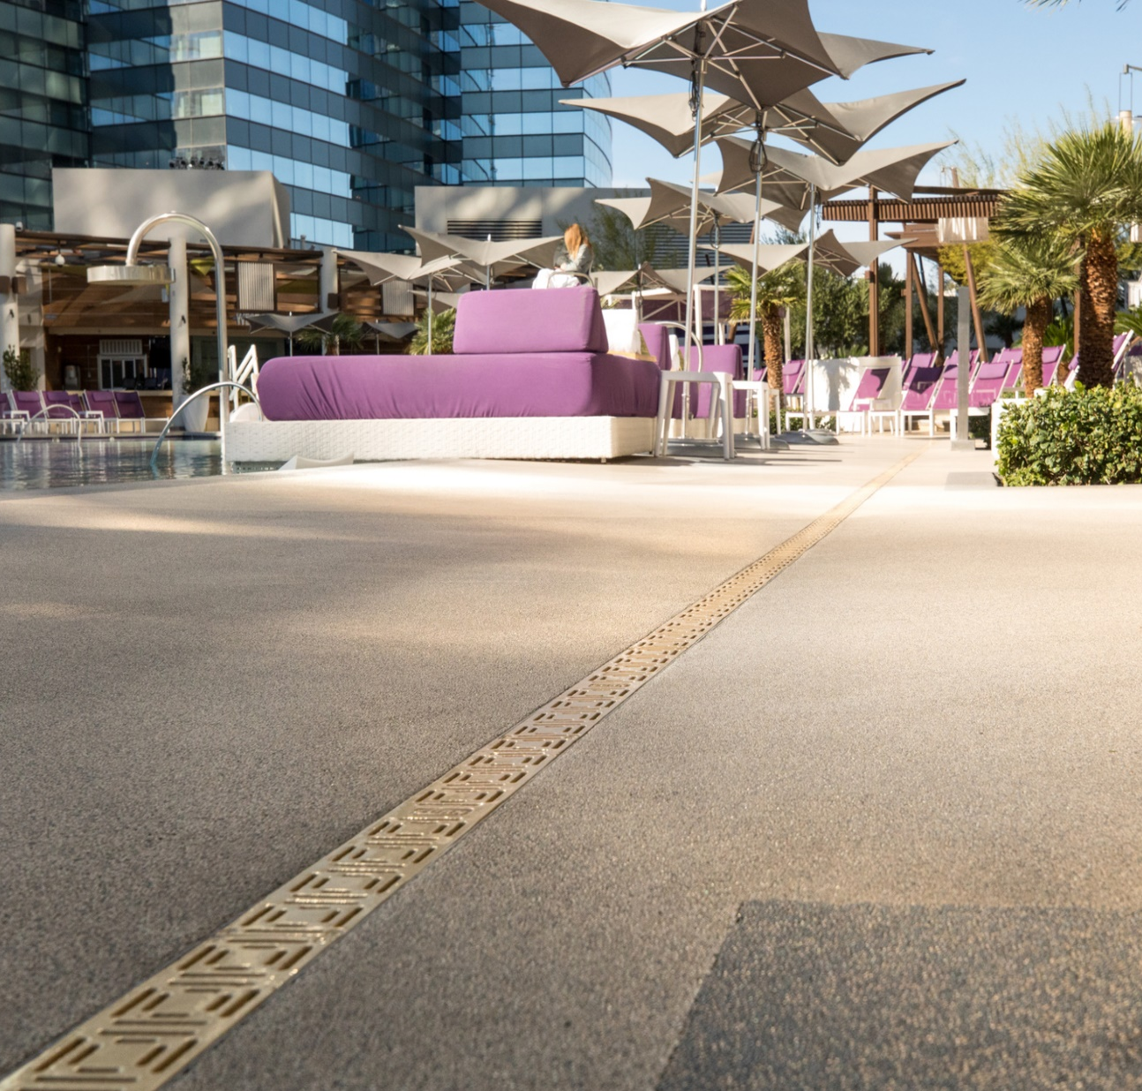
features & benefits trench drains for recreation areas
sports complex-recreational
collection, storage, and conveyance of water around running tracks, pools, amusement parks, and concession areas
key features & benefits
ADA and pedestrian compliant for safety
custom grate designs, blending into existing aesthetics
radius custom designs allows for complex construction configurations
waterproof membrane allows for elevated installations
2:32 Video:
Zurn Customer Story: PTR Mechanical

Slide 14
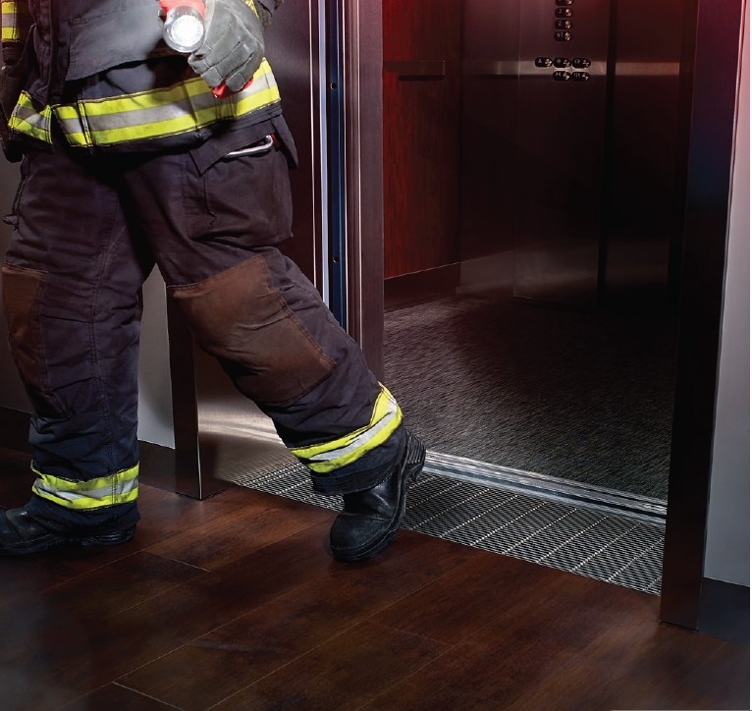
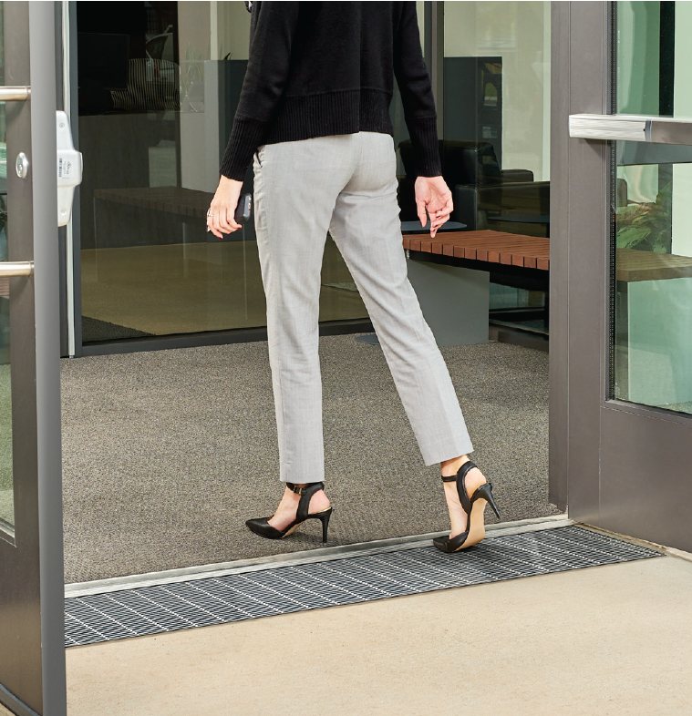
features & benefits trench drains for elevator/threshold areas
commercial buildings
water prevention of elevators and thresholds, ultimately allowing fire personnel access and egress in the case of an emergency
key features & benefits
Patented, shallow drain body for use in shallow, post-tension concrete decks
2 ¼” drain body depth for shallow floor installation and code compliance
Evacuates water at 100 GPM
Custom designs available for architectural aesthetics
Building code compliant stainless steel construction

Slide 15
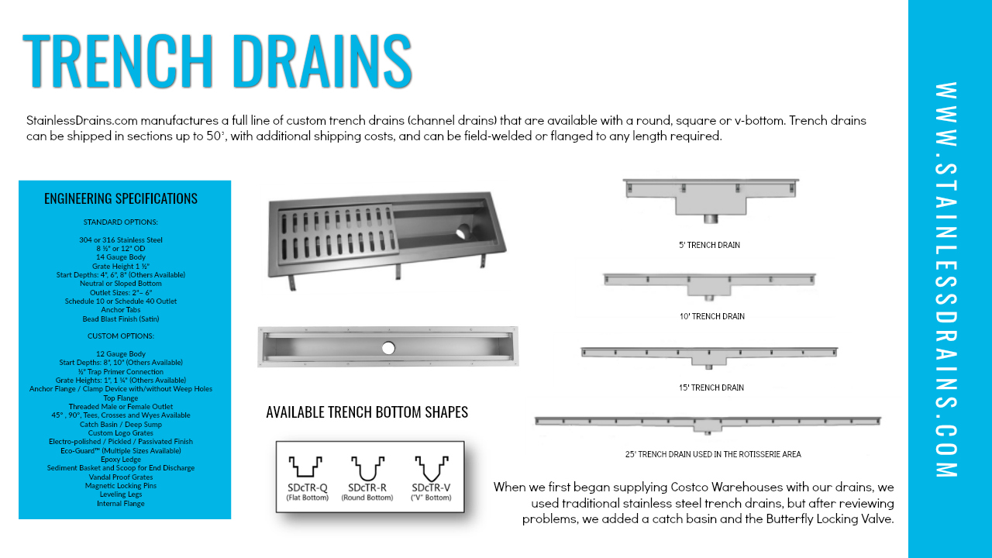
stainless products trench drain systems
TRENCH BOTTOM SHAPES
When we first began supplying Costco Warehouses with our drains,
we used traditional stainless steel trench drains, but after reviewing problems, we added a catch basin and the Butterfly Locking Valve.

Slide 16
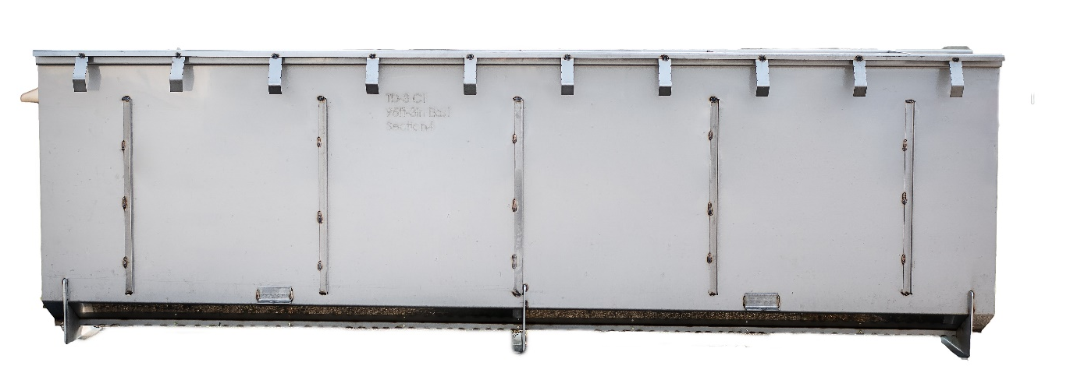
stainless products trench drains for poultry plants

Slide 17
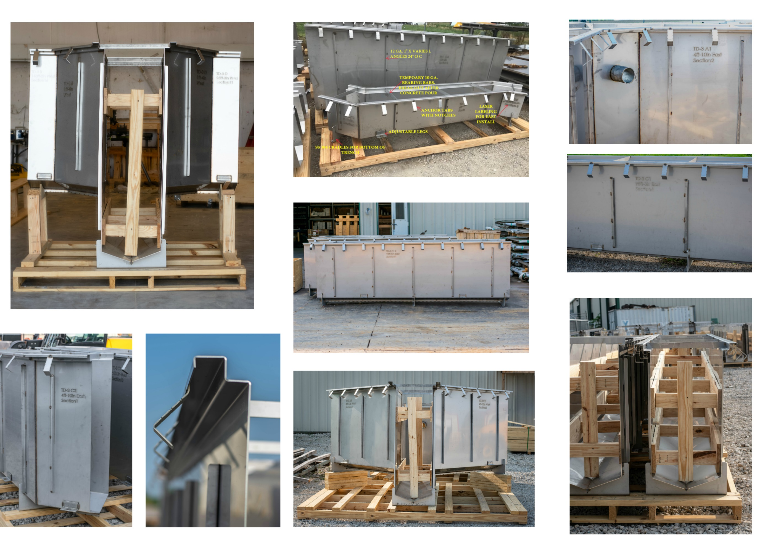
stainless products trench drains for poultry plants

Slide 18
features & benefits trench drains for chemical waste
food processing and chemical waste water
collection, storage, and conveyance of high temperature water, chemicals, and food waste water
Z806 fiber reinforced
polymer trench drain system
key features & benefits
chemical resistant fiberglass provides flexibility of application
longer, lightweight sections for ease of installation
polyester and vinyl ester resin to allow for higher temperature capability
heavy-duty Z-frame; overlapping connections allows heavier loading
2:56 Video:
Zurn Customer Story: Four Day Ray Brewing

Slide 19
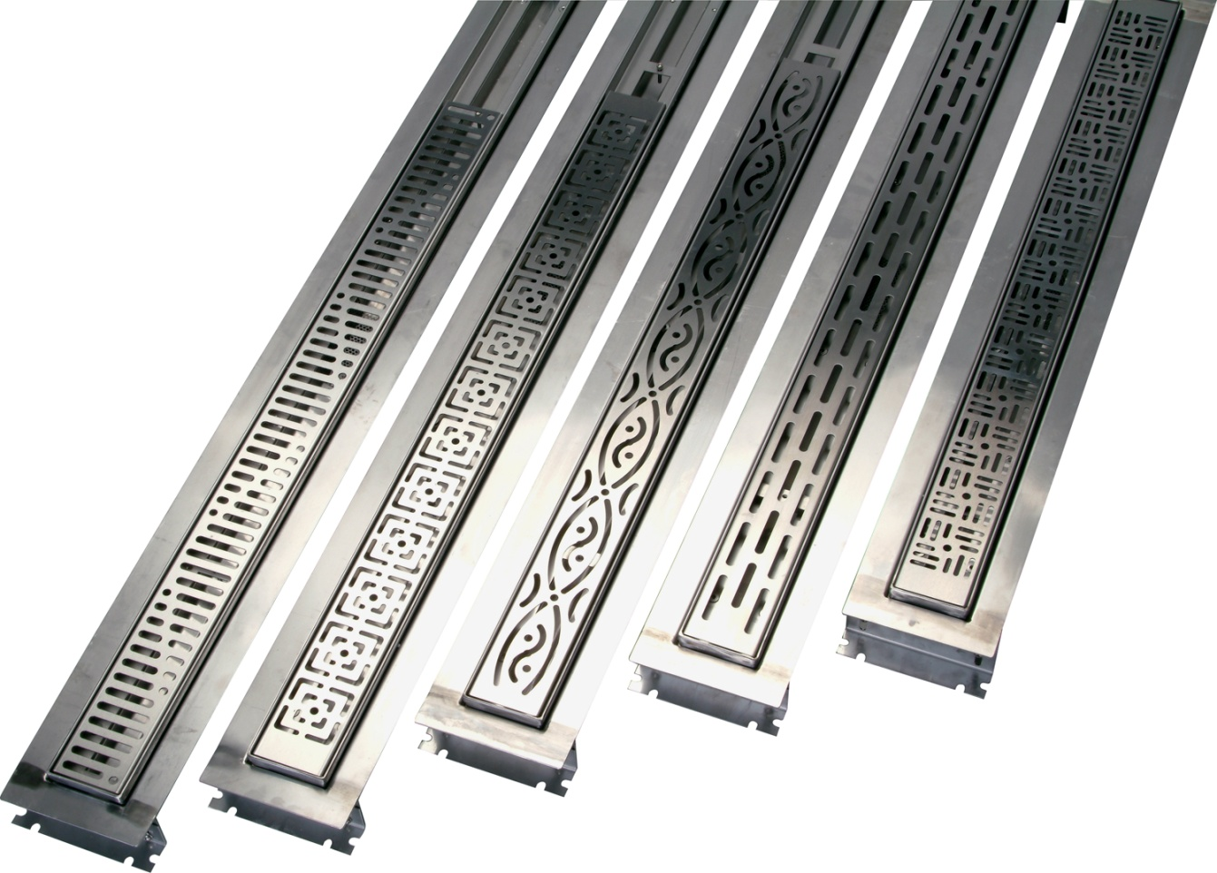
features & benefits trench drains for residential areas
home use
Collection, storage, and conveyance of water around patios, pools, sidewalks, driveways, and showers
key features & benefits
ADA and pedestrian compliant for safety
multiple colors and grate patterns for system integration to home design
ZA800-300B
aluminum trench drain
various widths and flow rates allows for various drainage conditions
lightweight and integral installation devices for ease of placement
3:18 Video:
Zurn Z5880 Stainless Steel Linear Shower Drain Options
Compatible to pavers and stamped concrete allows for multiple hardscape materials
5:23 Video:
Zurn Z5880 Stainless Steel Linear Shower Drain Introduction

Slide 20
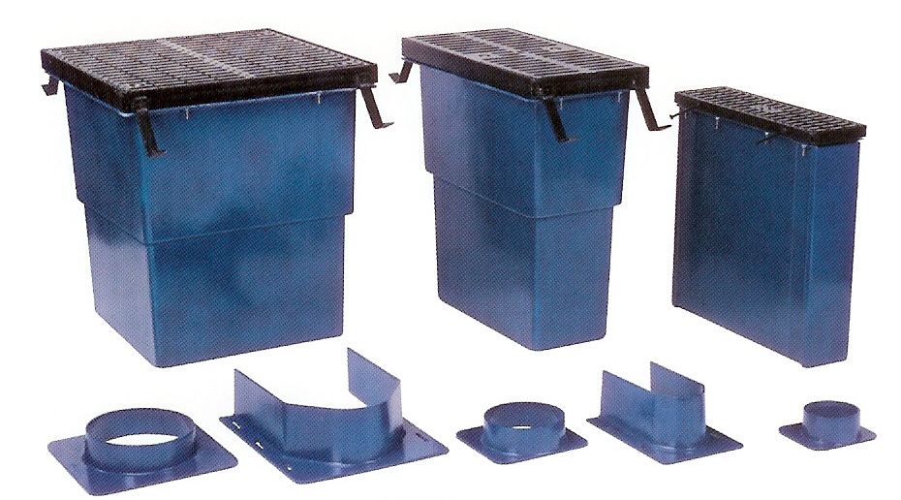
features & benefits catch basins
 |  | 0% water absorption corrosion resistant | fiberglass-polyester | fiberglass-vinyl ester | HDPE high-density polyethylene | 304 stainless steel (316 available)
817 | 6”x20” 12”x24” 24”x24” | class A to class F grates; chemical resistant; heavy duty Z-frame; 4” 6” 8” standard outlet sizes – larger, custom made; complete frame and gate assembly | yes=-ZFV | Yes-ZF
874 | inline | interlocking ends and flat bottom; class C and class F grates; FAA load rating |  |  | yes
887 | 6”x20” 12”x24” 24”x24” | Interlocking ends, combination tie-down/leveling; integral frame, integral frame, Dura-Coated cast iron grate; 3” 4” 6” standard outlet sizes |  |  | yes
897 | 6”x20” 14.5”x24 1/8” 26”x24 1/8” | classes A-E grates |  |  |  | yes
Easy to install, yet tough enough to weather any storm, our catch basins secure water-tight pipe-to-structure connections to collect storm water and capture waste without fail. The patented high density polyethylene construction is painless to lift, cut and air weld in the field. Even though it’s lightweight, it’s heavy duty, so you save time, labor…and concern.
Z817 Flo-Thru catch basins + connectors

Slide 21
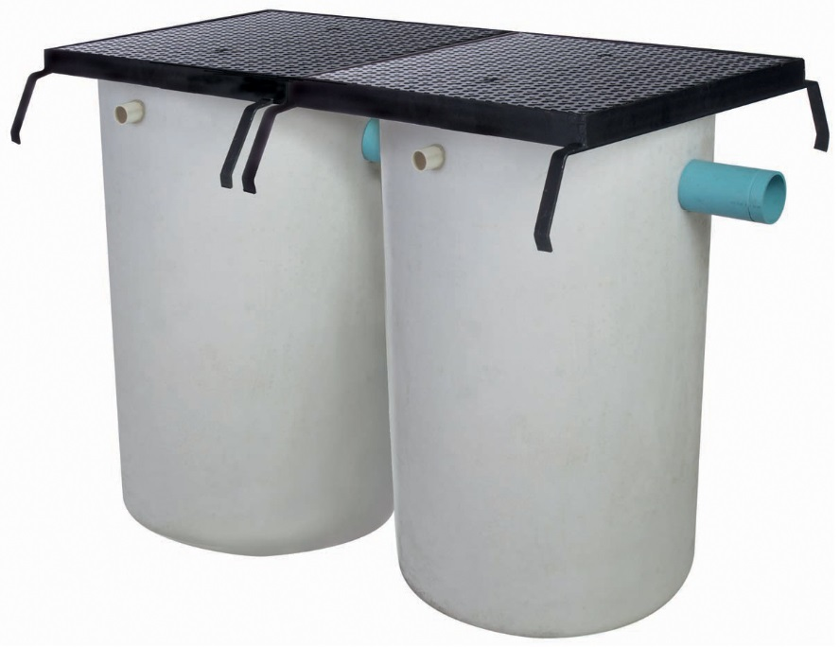
features & benefits oil separator
 |  | 0% water absorption corrosion resistant | polyethylene
885 | Single, double, and triple configurations, in multiple capacities and various diameters | ¼” thick body; heavy-duty, dura-coated steel frame and ¼” thick steel diamond plate covers with medium-duty top load classification; no-hub inlet/outlet with 2” diameter no-hub vent connections; long lasting | yes
Z885 oil separator

Slide 22
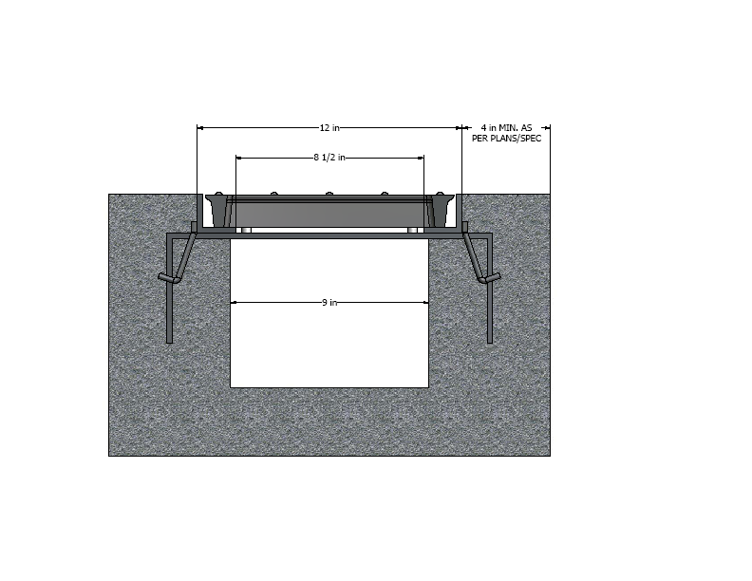
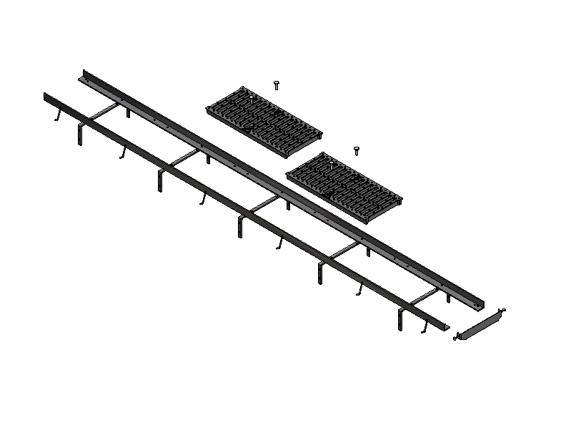
features & benefits frames and grates
 |  | corrosion resistant | light-duty grates (to 2,000 lbs/ft) | medium-duty grates (to 4,999 lbs/ft) | heavy-duty grates (to 7,499 lbs/ft) | extra heavy-duty grates (to 10,000 lbs/ft)
780 | 6.5”x18” | decorative grate only or with anchor strips, vandal-proof secured top | polished bronze or polished nickel bronze
784 | 12”x24” | grate only or with vandal-proof secured top | polished bronze and polished nickel bronze
792 | 12”x20” | fabricated steel frame with anchor straps, vandal-proof secured top option |  | dura-coated cast iron or with bronze, polished bronze, or polished nickel bronze
706 | 6”x120” | heavy-duty frame, co-plane straps to keep rails parallel |  |  | ductile iron + other options
712 | 12”x120” | powder coated heavy-duty carbon steel frame, co-plane straps, 4-corner grate lock down |  |  | ductile iron + other options
717 | 17”X80” | heavy-duty frame, 4-corner grate lock down, co-plane straps |  |  | ductile iron + other options
723 | 23”x80” | heavy-duty frame, co-plane straps to keep rails parallel, 4 corner grate lock down |  |  | stainless steel + other options
726 | 26.25”x21” | heavy-duty rated class C load classification (p to 56,200 lbs/ft), co-plane straps, 4-corner grate lock down |  |  | ductile iron, galvanized steel or stainless steel + other options
793 | 12”x24” | with fabricated steel frame with anchor straps |  |  | dura-coated cast iron or galvanized cast iron
782 | 6”x20” | grate only or with angle steel frame, with vandal-proof anchor tabs option |  |  |  | cast iron
794 | 12”x24” | grate only or with fabricated steel frame with anchor straps |  |  |  | dura-coated cast iron or galvanized cast iron
You can’t avoid jobsite challenges, but you can answer with smart choices. Zurn offers grates in a variety of materials, styles, load-ratings and composition for all applications and aesthetics. On top of making up your own mind, get peace of it with ADA compliance and safety in every class. They’ll meet your traffic requirements too, whether it’s load-bearing capacity or heel-wearing pedestrians.
Z712 frame and grate system

Slide 23
















features & benefits questions
How important is it that your grates be functional, durable, AND aesthetically pleasing? | Multiple colors and grate patterns for system integration to home design Custom grate design, blending into existing aesthetics | Aesthetically Pleasing
Would you like a one-stop shop for all your trench drain needs? How important is the cost and maintenance of your trench drains, on a long-term basis? | Numerous trench drain system sizes, materials, and applications Multiple widths and flow rates for various drainage conditions Large diameters and depths to handle high volume drainage Decorative, light-duty residential to FAA-approved extra heavy-duty trench systems Radius custom designs allows for complex construction configurations ADA and pedestrian compliant for safety Corrosion resistant trench drains, catch basins, separators, and frames and grates Waterproof membrane allows for elevated installations Acid and chemical resistant fiberglass provides flexibility of application 4 corner locked down grates prevent sliding of grates under heavy loading ASHTO H2O and FAA load rating for ability to handle truck traffic to heavy aircraft | Complete Trench Drain System Systems to Meet Every Need Minimal Total Cost of Ownership Minimal Maintenance
How important is ease of installation and maintenance? | Prefabricated offsets and weld capable joints Lightweight and integral installation devices for ease of placement Assembled and packaged complete system delivery | Ease and Labor-Saving Installation Easy Maintenance
 |  |  |  |  |  |  | ADA

Slide 24
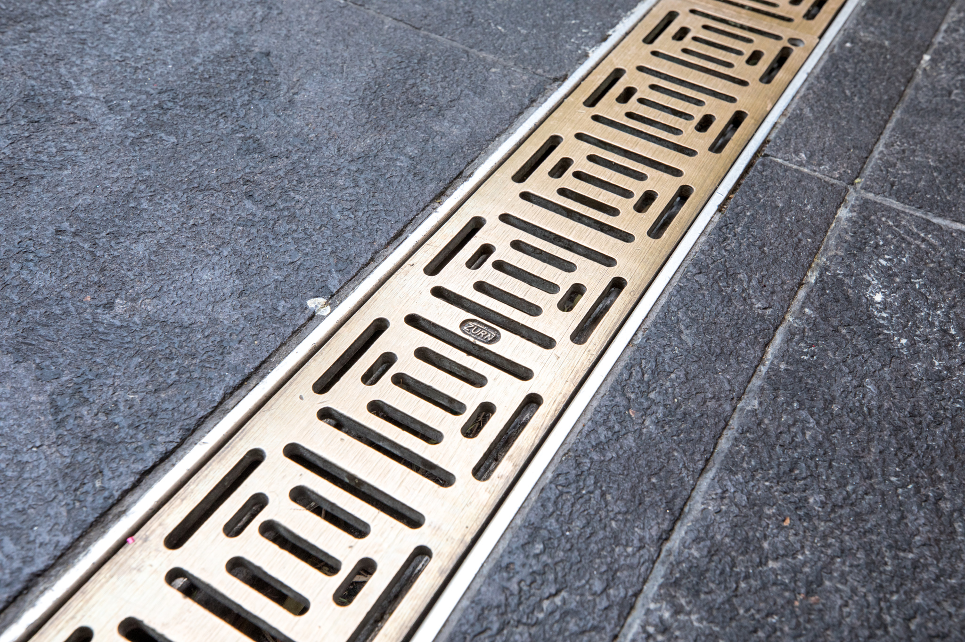
Test Your Knowledge
Which of the following are the top 3 features & benefits of Zurn’s trench drain systems?
A. Complete trench drain systems to meet every need
B. ADA compliant
C. Minimal maintenance and total cost of ownership
D. Ease and labor-saving installation

Slide 25
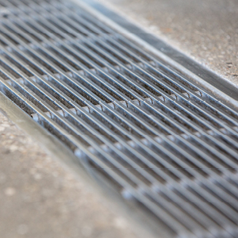
how to specify step-by-step
1
location
Internal (plumbing) or external (concrete)
2
channel material/temp
HDPE and polypropylene, fiberglass, aluminum, vinylester, stainless steel
3
flow capacity
Can accommodate minimal flows to 26237 GPM; 58 CFS
4
load bearing
Classes A-F

Slide 26
design & specify trench drain system channels
TRENCH DRAIN CHANNEL | LOCATION |  | SPECIFICATIONS
 | INTERIOR DRAIN | EXTERIOR DRAIN | CHANNEL MATERIAL | MAX TEMP | FOOD ACID + CHEMICAL RESISTANT | FLOW CAPACITY GPM | SYSTEM GRATE WIDTH | DECORATIVE GRATE | LOAD BEARING | ADA COMPLIANT | HEEL- PROOF
Z806 ZV806 Z812 ZV812 Z874 Z880 Showers / Pools Z882 Z883 Shallow Z884 Shallow Z886 Z888 | Interior Interior Interior Interior Interior Interior Interior Interior Interior Interior Interior | Exterior Exterior Exterior Exterior Exterior Exterior Exterior Exterior Exterior Exterior Exterior | Fiberglass Vinylester Fiberglass Vinylester HDPE HDPE, Aluminum, SS HDPE Polypropylene Polypropylene HDPE HDPE / LDPE | 150° F 210° F 150° F 210° F 140° F 140° F+ 140° F 140° F 140° F 140° F 140° F | Food Acids + Chemicals Food Acids + Chemicals | 88-510 88-510 583-3283 583-3283 1483-26237 557-3189 93-520 292-10771 | 6” 6” 12” 12” 12” 18” 21” 1-5/8” 2-1/2” 3” 12” 6” 4” 6” SLOT | 5 Colors + Metals 3 Materials + Colors 3 Materials + Colors 3 Materials + Colors | A,B,C,D,E, H-20 A,B,C,D,E, H-20 A,B,C,D,E,F H-20 A,B,C,D,E,F H-20 A,B,C,E,F H-20 A A,B,C,D,E,F H-20 A,B,C A,B,C A,B,C,D,E,F H-20 A,B,C,D,E,F H-20 | ADA Compliant ADA Compliant ADA Compliant ADA Compliant ADA Compliant ADA Compliant ADA Compliant ADA Compliant ADA Compliant ADA Compliant | Heel-Proof Heel-Proof Heel-Proof Heel-Proof Heel-Proof Heel-Proof Heel-Proof Heel-Proof Heel-Proof Heel-Proof
Z890 Z891 Z894 Z895 Z898 | Interior Interior Interior Interior Interior |  | Stainless Steel Stainless Steel Stainless Steel Stainless Steel Stainless Steel | 240° F 240° F 240° F 240° F 240° F | Food Acids + Chemicals Food Acids + Chemicals Food Acids + Chemicals Food Acids + Chemicals Food Acids + Chemicals | 97-639 51-201 1299-9385 548-2752 640-4844 | 6” SLOT 24” 12” 18” | Aesthetic Stainless | A,B,C,D,E,F H-20 A,B,C A A,B,C,D,E,F H-20 A | ADA Compliant ADA Compliant | Heel-Proof Heel-Proof
Z899 Elevator/Threshold | Interior |  | Stainless Steel | 240° F |  | 100 | 11-1/2” | Aesthetic Stainless | A | ADA Compliant | Heel-Proof
CHANNEL MATERIAL All Freeze Resistant | Maximum Temperature | Lightweight, for Easy Installation | Flexible, for Easy Installation | Chemically Resistant | Aesthetically Pleasing | More Affordable
Fiberglass | 150° F |  |  | Yes
Vinylester | 210° F |  |  | Yes
HDPE High Density Polyethylene / Polypropylene | 140° F | Yes | Yes |  |  | Yes
Aluminum | 240° F+ |  |  |  | Yes
Stainless Steel | 240° F |  |  | Yes | Yes

Slide 27
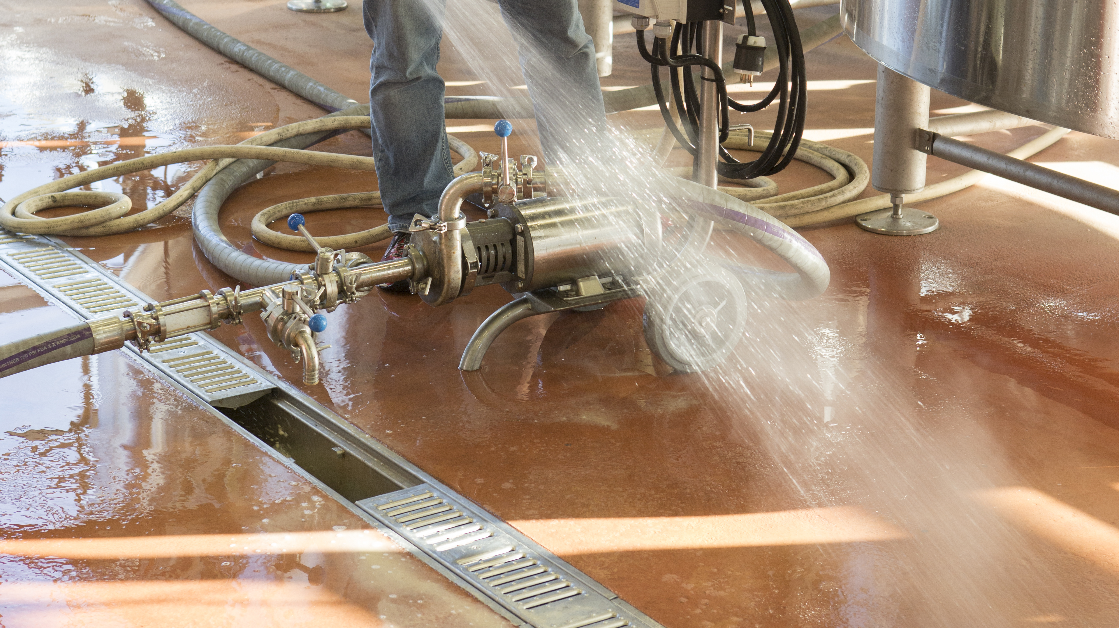
Test Your Knowledge
Place the following specify steps in the correct order:
A. Load bearing
B. Channel material
C. Location
D. Flow capacity

Slide 28
TRENCH DRAIN GRATES |  |  | TRENCH DRAIN CHANNEL (Z888 is a slot drain and does not require a grate)
 |  |  | Z806 | Z812 | Z874 | Z880 | Z882 | Z883 | Z884 | Z886
AWG | 94081 | Aluminum Wire Grate |  |  |  | Yes |  | Yes |  | Yes
BCD | 64255 | Circular Decorative | Decorative |  |  |  |  | Decorative |  | Decorative
BDC | 94472 | Black Acid Resistant Ductile | Yes | Yes |  |  | Yes | Yes |  | Yes
BDD | 67506 | Diagonal Decorative | Decorative |  |  |  |  | Decorative |  | Decorative
BDE | 94473 | Black Acid Resistant Ductile | Yes |  |  |  | Yes
BG | 61025 | Slotted Bar Grate | Yes | Yes |  |  | Yes | Yes |  | Yes
BZ | 64054 | Bronze Decorative |  |  |  | Yes |  | Yes | Decorative | Decorative
DBG | 61025 | Slotted Bar Grate | Yes |  |  |  |  | Yes |  | Yes
DC | 56780 | Solid Cover | Yes | Yes | Yes |  | Yes | Yes |  | Yes
DCD | 64255 | Circular Decorative | Decorative |  | Yes |  |  | Decorative |  | Decorative
DDD | 67506 | Diagonal Decorative | Decorative |  |  |  |  | Decorative |  | Decorative
DGC | 94472 | Slotted Grate | Yes | Yes |  |  | Yes | Yes |  | Yes
DGE | 94473 | Slotted Grate | Yes | Yes |  |  | Yes
DOG | 64054 | Decorative | Decorative |  |  |  |  | Decorative |  | Decorative
DTW | 94069 | Decorative Tidal Wave | Decorative |  |  |  |  |  |  | Decorative
DWV | 64450 | Decorative Wave | Decorative |  |  |  |  | Decorative |  | Decorative
FG | 64063 | Fabricated Slotted |  | Yes |  |  | Yes | Yes | Decorative | Yes
FS | 64063 | Fabricated Slotted |  | Yes |  |  | Yes | Yes | Decorative | Yes
GDC | 94472 | Slotted Grate | Yes | Yes |  |  | Yes | Yes |  | Yes
GDE | 94473 | Slotted Grate | Yes | Yes |  |  | Yes
GG | 56995 | Slotted Grate | Yes | Yes |  |  | Yes | Yes |  | Yes
GHPD | 58524 | Heel-Proof Slotted | Yes |  |  |  | Yes | Yes |  | Yes
GHPDE | 94454 | Heel-Proof Slotted | Yes | Yes |  |  | Yes
GMG | 64249 | Mesh Screen |  |  |  |  |  | Decorative |  | Decorative
HPB | 58524 | Heel-Proof Slotted | Decorative |  |  |  |  | Decorative |  | Decorative
HPD | 58524 | Heel-Proof Longitudinal | Yes | Yes |  |  | Yes | Yes |  | Yes
HPDE | 94454 | Heel-Proof Slotted | Yes | Yes |  |  | Yes
HPP | 94001 | Heel-Proof Slotted | Yes |  |  |  |  | Yes | Decorative | Yes
HPS | 58524 | Heel-Proof Slotted | Decorative |  |  |  |  | Decorative |  | Decorative
LD | 57153 | Longitudinal Slotted | Yes |  |  |  |  |  |  | Yes
PG | 64078 | Fabricated Perforated |  | Yes |  |  | Yes | Yes | Decorative | Yes
PGR | 301238 | Raised Perforated |  |  |  |  |  |  |  | Yes
PPC | 94149 | Perforated Grate |  |  |  |  |  | Yes |  | Yes
PS | 64078 | Fabricated Perforated |  | Yes |  |  | Yes | Yes | Decorative | Yes
PSR | 301238 | Raised Perforated |  |  |  |  |  | Decorative |  | Decorative
RFGC | 308340 | Reinforced Slotted | Yes | Yes |  |  | Yes |  |  | Yes
RFG | 64063 | Reinforced Slotted | Yes | Yes |  |  |  | Yes |  | Yes
RFSC | 308340 | Reinforced Slotted | Yes | Yes |  |  | Yes |  |  | Yes
RPGC | 308342 | Reinforced Perforated | Yes | Yes |  |  | Yes |  |  | Yes
RPGR | 304738 | Reinforced Perforated Reverse Punch | Yes |  |  |  |  |  |  | Yes
RPGRC | 308341 | Reinforced Perforated | Yes | Yes |  |  | Yes |  |  | Yes
RPG | 64078 | Reinforced Perforated | Yes | Yes |  |  |  | Yes |  | Yes
RPSC | 308342 | Reinforced Perforated | Yes | Yes |  |  | Yes |  |  | Yes
RPSRC | 308341 | Reinforced Perforated Reverse Punch | Yes | Yes |  |  | Yes |  |  | Yes
SBG | 94221 | Slotted Bar Grate | Decorative | Yes |  |  | Yes | Decorative
SC | 60746 | Stainless Steel Slotted Cover |  |  |  |  |  |  |  | Yes
SCD | 64255 | Circular Decorative | Decorative |  |  |  |  | Decorative |  | Decorative
SDD | 67506 | Diagonal Decorative | Decorative |  |  |  |  | Decorative |  | Decorative
SMG | 64249 | Mesh Screen | Decorative |  |  |  |  | Decorative |  | Decorative
SOG | 64054 | Decorative | Decorative |  |  | Yes |  | Decorative |  | Decorative
SWG | 94081 | Stainless Steel Wire Grate |  |  |  | Yes |  | Decorative |  | Decorative
 |  |  | Z886
P886-FGF | 64355 | Ductile Frame & Grate | Yes
P886-GFG | 64355 | Galvanized Ductile Iron | Yes
P886-HDD | 94045 | Fixed Grate | Yes
P886-HR | 94066 | Removable Grate | Yes
P886-PVS | 94287 | Paver Slot Grate | Decorative
P886-PVSG | 94287 | Paver Slot Grate | Decorative
P886-PVSS | 94287 | Paver Slot Grate | Decorative

Slide 29
TRENCH DRAIN GRATES |  |  | TRENCH DRAIN CHANNEL (Z891 is a slot drain and does not require a grate)
 |  |  | Z890 | Z894 | Z895 | Z898 | Z899
BCD | 64255 | Circular Decorative | Decorative
BDC | 94472 | Black Acid Resistant Ductile | Yes |  | Yes
BDD | 67506 | Diagonal Decorative | Decorative
BDE | 94473 | Black Acid Resistant Ductile | Yes |  | Yes
BZ | 64054 | Bronze Decorative | Decorative
DC | 56780 | Solid Cover | Yes |  | Yes
DCD | 64255 | Circular Decorative | Decorative
DDD | 67506 | Diagonal Decorative | Decorative
DGC | 94472 | Slotted Grate | Yes |  | Yes
DGE | 94473 | Slotted Grate | Yes |  | Yes
DOG | 64054 | Decorative | Decorative
DWV | 64450 | Decorative Wave | Decorative
FS | 64063 | Fabricated Slotted | Yes | Yes | Yes | Yes | Yes
GG | 56995 | Slotted Grate | Yes | Yes | Yes | Yes
HPB | 58524 | Heel-Proof Slotted | Decorative
HPD | 58524 | Heel-Proof Longitudinal | Yes |  | Yes
HPDE | 94454 | Heel-Proof Slotted | Yes |  | Yes
HPP | 94001 | Heel-Proof Slotted | Yes
HPS | 58524 | Heel-Proof Slotted | Decorative
LD | 57153 | Longitudinal Slotted | Yes
PDE | 84474 | Decorative | Decorative
PPC | 94149 | Perforated Grate | Yes
PS | 64078 | Fabricated Perforated | Yes | Yes | Yes | Yes
PSR | 301238 | Raised Perforated | Decorative
RFSC | 308340 | Reinforced Slotted | Yes |  | Yes
RPSC | 308342 | Reinforced Perforated | Yes |  | Yes
RPSRC | 308341 | Reinforced Perforated Reverse Punch | Yes |  | Yes
SBG | 94221 | Slotted Bar Grate | Decorative | Yes | Yes | Yes
SCD | 64255 | Circular Decorative | Decorative
SDD | 67506 | Diagonal Decorative | Decorative
SMG | 64249 | Mesh Screen | Decorative
SOG | 64054 | Decorative | Decorative
SWG | 94081 | Stainless Steel Wire Grate | Decorative |  |  |  | Yes

Slide 30
design & specify frames & grates
WIDTH | HEAVY-DUTY STEEL FRAME SPECIFICATIONS |  | GRATE SPECIFICATION OPTIONS
 | MODEL | DIMENSIONS | GRATE MATERIAL | DECORATIVE GRATE | LOAD BEARING | ADA COMPLIANT | HEEL-PROOF
6” 12” 17” 23” 26” | Z706 Z712 Z717 Z723 Z726 | 1”x1”x ¼” angle 1-3/4”x1-3/4”x1/4” angle 2”x2-1/2”x1/4” angle 2”x2-1/2”x1/4” angle 2”x2-1/2”x¼” angle | Ductile Iron, Fiberglass, SS, Aluminum Ductile Iron, Fiberglass, SS Ductile Iron, Fiberglass, SS Ductile Iron, Fiberglass Ductile Iron | Bronze, Nickel, SS | A,B,C,E,H20 A,B,C,E,F,H20 A,C,E,F,H20 A,C,E,F,H20 A,C,E,F,H20 | ADA Compliant ADA Compliant ADA Compliant ADA Compliant ADA Compliant | Heel-Proof Heel-Proof Heel-Proof Heel-Proof Heel-Proof

Slide 31
design & specify options
ADDITIONAL OPTIONS | LOCATION |  | SPECIFICATIONS
 | INTERIOR USE | EXTERIOR USE | BODY MATERIAL | FOOD ACID + CHEMICAL RESISTANT | REVEAL | LOAD BEARING | ADA COMPLIANT
FLOOR RECEPTOR Z893 WITH LIP | Interior |  | Stainless Steel | Chemicals | 12” | AC
UTILITY CONDUIT Z874U | Interior | Exterior | HDPE |  | 4” 9” 12” 18” 24” | A,B,C,E,F,H-20
CATCH BASINS Z817 Z874 Z887 Z897 | Interior Interior | Exterior Exterior Exterior Exterior | Fiberglass HDPE HDPE Stainless Steel | Chemicals Chemicals | 6” 12” 24” 6” 12” 24” 6” 12” 24” 7” 14-1/2” 26” | A,B,C,E,F,H-20 A,B,C,E,F,H-20 A,B,C,E,F,H-20 A,B,C,E,F,H-20 | ADA, Heel-Proof ADA, Heel-Proof ADA, Heel-Proof ADA, Heel-Proof
CLEANOUT PORT Z889 Port |  | Exterior | LLDPE | Chemicals | 8” | A,B,C,D,E,F H-20

Slide 32
specify tools
Zurn.com tools | description
Manufacturer Cross Reference | Select a manufacturer, then product, type, or competitor product number to find the corresponding Zurn Product
ARCAT | Review CAD, BIM, and spec files
MasterSpec | Review spec files
BIM/Revit Files | Browse BIM objects
Cross Reference Guides | Review cross reference guides for individual products
Replacement Repair Parts | Review replacement and repair part information
Technical Resources | Review specs, calculation sheets, engineering guides, sizing and selections, materials and finishes, installation +
Product Warranties | Review One Zurn terms and conditions

Slide 33
summary what you learned
building owner
architect & engineer
contractor
aesthetically pleasing, yet highly durable grates corrosion resistant trench drain systems low total cost of ownership minimal maintenance and downtime
aesthetically pleasing, yet highly durable grates
compliant to specifications
complete trench drain systems to meet every need
minimal total cost of ownership
ease of installation
lower project cost
complete system delivery

Slide 34
summary
Zurn overview
For more than a century, Zurn Engineered Water Solutions® has established itself as an innovator and leading manufacturer of highly engineered water product solutions.
Markets We Serve
Zurn Engineered Water Solutions is a recognized leader in commercial, municipal, and industrial markets, delivering sustainable building solutions for new construction and retrofit applications.
Industry Leading Product Lines
The Zurn product offering includes items such as specification drainage products, manual and sensor operated flush valves, radiant heating systems, snow melt systems, linear drainage, backflow and fire protection systems, and much, much more.
Solutions We Provide
At Zurn we are committed to providing smart solutions that save time and money. Our goal is serving the customer through innovation, continuous improvement, and assurance behind every installation.
One Choice. One Zurn.
Choose Zurn for a reliable, recognized manufacturer to supply your entire installation, from behind the wall rough-in, to finished trim product and fixture systems.

Slide 35
resources support
address
phone
online
511 Freshwater Way
Milwaukee, WI 53204
toll-free 1-855-ONE-ZURN
zurn.com
Product Pages | Tools, Specifications, & Resources | Vertical Market Solutions
inSpec | Manufacturer Cross Reference | ARCAT | MasterSpec | SpecBuilder |
Specifiers | BIM/Revit Files
zurn.com/resources/product-training
Zurn Product - Overview
How to Install and Support
facebook.com/ZurnIndustries
twitter.com/ZurnIndustries
linkedin.com/company/ZurnIndustries
youtube.com/ZurnIndustriesLLC

