Slide 1
Zurn Water Hammer Arrestors –
Overview
April 15, 2019

Slide 2
agenda what you’ll learn
01
value proposition
02
how it works
03
features & benefits
04
design & specify
05
summary
06
resources

Slide 3
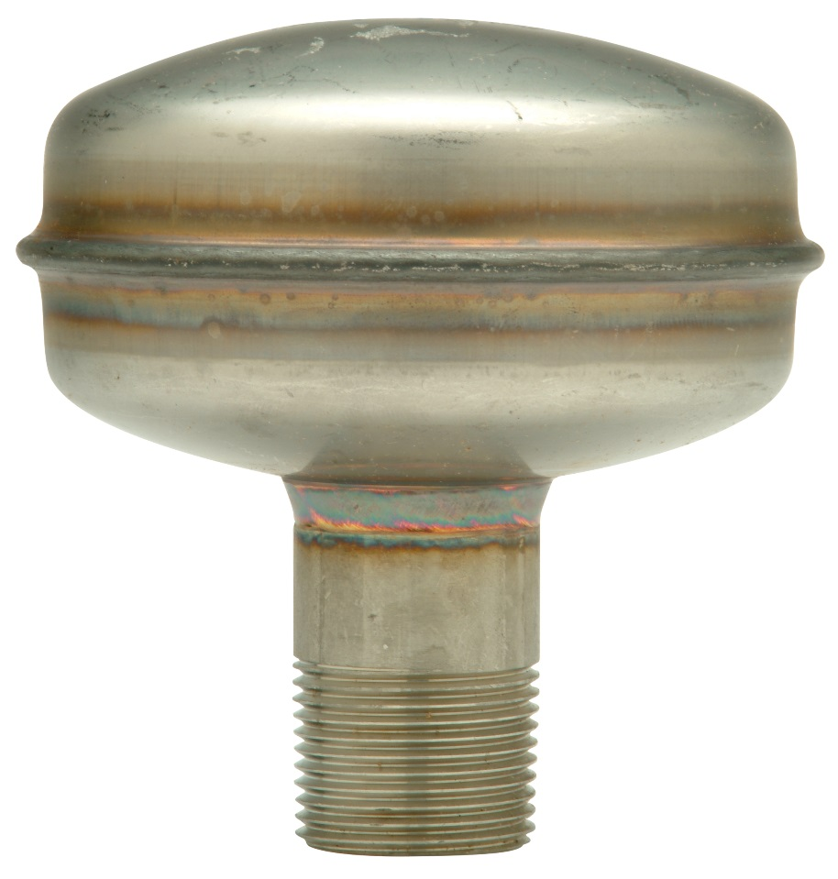
Z1700 stainless steel (lead-free) Shoktrol water hammer arrestor, with hermetically (airtight) sealed bellows
For building owners, engineers, and contractors,
Zurn Industries provides water hammer arrestors
that protect water lines and absorb loud knocking sounds in pipes caused by over-pressure after the sudden shut off
of water flow, preventing damage to plumbing pipes

Slide 4
voice of customer industries
building owner
architect & engineer
contractor
“I need products that are durable and have a low total cost of ownership + require minimum downtime for maintenance.”
“I need products that are durable and cost-effective.”
“I need products that are easy and cost-effective to install and maintain, that are assembled and packaged in a manner that streamlines installation.”
Healthcare | Retail | Food Service | Hospitality | Restaurants | Institutional/Education | Government

Slide 5
how it works step-by-step
3:31 Video:
Zurn Water Hammer Arrestors – How to Mitigate Water Hammer
1
backflow surge occurs
A sudden shut off of water flow causes backflow surges and increased pressure
2
piston goes up
Pressured backflow water pushes the piston spring up into the air bladder, absorbing the force of moving water
3
piston returns down
Piston returns down when the water returns to normal pressure, thus avoiding the rattling of pipes and loud banging noise (water hammer)

Slide 6
Test Your Knowledge
How do Zurn water hammer arrestors function?
Place the following in the correct order:
Water pressure increases due to quick valve closure
Piston goes up in the air chamber to absorb increased water pressure
Piston returns down with lowered, normal water pressure

Slide 7
features & benefits Z1700 Shoktrol water hammer arrestor
3:21 Video:
Zurn Wilkins Water Hammer Arrestors Shoktrol Z1700
protects water lines
Avoid pipe damage caused from over-pressure of quick closing valves
key features
18-8 stainless steel construction
Complies with PDI, ASSE, ANSI requirements
Hermetically (airtight) sealed bellows
Factory machine welded
Six sizes to accommodate varying capacities
Max working pressure = 125 psi; max static pressure = 250 psi
Temperature range = 33°F to 300°F
Install immediately upstream of the quick closing valve

Slide 8
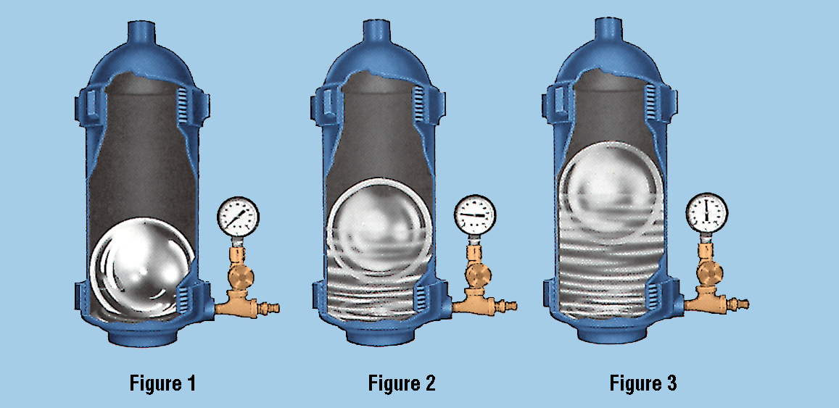
features & benefits Z1712 Accumutrol arrestor
for heavy equipment
Pressure spike from water hammer forces ball to rise in pressurized chamber. This displaces energy which otherwise would damage piping. Serves heavy equipment including laundry machines, dishwashers, etc.
key features
Z1712 Accumutrol water hammer arrestor, with bronze surge chamber and
floating stainless steel spherical piston + solenoid
Bronze surge chamber
Floating stainless steel spherical piston
Viton valve and gauge assembly
Max temperature = 500°F; max pressure = 200 psi
Easy start up

Slide 9
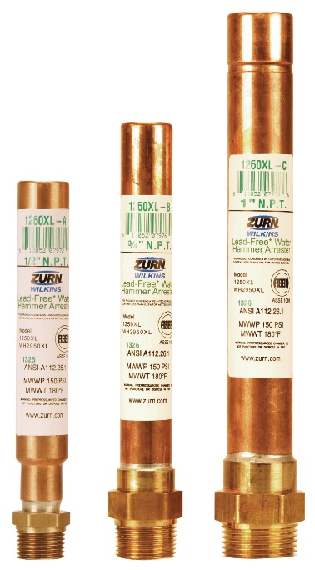
features & benefits 1260XL water hammer arrestor
1260XL water hammer arrestors,
with all copper and brass external construction
residential, commercial, industrial
Protects water lines against over-pressure during surges
key features
Pre-charged cushion of air permanently sealed within
Lead-free
Temperature range = -40°F to 212°F
Sizes A-F
Max static pressure = 200 psi; max static line pressure = 85 psi; max spike pressure = 400 psi
Max fixture unit capacity = 330 psi
May be installed within a stud bay without the need for an access panel

Slide 10
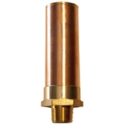
features & benefits WH2950XL water hammer arrestor
WH2950XL water hammer arrestor
residential, commercial, industrial
Protects water lines against over-pressure during surges
key features
Copper tube and brass
Pre-charged cushion of air permanently sealed
Acetal (NSF listed) polycarbonate or low lead brass
Buna nitrile or EPDM rubber o-rings
Temperature range = 33°F to 180°F
Sizes A-F
Rates to 250 psi
Can be installed within a stud bay without the need for an access panel

Slide 11
features & benefits questions
How important is pipe safety and longevity? | Use Avoid loud noises and pipe damage Brass, copper, and stainless construction | Maintain pipe safety and longevity Durability
Do you need a wide range of options? | Design & Specify Various size, pressure, and temperature capacities Residential, commercial, and industrial applications Low lead to meet UPC requirements | Arrestors for diverse needs Lead-free
How important space efficiency? | Install Some options provide compact design for 2x4 narrow wall cavities Some options require no access | Narrow footprint
 |  |  |  |  |  |  | ADA

Slide 12
Test Your Knowledge
What are Zurn water hammer arrestors’ top 3 benefits?
Provides optimal pipe safety
Durable body construction
Space efficient
Wide range of options

Slide 13
how to specify step-by-step
1
industrial, commercial or residential use
Shoktrol or Accumatrol
2
is maintenance or product life a concern?
3
sizing and installation
4
finish
Lead free brass or stainless steel

Slide 14
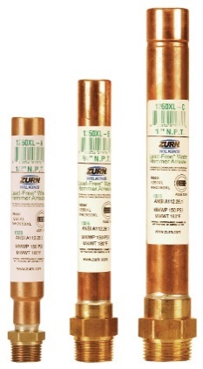
design & specify water hammer arrestors
WATER HAMMER ARRESTORS | Z1700 | Z1712 | 1260XL | WH2950XL
Commercial or industrial | Commercial (Shoktrol) Nesting type bellows | Industrial (Accumutrol) With solenoid or other quick-closing valves serving heavy equipment, such as laundry machines, dishwashers, etc. Bronze surge chamber with floating stainless steel spherical piston | Commercial or industrial Piston style air charge cylinder Commonly used for irrigation systems Single or multiple control valve clusters | Residential or commercial Ideal for use where lead free fittings are required Pre-charged and sealed at the factory
Is maintenance/product life a concern? | Requires no maintenance | Pressure checks weekly | Permanently sealed air chamber | Permanently sealed air chamber
Sizing and installation | Mounted on horizontal water supply line 100-600 sizes 125 max working pressure 250 max static pressure 33 °F to 300 °F operating temperature range | High-capacity Installed quickly and economically 2000-16000 sizes | -40 °F to 212 °F operating temperature range Maximum transient pressure surge 150 psi max static pressure ¾” and 1” supply line sizes | 33 °F to 180 °F operating temperature range Maximum transient pressure surge 150 psi max static pressure ¾” and 1” supply line sizes
Lead free brass or stainless steel | Stainless steel | Stainless steel | Lead free brass | Lead free brass

Slide 15
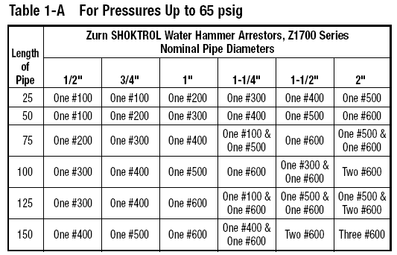
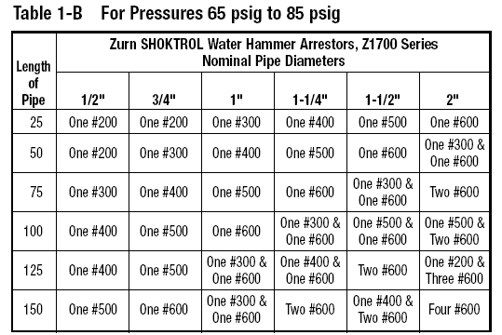
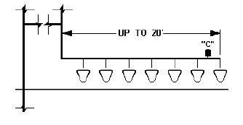
design & specify Shoktrol water hammer arrestors
sizing and placement
Pipe diameter
Pipe length
Line pressure
Flow rate

Slide 16
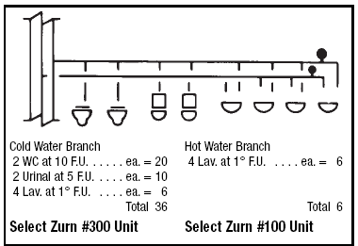
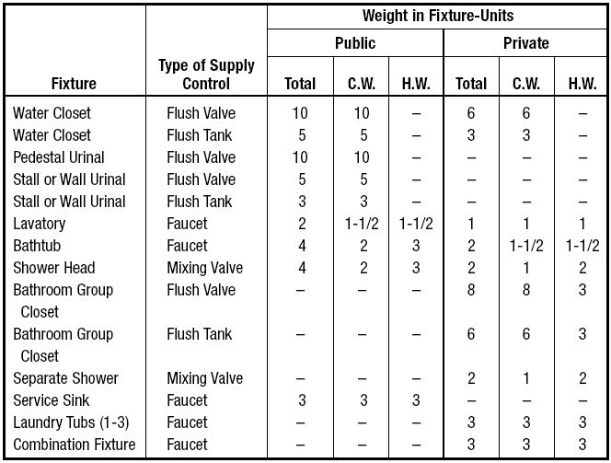
design & specify Shoktrol water hammer arrestors
sizing example

Slide 17
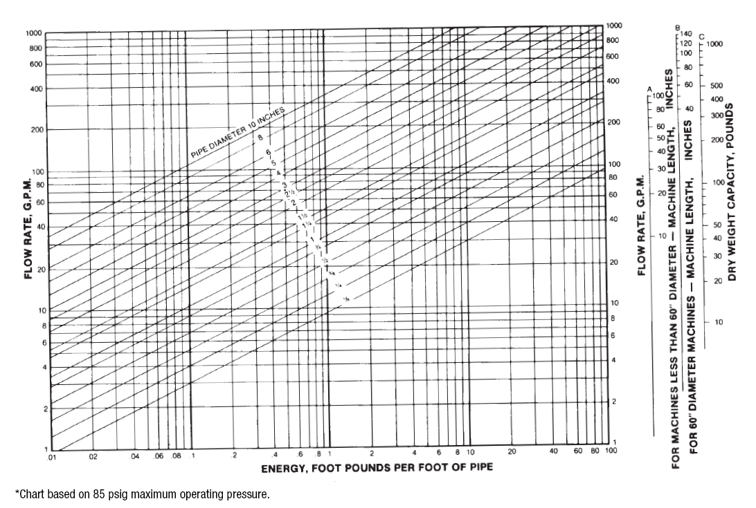
design & specify Accumutrol water hammer arrestors
sizing
Pipe diameter
Pipe length
Line pressure
Flow rate

Slide 18
design & specify 2950 water hammer arrestors

Slide 19
design & specify 2950 water hammer arrestors

Slide 20
design & specify 2950 water hammer arrestors

Slide 21
Test Your Knowledge
Place the following specify steps in the correct order:
A. Industrial, commercial, or residential use
B. Sizing and installation
C. Finish
D. Is maintenance or product life a concern?

Slide 22
design & specify tools
Create unlimited configurations
Solidify your basis of design
Generate your submittal package
Edit, share and copy projects
Zurn.com tools
inSpec | Create configurations, solidify your basis of design, generate your submittal package, edit/share/copy projects
Manufacturer Cross Reference | Select a manufacturer, then product, type, or competitor product number to find the corresponding Zurn Product
ARCAT | Review CAD, BIM, and spec files
MasterSpec | Review spec files
BIM/Revit Files | Browse BIM objects
Cross Reference Guides | Review cross reference guides for individual products
Technical Resources | Review specs, calculation sheets, engineering guides, sizing and selections, materials and finishes, installation +
Product Warranties | Review One Zurn terms and conditions

Slide 23
summary what you learned
building owner
architect & engineer
contractor
Durable Construction Effective Noise Control Lead-Free
High Performance
Product Durability
Space Efficient Options
Retrofit Options
Compact Design Options
Low Maintenance

Slide 24
summary Zurn overview
For more than a century, Zurn Engineered Water Solutions® has established itself as an innovator and leading manufacturer of highly engineered water product solutions.
Markets We Serve
Zurn Engineered Water Solutions is a recognized leader in commercial, municipal, and industrial markets, delivering sustainable building solutions for new construction and retrofit applications.
Industry Leading Product Lines
The Zurn product offering includes items such as specification drainage products, manual and sensor operated flush valves, radiant heating systems, snow melt systems, trench drain systems, backflow and fire protection systems, and much, much more.
Solutions We Provide
At Zurn we are committed to providing smart solutions that save time and money. Our goal is serving the customer through innovation, continuous improvement, and assurance behind every installation.
One Choice. One Zurn.
Choose Zurn for a reliable, recognized manufacturer to supply your entire installation, from behind the wall rough-in, to finished trim product and fixture systems.

Slide 25
resources support
address
phone
online
511 Freshwater Way
Milwaukee, WI 53204
toll-free 1-855-ONE-ZURN
zurn.com
Product Pages | Tools, Specifications, & Resources | Vertical Market Solutions
inSpec | Manufacturer Cross Reference | ARCAT | MasterSpec | SpecBuilder |
Specifiers | BIM/Revit Files
zurn.com/resources/product-training
Zurn Product - Overview
How to Install and Support
facebook.com/ZurnIndustries
twitter.com/ZurnIndustries
linkedin.com/company/ZurnIndustries
youtube.com/ZurnIndustriesLLC

